Slide 1

Slide Numbers Index and Hyperlink (106 slides)
2-22 General Course Info
24-28 myDAQ specifications
29-44 LabVIEW DAQ Assist
45-67 LabVIEW Block Diagram and Front Panel Controls, Indicators and Functions
68-90 LabVIEW data types
91-96 Shift Register, Mechanical Action, Formula Node
97-101 Array Basic

Slide 2

CAM83012E Fall 2018 (Week 1) Microcomputer Interfacing My Contact Information
Week 1 -- 108 slides Michel Hanbury Sept. 4th 2018
Michel Hanbury
Office Room – CA532 (ACCE building 5th floor)
Office Tel. - 613-727-4723 x3471
Labs in CA219B
hanburm@algonquincollege.com

Slide 3
Fall 2018 CAM8302E Microcomputer Interfacing
Microcomputer Interfacing:
During the course you will connect a microcomputer (Arduino) or a data acquisition device (myDAQ) to analog and digital inputs and outputs.
Use Brightspace LMS for labs, notes and quizzes.

Slide 4
Grading Information (2018)
Lab Section:
Lab Assignments
and Pre-Lab Quizzes ------------------------- 40%
Theory Section:
Quizzes ( on-line -- in theory class) --- 10%
Midterms (2) -------------------------------- 20%
Exam ------------------------------------------ 30%
Important Note: You must pass both the theory and lab section to pass the course.

Slide 5
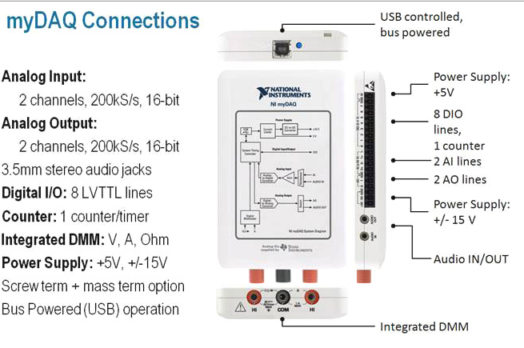
NI myDAQ USB Interface

Slide 6
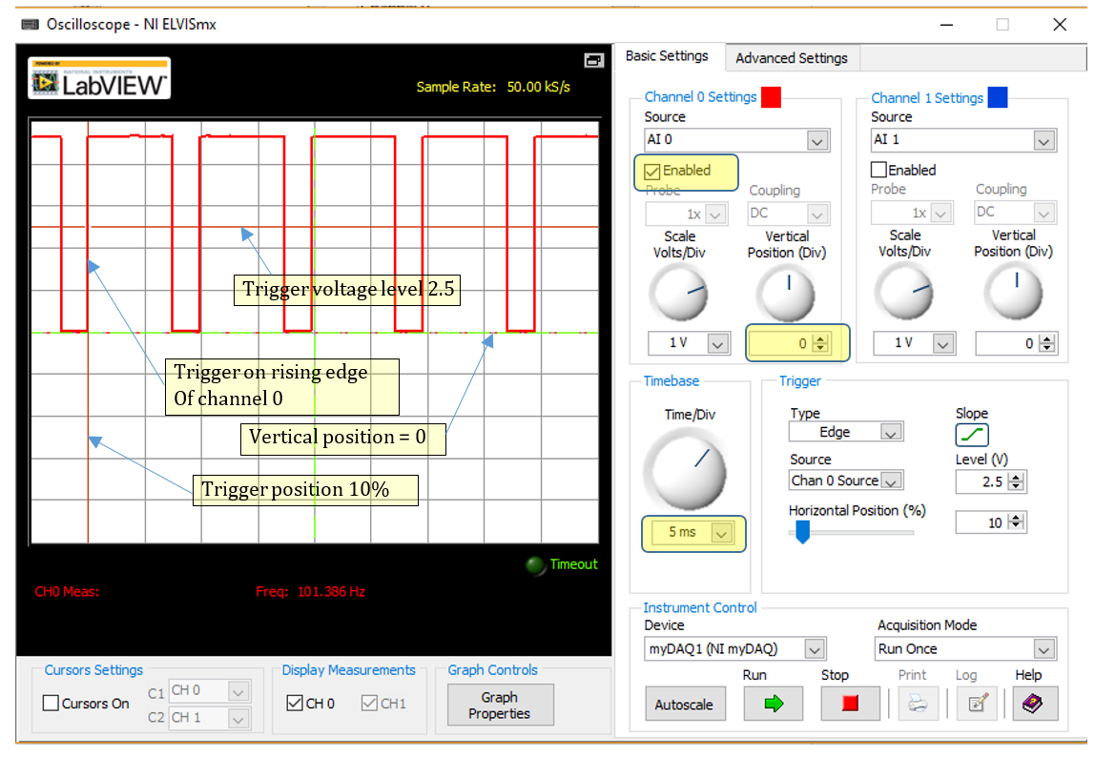
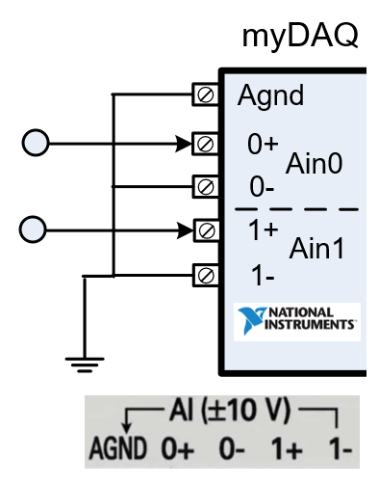
NI myDAQ USB Oscilloscope

Slide 7
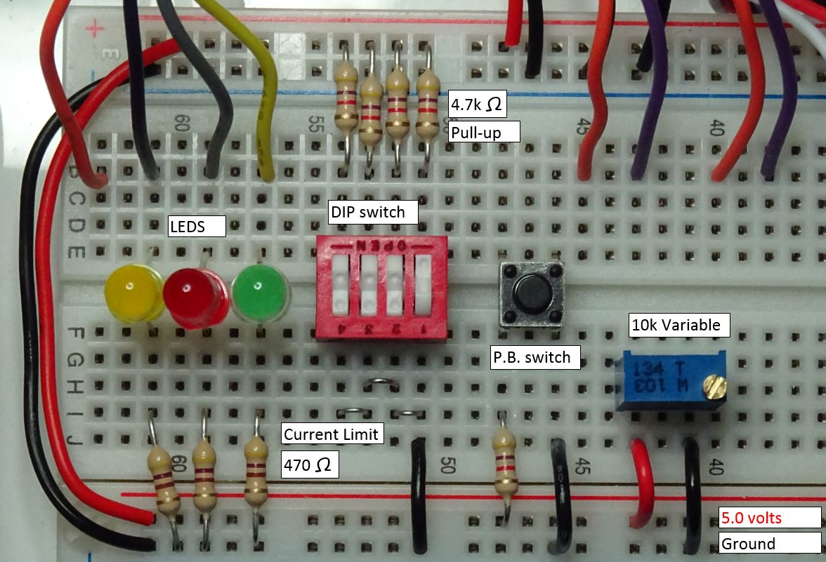
myDAQ Interface Circuit
Wiring:
Do not place wires over components.
Use only red and back wires for connections to ground and the supply voltage.
Keep the components organized.

Slide 8
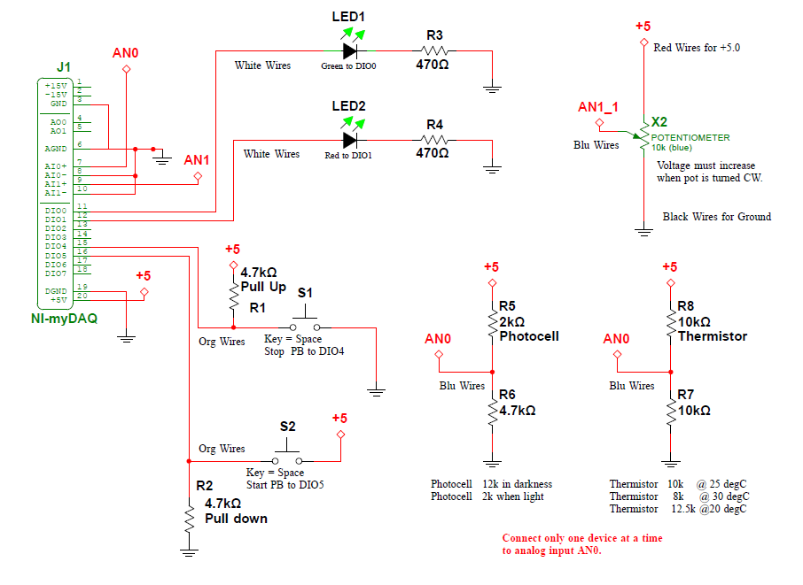
myDAQ Basic I/O Circuit (2018):
This is a typical schematic using Multisim 14. The schematic shows all the components, component values and their connection to ground, the supply, other parts of the circuit or to the myDAQ interface device.

Slide 9
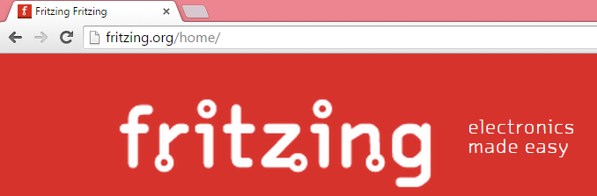
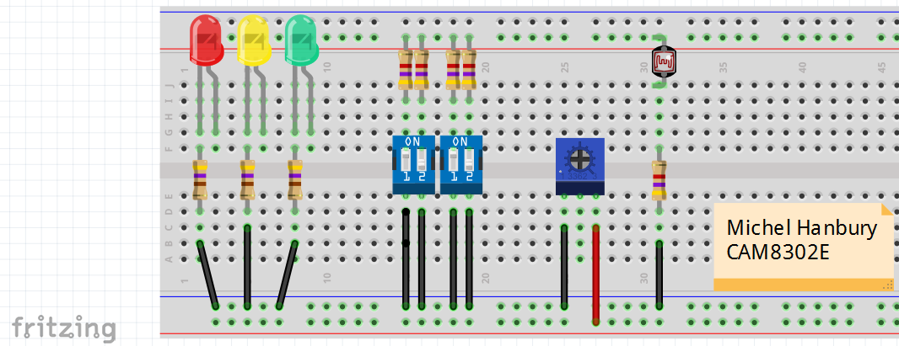
Fritzing – free software to draw circuits and board layouts. You may also use NI Multisim 14

Slide 10
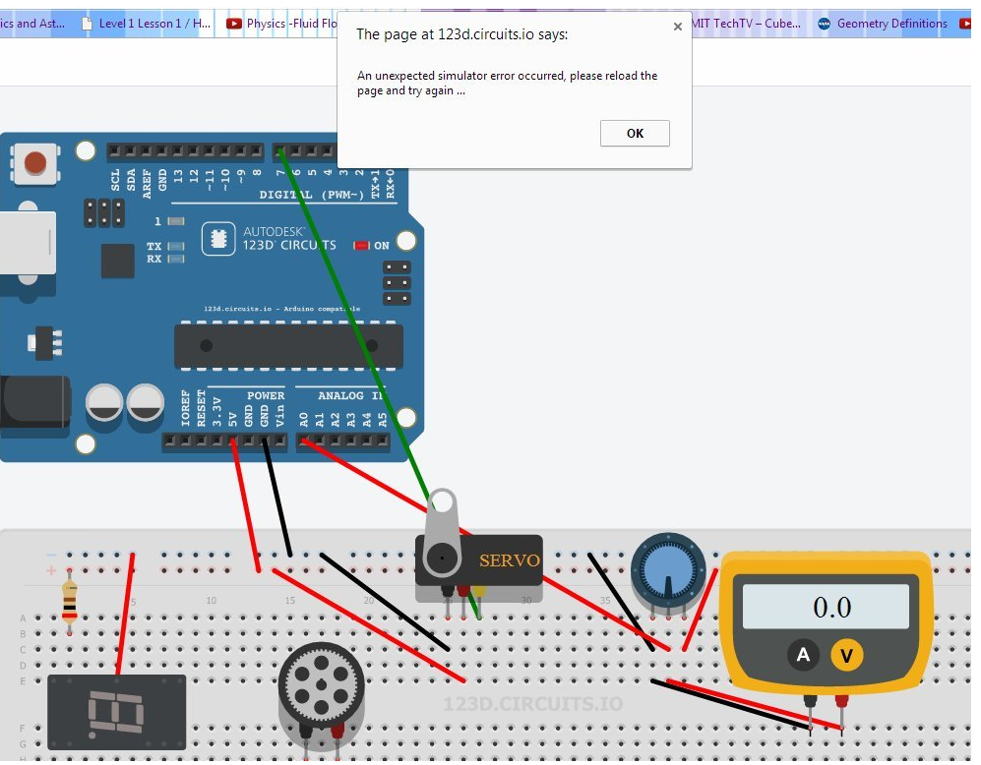
(123d.circuits.io)
Free Web Simulation
Allows simulation of hardware and software. Try it out.

Slide 11
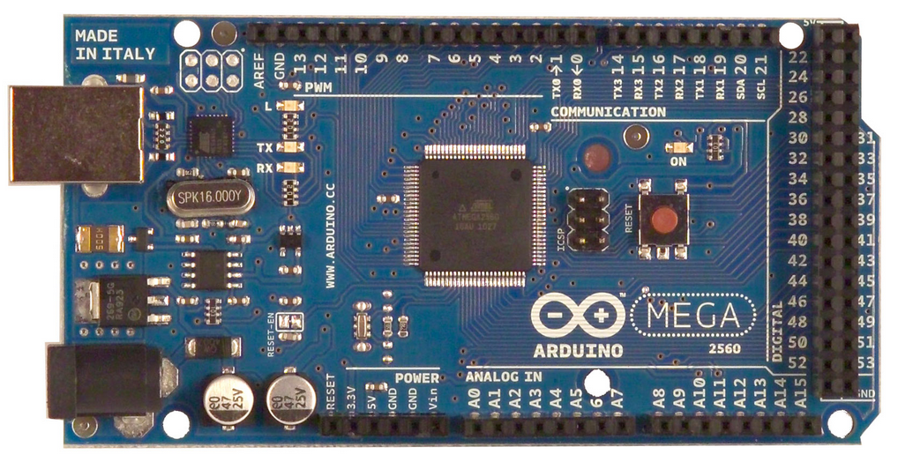
Arduino Microcontroller Powerful high speed (16 MHz) Atmega 2560 processor 52 I/O pins 8k RAM, 256k of FLASH, and 4k EEPROM Free IDE (Integrated Development Environment) – easy to use and program. Low power device. Automatically starts program when powered. A/D converters, digital I/O, serial I/O, counters, timers, communications

Slide 12
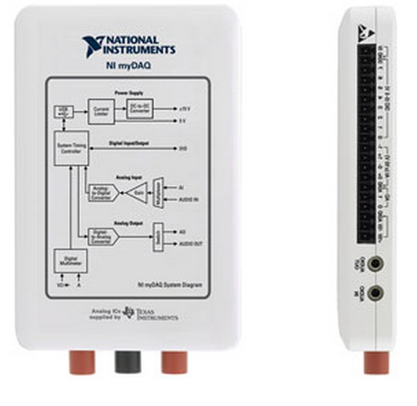
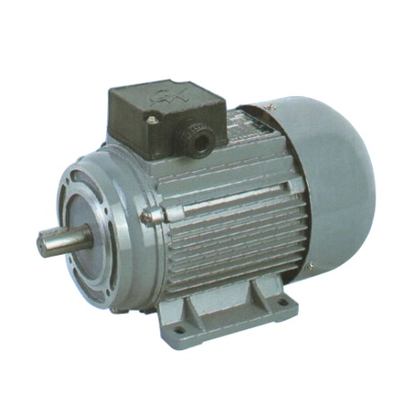
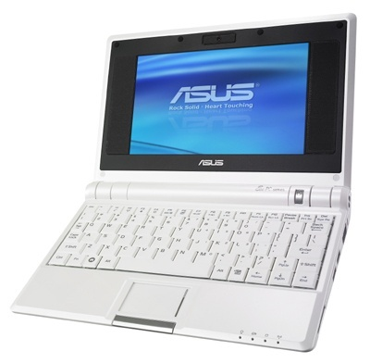
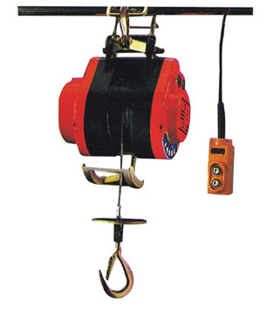
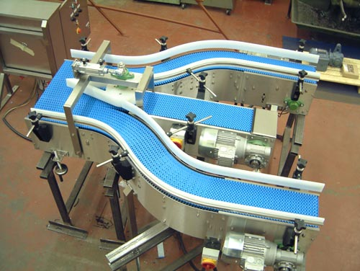
myDAQ USB Output Interface
Motor
Interface
Computer
High current, high voltage signals must connect to the myDAQ using an electronic interface circuit to provide the device with voltage and current level which can be safely handled by the myDAQ.
Conveyor
Hoist

Slide 13
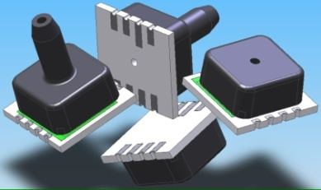
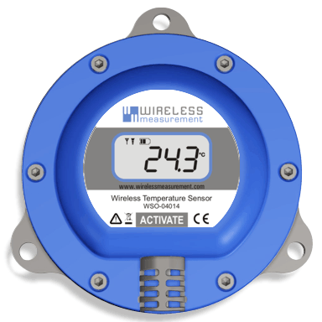
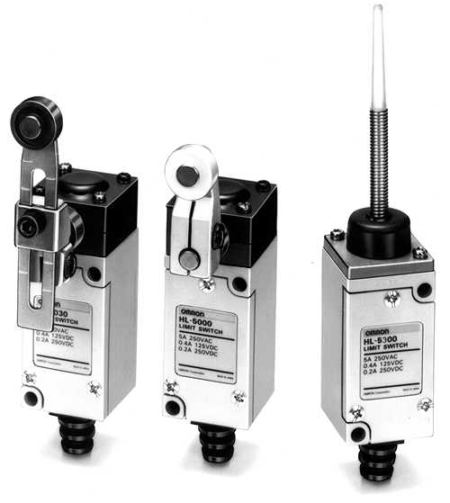
myDAQ USB Input Interface
Internal Controller
Pressure Sensors
Interface
Computer
Limit switches
Temperature Sensors

Slide 14
Arduino Embedded Output Interface
Motor
Interface
High current, high voltage signals must connect to the Arduino using an electronic interface circuit to provide the device with voltage and current level which can be safely handled by the Arduino.
Conveyor
Hoist

Slide 15
Arduino Embedded Input Interface
Pressure Sensors
Interface
Limit switches
Temperature Sensors

Slide 16
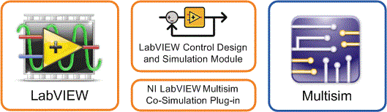

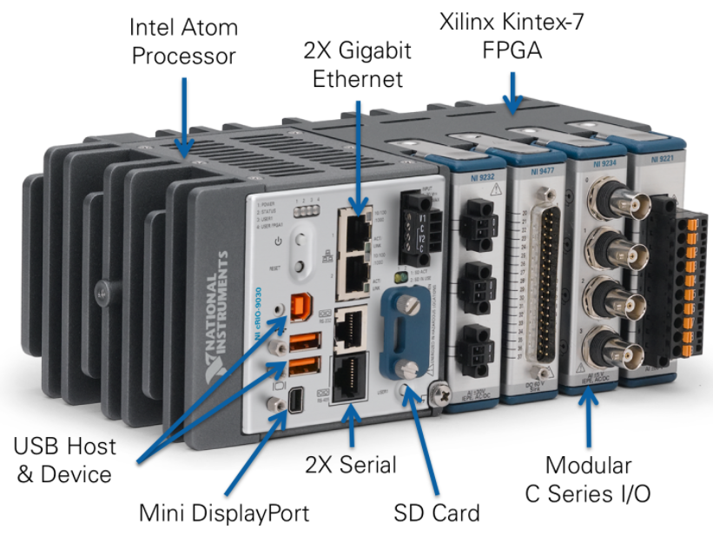
Overview
NI LabVIEW is a graphical programming language designed for engineers and scientists to develop test, control, and measurement applications. Created and optimized more than 20 years ago for engineers and scientists, the intuitive nature of LabVIEW graphical programming makes it easy for educators and researchers to incorporate the software in a range of courses and applications. Graphical system design is a modern approach to designing, prototyping, and deploying embedded systems. It combines open graphical programming with hardware to dramatically simplify development.

Slide 17
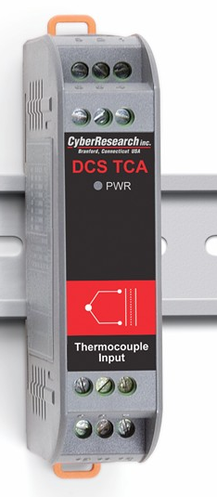
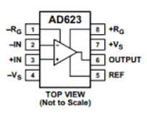

You will solve problems such as:
How do you measure the signal from a thermocouple that has an output of 42 uv/degree C.
Using an A/D converter with a 10 bit 5.0 volt ADC with a resolution of 4.9 millivolts.
In this case an amplifier with a high gain could be used.

Slide 18
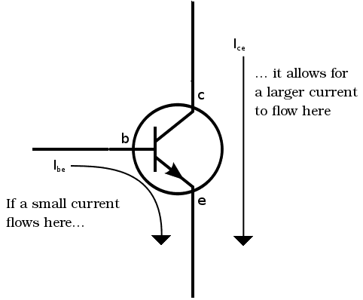
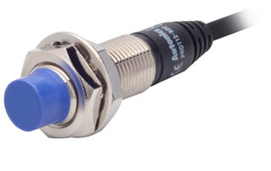
How do you measure the signal from an industrial discrete sensor with an output of 0 or 24 volts DC.
Using the myDAQ and LabVIEW or an Arduino(They operate at 5 volts and 3.3 volts.
Digital 0 to 24 volts
Digital 0 to 5 volts

Slide 19

How do you measure the signal from an industrial discrete sensor with an output of 4 or 20 mA using the myDAQ and LabVIEW or an Arduino, they typically measure analog signals in the range of 0 to 5 or 0 to 10 volts?
4 to 20 mA
Analog 0 to 10 volts.

Slide 20
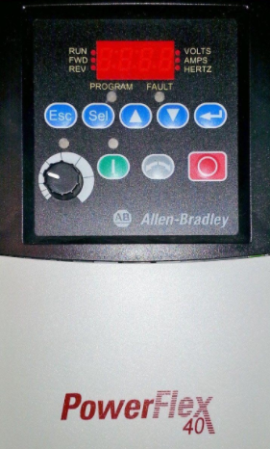
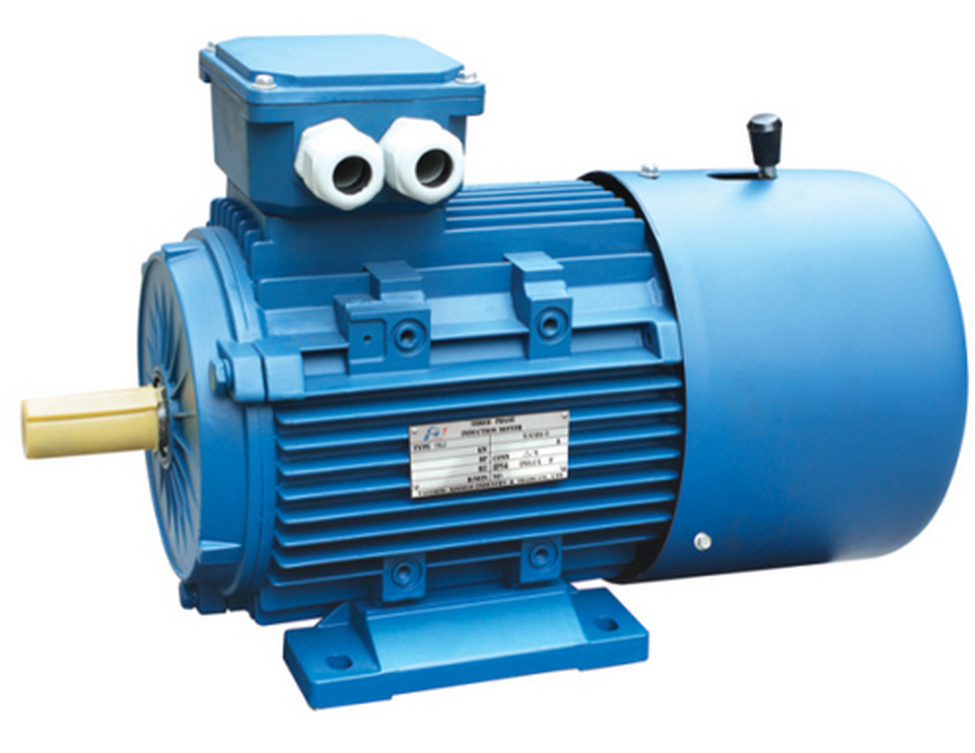
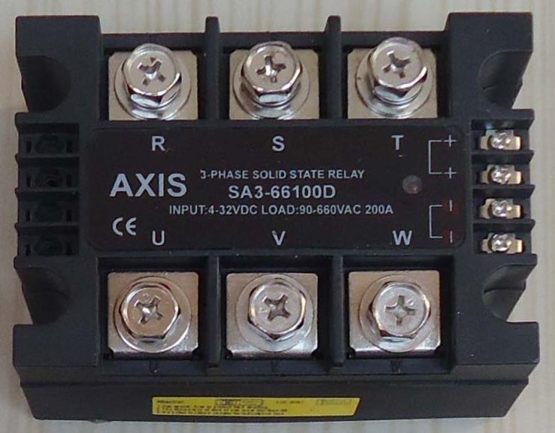
How do you control a 3 phase 30 amp motor using a myDAQ or Arduino?
3.3 volts, 4 mA
3 PH 380 volts 30 amps

Slide 21
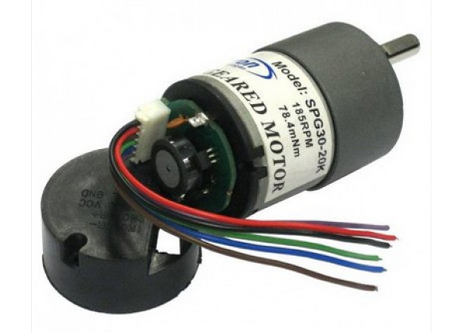
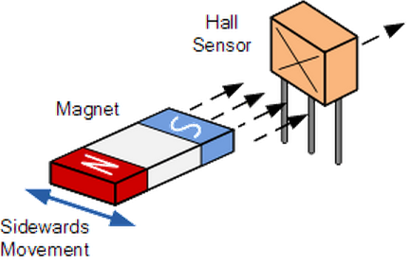
How do you measure the speed of a motor using hall effect quadrature encoder?
Pulses
High speed counter.

Slide 22
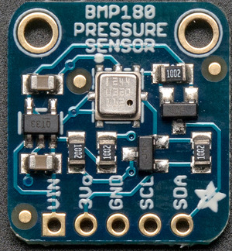
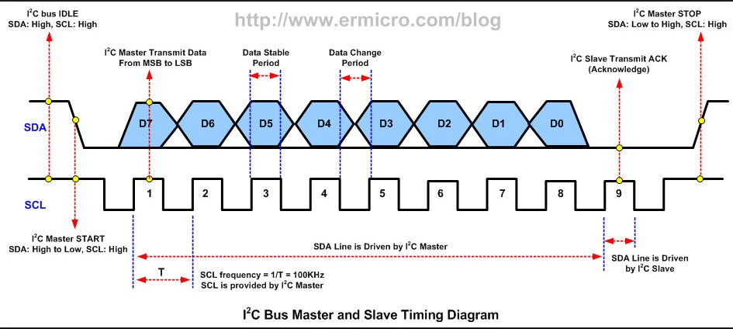
How do you measure altitude or barometric pressure using an Arduino controller?
2 wire I2C
2 wire I2C
Inter IC communications

Slide 23
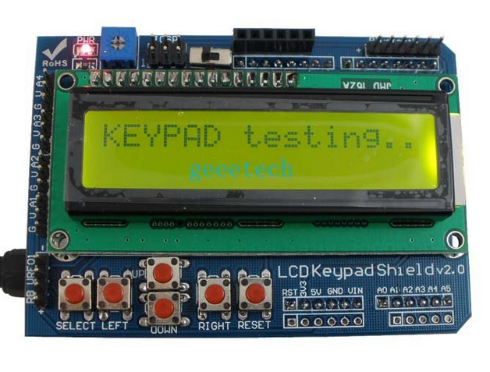
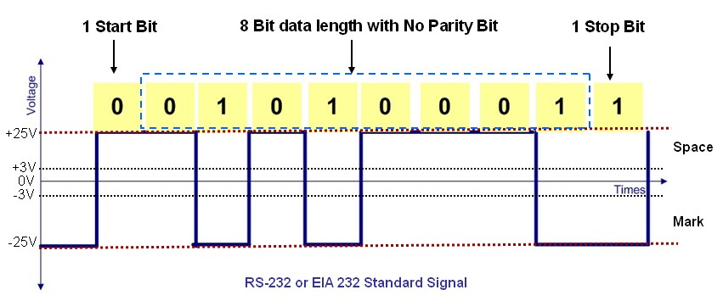
How do you display data in an embedded system using an LCD display?
Parallel or Serial Data?

Slide 24

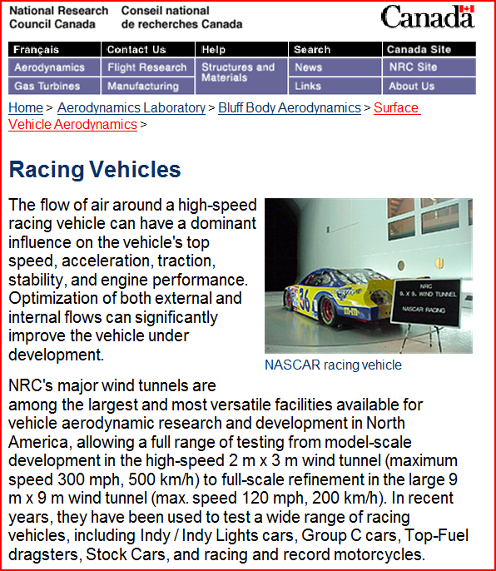
Organizations that Use LabVIEW

Slide 25




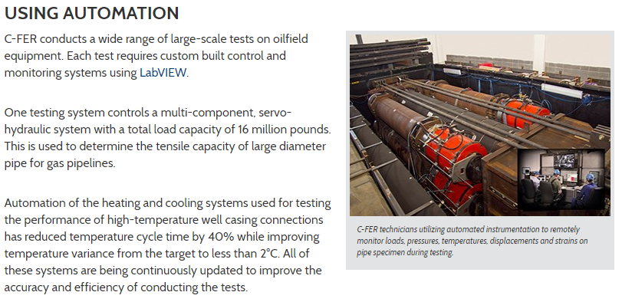

Organizations that Use LabVIEW

Slide 26
myDAQ Specifications

Slide 27
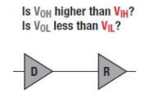
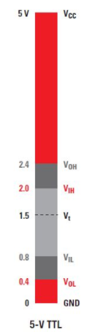
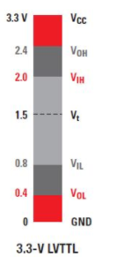
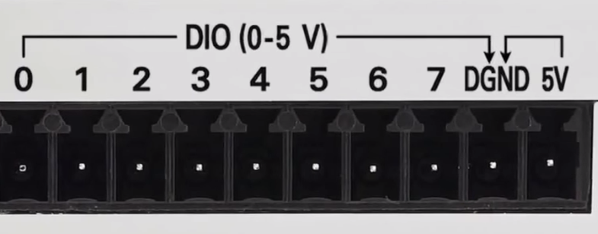
myDAQ Digital I/O Specifications:
Digital In:
Digital Out:
3.3 volts LVTTL inputs
5.0 TTL volt tolerant inputs
3.3 volt LVTTL
Max. 4 mA drive
LVTTL – low voltage transistor-transistor logic.

Slide 28
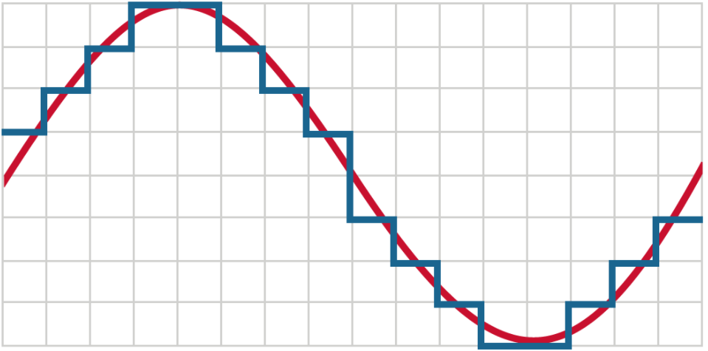
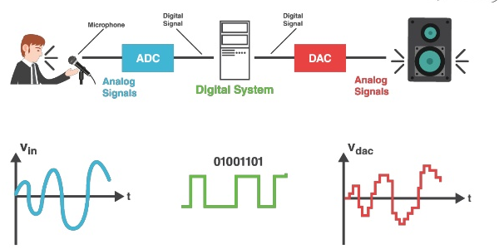
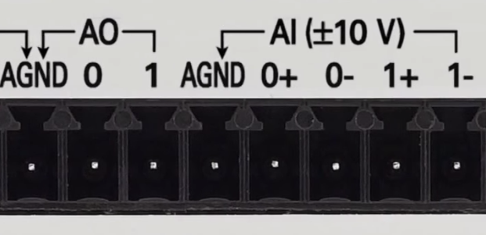
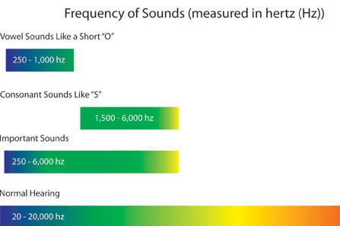
myDAQ Analog I/O Specifications:
Analog Out
Analog In
+/- 10 volts
2 mA drive
16 bit resolution
200 kilo samples/second
+/- 10 volts
10 G ohms input impedance
16 bit resolution
200 kilo samples/second
For single ended inputs, using a ground reference, the 0- and 1- inputs must connect to ground. Resolution = 20v/65,535 = about 0.3 mV.

Slide 29
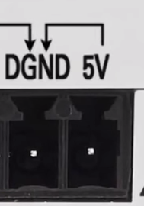
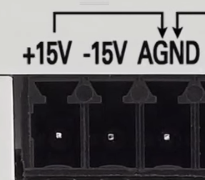
myDAQ Power Supply Specifications:
+/- 15 volts
32 mA drive / supply
+/- 14 volts at max. load
+ 5.0 volts
100 mA max. drive
4.0 volts(min) at maximum load
Note the current limitations of the supplies. Going over the current limits will cause the supply voltage level to decrease. Powered by USB 5v, 500 mA. Most laptops have an automatic resettable fuse if overcurrent occurs.
Caution:
Do not connect another power supply to the myDAQ.
There is a 1.25 A internal
fuse.

Slide 30

Protecting your myDAQ.
Do not change your circuit wiring while connected to the USB supply.
Use the myDAQ voltmeter to test circuit voltages.
After making a change to your circuit test it with a basic program (VI).
Do not leave your circuit connected to the USB if it does not function as expected. Something may be drawing too much current and may damage your circuit or the myDAQ.
Always have a circuit diagram and a layout diagram available when troubleshooting your circuit.

Slide 31
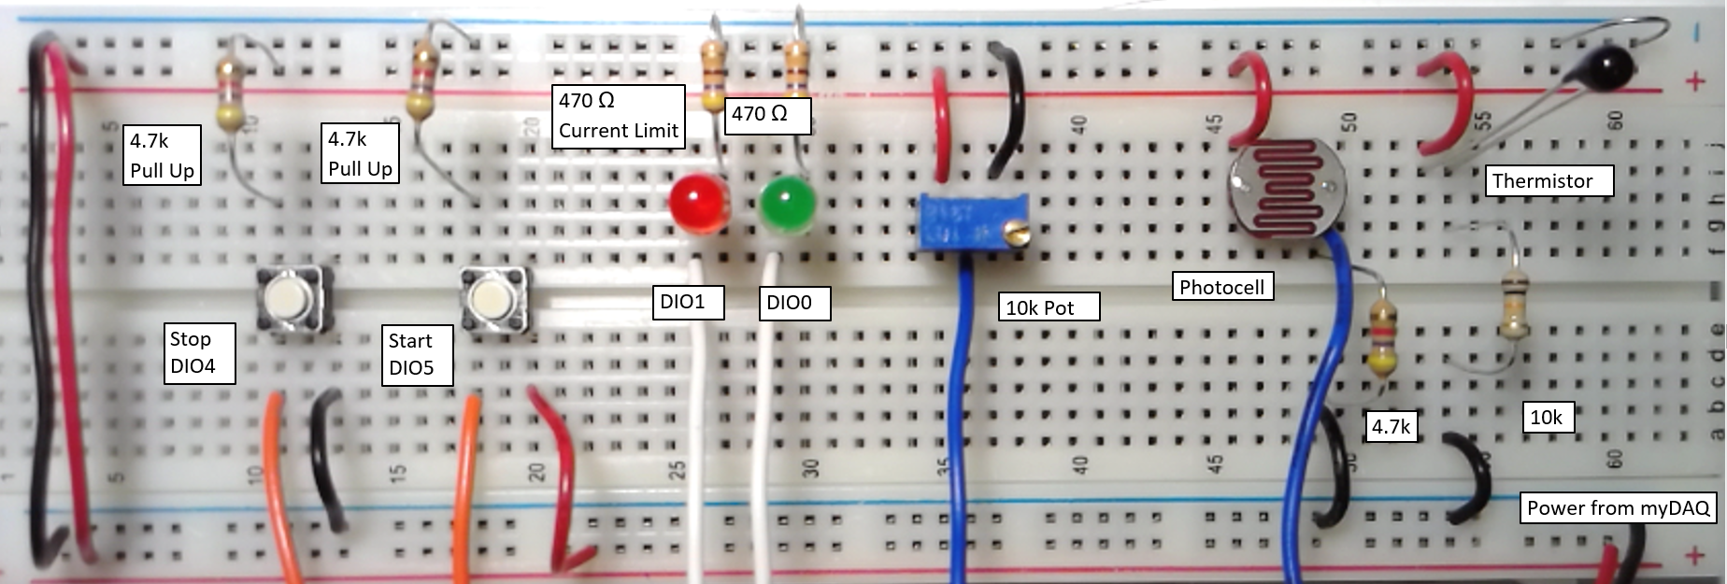
myDAQ Basic I/O Circuits
And Sensors

Slide 32
myDAQ Basic I/O Circuit (2018):
This is a typical schematic using Multisim 14. The schematic shows all the components, component values and their connection to ground, the supply, other parts of the circuit or to the myDAQ interface device.

Slide 33
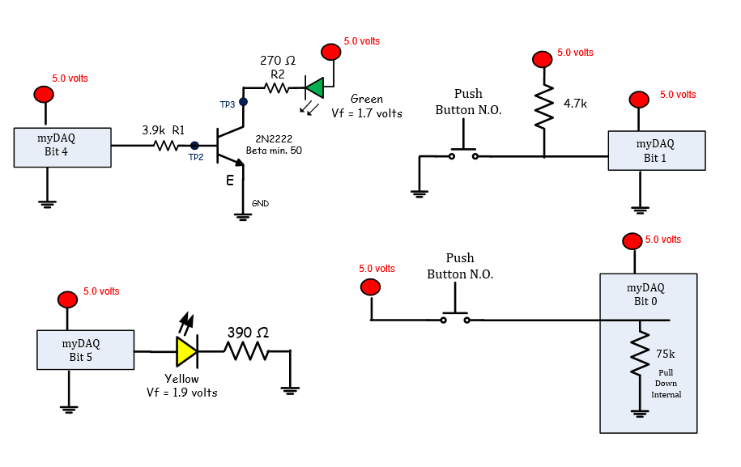
myDAQ Basic I/O Circuits
And Sensors

Slide 34
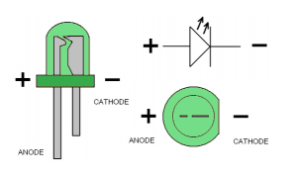
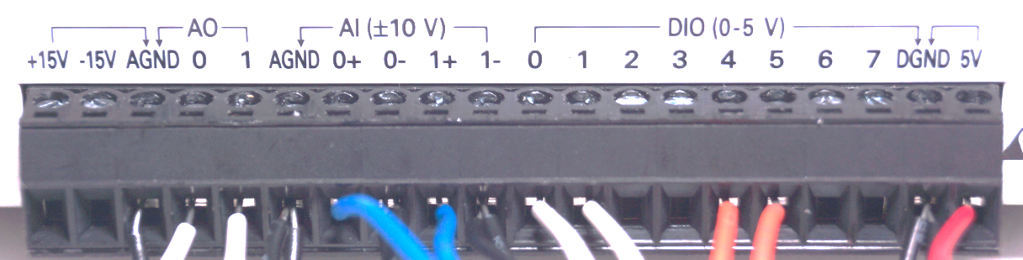
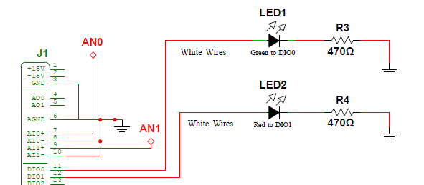
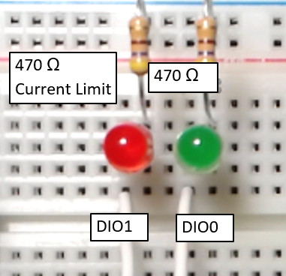
myDAQ Basic I/O Circuits
And Sensors
Wire neatly on the prototype board, use red wires to connect to the supply and black wires to connect to ground. The circuit uses 470 ohm resistors for current limiting and 4.7 k pull up resistors to prevent a floating input. An open switch is pulled to 5 volts, a closed switch connects to ground. The 470 ohm led resistor limits the myDAQ current to about 3.4 mA, it has a max of 4.0 mA.

Slide 35




myDAQ Basic I/O Circuits
And Sensors

Slide 36


myDAQ Basic I/O Circuits
And Sensors

Slide 37

myDAQ Basic I/O Circuits
And Sensors

Slide 38





myDAQ Analog I/O Wiring
Voltage Divider
The AGND, 0- and 1- must connect to the ground of your circuit when measuring signals that are referenced to ground.
AIN0
A thermistor decreases resistance as it is heated and increases resistance when cooled. The thermistor used in the lab is:
10k at 25 degC.
8k at 30 degC
12.4k at 20 degC.
As the temperature increases the voltage to AN1 increases.
Photocell
A photocell increases resistance in darkness and decreases when exposed to daylight. They typically range from about 200 ohms to 100,000 ohms and are non linear. When the circuit is wired as above the AIN0 voltage decreases in darkness.
The 10k variable is used to provide a variable DC signal from 0 – 5 volts to the analog inputs. Connect the device so that turning it CW increases the voltage on the middle terminal.

Slide 39



myDAQ/Arduino Sensors – Photocell
The photocell resistance decreases with higher visible light and increases in darkness.
Placed in a voltage divider circuit, as shown, the output voltage will increase when exposed to brighter light levels.
(Wikipedia) Illuminance is a measure of how much luminous flux is spread over a given area. One can think of luminous flux (measured in lumens) as a measure of the total "amount" of visible light present, and the illuminance as a measure of the intensity of illumination on a surface. A given amount of light will illuminate a surface more dimly if it is spread over a larger area, so illuminance (lux) is inversely proportional to area when the luminous flux (lumens) is held constant.
200 k ohms dark room
2.0 k ohms office lighting
200 ohms - daylight

Slide 40


myDAQ/Arduino Sensors – Thermistor
In this voltage divider the voltage increases as the temperature increases. For example at 30 degC the voltage out of the divider equals 2.7 volt. At 20 degC the voltage out is about 2.2 volts. The value in the Arduino register will range from 0 to 1023 (10 bits) At 20 degC the register equals 454.
Data for the thermistor used in the lab.
Resistance decreases as the temperature increases.
The change is not linear.
The change in ohms/deg at low temperature is greater than at high temperatures.
At 25 degC the resistance = 10k
https://learn.adafruit.com/thermistor/using-a-thermistor
You can also determine resistance given the A/D register value.
For example the register value (AN1) equals 566.
AN1 = 10k / (10k + Rtherm) * 1023
or
Rtherm = ((10k * 1023)/AN1) – 10k
Answer = 8080 ohms. (about 30 degC)

Slide 41

LabVIEW block diagram used to interface to the myDAQ.
The DAQ Assistant is a configurable function that is used to allow signals from the myDAQ interface to be controlled or monitored. There are 4 possibilities.
1) Digital In to read the digital signals. 2) Digital Out to control the logic levels on an output pin.
3) Analog In to read the voltage on an analog input pin.
4) Analog out to control the voltage on a pin.
Array
Array
Dynamic
Data
Type
Dynamic
Data
Type
DAQ
Assistant
Express VI

Slide 42

LabVIEW Front Panel (User Interface)
The front panel acts as the user interface. Controls and indicators are placed on the front panel. The controls allow the user to change a Boolean or numeric value. The indicators display the results.

Slide 43


myDAQ Express Digital Output (generate)
The following is the VI (virtual instrument) or block diagram used to control a digital output on the myDAQ interface. The input to the Express VI is a Boolean array. The build array function combines the array elements into the array. The upper element is element 0.

Slide 44


myDAQ Express Digital Output
Configuration
The express VI, is used to select the channel (pin) to which the signal passes through. The signal can also be tested at this point.

Slide 45


myDAQ Express Digital Input (acquire)
Output from DAQ Assistant is an Array.
Use index array function to convert to Boolean data type.
The following is the VI (virtual instrument) or block diagram used to display the data from digital inputs of the myDAQ interface. The DAQ assistant outputs the data as an array. The index array breaks down the data to individual bits. The top element is bit 0 of the array.

Slide 46

myDAQ Express Digital Input
Configuration

Slide 47

myDAQ Express Analog Output
The merge signal function inputs scalar numeric values and outputs dynamic data type. The dynamic data type is the input to the express VI.
The following is the VI (virtual instrument) or block diagram used to control the analog voltage to the myDAQ analog out terminals. The data into and out from the DAQ assistant for analog data is a Dynamic data type. The merge signals function can combine many scalar data values into one dynamic data type signal. The express VI reads the signals in sequence. The upper value will be applied to the first output signal.

Slide 48

myDAQ Express Analog Output
Configuration

Slide 49


myDAQ Express Analog Input
The following is the VI (virtual instrument) or block diagram used to monitor the analog voltage to the myDAQ analog input terminals. The data into and out from the DAQ assistant for analog data is a Dynamic data type. The split signals function can breakdown multiple signals to individual scalar data types. The express VI outputs the signals in sequence. The upper value is from the first input(CH0) the lower value from (CH1).
The dynamic data type includes the data associated with a signal, as well as attributes that provide information about that signal, such as the name of the signal or the date and time the data was acquired.

Slide 50

myDAQ Express Analog Input
Configuration

Slide 51
LabVIEW Block Diagrams and Front Panel Indicators and Controls

Slide 52
LabVIEW
A graphical programming language used for instruments and control applications.
LAB Virtual Instrument Electronic Workbench.
LabVIEW easily allows developers to create graphical interfaces that control and monitor hardware devices and sensors.

Slide 53

LabVIEW Data Flow Execution
LabVIEW uses data flow execution, when all inputs to a function are available, the function executes, and produces an output.

Slide 54

LabVIEW Data Flow Programming

Slide 55

LabVIEW Front Panel & Block Diagram
Icons/Objects
Terminals
Wires
Control
Indicators
Front Panel
Block Diagram
Place Graphical Objects on the Front Page – objects are automatically generated on the block diagram.

Slide 56

LabVIEW Block Diagram (Program)
Boolean front panel(FP) controls will control the digital signal on a myDAQ output pin.
Boolean front panel(FP) indicators will display the digital state of the signals on a myDAQ digital input pin.
Numeric front panel(FP) controls will control the analog value of the signals on a myDAQ analog output pin.
Numeric front panel(FP) indicators will display the analog value of the signals on a myDAQ analog input pin.

Slide 57

LabVIEW Front Panel (User Interface)
This is the front panel used to monitor and control digital and analog signals from and to the myDAQ interface.

Slide 58

LabVIEW Block Diagram (program)
Program
Node
Numeric
Function
Wires
Numeric Indicator
Boolean
Function
Numeric Control
Terminals
Boolean Indicator

Slide 59


Properties such as scale, colours and
representation can be modified
with a right-click of the mouse.
Boolean Indicator
Compare Function
Controls have a darker frame
around the icon.
Boolean Indicator
Signed Integer Control
Indicators have arrows
that point inwards
Block Diagram
Front Panel

Slide 60
LabVIEW Menu Bar – (Running and Stopping a Program)
Run Once
Run Continuously
Stop
Pause
Step (step through program)
Note:
It is quite common to use a while loop in all programs. The while loop executes until a condition is met.

Slide 61

LabVIEW Front Panel Controls Palette
Controls
Dials
Tanks
Thermometers
Switches
Indicators
Leds
Gauges

Slide 62

LabVIEW Numeric Functions Palette
Block Diagram Functions:
Add
Subtract
Multiply
Sum
Square Root
Functions that require numeric inputs and produce numeric outputs.

Slide 63

LabVIEW Numeric Functions Palette
Floating point numbers can be Double Precision (8 bytes) or single precision (4 bytes)
Boolean variables have only one of two possibilities zero or one or (true / false), (on/off).
Double Precision numbers are floating point numbers (Ex. 2.3456), they can be used to represent fractional amounts.
LabVIEW uses the colour orange to indicate floating-point numbers.
The variable shown in blue is an integer variable. Integers can be signed or un-signed. Signed numbers use the most significant bit to indicate sign. Integers can be 8,16,32 and 64 bits.

Slide 64

LabVIEW Boolean Functions Palette
Block Diagram Functions:
Logical And
Logical OR
Logical Invert
The two green T/F boxes near the bottom are Boolean constants.
The function with the question mark is used to convert from Boolean to numeric.

Slide 65

LabVIEW Comparison Functions Palette
Block Diagram Functions:
Comparison Functions
Greater than
Less than
Not equal to zero
Select
Min and Max
The Select function requires a Boolean input and outputs one of two values based on the condition of the Boolean input.

Slide 66

LabVIEW Structures Palette:
Structures:
For Loop Structure
Executes the loop a specific number of times.
While Loop Structure
Continues until a condition is true.
Case Statement
Executes a statement bases on the input value of the case statement.
Local Variables
Use local variable instead of wires to connect one point to another.
Sequence Structure
Used to execute code sequence.
Decorations
Used to draw boxes, test and graphics.

Slide 67

LabVIEW Front Panel Boolean Controls and Indicators
Switches
Push Buttons
LEDs
True/False
Check Boxes

Slide 68

LabVIEW Front Panel Numeric Controls and Indicators
Numeric Controls
Numeric Indicators
Slides
Knobs
Meters
Gauges

Slide 69

LabVIEW Front Panel Strings:
String / Characters /Text
Controls
Indicators
Allows text to be entered and displayed on the Front Panel.

Slide 70

LabVIEW Structures – For Loops and While Loops.
To repeat code – use a While Loop. The code will continue to execute until stop is true. The loop also has an iteration counter that increments by one for each loop count.

Slide 71

LabVIEW Functions – Time Delay
Programs often require time delays. LabVIEW has a function to create a delay in increments of milliseconds.

Slide 72

LabVIEW Functions: Numeric to Boolean Conversions

Slide 73


LabVIEW Select Function

Slide 74
LabVIEW Data Types

Slide 75

LabVIEW Data Types
LabVIEW contains various numeric types.
Numeric types can be changed with a right-click of the mouse and then select representation.
I – Signed Integer
U – Unsigned Integer
SGL – single precision real data

Slide 76

LabVIEW Variable Types
Controls or indicators in blue represent integer data type.
Integers can be 8,16,32 and 64 bit values.
Integers may also be signed (negative and positive) or unsigned (positive only).

Slide 77

LabVIEW Integer Data Type
Eight bit unsigned integers (U8) range from 0 to 255 in decimal.
Signed eight bit integers (I8) range from -128 to positive 127.
Bit 7 of the 8 bit number is called the sign bit. (a 1 in bit 7 indicates a negative value)
Integers do not have a fractional part in the number. Besides 8 bit signed and un-signed there are also 16,32 and 64 bit signed and unsigned integers.
Integers are used to represent: - a count, a value in memory, an address location or any whole number.

Slide 78
Single/Double Precision
Single precision numbers require less storage space. Single precision numbers can store data to 6.000000 decimal places. This is more than enough for what is typically done in the lab.
LabVIEW uses double precision by default.
Double precision numbers allow more significant digits ( approx. 15 ).

Slide 79
Real Number: Single/Double Precision Floating-Point
Represents analog values – real numbers have an integer and a fractional part. Examples are shown below.
Temperature – 34.56 degrees C
Level – 2.658 metres
Voltage – 12.678 volts
Pressure – 22.4 kPa

Slide 80

Boolean Data Type:
True or False
1 or 0
Only two possibilities
A false is stored as an 8 bit value of all zeroes.
Boolean values are used to read the state of a switch or a two state sensor. As outputs Boolean data can be used to control the state of motors, relays, lamps and heaters.

Slide 81

LabVIEW Numeric Types

Slide 82

LabVIEW Wire Colours and Type:

Slide 83

LabVIEW Wire Colours:

Slide 84

Most values used in LabVIEW are numeric scalars.
Scalars have magnitude only.
A scalar example would be a distance such as 8 km.
Vectors have magnitude and direction.
Example: Displacement is a vector – move 8 metres north and then 4 metres north-east.
Vectors have magnitude and direction.

Slide 85


Slide 86




Express Vis in LabVIEW use dynamic data types. Dynamic data types may include multiple signals, arrays, different data types and time stamps. Split Signal, Combine signal, convert to DDT and convert from DDT are functions that may be required when using dynamic data types. These functions are found under Express -- Signal manipulation.

Slide 87



Working with Dynamic Data Types:
The example below shows the use of convert, split and merge dynamic signals. The order in which the signals are merged will be the same in which they are split.
When converting to or from dynamic data type you must double click on the function to select the data type, in this example the data is a single numeric scalar. A scalar is a value with magnitude only.

Slide 88


Slide 89



Slide 90


Slide 91


Slide 92


LabVIEW Tools:

Slide 93

Front Panel Example:

Slide 94

Block Diagram Example:

Slide 95

Working with Numeric Data Types:
The example below uses a Multiply Function to multiply a numeric input from the Front Panel and multiply it by 2. The result is displayed on a Front Panel (FP) meter and Waveform Chart.
A Compare function is used to compare the multiplication result with 6. If the result is greater than six the Boolean output is True.
The Select Function then uses the Boolean result to display “too high” if true and “too low” if the Boolean input is false. The Select input can accept many different data types that will be sent to the output. The centre input must be Boolean.

Slide 96


While Loop – the loop continues until stop is true.
The number of time the loop has executed is shown by the iteration indicator.
Boolean indicator and control.
Controls have a darker boarder and an arrow pointing outwards.
Controls are a source of data.
Indicators have arrows pointing inwards, they receive data.
Boolean
function
indicator
control

Slide 97
LabVIEW
Shift Registers
Mechanical Action
Formula Node

Slide 98

Shift Register –
On each iteration of the loop the data from the right side of the loop is sent to the left. The constant on the left is only active on the first iteration.

Slide 99

Expression Node –
“C” like code used within LabVIEW. Inputs are created by right clicking on the left side of the frame. Outputs are on the right.

Slide 100


LabVIEW Shift Register Example
To create the shift register right click on the border the While Loop.
Select Add Shift Register.
On each iteration of the loop the data from the right side of the loop is sent to the left. The constant on the left is only active on the first iteration.

Slide 101


LabVIEW Shift Register Example
Shift Register 2nd Example:
To create the shift register right click on the border of the while loop.
Select Add Shift Register.
The motor signal will go true when start is true and remain that way because of the shift register until stop is true. Take some time to understand the shift register, try it out in the lab.
The Boolean constant “F” is true only on the first iteration of the while loop.

Slide 102

Formula Node:
The Formula node allows a programmer to write “C” code within LabVIEW. The program uses functions to convert Boolean to numeric and numeric to Boolean. The program also uses local variables to reduce the amount of wiring. The block diagram (BD) includes an express VI for myDAQ digital input and output.

Slide 103



Mechanical Action:
LabVIEW push buttons have a feature called mechanical action which can be changed to suit the type of switch the application requires. The are 6 choices.
** Use Switch until release when you use a local variable.

Slide 104
LabVIEW Arrays Basics

Slide 105

LabVIEW Arrays
An array is a group of elements of the same data type. Arrays are often used in LabVIEW to store data from analog readings. The data can then be used in a spreadsheet file. Arrays are accessed by their indices; each element‘s index is in the range of 0 to N-1 where N is the total elements in the array.
The lines connecting arrays are thicker than integer or numeric values. The first element in an array is 0.
An Array Index is used to point to a specific element within the array.
The Array size function returns the number of elements in an array.

Slide 106






Creating Arrays in LabVIEW
Place an empty array shell onto the block diagram.
Drag a data object(such as a numeric indicator or control) into the empty element window. Resize the shell by dragging the frame handles. Arrays can be an any data type including character and Boolean. The arrays can be indicators or controls.

Slide 107


LabVIEW Arrays for Data Acquisition
An array is often used in data acquisition systems to read or sample data and store the sample in an array. The data can later be displayed in a spreadsheet file once it has been captured. The example below uses a “For Loop” that executes 6 times (once/second) and captures one sample of data on each loop and stores the data in an array.

Slide 108








Arrays Functions:
There are array functions to:
Find the size of an array
Find the sum of an array.
Find the min and max value of an array.
Find the index of the min and max value.
Find the average of the array values.
Array
Size
Index Array
Build
Array
Array
Min/Max
Linear Interpolation
Array Constant

