Slide 1
Index slide
Slide Index
3-17 Arduino Specifications and Hardware
18-34 Arduino Install, IDE and Software

Slide 2

Fall 2018 CAM8302E (Week 3) Microcomputer Interfacing Arduino Overview
Week 3 -- 44 slides Michel Hanbury Sept. 21st 2017

Slide 3

Arduino Specifications and Hardware

Slide 4
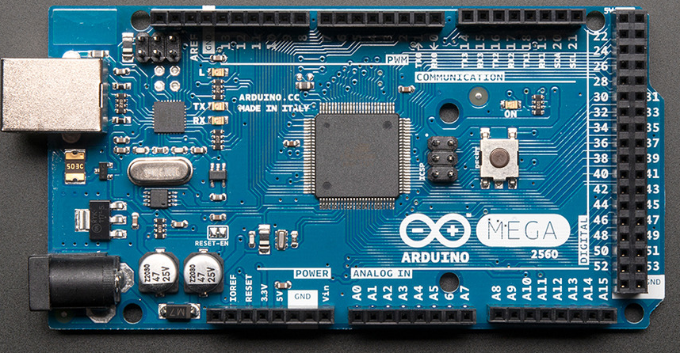
Arduino Microcontroller
A popular inexpensive microcontroller used for embedded systems. It has 16 (10 bit A/D) inputs and synchronous and asynchronous serial ports. The device has 54 programmable digital I/O pins.

Slide 5
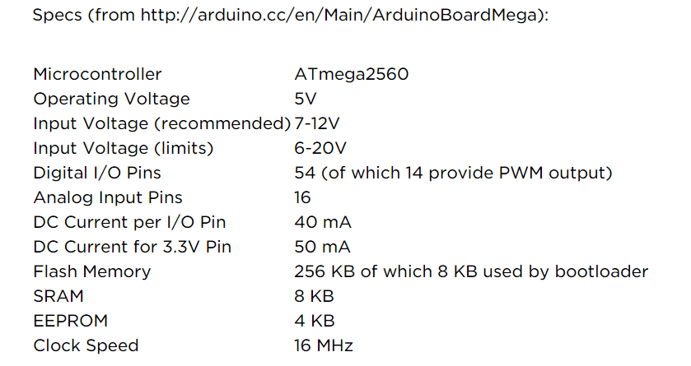
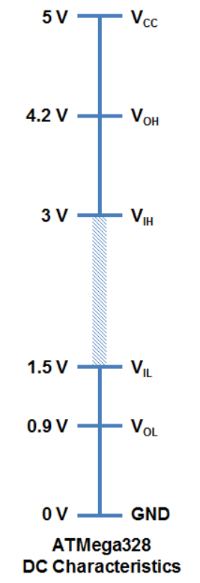
Arduino Mega Specs:
Logic Levels
Indicates amount of memory, I/O pins and basic voltage and current specs.
min
Logic High
min
10 bit (0-5 volts)
max
Logic Low
max
Flash – non volatile program storage. SRAM – variable storage.

Slide 6
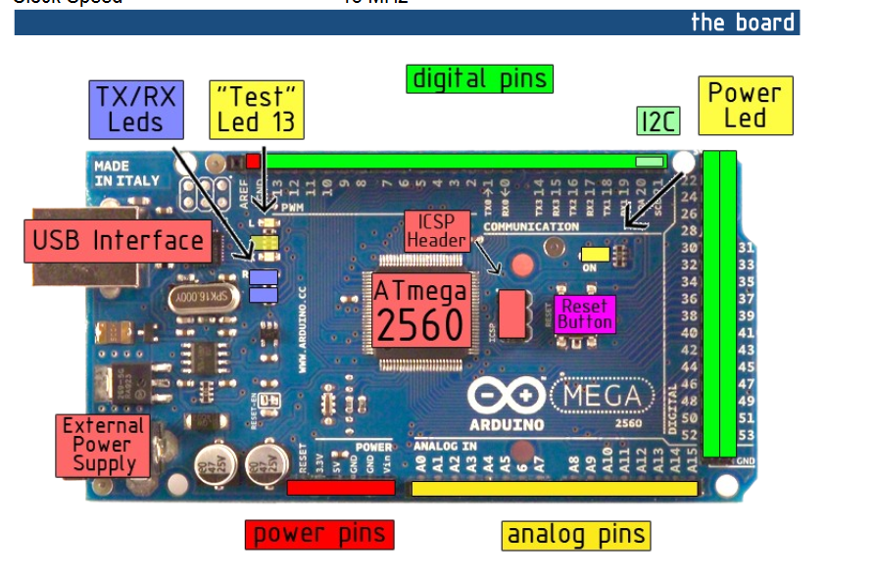
Arduino Hardware
Serial I/O (0,1)
SPI (19-22)

Slide 7
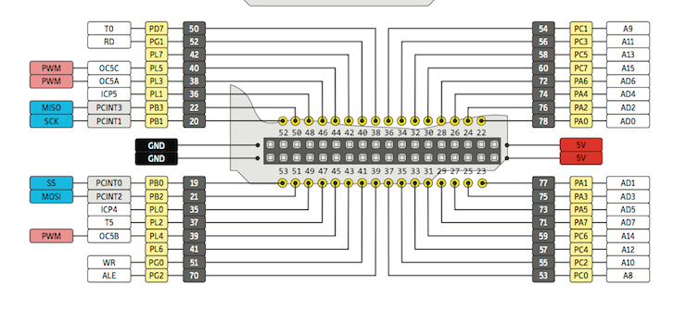
Connect to these points to power the circuits on your proto board.
Disconnect the USB cable when making changes to your circuits. (Maximum current 100 mA)
+5
Gnd

Slide 8
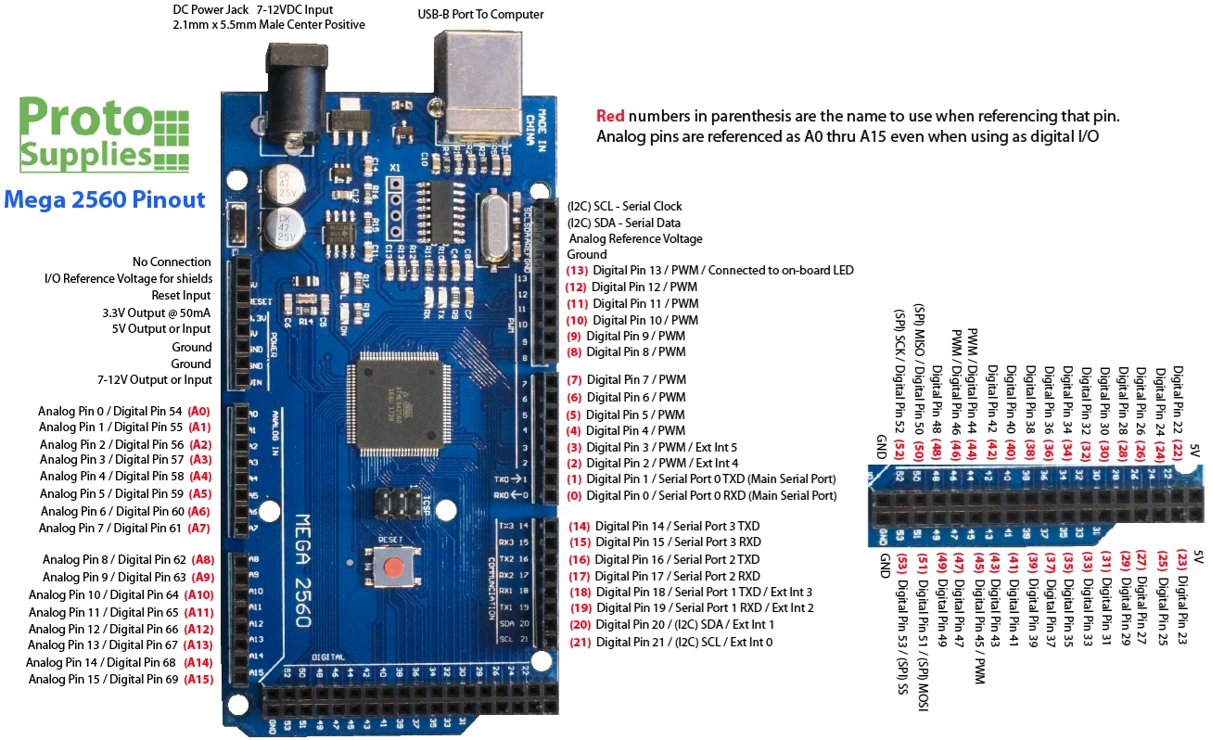

Slide 9
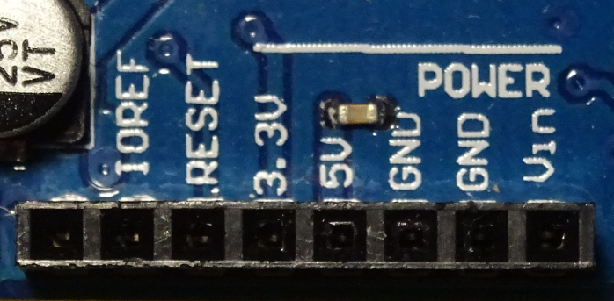
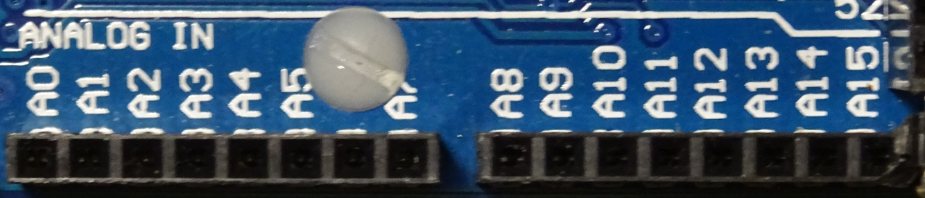
Connect power to your circuit from 5V and ground. Max of 100 mA through +5
The 5 volt pin is an output supply. Do not connect 5.0 volts from a power supply to this pin. Do not connect power to any other pin.
Arduino I/O Pins
16 analog to digital converter channels (0 to 5.0 volts) 0 to 1023 10 bits 4.88 mV resolution.

Slide 10
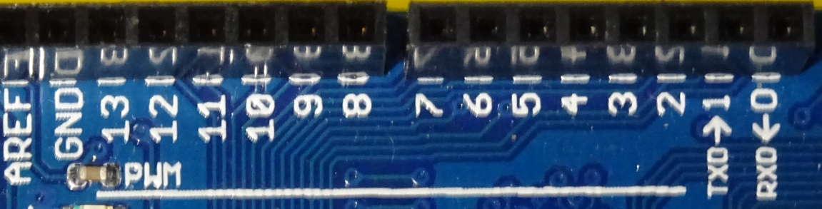
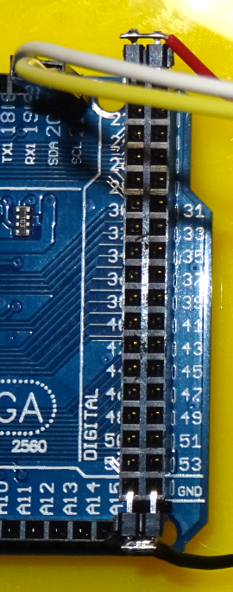
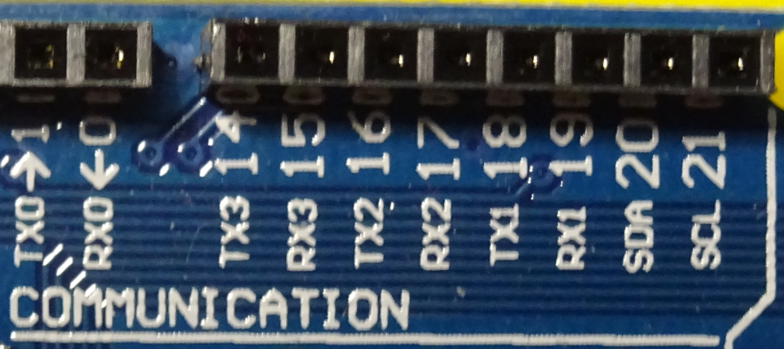
PWM
Main Digital I/O
TTL o/p max. 40 mA
Serial I/O
Arduino I/O Pins
Serial I/O
I²C
More Digital I/O

Slide 11

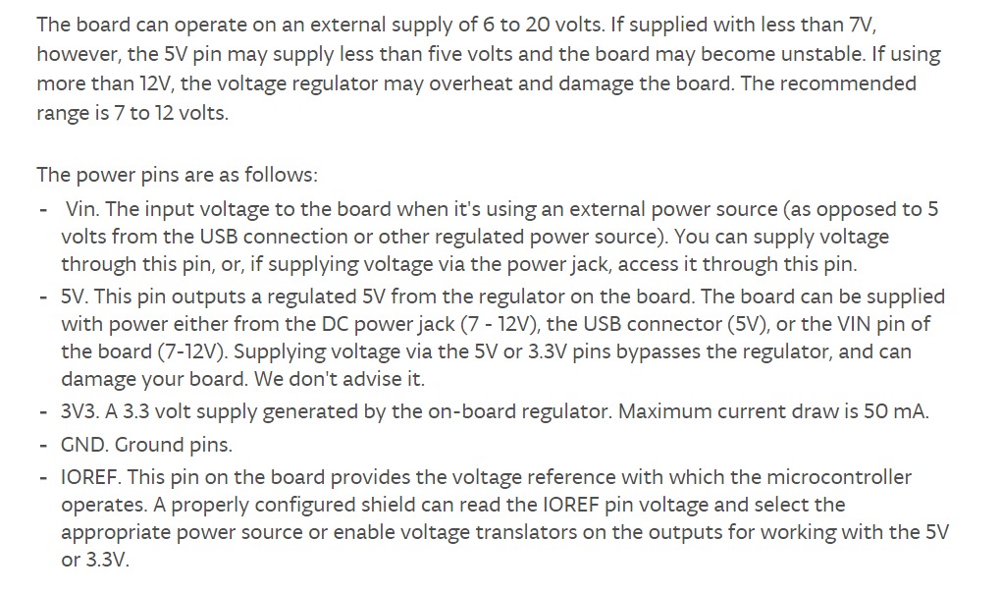
Arduino Specs:
** Read this section carefully.

Slide 12
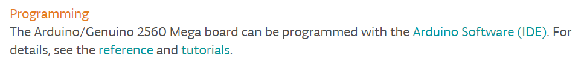
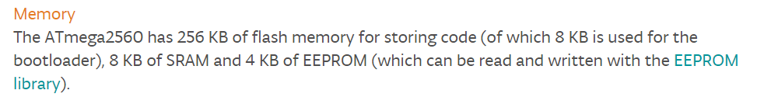
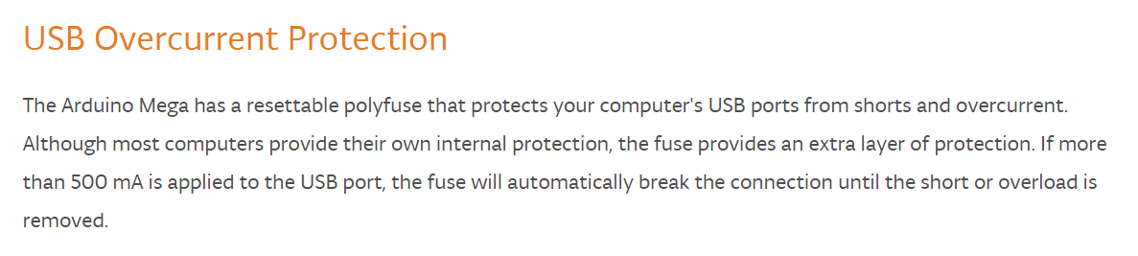
Arduino Specs:

Slide 13
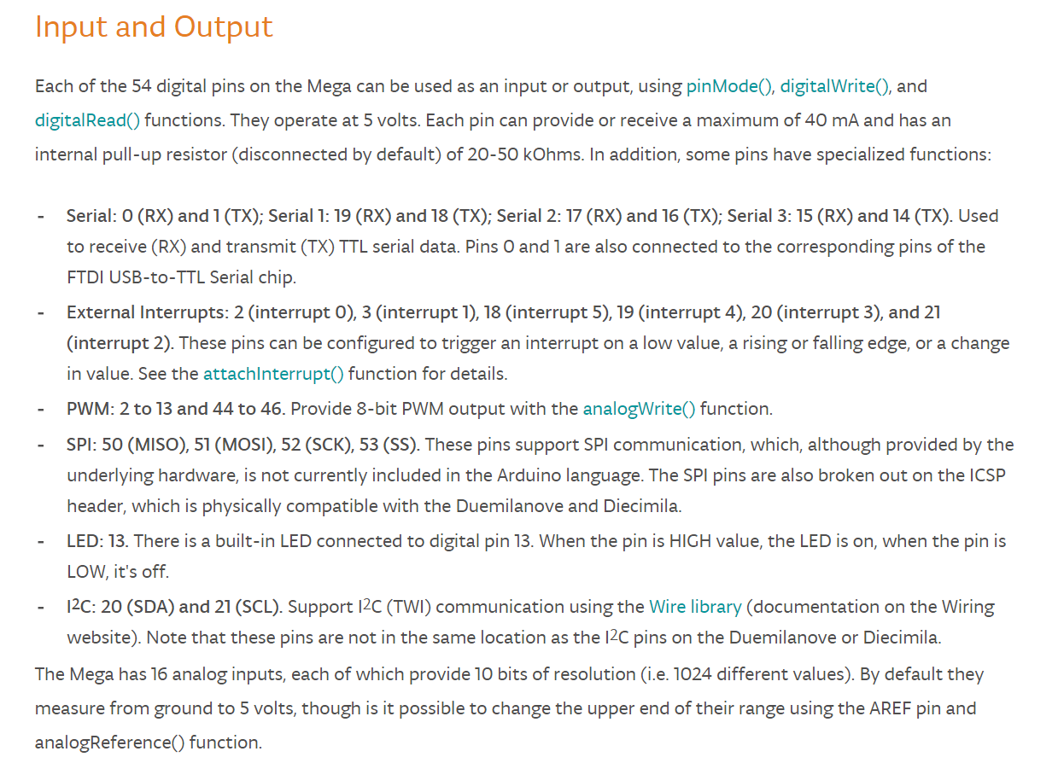
Arduino Specs:

Slide 14
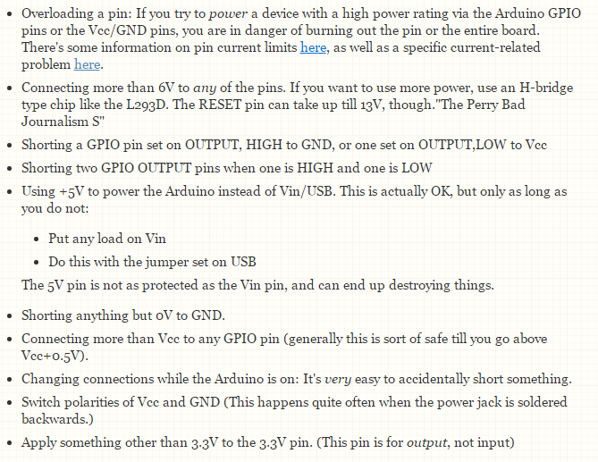
Avoid Damaging the Arduino
** Read this section carefully.

Slide 15
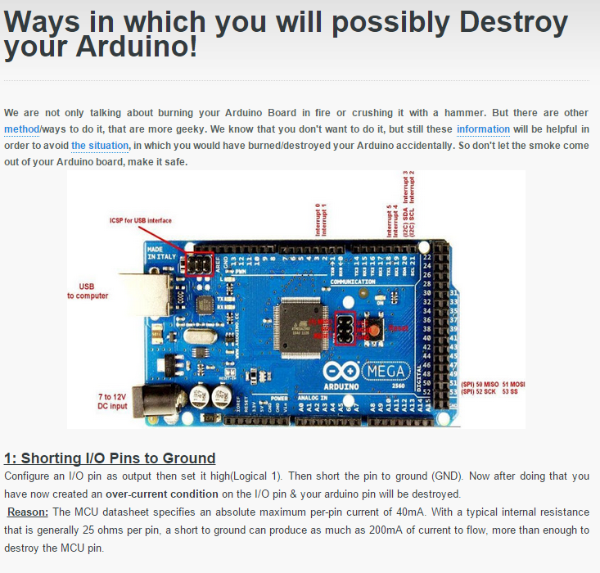
** Read this section carefully.

Slide 16
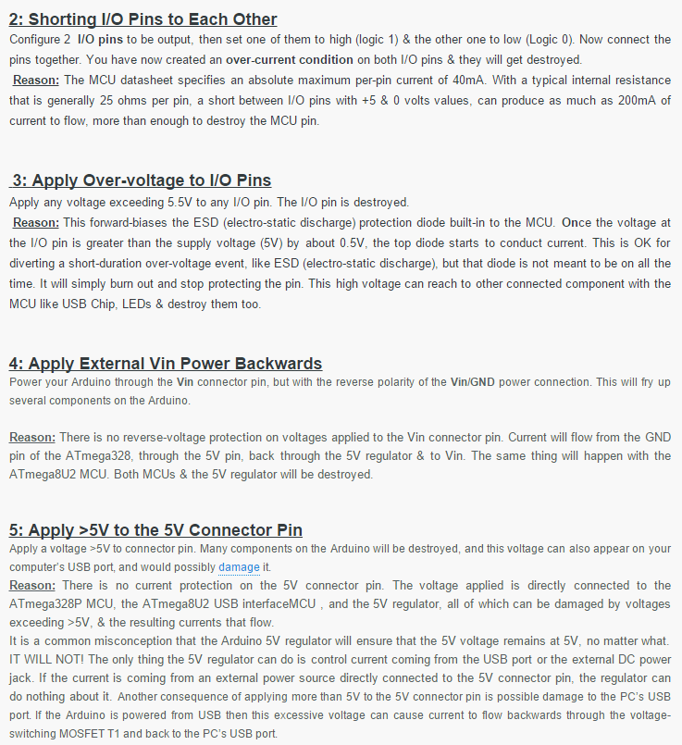

Slide 17
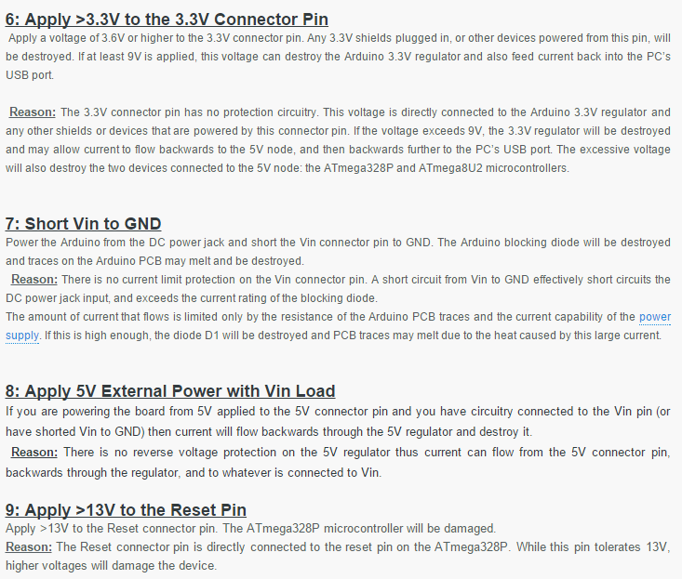

Slide 18
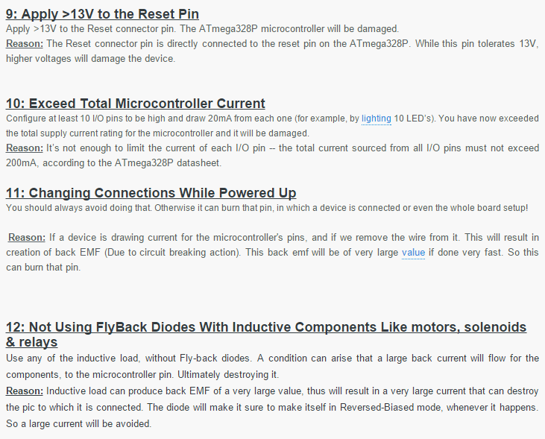

Slide 19

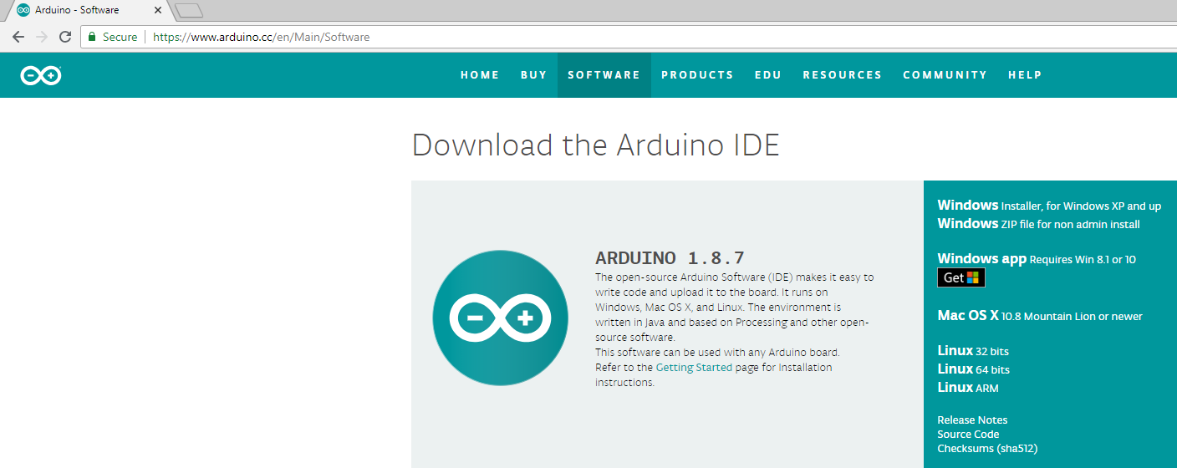
Arduino IDE Install and Software
(IDE) Integrated Development Environment
The Arduino IDE is a free open-source program.
The latest version is 1.8.7

Slide 20
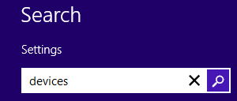
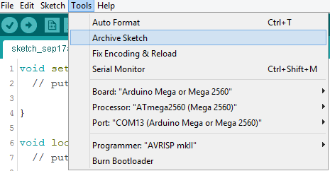


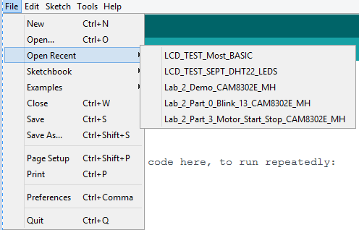

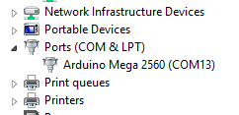
Arduino Board Setup:
1
The Arduino converts the serial data to USB.
The PC converts the USB data to asynchronous serial.
4
2
5
3

Slide 21
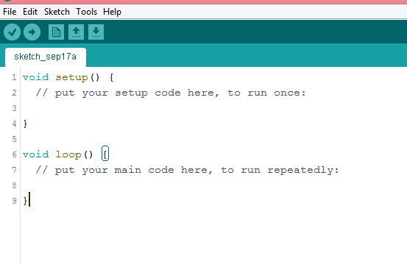
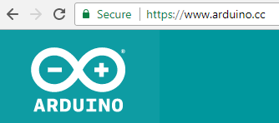
Arduino IDE (Integrated Development Environment)
Verify
Save
Upload
Open
(Transfer to Arduino)
New
Use the IDE to write, debug, verify and transfer your program.
The IDE can be downloaded for free:

Slide 22
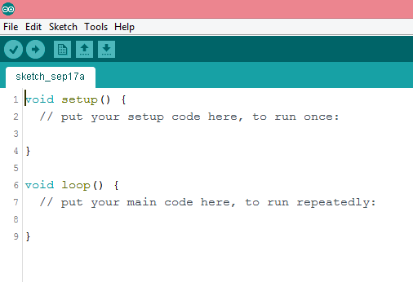
Basic Arduino program structure. Setup() runs once
and the loop() functions runs continuously once started.

Slide 23
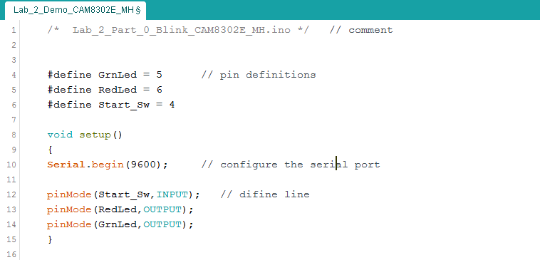
Arduino Program (sketch.ino): Definitions, Libraries, Setup, Loop

Slide 24
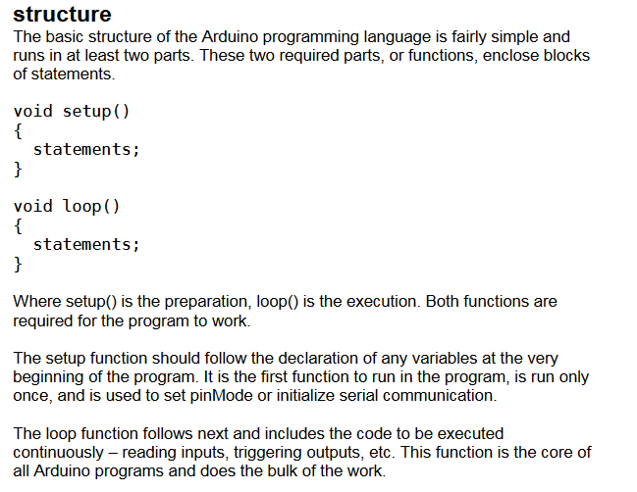

Slide 25
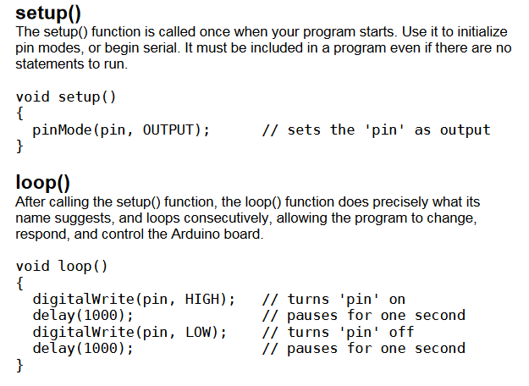

Slide 26
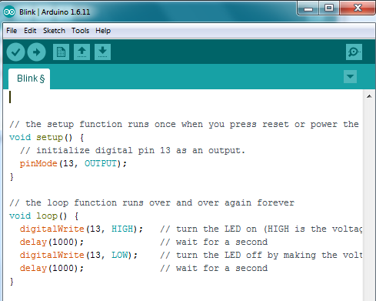

Slide 27
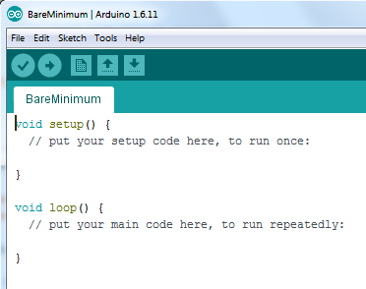

Slide 28
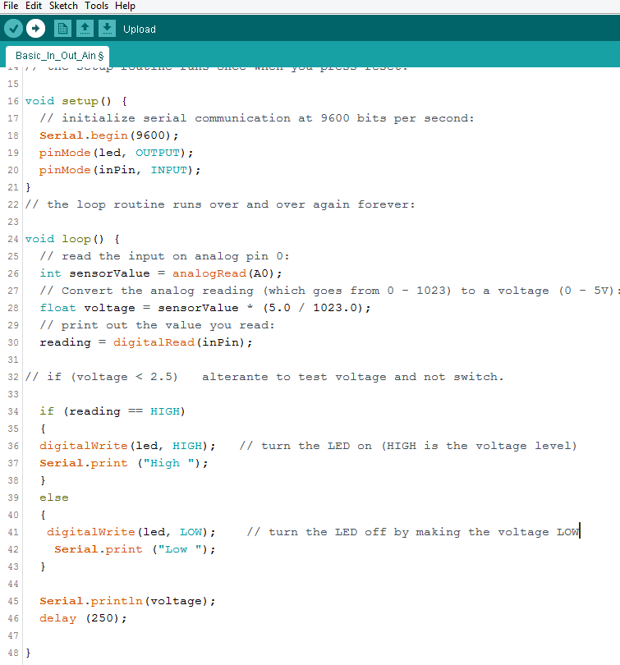



Slide 29
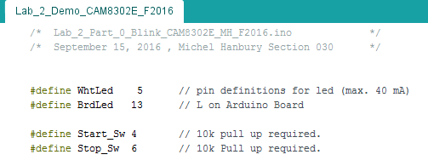

Slide 30
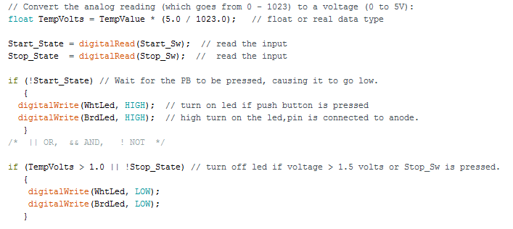

Slide 31
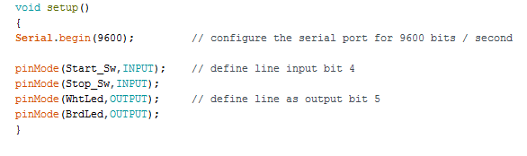
Code that is run only once
The code in the setup() function is executed once and is not part of a program loop.

Slide 32
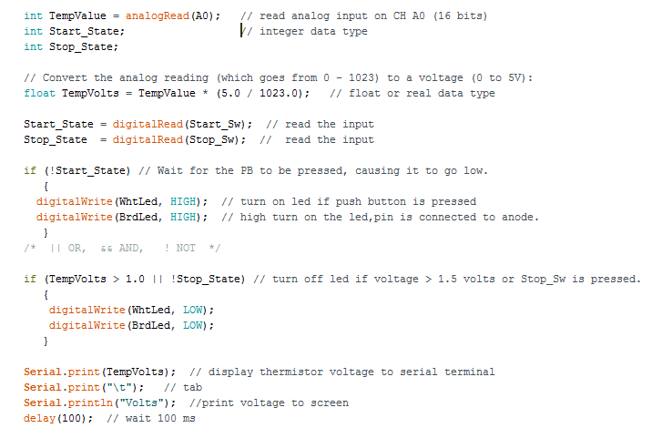
Software Example:

Slide 33
Arduino IDE (Integrated Development Environment)
Verify
Save
Upload
Open
(Transfer to Arduino)
New
Use the IDE to write, debug, verify and transfer your program.
IDE -- Integrated Development Environment

Slide 34
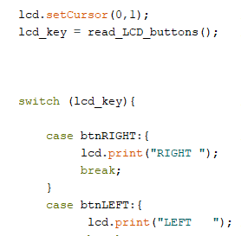
Arduino Program (is called a Sketch): Definitions, Libraries, Setup, Loop

Slide 35
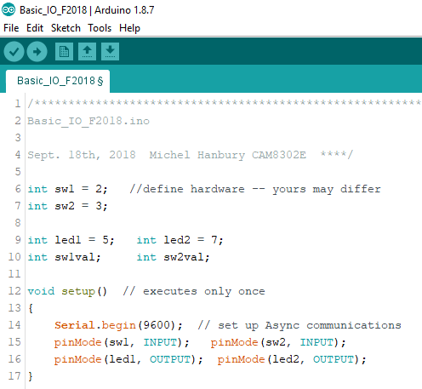

Slide 36
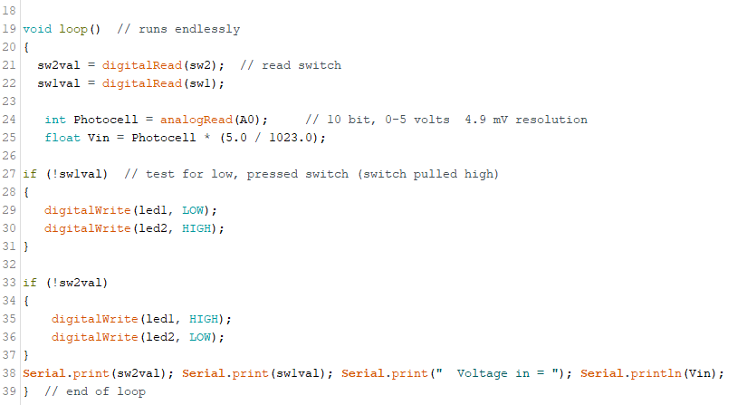

Slide 37
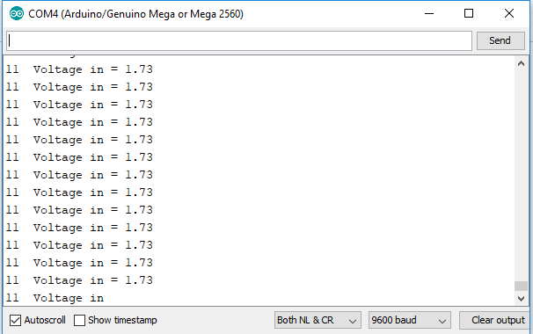

Slide 38

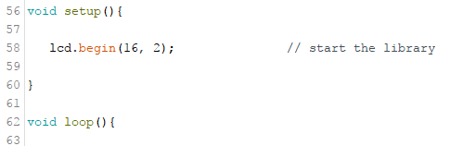
Arduino LCD Library

Slide 39
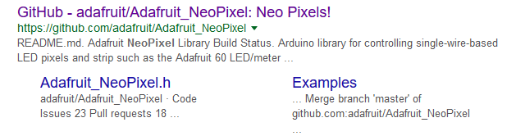

Many add-in libraries can be found on the GitHub web site.
These libraries are installed using the Arduino IDE.
The Arduino can call functions that are part of the library.

