Slide 1
Slide Index
3-10 Basic I/O Hardware for the Arduino
11-25 LCD Display and Keypad
26-30 Basic Input / Output Circuits and Transistors
31-41 1 Wire Data Communications and the DHT22 Sensor
42-60 I2C and the MCP4725 DAC
61-68 Asynchronous Serial Communications and RS-232
69-75 Arduino and Logic Gate Parameters
76-101 Arduino Software

Slide 2

Fall 2018 CAM8302E (Week 4) Microcomputer Interfacing
Week 4 – 102 slides Michel Hanbury Sept. 18th 2018

Slide 3

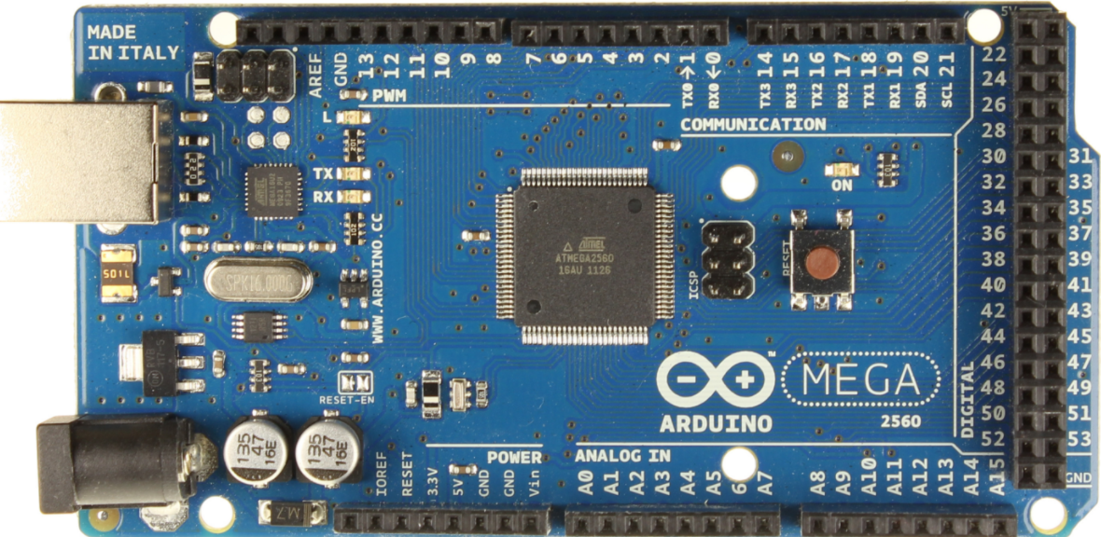
Basic I/O Hardware for the Arduino

Slide 4
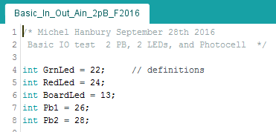
The first few lines of the Arduino program define labels used later in the program.
For example if the label “GrnLed” is used it is actually replaced with the value 22.

Slide 5
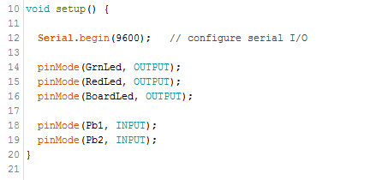
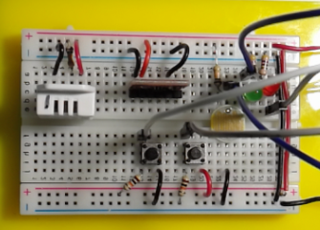
Configure Input and Output pins. To protect the I/O hardware and the Arduino the I/O pins are defaulted as inputs until the software configures them as outputs.

Slide 6
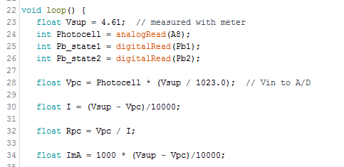
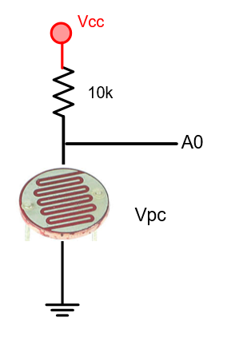
Calculations on data from photocell. The code converts the integer value from the A/D converter to a voltage and then to a resistance.

Slide 7
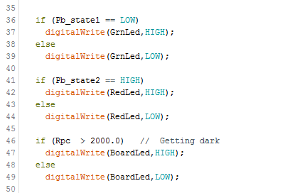
PB1 push button is normally HIGH using a pull up resistor. When the push button is pressed the pins short and a connection to ground is made.
Control output based on input conditions.
PB2 is normally LOW, a resistor is used to pull the signal to a low and a short on the pin ties it to +5.
Pin 13 L on the board.

Slide 8
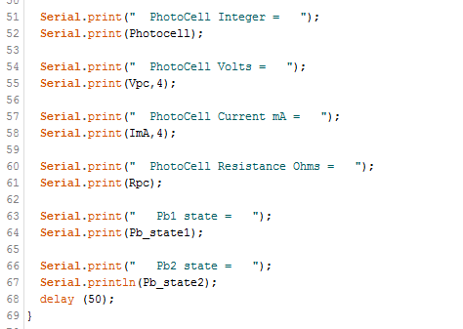


The Arduino Serial monitor can be used to output variable data to a computer screen.
The BPS (bits/second) baud rate must match the configuration in software. In this example the rate is 9600 bits per second.
Serial.println moves to the start of the next line, then prints.

Slide 9
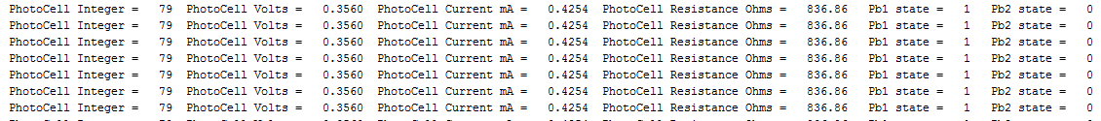
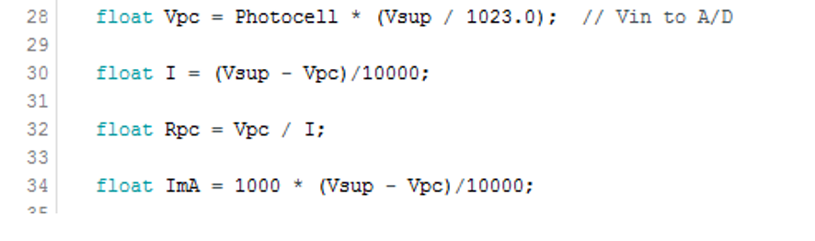
Check the results based on the code.

Slide 10
Check the results based on the code.

Slide 11
LCD Display and 5 key Analog Keypad

Slide 12
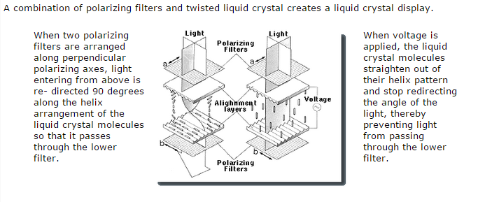
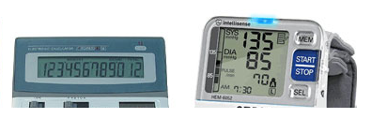
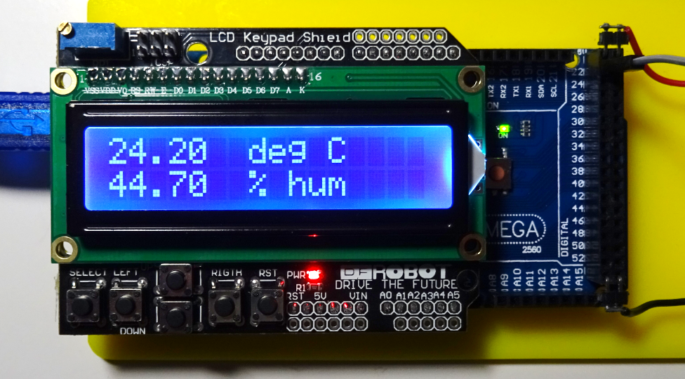
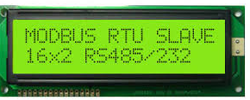
Liquid Crystal Display (LCD)
LCD – Liquid Crystal Display
- Low Power (mA)
- Easy to use libraries available
- Inexpensive and common.
- Easy to wire (8 pins)
LCD Display 16 x 2

Slide 13
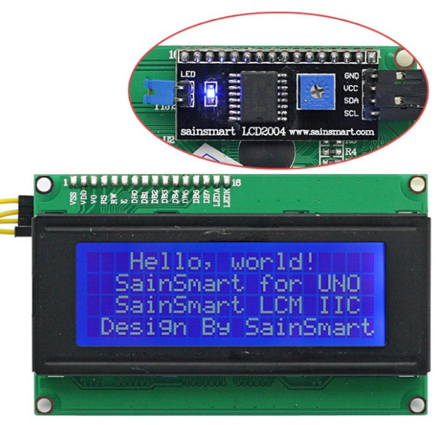
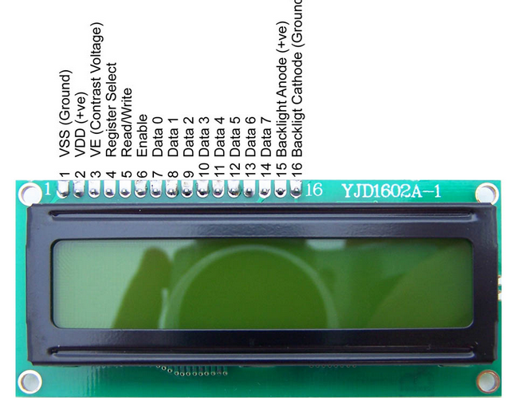
I2C serial
LCD Display
20 char x 4 lines
LCD Display
20 char x 4 lines
Parallel Interface.
A special circuit attached to the rear of the display converts the display from parallel to I2C serial. Connecting to this display requires only 4 wires.
The display includes a backlight and a contrast adjust.
This is the type that comes with the lab kit. It is less expensive and the software is less complex than the I2C type

Slide 14
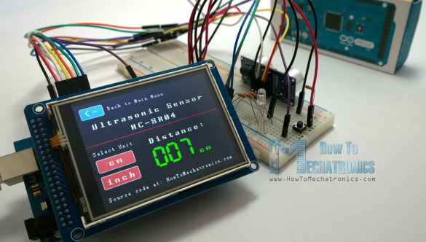
Touch colour display. Adds input and output to an embedded system. A great way to create a basic HMI. You can add sliders, gauges and graphics. Programming is more complicated. Most displays have drivers and functions that make programing easier.

Slide 15
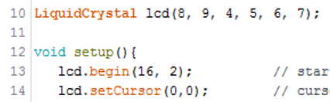
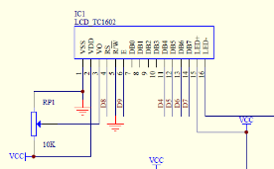
Parallel LCD Display 16 char. By 2 lines.
This LCD display uses a 4 bit parallel interface. The RS and E are signals used to control data.
Only the upper 4 bits of the display are used by the Arduino.
The “E” pin is the clock signal.
The “RS” is the register select and selects between data and control.
The LCD function needs to know which Arduino pins will control the LCD.
2 pins for control and 4 pins for data.
The (16,2) tells the function that the display is 16 character wide and 2 characters high.
The resistor is used to control the display contrast. Some displays include a backlight,

Slide 16
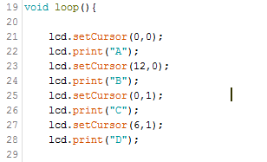
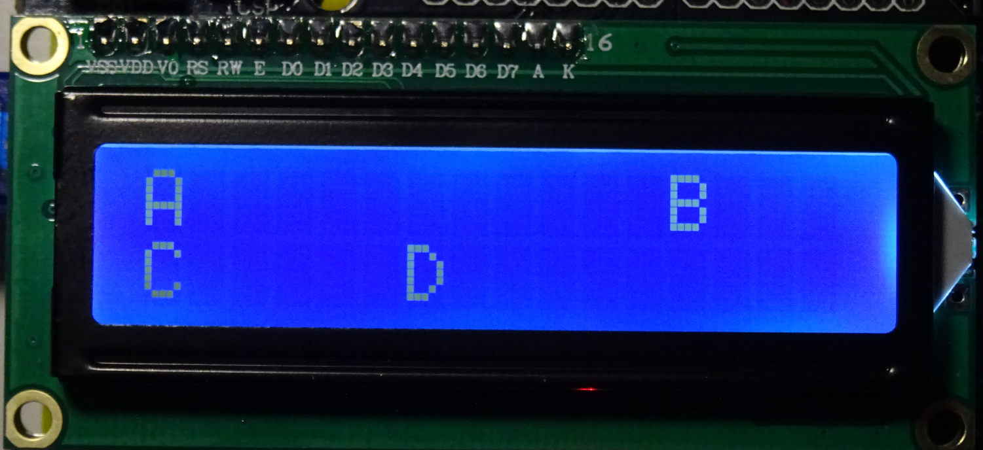
The LCD display is arranged as 2 rows and 16 columns. The numbering starts at 0 for the rows and columns. The first number represents the column the second the row.
The top left character is at 0,0.
For example 6,1 is the bottom row and the 7th position over.

Slide 17
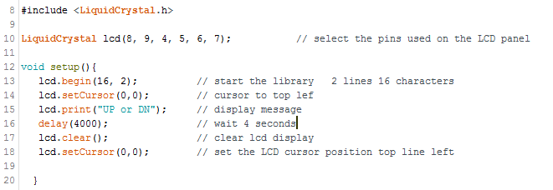
Arduino LCD Setup()
The Arduino IDE includes a library for an LCD display with an HD44780 controller. LiquidCrystal lcd(8, 9, 4, 5, 6, 7) defines the pins that are required by the display. The display uses 4 data lines, an enable signal and a RS - register select pin that selects between either data or control signals. The display uses a Hitachi HD44780 controller, this is the most common type. You must include the “LiquidCrystal.h” header file in your Arduino sketch to use the LCD functions.

Slide 18
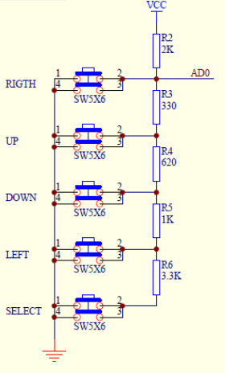
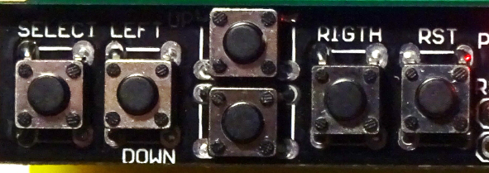
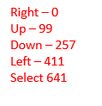
Arduino LCD / Shield Keypad
302
3k Ω
331
330 Ω
The LCD display board also has a set of push button switches which are connected to a set of resistors used in a voltage divider. Pressing different switches will cause the voltage on Analog 0 (AD0) to change. The resistors shown are the actual values used on the board.
The numbers in red are values I found when testing my keypad. The range may vary by +/- 3.
681
680 Ω
102
1k Ω
302
3k Ω

Slide 19
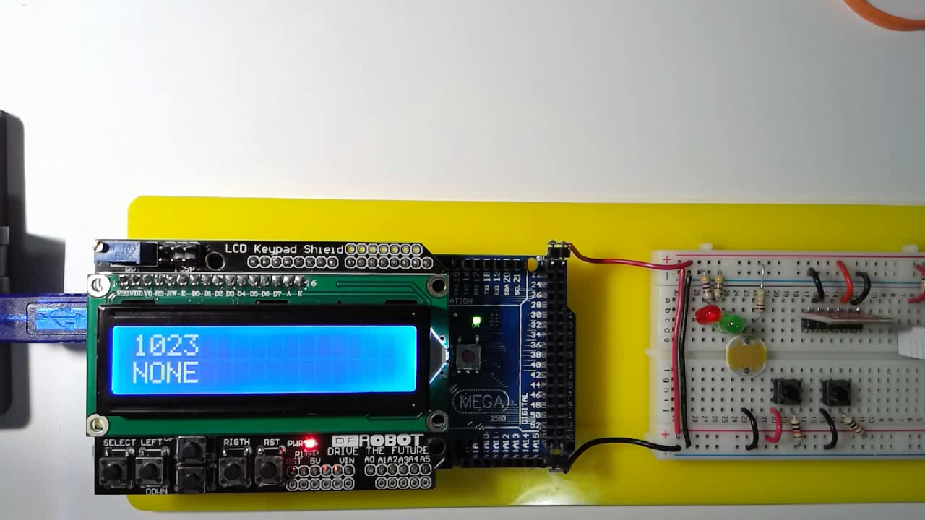
When no buttons are pressed the A/D reads 1023.
The number “3” is at LCD position 3,0.
The letter “E” is at LCD position 3,1.

Slide 20
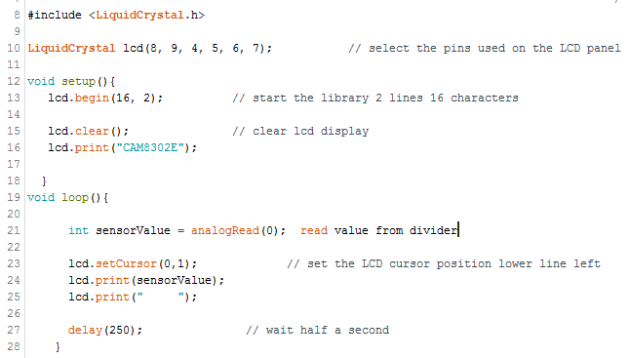
Arduino LCD / Keypad Shield
Read and display the value from analog input 0.

Slide 21
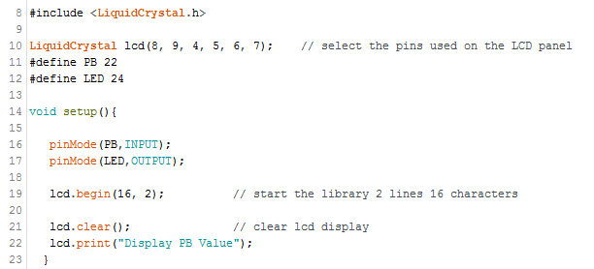
Example – Setup for LCD and I/O

Slide 22
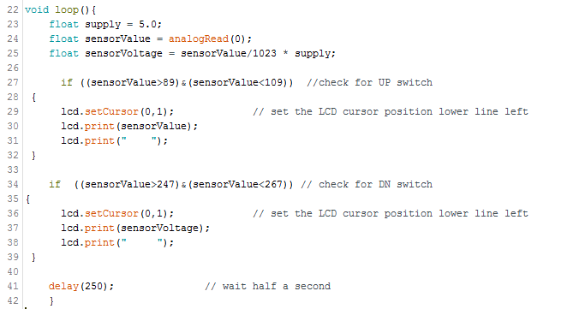
Using the push-buttons to make decisions
This program reads the analog 0 input voltage to determine if the sensor voltage.
The program uses a range to determine which key is being pressed.
A range is chosen because the resistor have a tolerance of +/- 5%

Slide 23
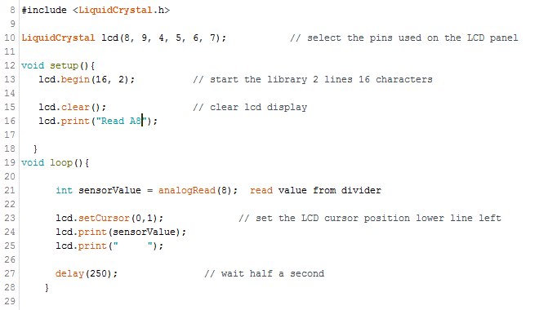
Example – Using the LCD display to show the value of analog Input 8.
Read and display the value from analog input 8.

Slide 24
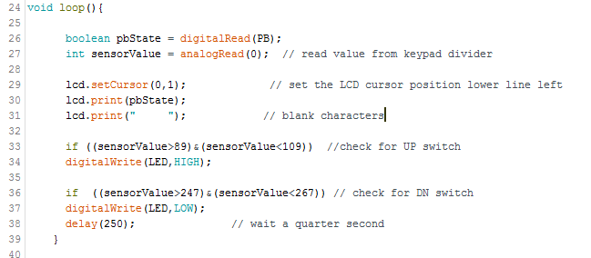
Example – Using the UP/DN buttons to control Outputs

Slide 25
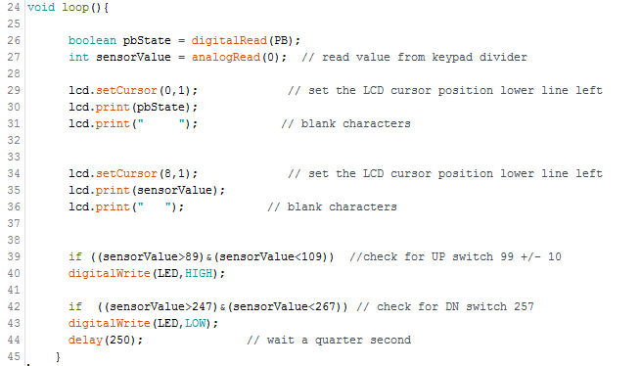
Example – Using the LCD display to show the value of analog Input 8.

Slide 26
Basic Arduino Inputs and Outputs
Transistor Switch

Slide 27
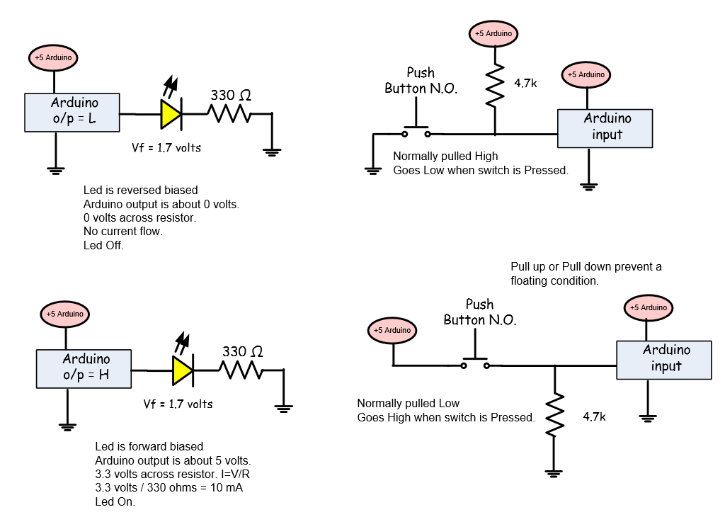

Slide 28
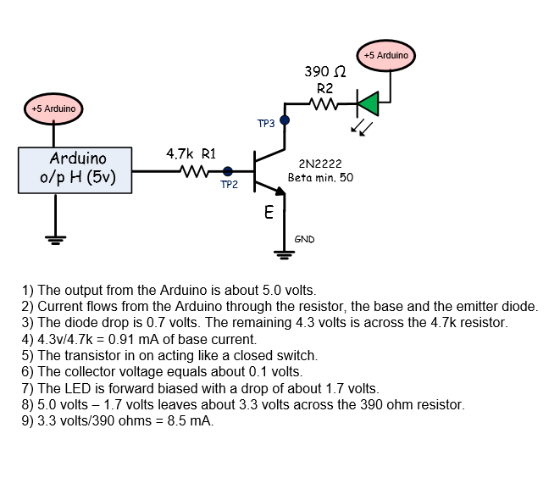
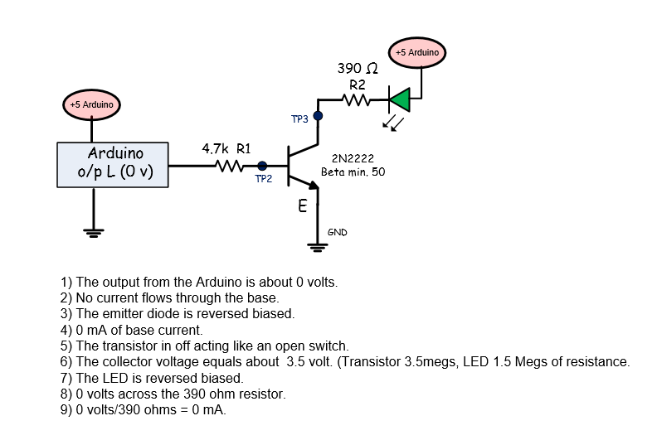
On
Off

Slide 29
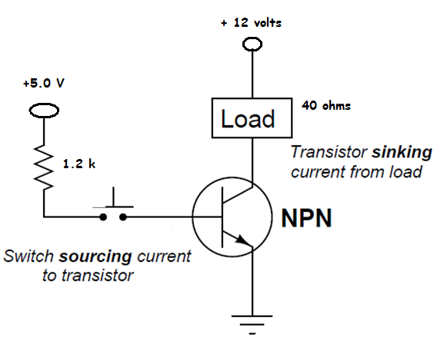
NPN 2N2222 Transistor Switch – “ON”
Saturation – Transistor is turned on: The collector to emitter junction acts like a closed switch.
The base voltage must be greater than the emitter voltage by 0.8 volts.
The transistor has a gain of about 75.
Example: If the base current equals 3.5 mA and the gain = 75 mA the transistor will allow up to 263 mA of current to flow.
Transistors can only handle a certain amount of collector current specified in the data sheets.
The CE junction does not act like a perfect switch and may have a voltage across the CE junction of about 0.2 volts.
6.3 volts
153 mA
6.11 volts
3.5 mA
4.2 v
closed
0.8 v
CE = 0.2 v
Current Gain:
Ic/Ib
Minimum of 75 for 2N2222

Slide 30
NPN 2N2222 Transistor Switch – “Off”
6.3 v
NPN Transistor Switch off:
Cut-off – Transistor is turned off: The collector to emitter junction acts like an open switch.
The BE voltage must be less than 0.8 volts.
5.0 v
0 mA
0 volt drop
0 volt drop
0 mA
6.3 v
open
5.0 V
Current Gain:
Ic/Ib
Minimum of 75 for 2N2222

Slide 31
1 Wire Data -- Temperature and Humidity Sensor
DHT22

Slide 32
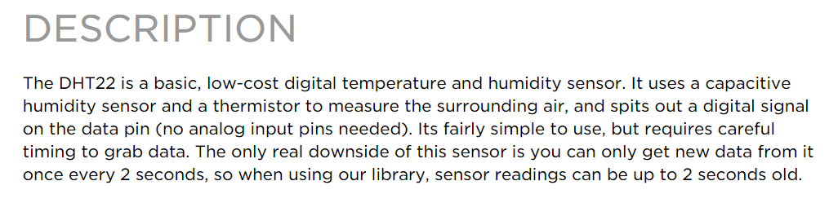
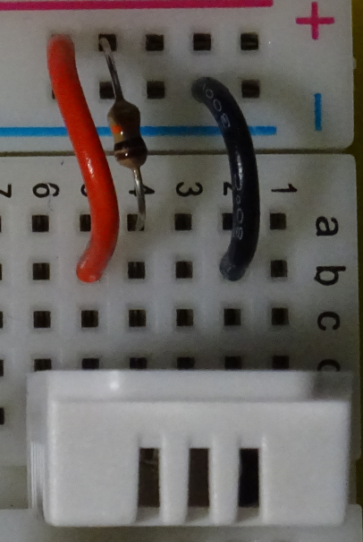
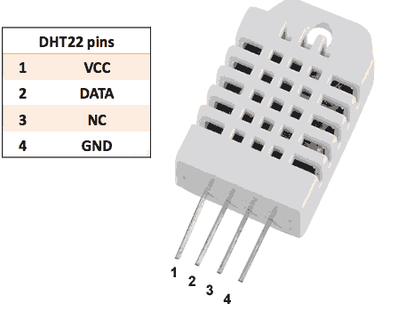
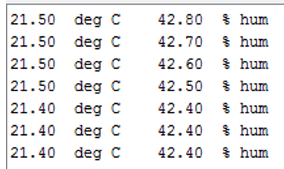
DHT22 Digital Temperature and Humidity Sensor (Serial Data Output)
The temperature / humidity sensor connects the Arduino using a 1 wire serial interface. The sensor transmits 32 bits of data representing the % humidity and the temperature in degrees Celsius.

Slide 33
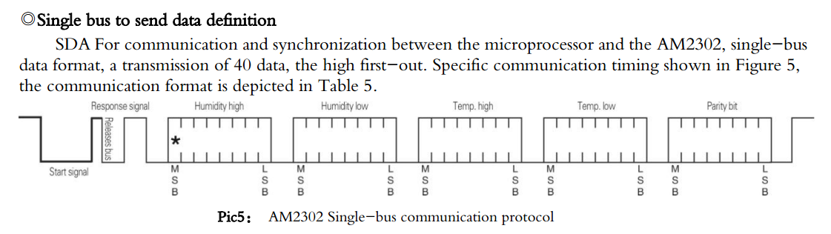
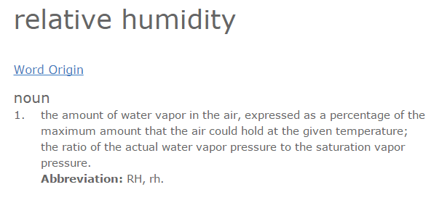
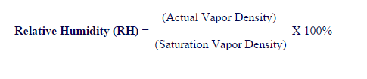
DHT22 Digital Temperature and Humidity Sensor (Serial Data Output)
The DHT22 temperature and humidity sensor sends a digital pattern to the Arduino representing % relative humidity and temperature in degrees Celsius .
The first 16 bits transmitted represent the humidity, the second 16 the temperature and the last 8 bits are a checksum to verify the data.

Slide 34
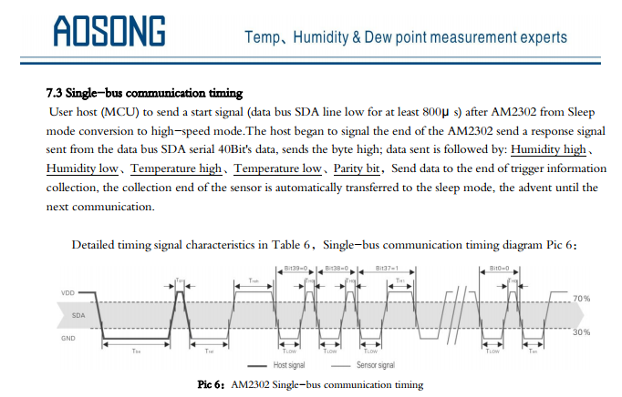
Data from humidity and temperature sensor.
40 bit data
32 bits of data
8 bit checksum.
16 bits for humidity
16 bits temperature

Slide 35
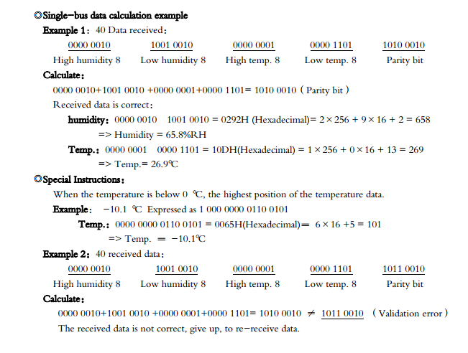
DHT22 Example: Digital Temperature and Humidity Sensor (Serial Data Output)

Slide 36
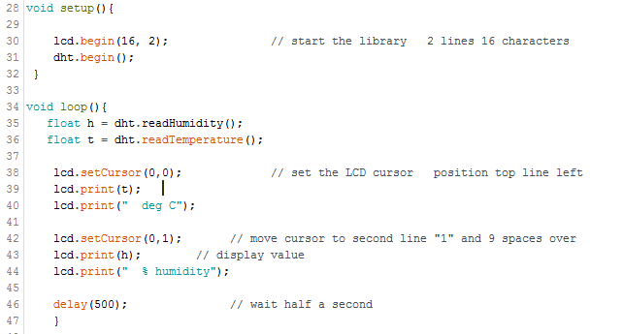
DHT22 Example: Digital Temperature and Humidity Sensor (Serial Data Output)

Slide 37
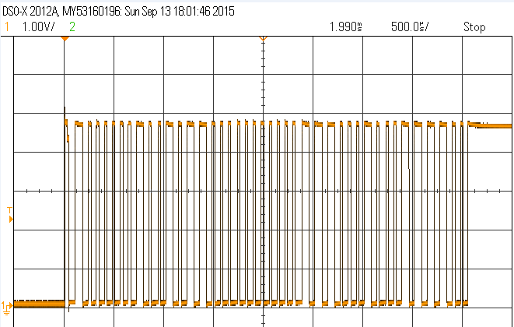
DHT22 Example: Digital Temperature and Humidity Sensor (Serial Data Output)
Data from humidity and temperature sensor.
40 bits in total
32 bits of data
8 bit checksum.
16 bits for humidity
16 bits temperature
This capture shows all 40 bits transmitted.

Slide 38
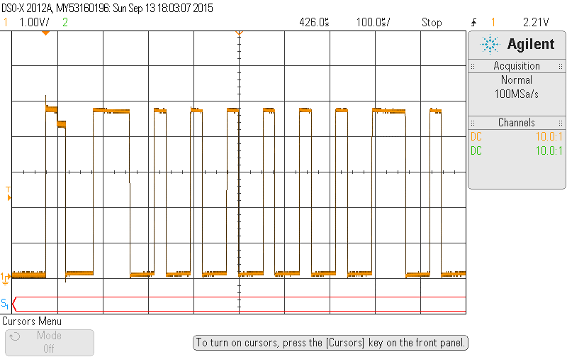
1st of 5 DHT22 Example: Humidity High Byte 0x02 70us (70) and 30 us (low)
D7
D0
Note: scope is set to 100 us /div.
If the bit has about 70 us high it represents a high.
If the data is about 30 us high it is a low.
low
high
Humidity
High byte
00000010 = 0x02
0000 0010 0x02

Slide 39
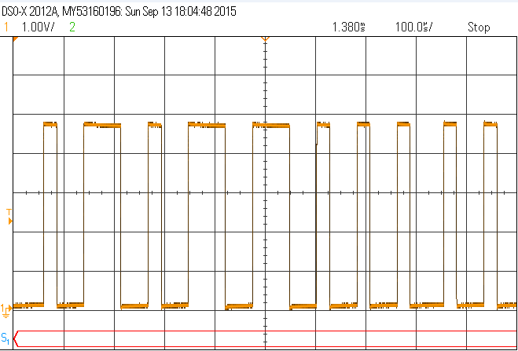
2nd of 5 DHT22 Example: Humidity Low Byte 0x58
Humidity
Low byte
01011000 = 0x58
From high + low
0x0258 = 600d
Divide the value by 10 = 60%
D7
D0
0101 1000 0x58

Slide 40
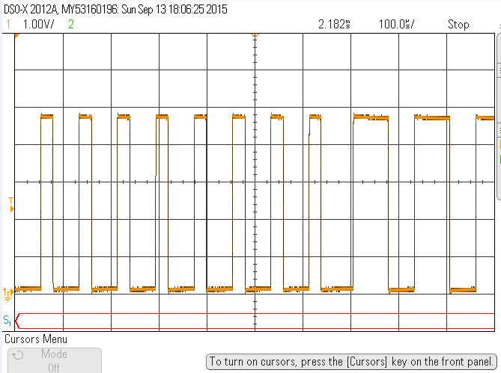
3rd of 5 DHT22 Example: Temperature High Byte 0x00
Temperature
High byte
00000000 = 0x00
D7
D0

Slide 41

4th of 5 DHT22 Example: Temperature Low Byte 0xE2
Temperature
Low byte.
11100010 = 0xE2
High + low byte
= 0x00E2
= 226 / 10 = 22.6
D7
D0
1110 0010 0xE2

Slide 42
I2C Eye 2 Sea -- Inter IC communications and the MCP4725 12 bit I2C DAC

Slide 43



Slide 44




Devices that use I2C

Slide 45




The I2C bus uses Vcc, ground and 2 signal wires.
SDA – serial data
SCL – serial clock.
The bus is used to connect many devices to the I2C signals on the Arduino or other controllers such as a Rasberry PI low cost computer.

Slide 46



Each I2C device has a specific 7 bit address to select the I2C device.
In the lab three I2C devices will be used.
A MCP4725 12 bit DAC.
An ADXL345 Accelerometer.
A DS3231 real time clock.
There are many I2C devices that can be connected to the Arduino.
Displays, pressure and temperature sensors, etc.

Slide 47

I²C Protocol MCP4725 Start, Stop, Address and Data and ACK
Start – Clock is high when data changes to a low.
Stop – Clock is high when data goes high.
Stop/Start – only time data changes when clock is high. Normally data is stable when clock is high.
The clock signal is used to synchronize the data. The data is sampled and captured on the positive level of the clock signal. Each byte of data includes a start condition, a stop condition and an acknowledge bit that verifies the data transmission.

Slide 48


MCP4725 12 bit DAC Waveform
Data is sampled when clock is high.
First bit is MS.
Bit 9 is the acknowledge bit.
0 is ok ( ACK )
1 is not ok. (NACK)

Slide 49



MCP4725 12 bit DAC Waveform
The start sequence and stop sequence are special in that these are the only places where the SDA (data line) is allowed to change while the SCL (clock line) is high. When data is being transferred, SDA must remain stable and not change whilst SCL is high. The start and stop sequences mark the beginning and end of a transaction with the slave device.
Device Address
Device Data

Slide 50


MCP4725 12 bit DAC Waveform

Slide 51


Slide 52


Slide 53


Slide 54


Slide 55

MCP4725 12 bit DAC Waveform
MCP4725 I2C DAC
In this example 8 bits of data
10000100 are transmitted. MSB is first.
Data rate = 100,000 bps.
10 us / bit
D7
D6
D5
D4
D3
D2
D1
D0
Ack
msb
1
0
0
0
0
1
0
0
ack

Slide 56



MCP4725 12 bit DAC (Arduino sketch)
MCP4725 I2C DAC
Data = 0x7AD
First 12 bits of the two byte number
= 1965 decimal
1965/4096
= 0.4797
0.4797 * 5.0 volts
= 2.4 volts.

Slide 57

MCP4725 12 bit DAC (Arduino sketch)
MCP4725 I2C DAC
Data = 0x900
= 2304 decimal
2304/4096
= 0.5625
0.5625 * 5.0 volts
= 2.8 volts.
MCP4725 Addr = 0x60
MCP4725 Command 0x40
DAC value upper 8 bits
DAC low 4 bits
The DAC Data is transmitted as two bytes (4 nibbles). The first byte represent the 1st 8 bits of the data. The next byte (upper 4 bits) represents the lower 4 bits of the data. There are 12 bits in the data. The MCP4725 address is 0x60.

Slide 58
MCP4725 12 bit DAC Waveform
MCP4725 I2C DAC
Data = 84
Data rate = 100,000 bps.
10 us / bit
D7
D6
D5
D4
D3
D2
D1
D0
Ack

Slide 59

MCP4725 12 bit DAC Waveform
MCP4725 I2C DAC
Data = FFF
FFF/FFF * 5.0 volts
= 5.0

Slide 60

MCP4725 12 bit DAC Waveform
MCP4725 I2C DAC
Data = 0x84C
0x84C = 2124 _{dec}
2124/4096 * 5.0 volts
= 2.6 volts.

Slide 61
Asynchronous Serial I/O and RS-232

Slide 62

American Standard Code for Information Interchange
The ASCII table shows the standard code used to transfer characters.
Examples: “1” = 0x31, “A” = 0x41 “U” = 0x55 or 01010101 in binary

Slide 63


An RS-232 serial connector has 9 pins. At least 3 pins are required to transmit and receive data
At TTL level the data begins with a low start bit, 8 data bits and a high stop bit.
To transmit at greater distance RS-232 levels are used. Typical values are +/- 12 volts.

Slide 64




Slide 65


To convert from TTL levels to RS-232 levels it is common to use a level translator called a MAX232. This chip is manufactured by MAXIM.
The chip converts a logic high (5 volts) to (-12 volts)
A logic low (0 volts) is converted to (+12 volts DC)

Slide 66





A typical USB to RS-232 converter.
Standard asynchronous serial bit rates.
Putty is a common (free) serial terminal program for a PC or MAC computer. It can be used to receive and transmit serial data from the Arduino or myDAQ to a PC or MAC.

Slide 67



The receiver and transmitter must operate at the same data rate. One of the more common data rates is 9600 bps. Other “standard” bit/second rates are 1200, 2400, 4800, 19200, 38400, 57600, and 115200.
At 9600 bits/second one data bit takes 104 us.
Start and stop bits are used for synchronization.
Many devices used in the electrical industry transmit and receive data using Asynchronous serial transmission. This method of communications requires only 3 wires, TXD, RXD and ground. Data can transmit at rates from 9600 bps to

Slide 68

Asynchronous Serial Data Waveform
Asynchronous Serial Data
Start bit is always low, stop bit is always high.
1 byte transmits in 1.06 ms.
That is about 1000 bytes per second.
Not fast enough to send a video but more than fast enough to transmit data such as temperature and humidity.
One Byte of Data ASCII “V” = 0x56
start
D0
D1
D2
D3
D4
D5
D6
D7
stop
01010110 = 0x56 = “V”
This is an example of the ASCII code “V” being transmitted.

Slide 69

Asynchronous Serial Data Waveform
Asynchronous Serial Data -- Example
This is an example of a message being transmitted. 8, horizontal tab, V,o,l

Slide 70
Arduino and Logic Gate Voltage Parameters

Slide 71


Slide 72


Slide 73

VOH – the minimum output voltage from the Gate.
VOL – The maximum gate output voltage.
VIH – The minimum input voltage for the gate.
VIL – The maximum input voltage for the gate.
If the voltages do not meet the minimum or maximum values indicated, the device may not read the voltage as a proper logic high or low.
When connecting two digital devices you must verify that the input and output voltages will meet the specifications of the two devices. You must check the VOH, VOL, VIH, VIL spec.

Slide 74

Arduino DC Electrical Specs:
VIH, VIL, VOH, VOL DC specs. For the Arduino

Slide 75


Slide 76



VIH, VIL, VOH, VOL DC specs. For the 74HC04

Slide 77

Arduino Software

Slide 78

Under the Tools tab verify that the board type and Port are properly configured. What is the problem with the setup?
Device not connected. No port.

Slide 79

Proper Configuration Board, Processor and Port Match:

Slide 80


Verify the program before uploading to the Arduino.
An Arduino Mega is connected to COM8. What is the problem with the setup?
Verify
Check the program for syntax errors.
Upload
Transfer the program to the Arduino

Slide 81


Arduino.ino file must be inside a folder of the same name.
The first save creates the folder.

Slide 82


Slide 83


Slide 84


Lower voltage when
brighter.
~ 500 ohms outdoors sunny (0.24 v)
~ 6,000 ohms room light (1.9 volts )
~ 50,000 ohms in darkness (4.2 volts)

Slide 85




Slide 86



Slide 87


2nd approach

Slide 88



Voltage increases
when darker.
Voltage increases
when brighter.

Slide 89



Slide 90


Arduino Compile Errors
What is the error?
Serial should be Uppercase.

Slide 91


Arduino Compile Errors
What is the error?
What is the error?

Slide 92


Arduino Compile Errors
What is the error?

Slide 93



Arduino Compile Errors
What is the error?
Declared humidity a second time.
What is the error?
What is the error?
“Lab 3”
Missing // comment .

Slide 94


Pin 2
Digital Output
Pin 4
Digital input
Arduino I/O setup

Slide 95


Arduino I/O setup

Slide 96



Thermistor temperature in degC versus resistance in ohms
Serial Port
Viewer
Sensor Values and input status.

Slide 97


Slide 98


Slide 99



https://www.arduino.cc/en/Guide/Libraries

Slide 100




DHT Library
22,DHT22
Serial Port
Viewer
Baud must match setting
in your program.
Library Functions
Sensor Pin (22)

Slide 101



Slide 102




DHT.cpp C++ program code
DHT.h header file
https://www.arduino.cc/en/Guide/Libraries

