Slide 1

Week 7 Notes:
Counters / Timers
Optical Devices
Measurement Files
CAM8302E Fall 2018

Slide 2
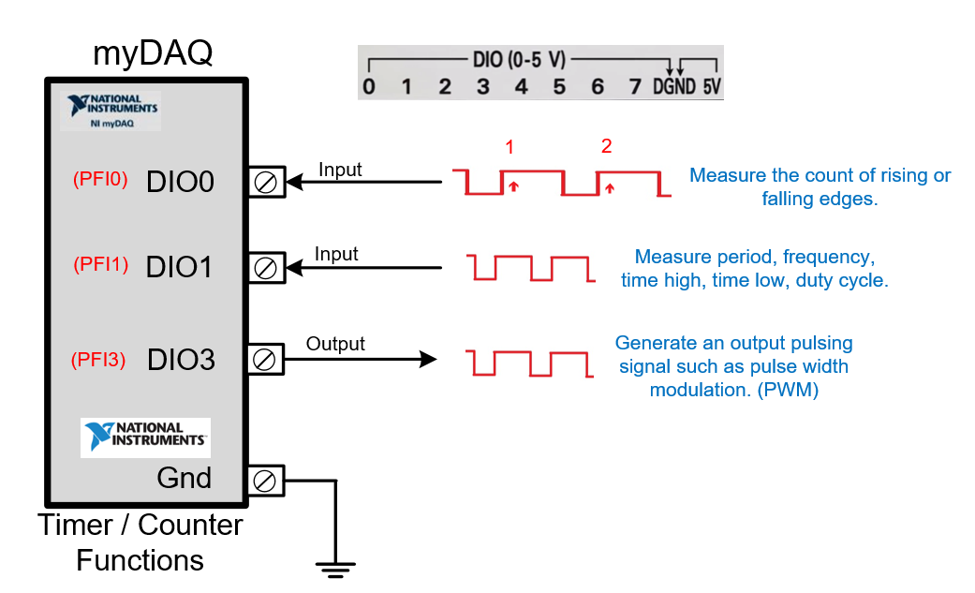
Slide Index – Week 7 Timer/Counter
Slides Topic
3 Counter/Timer Tasks
4 Counter/Timer myDAQ pins
5 Counter/Timer Acquire and Generate
7 Edge Counting
8 Switch De-bouncing
11 Schmitt Trigger Data Sheet
12 Slotted Optical Switch
17 Scope Measurements
21 DAQ Assist to Measure Frequency
24 Rotary Encoder
25 Counter with Reset
26 Writing data to an Excel File
30 CMOS 555 Timer
33 Hall Effect Magnetic Sensor
34 Angular Quadrature Encoding
36 D-Type FF
37 Array Review

Slide 3
Timer / Counter -- General Information
– Many controllers and data acquisition devices have a built in timer counter block.
The Arduino Mega has 5 timer/counters.
The myDAQ has 1 timer / counter.
Each timer counter can be used to count rising or falling edges.
Each timer / counter can measure frequency, period, time high and time low using a function called input capture.
Each timer / counter has an output compare function that can be used to generate a pulse width modulated signal at various frequencies and duty cycles.

Slide 4
Timer / Counter Functions -- How are they used?
Measure the speed of rotation of a motor.
Determine the direction of a motor using quadrature encoding.
Control the speed of a stepper motor.
Count the number of parts on a conveyor belt.
Control the PWM to a servo motor.
Measure the flow rate using a pulsed rotary flow meter.
Measure linear position (moving in a line) or angular position (rotating) using quadrature encoding.

Slide 5


myDAQ Timer / Counter Tasks (What can they do?)
The NI myDAQ counter can be used for various different counter tasks. These tasks include:
Count rising or falling edges
Measuring frequency
Measuring period
Measuring pulse width (time high or time low)
Measuring position from a linear encoder
Measuring position from an angular encoder
Generating a pulse output (PWM – frequency, % DC)
Each of these tasks will require different inputs or outputs to be connected to the terminals of the myDAQ PFI (programmable function interface).

Slide 6
myDAQ Timer / Counter Functions

Slide 7
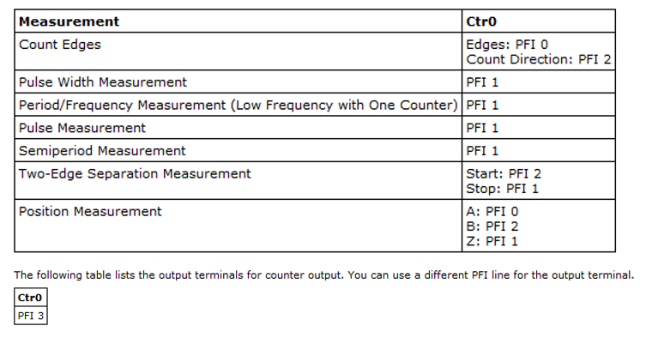
DAQ Assistant Timer / Counter (CTr0)
Digital I/O pins 0,1,2,3 are used by counter timer 0 on the myDAQ terminal.
PFI – programmable function interface.
D3 is an output terminal for the counter/timer output.
This pin is used to create output pulses.

Slide 8
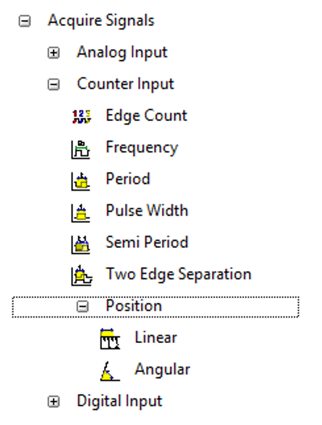
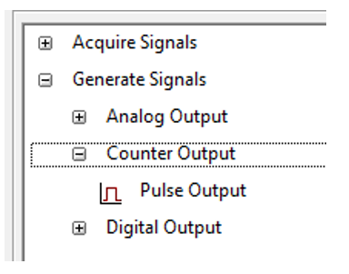
DAQ Assistant Counter/Timer
The myDAQ counter / timer uses a 32 bit register. The timer uses a base frequency
of 100 MHz. 1/100 MHz = 10 ns The clock “Tick” time equals 10 ns.
Acquire
Generate

Slide 9
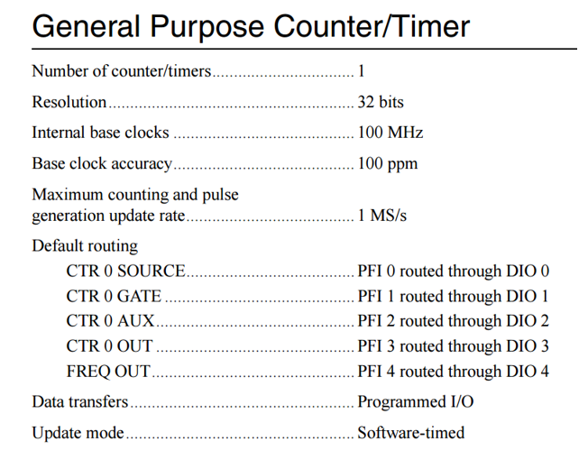
DAQ Assistant Timer/Counter
PFI – programmable function interface.
The MyDAQ internal counter is 32 bits.
The clock frequency is 100 MHz
The clock period = 10 ns. National Instruments calls this 1 tick of the clock. ( I guess from tick-tock ??)

Slide 10
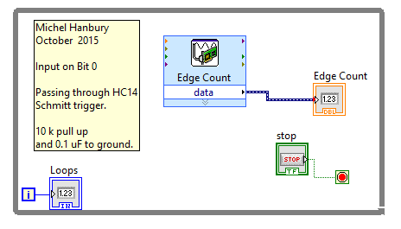
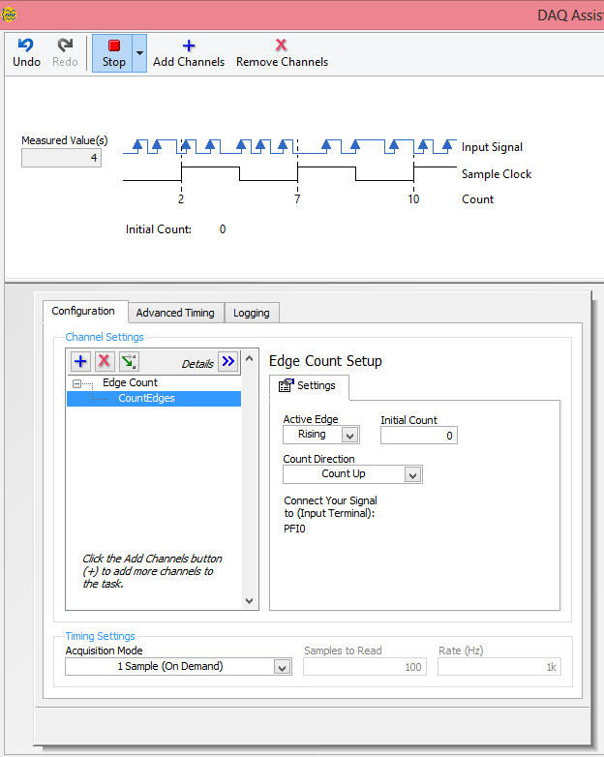
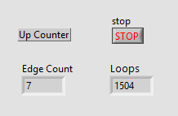
DAQ Assistant Edge Up Counter (Rising or falling)
This DAQ Assistant is configured to count edges arriving at DIO0 input.
The initial counter value is set to zero. On each edge the counter increments by 1.
The hardware will detect and measure rising edges.
Place a signal on the DI0 pin of the myDAQ to count rising or falling edges. When using mechanical switches or encoders they must be de-bounced.
* Only Count up on the myDAQ

Slide 11
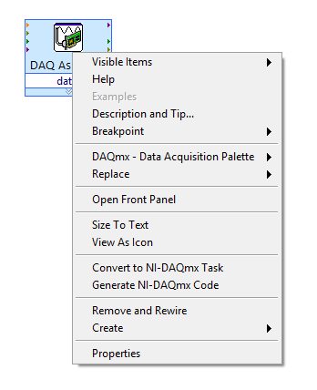
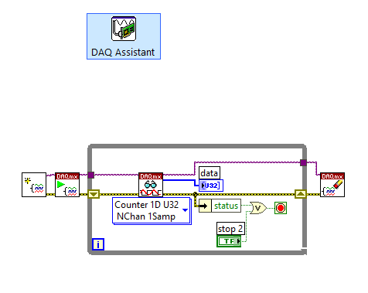
Converting DAQ Assistant to NI-DAQmx Code
There are situations that do not give you the flexibility to configure the timer using the DAQ Assistant. In these situations you can convert the DAQ Assistant to NI-DAQmx code. This is done my clicking on the Assistant and selecting Generate NI-DAQmx code.
After converting various functions are displayed. Each function has a number of inputs that can be configured.
Functions configure the timer, read the timer task and then delete the task.
Converted

Slide 12
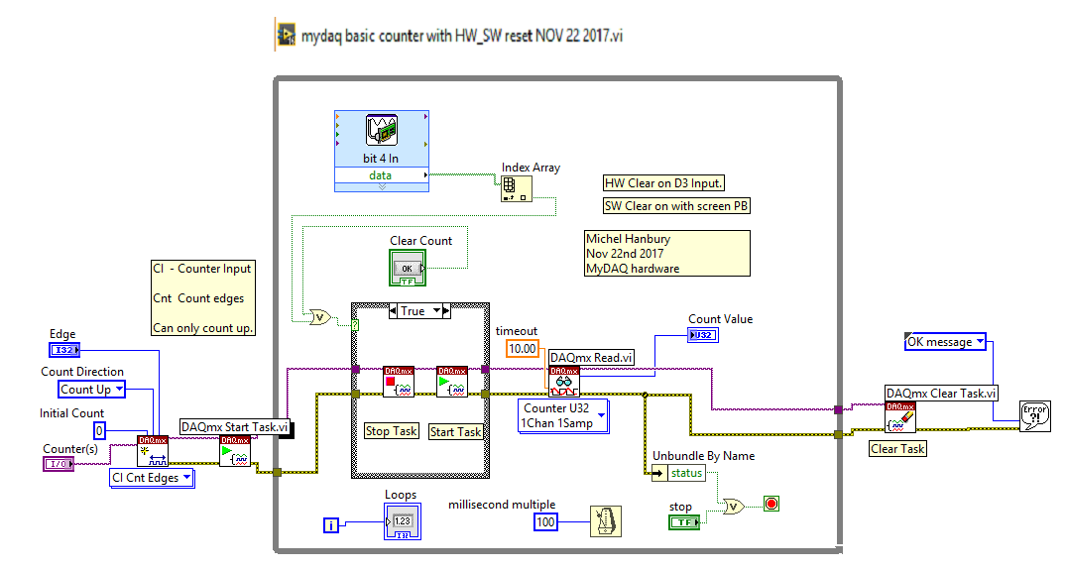
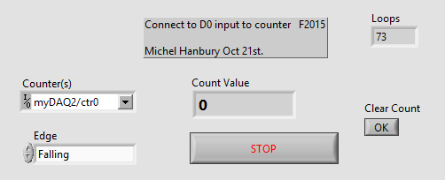
Counter with hardware and software reset.
There are situations that do not give you the flexibility to configure the timer using the DAQ Assistant. In these situations you can convert the DAQ Assistant to NI-DAQmx code. This is done my clicking on the Assistant and selecting Generate NI-DAQmx code.
In this example a user can select the edge type and clear the count using hardware or software.
While loop
case

Slide 13
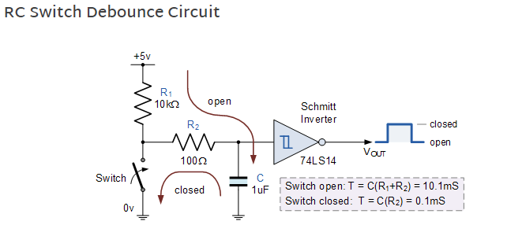
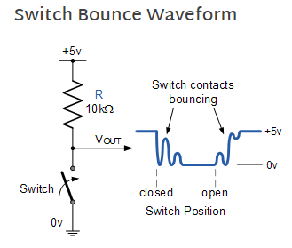
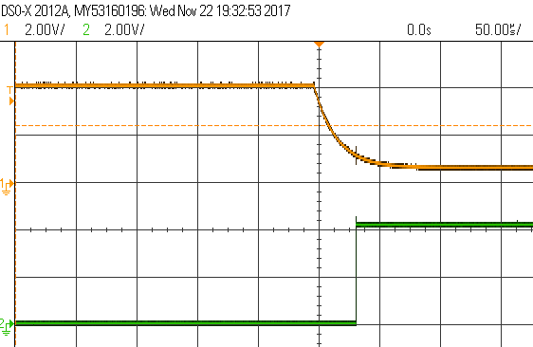
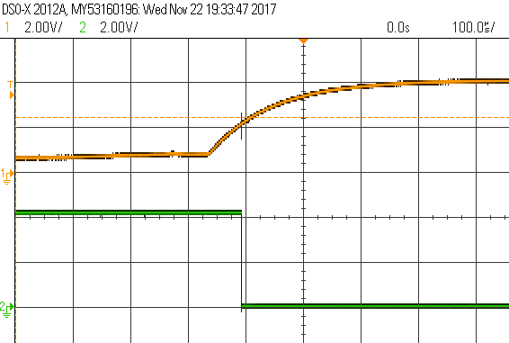
Switch De-bounce Circuit using a low pass filter and a Schmitt Trigger Inverter
Close sw
Open sw

Slide 14
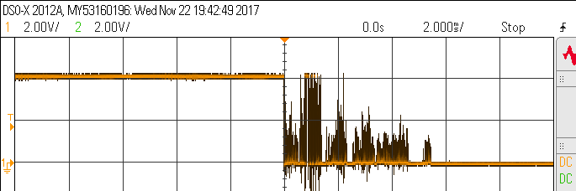
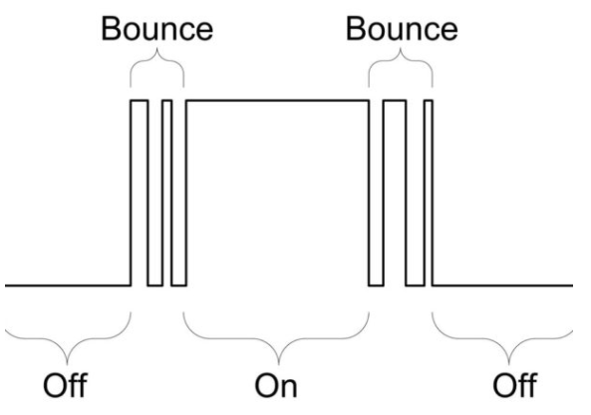
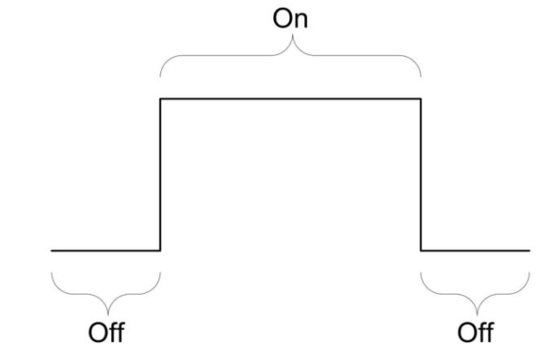
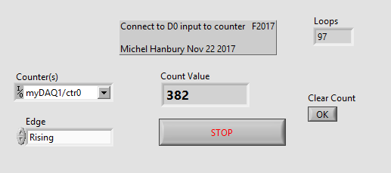
Switch bounce measured on a scope
In this example the counter input was connected directly to a wire that was pulled high and then touched to ground. The counter measured 382 edges of the bouncing signal. Switch bounce occurs with mechanical devices.

Slide 15
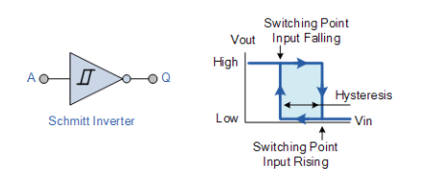
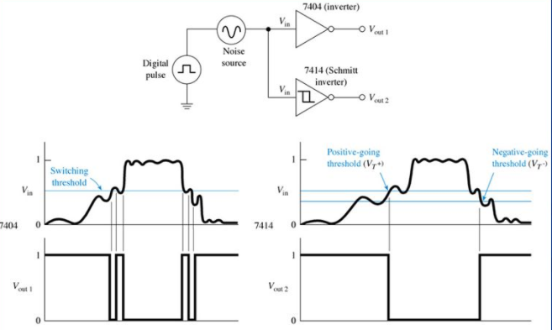
Schmitt Trigger Operation
The 74HC14 is a Schmitt trigger inverter. It has an upper and a lower switching point. The 74HC14 inverter must be used when interfacing to mechanical switches and signals with slow changing inputs. The Schmitt trigger produces sharp and clean rising or falling edges at the output. It is most important to use the Schmitt trigger when the device connects to an edge counting input on a controller.

Slide 16
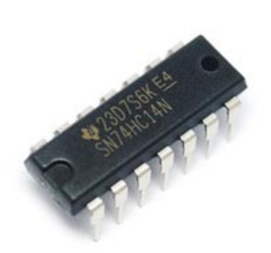
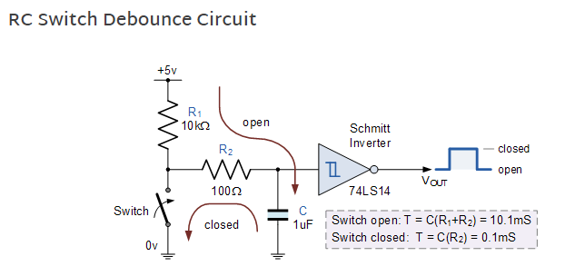
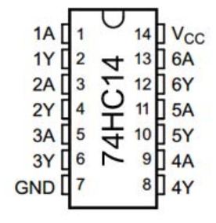


Mechanical Switch De-bouncing using an HC14 Schmitt Trigger

Slide 17
De-bounce circuit timing.
Switch Pressed
Grounded
HC14 Input
Switch Released
Pulled High
HC14 Output
HC14 Output

Slide 18
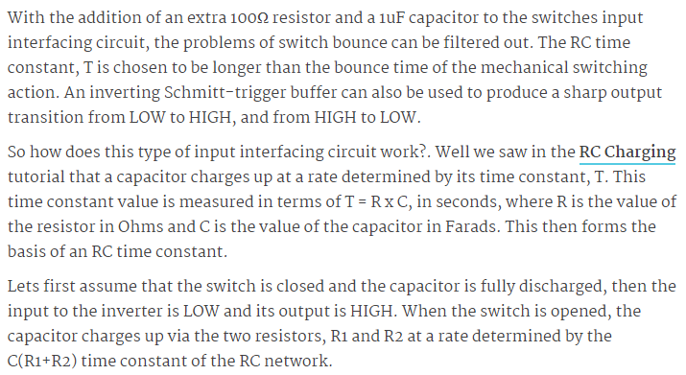
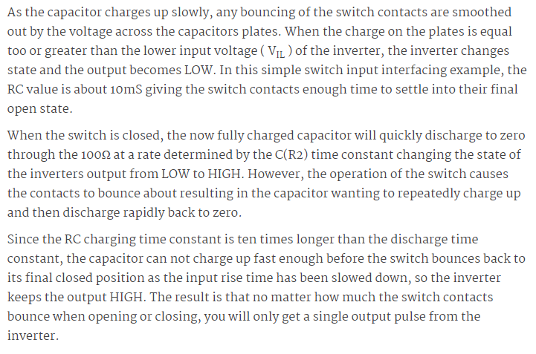
Mechanical Switch De-bouncing

Slide 19
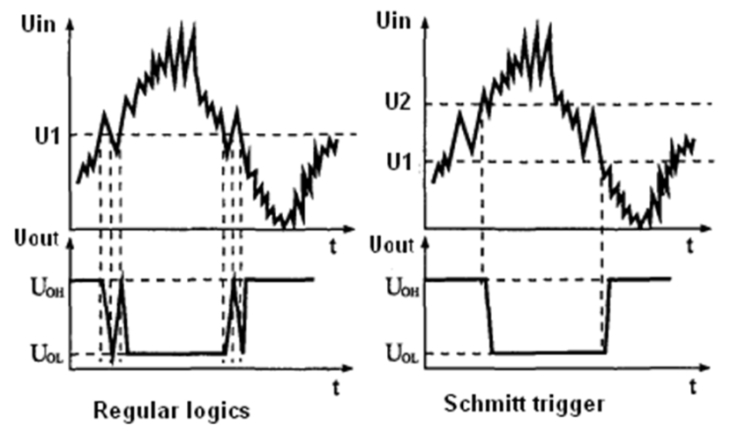
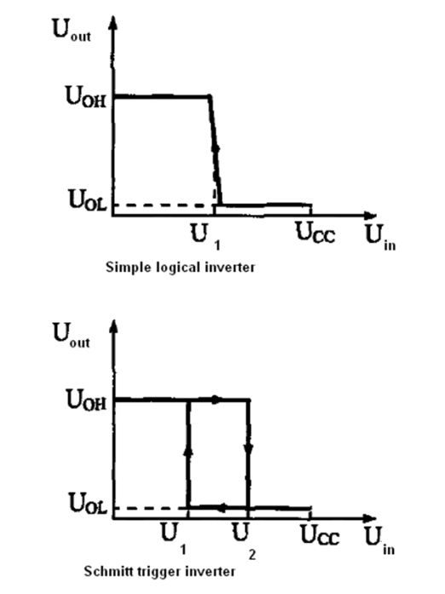
Schmitt Trigger Operation (Two switching points – hysteresis)
When de-bouncing or wave shaping an HC14 Schmitt trigger inverter must be used.
HC04 (bad)
Multiple edges.
HC14 (good)
Single edges.
The Schmitt trigger converts the noisy or slow changing signals to vertical single edges.

Slide 20
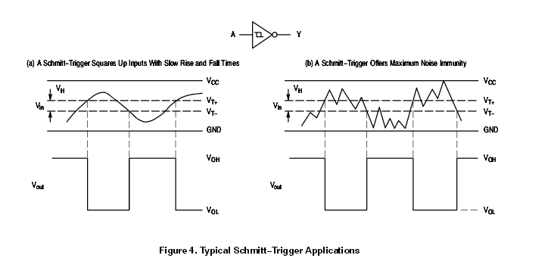
Schmitt Trigger Operation
The 74HC14 Schmitt trigger inverter is used produce square wave outputs with slowly changing input signals.
The 74HC14 is often used in switch debounce circuits to reduce the multiple edges produced from a non-debounced circuits.
Assume:
(Vthreshold +) = (+3.0 v)
(Vthreshold -) = (+1.5 v)

Slide 21
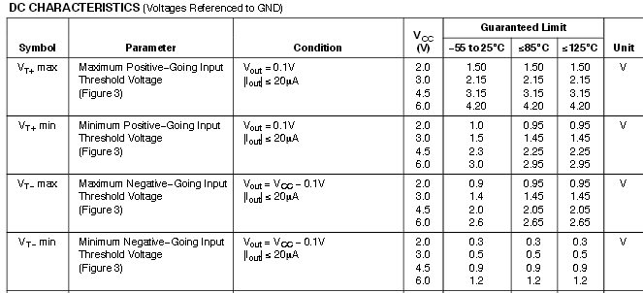
Schmitt Trigger Data Sheet
The Schmitt trigger inverter (HC14) has an upper and lower threshold to give the device hysteresis. The HC04 switches at any point between a valid logic low and valid logic high input.

Slide 22
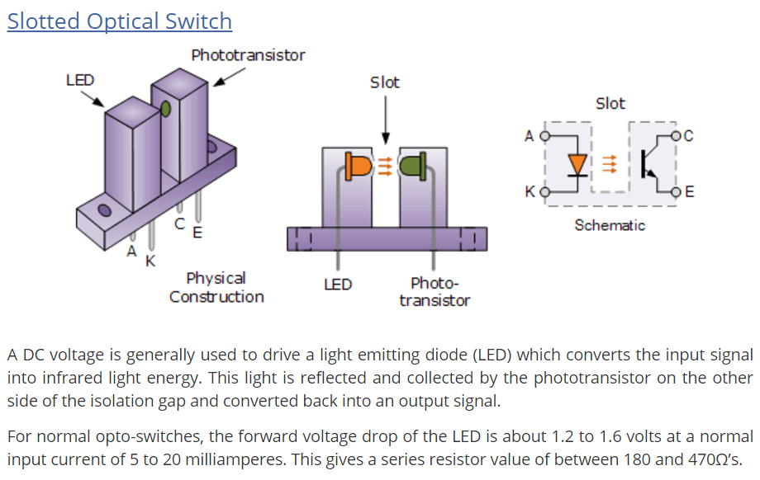

Slotted Optical Switch
Your smartphone can detect infrared light. It is not visible to the human eye but it can be seen by the smartphone camera.

Slide 23
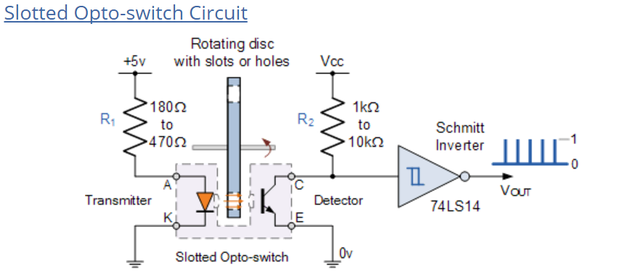
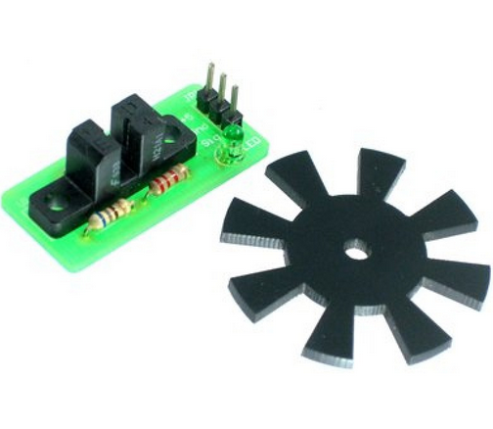
Slotted Optical Switch Circuit

Slide 24
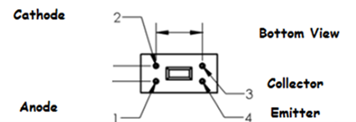
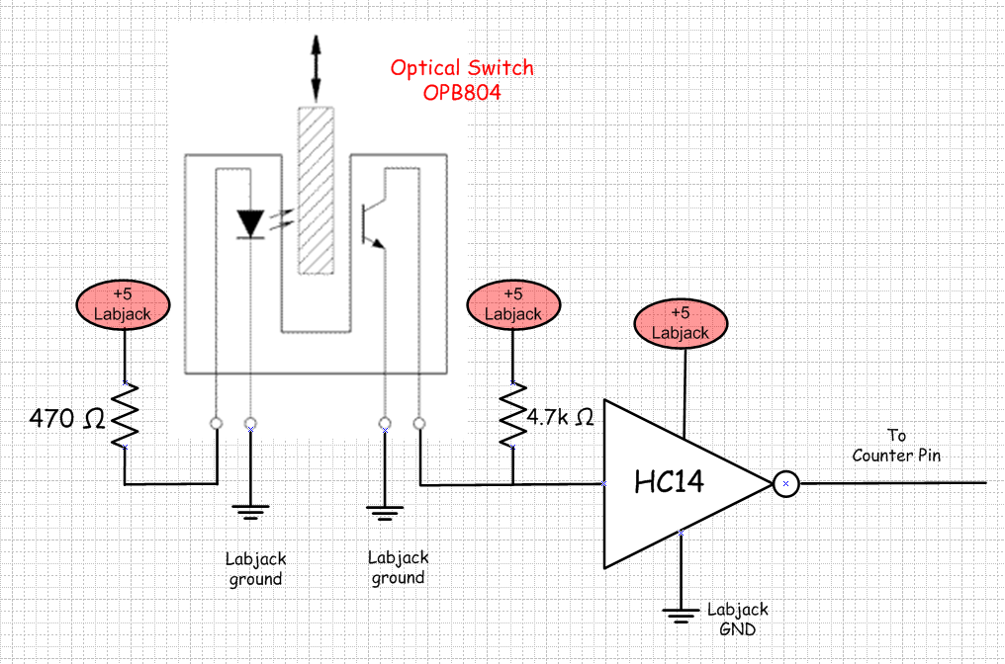
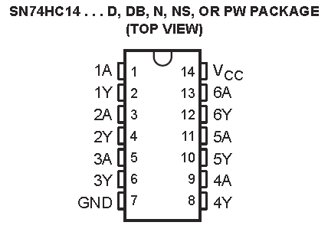

Optical Switch Conditioning using a Schmitt Trigger Inverter
An optical switch is used to count the number of times an object passes through the slot of the switch. An HC14 Schmitt trigger is used to reduce signal noise, to obtain an accurate count.

Slide 25
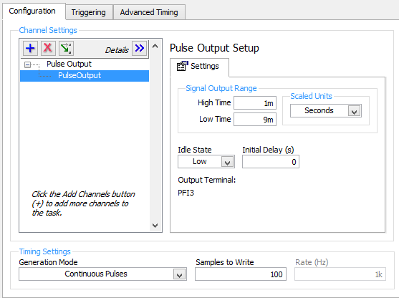
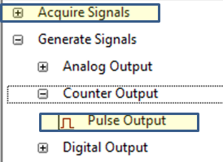
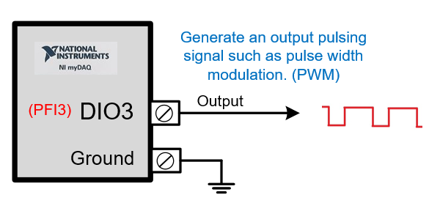
DAQ Assistant PulseOutput – generate PWM
Pulse output can be configured to produce a time low or time high of any given value. The pulse out can be used to PWM (pulse width modulate ) loads such as heater, motors, lamps and servo motors. The output signal is created on terminal DIO3. In this screen capture example the output has a period of 10 ms. and a time high of 1 ms. and a time low of 9 ms. The % duty cycle equals 10% (% Duty cycle = on time/period * 100%)
The signals are LVTTL.

Slide 26
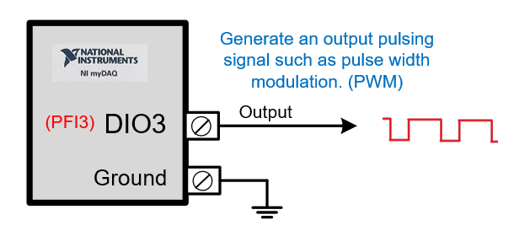
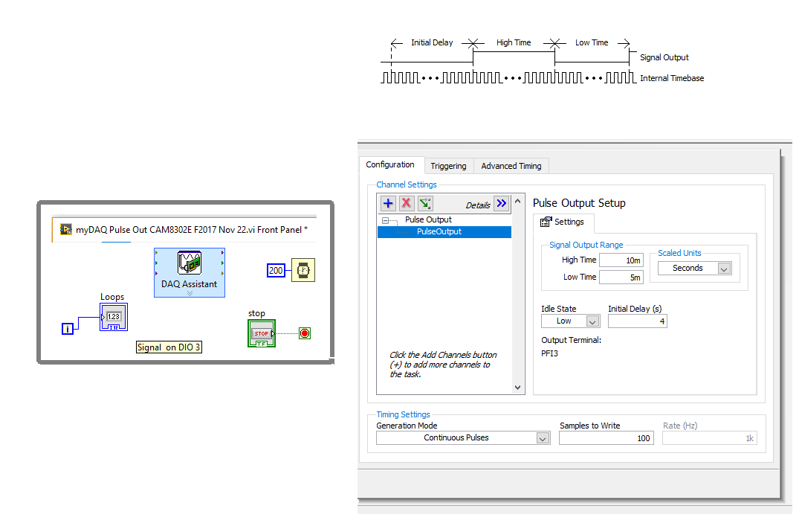
DAQ Assistant Pulse Output
What is the signal frequency and % duty cycle based on the screen capture?
The LabVIEW DAQ Assist is configured to produce continuous pulses with a time high of 10 ms. and a time low of 5 ms. The signal output is measured on DIO3.

Slide 27
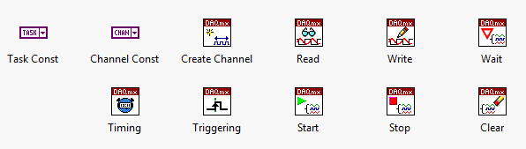
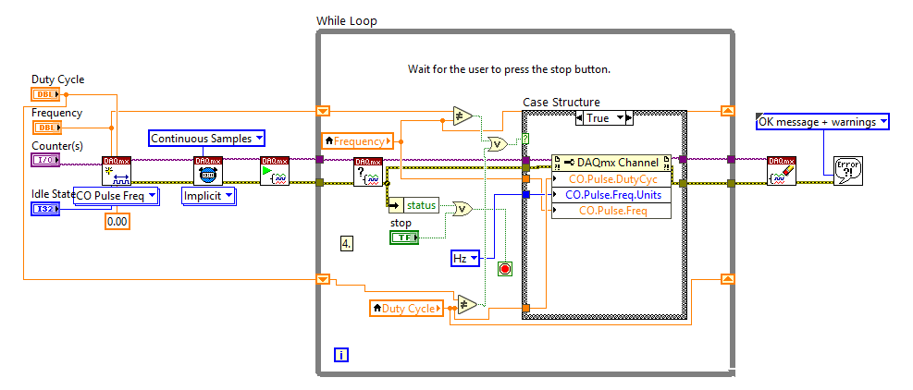
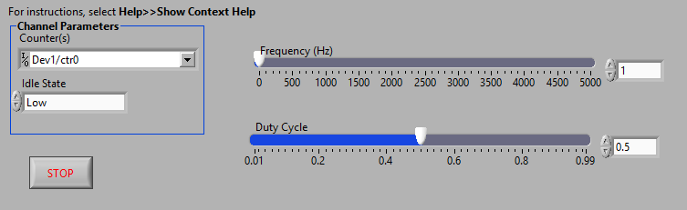
PWM (programmatically) – Using DAQmx Code
This LabVIEW program does not use the DAQ Assistant. The assistant Express VI is converted to NI-DAQmx code to give the user additional flexibility for timer configuration.
In this case the pulse period and duty cycle can be modified while the program is executing. LabVIEW includes functions such as Read, Write, Start, Stop, Clear and Timing – Each function has input and output parameters. Using the Express VI’s such as (DAQ Assistant) make programming easier but limits functionality.

Slide 28
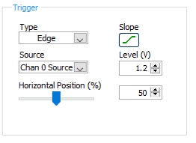
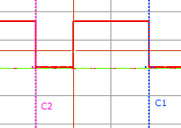
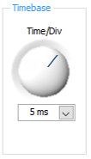
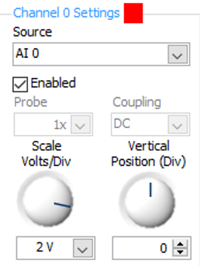
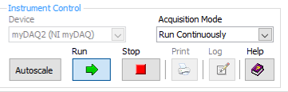
NI Elvis Scope Configuration
1) The scope is set to trigger on a rising edge (slope) with the trigger level set to 1.2 volts (Level).
2) The scope will be triggered in the centre of the screen (50%).
3) Horizontal time base set to
5 ms./division.
4) Scope is measuring Channel A0 there is no horizontal offset and the volts/vertical division equals 2.

Slide 29



DAQ Assistant PulseOutput Example
Frequency is 66.7 Hz.
Time high = 10 ms.
Time Low = 5 ms.
Period = 15 ms.
% Duty Cycle =
Time high/ Period * 100%
10ms/15ms * 100%
66.7%

Slide 30

NI ELVISmx Scope Example with questions.
What is the time base set to?
What is the volts / division set to?
What is the period of the signal?
What is the frequency of the signal?
What is the time high and time low of the signal?
What is the % duty cycle of the signal?
What is the trigger voltage level?
Is the input signal triggered on a positive or negative edge?
What is the high voltage level of the signal?
Which channel is displayed?

Slide 31



My DAQ Pulse Output Setup and Scope Measurement
Frequency is 100 Hz. Output is measured on PFI3 (programmable function input 3)
Time high = 1 ms. Time Low = 9 ms.
Volts/div = 2, time/div = 5 ms

Slide 32



My DAQ Pulse Output Setup and Scope Measurement

Slide 33


DAQ Assistant Measure Period and Frequency

Slide 34


DAQ Assistant Measure Negative and Positive Pulse Width
Measure Low Time
Measure High Time

Slide 35


DAQ Assistant Timer Input
(Pulse)
(Pulse)
This LabVIEW program uses a flat sequence structure. The code in each box is executed from left to right in sequence. When the code on the right has completed the sequence begins again on the left. In this example the time high is measured, then the time low, then the period of the signal followed by the frequency of the signal. The final sequence waits for the user to press the next button on the LabVIEW front panel.

Slide 36


DAQ Assistant Timer Input
The LabVIEW program is used to measure the period and frequency of an input signal connected to DIO0 on the myDAQ.
The program uses 4 timer DAQ assistance to determine the properties of the incoming signals.

Slide 37


TLC555 CMOS Astable Timer
An Astable timer is a device which has no stable state. Its output oscillates continuously between its two unstable states without the aid of external triggering. The time period of each state is determined by a resistor/capacitor ( RC ) time constant. (Wikipedia) The capacitor charges through RA + RB and discharges through RB only.
The decimal value of the natural logarithm of 2 is approximately equal to 0.693.

Slide 38


Slide 39



DAQ Assistant Timer Input Signals
This is a myDAQ Elvis scope screen capture of the signal at the output in blue.
The signal in red is the charge, discharge of the capacitor on pin 2 of the CMOS 555 timer. The capacitor charges through RA and RB and discharges only through RB.

Slide 40

TLC555 CMOS Timer Online Calculator
http://www.ohmslawcalculator.com/555-astable-calculator

Slide 41



Quadrature (4 edges) Rotary Encoders

Slide 42



Hall Effect Sensor – Used in the motor Quadrature Encoder
The Hall effect sensor can detect a magnetic field. The magnet cause the electrons in the sensor to line up on one side creating a small voltage, the Hall voltage. In this case two of them are used to determine the speed and direction of a DC motor.

Slide 43


Quadrature (4 edges) Rotary Encoding
Two hall sensors are placed 90 degrees apart.
As the motor rotates in one direction or the other the signals change position.
CW - phase A is high followed by phase B.
CCW – phase B is high followed by phase A.

Slide 44


Quadrature Rotary Encoders

Slide 45




Rotary Encoder – Used to measure degrees of rotation.
This encoder also has a built in push button switch. As the control is moved clockwise or counter-clockwise output pulses are generated.
Clockwise
Channel A
Channel B
A quadrature encoder has two outputs and 4 edges.
As the encoder is rotated clockwise the edge sequence is as follows.
- a rising edge on output A
- a rising edge on output B
- a falling edge on output A
- a falling edge on output B
Counter clockwise
Channel A
As the encoder is rotated counter clockwise the edge sequence is as follows.
- a rising edge on output B
- a rising edge on output A
- a falling edge on output B
- a falling edge on output A
Channel B

Slide 46



myDAQ Rotary Encoder – Used to measure rotational position.

Slide 47


Quadrature (4 edges) Linear Encoding
Can determine direction and linear movement, cm, metres, inches, speed.

Slide 48




74HC74 – D-Type Flip Flop – Used to determine direction
One phase of the encoder will attach to the clock input the other phase to the data input.
When turning in one direction the data will be low when the clock goes through a rising edge.
In the opposite direction the data will be high when the clock goes through a positive edge,
H
CW = H
CCW = L
H

Slide 49

Write to Microsoft Excel File – Block Diagram
The Express VI is used to write to an Excel file. This program uses a progress bar to display the loop status.
After all data is written to the file, the array is created.
The program stops when the loop counter equal 19 or the stop button is pressed.
0 to 19 equals 20 samples.

Slide 50


Configure and write to Microsoft Excel File
Front panel of the previous program.
Express VI to configure write to measurement file.
The file can include a date and time stamp for each sample.

Slide 51

Write to Excel Spreadsheet
File opened in Excel to view the time stamp and data.
Graph created using the date.
The sample time can be in ms. to many seconds or even days.

Slide 52
Scalars, Vectors and Arrays
Scalar – a value with magnitude only, data type that contains a single value, scalars have no direction.
Vector – vectors have magnitude and direction.
Array – A collection of data elements that are all of the same data type.

Slide 53
Arrays
An array is a collection of data elements that are all of the same type.
Arrays are accessed by their indices; each element ‘s index is in the range of 0 to N-1 where N is the total elements in the array.
Index
Elements
10-Element Numeric Array
How to create an array Video – Good Example.
http://cnx.org/content/m14768/latest/lvt_arrays-creating.html

Slide 54
Arrays
Arrays are often used to store data obtained from sensors, voltages and inputs that are read from a data acquisition (DAQ) system.
Arrays have many functions that makes working with a group of data easier.
    Finding the number of values in the array.
    Finding the minimum and maximum in the array.
    Finding the average of the array.

Slide 55


Creating Arrays in LabVIEW
Place an empty array shell onto the block diagram.

Slide 56



Creating Arrays in LabVIEW
Drag a data object(such as a numeric indicator or control) into the empty element window. Resize the shell by dragging the frame handles.

Slide 57


Arrays Example - LabVIEW
Arrays can be a group of characters, Booleans, Numeric etc.
Wires connecting the array Control to the Array Indicator are bolder.
Arrays can be indicators or controls.

Slide 58







LabVIEW – Array Functions
Array Palette
Array
Size
Index Array
Build
Array
Array
Min/Max
Linear Interpolation
Array Constant

Slide 59


Boolean and Meter Array
Example 1: This example shows how arrays can be a group of numeric values, Booleans and even an array of meters. Practice arrays by creating this VI.

Slide 60

Array Example 2 - LabVIEW
0
2
3
This example includes a linear interpolation of data between two sample. Ex. (7296.44+13472.2/2) = 10384.3
19

Slide 61

Build Array- LabVIEW
Build array function – Used to add elements to an array.

Slide 62

Index Array- LabVIEW
Index array function – Used to select an element within
an array.

Slide 63

Array Average - LabVIEW
Array size and sum – used to calculate average.

Slide 64

Array Example 2
This example determines the:
Max value and element of the array.
Min value and element of the array.
Finds the array size.
An selects and element from the array.

Slide 65

Array Example 2 - LabVIEW
Array Size
Total Sum/Element in the Array
This example reads a data file, displays the data on a waveform chart and then finds the minimum, maximum and the number of elements in the array.
This VI also interpolates a value between two elements in the array.
Min/Max
Index of the
Maximum value.

Slide 66

LabVIEW “For Loop”
For Loop:
The For Loop executes the code within the loop the number of times indicated by the loop control.
In this example the “For Loop” will end after reading 20 samples (0-19). Each loop takes 100 ms. So the program will loop for 2 seconds. If the progress bar is set to 19 it shows the progress of the acquisition loop.

Slide 67


LabVIEW Write to Spreadsheet File
Write to spreadsheet file.
This function allows the user to write the array data to a file compatible with Microsoft Excel.
You must attach a path and file name to the dialog box. The path must exist. The file will be created or overwritten every time you write to the file.

Slide 68

Dialog Box and Write to Spreadsheet File
Dialog box –
When executed the dialog box places a pop-up message on the front panel. The user must then click on the message to continue.
Read from Spreadsheet File –
This function will read the data from a file and place it into an array.

Slide 69



Clearing Chart History
To clear the chart history.
Right click on the chart.
Select Create
Select Property Node
Select History Data
Right click on History Data
Change to write.
Right click on the History Data Terminal and select create constant.
Property Node:
A property node gives the programmer the ability to change the properties of a chart, control, indicator or other front panel objects programmatically. Property nodes can be used to change the colour, position, size and other properties of front panel objects.
The node can be changed to read or write the property.
To change the visibility of the waveform chart.
Right click on the chart.
Select Create
Select Property Node
Select Visible
The property node will be placed on the block diagram.
Connect it to a digital control to make the object visible or invisible.

Slide 70


Rotary Quadrature Encoder

Slide 71


Rotary Quadrature Encoder

Slide 72

Scope triggering – immediate and edge

Slide 73

Scope triggering – immediate and edge

