Slide 1
Week 6 Notes for Lab 4:
CAM8302E Fall 2018

Slide 2
Slide Index – Week 6
Slides Topic
3 Lab 4 heater control
4,5 Expression Node
7-9 Mapping and Scaling, linear interpolation
10,11 Moving Average Filter
12 Signal Conversion
13-14 Opto Isolators
15-18 MOSFETS
19,20 Lab 4 Lamp Driver Circuit
21-25 Lab 4 LabVIEW Software
26-30 MOSFET Control Circuits

Slide 3
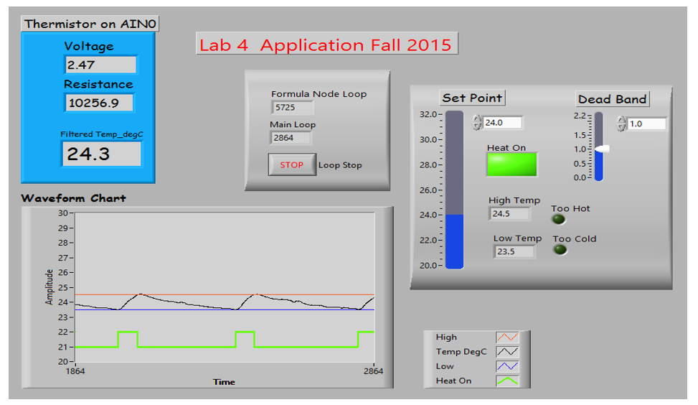

Lab 4 front panel: Chart indicates temperature, high and low limits and the state of the heater. The waveform is configured by right clicking on the chart and changing chart properties. The user configures the Set Point and Dead Band.

Slide 4
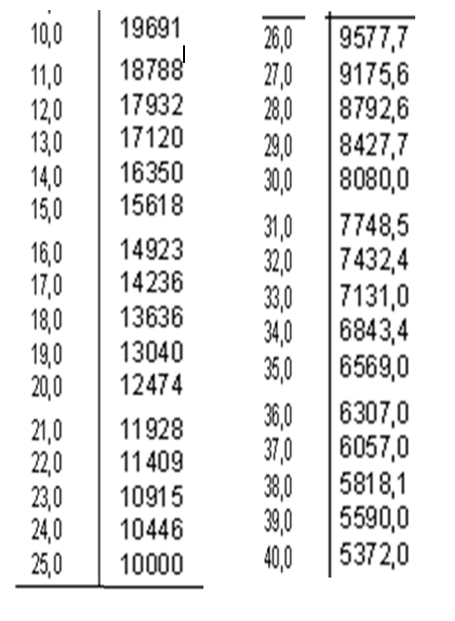

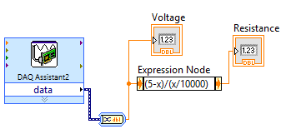
Thermistor Data and Conversion
The expression node can be found under the numeric palette. It is used in a VI to create a simple math expression. The “x” represents the input value. The result of the expression is the output on the right. The input signal originates from the A/D converter. The dynamic data type from the DAQ assist is converted to a numeric scalar using a convert from DDT function. In this example the voltage from the thermistor voltage divider is converted to thermistor resistance.
Data sheet for the thermistor comparing resistance to temperature.

Slide 5

2.34 volts
11368
If input = 2.34 volts
output equals 11,368 Ω.
About 22 °C using the lookup chart.
Expression Example

Slide 6
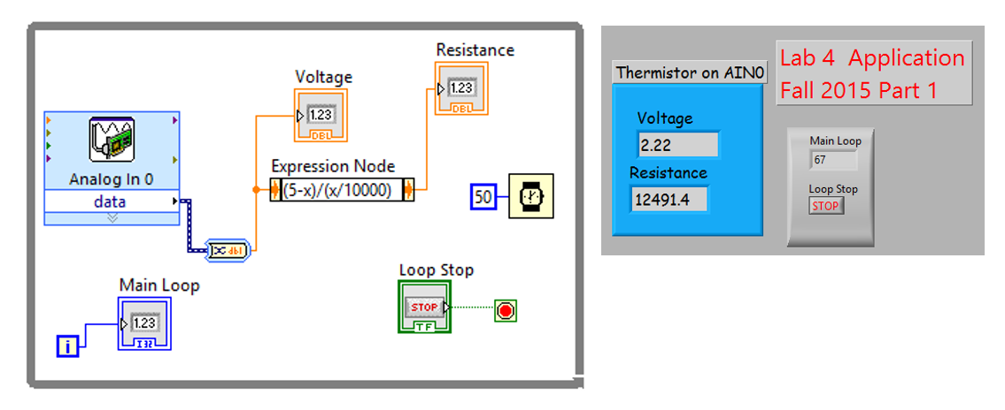
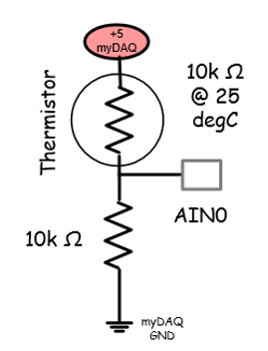
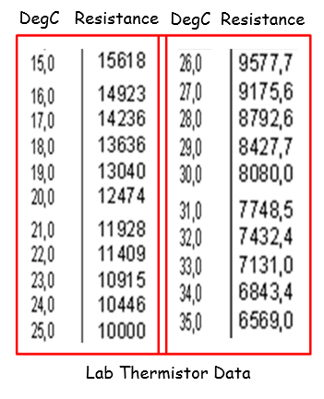
Complete VI with expression.

Slide 7
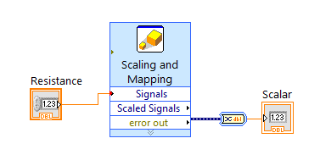
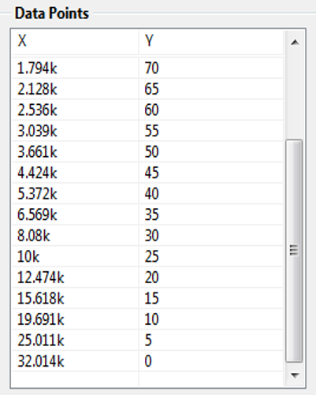
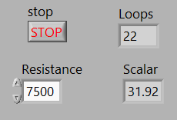
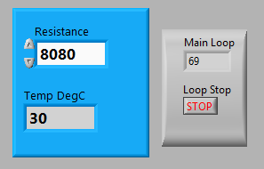
Mapping and Scaling – Convert resistance change to temperature using a look-up table.
Resistance
Temp degC
The input to the scaling and mapping function is the x value (the resistance) the output is the y value (the temperature). The function interpolates the values between the data points.

Slide 8
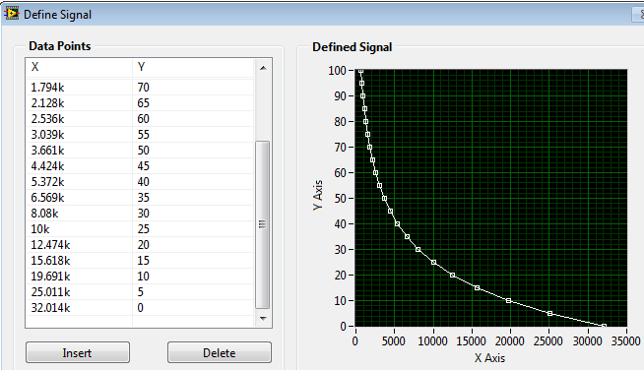
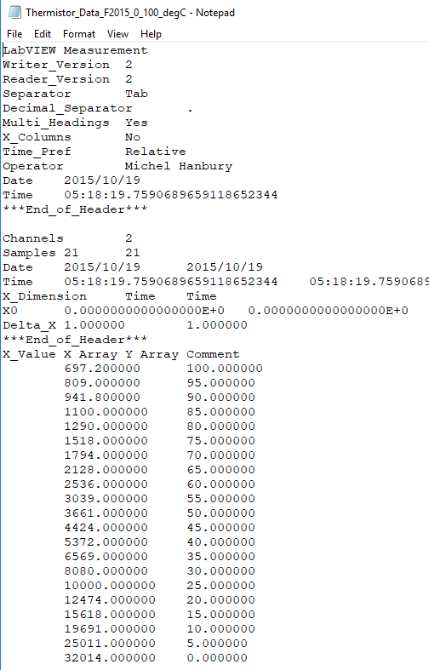
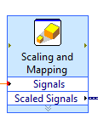
The chart is created using the thermistor data sheet. The x column represent the thermistor resistance. The Y-column the thermistor temperature.

Slide 9
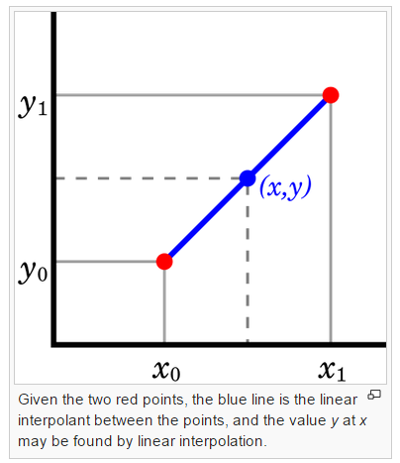
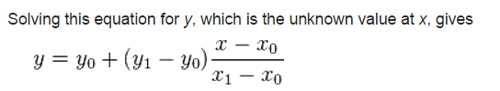
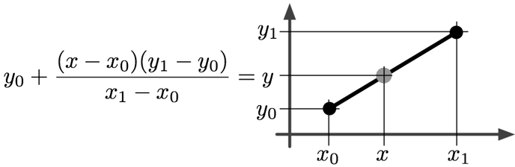
Linear interpolation between two known points. Resistance is fairly linear between 30 to 35 degrees Celsius. Given a resistance value between 8080 ohms and 6569 ohms the temperature can be determined.
35
30
8080
6569
7500- 8080
35 - 30
30
7500
6569- 8080
Y = 31.92
In this example the known resistance equals 7500 ohms (the x value). Using the formula above the value of the temperature can be calculated. In this example the answer is 31.9 degC.

Slide 10
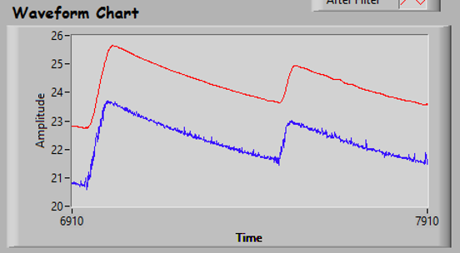
Smoothed
This chart is an example of a smoothing filter. The program uses a moving average filter to remove noise. The filter removes the noise from the A/D input signal and any electrical noise.

Slide 11
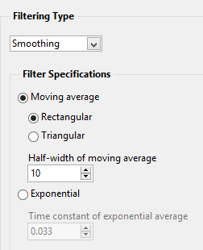
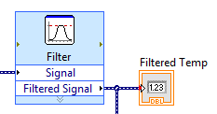
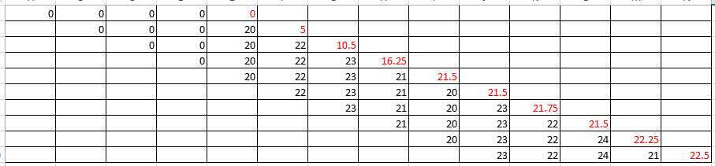
Moving Average Filter
Dynamic Data Type
Express VI, Double Click to Configure

Slide 12
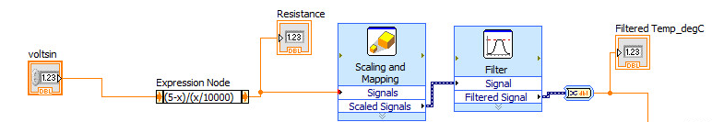
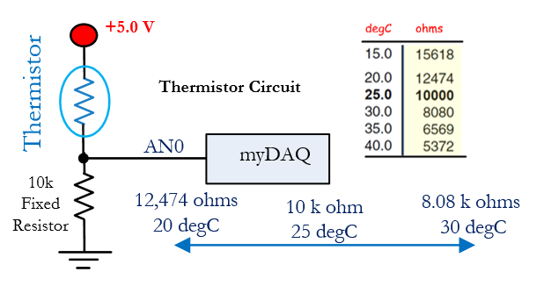
Assume 30 °C
R = 8080 Ω
Read Voltage
From Divider.
Convert to resistance
Convert to temperature
Smooth out the signal.
Send the value to the rest of the program.
Assume 30 °C
Signal Conversion Steps

Slide 13
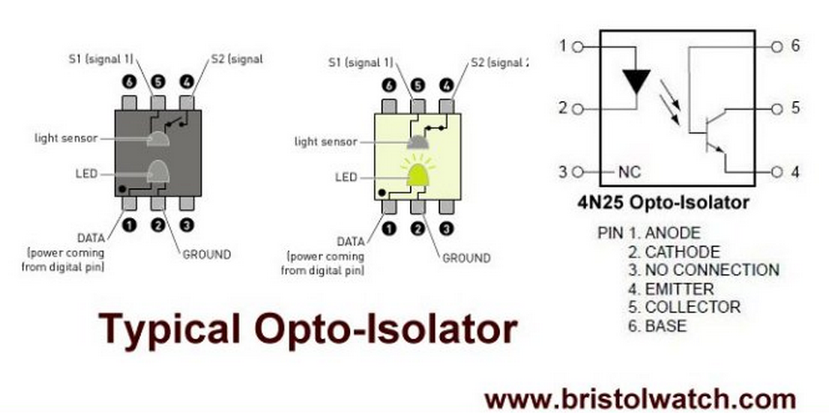
When current flows through the internal IR LED, light strikes the base of a photo sensitive transistor turning the transistor on, providing a path to ground between pins 4 and 5.
When no current flows the transistor is turned off, acting like an open circuit.

Slide 14
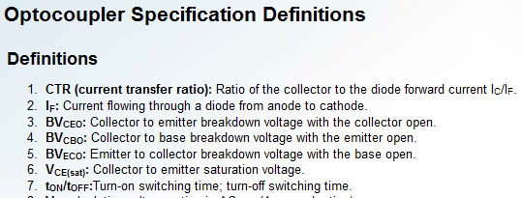

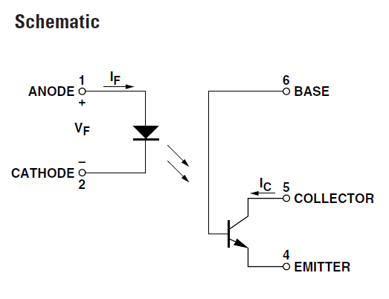
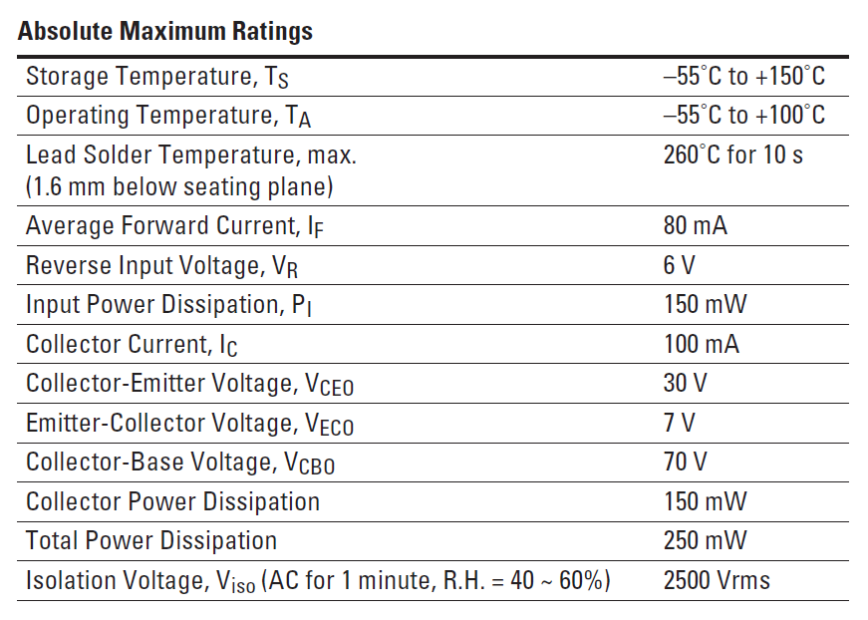

4N25 Opto-coupler

Slide 15
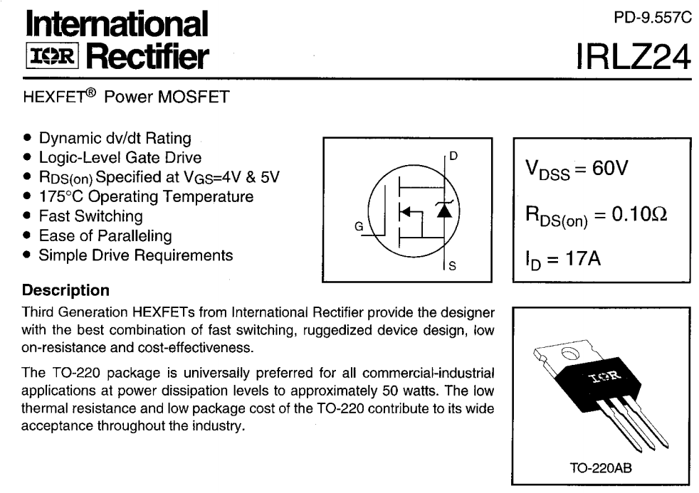

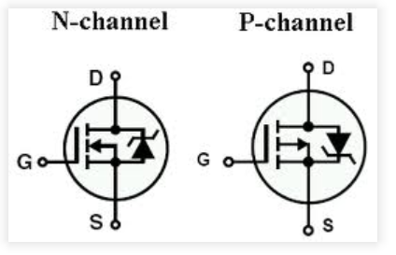

Slide 16
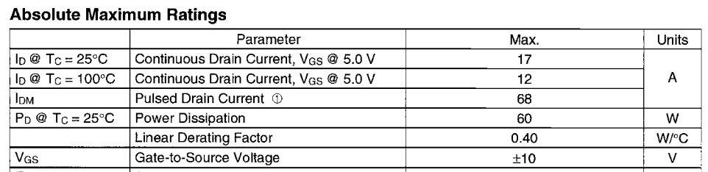
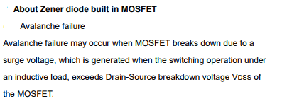
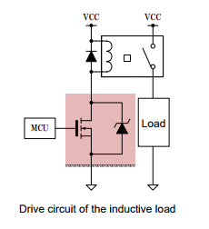
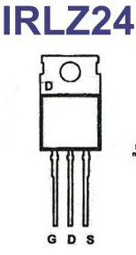
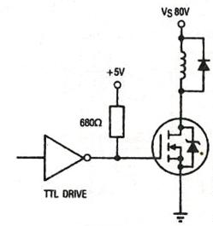
MOSFET – metal oxide semiconductor field effect transistor.
This type of device is not controlled by current, it is switched on or off by a voltage.
Applying a voltage above the gate threshold turns on the drain to source.
The main advantage of the MOSFET is the very low on resistance between the gate and source.
Drain
Gate
Source

Slide 17
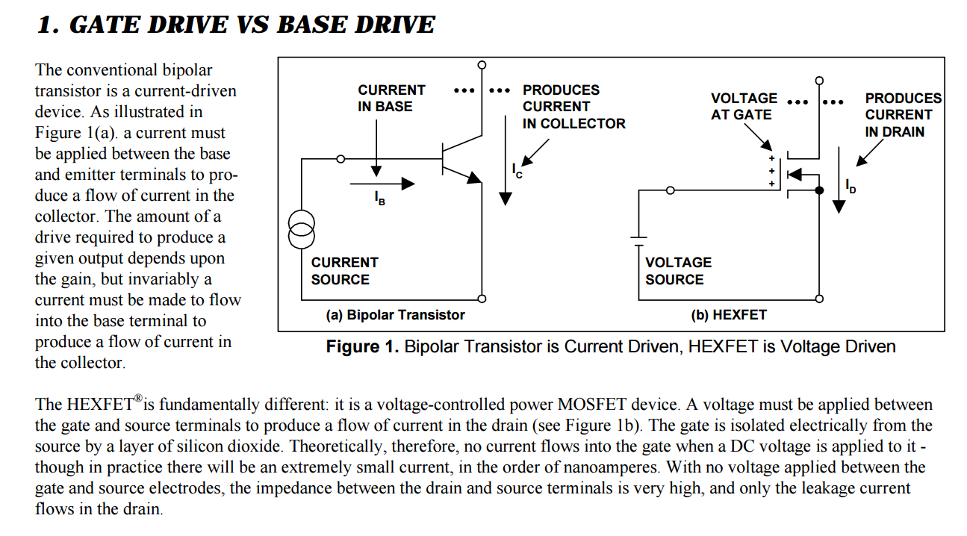

Slide 18
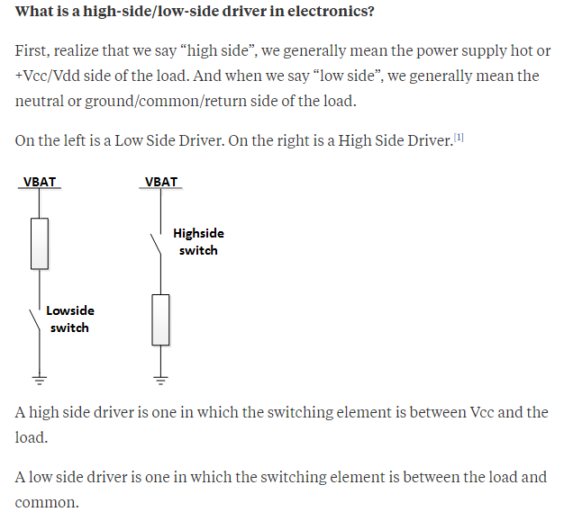

Slide 19
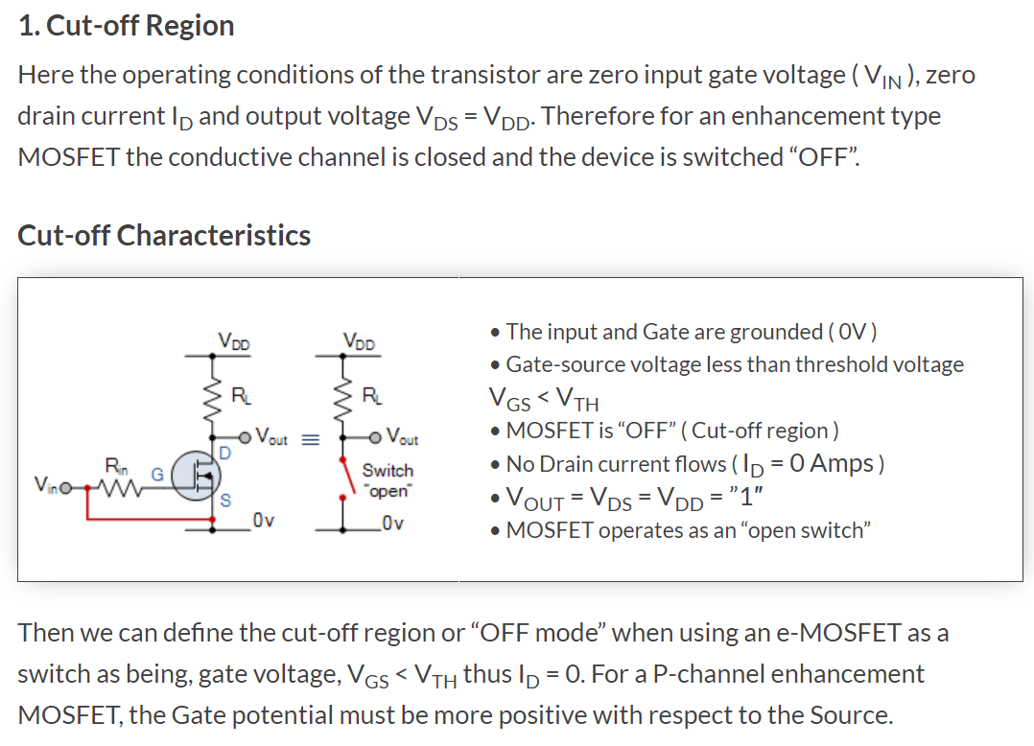
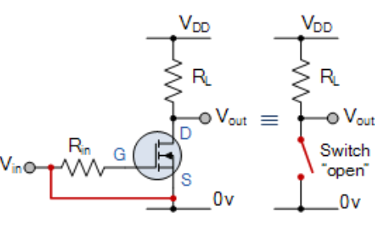


Slide 20
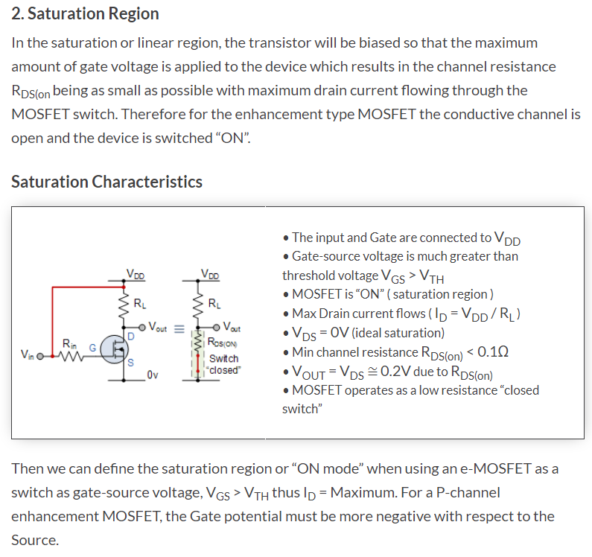
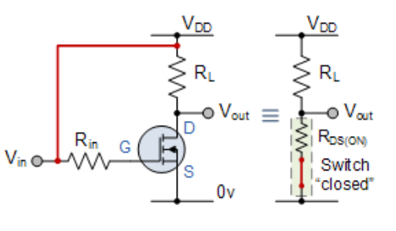

Slide 21
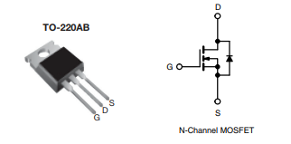
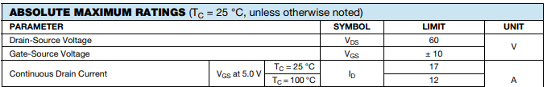
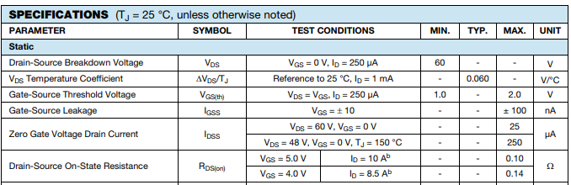
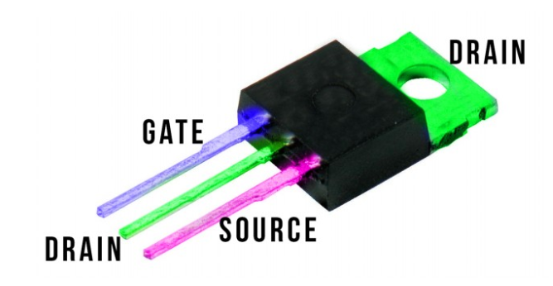

Slide 22



Slide 23
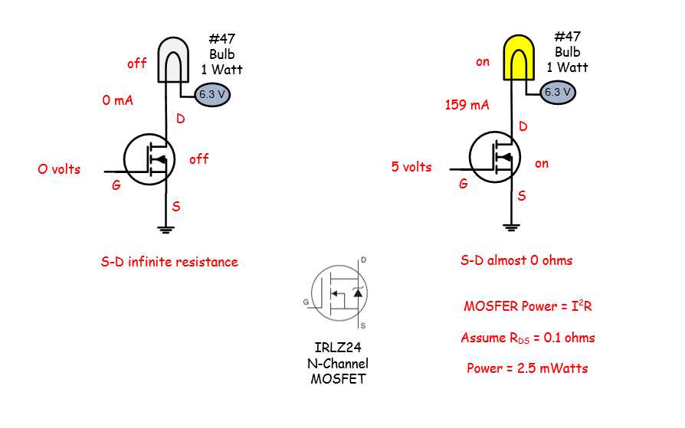
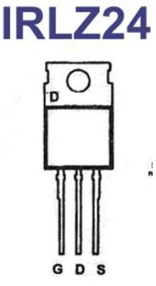
The metal–oxide–semiconductor field-effect transistor (MOSFET, MOS-FET, or MOS FET) is a type of transistor used for switching electronic signals. The device is controlled by a gate voltage.
IRLZ24 Logic Level MOSFET device
A MOSFET device is controlled with a voltage at the gate. When the voltage between the gate and source is greater than the threshold the device turns ON. The resistance between drain and source is about 0.1 ohms. When the gate is 0 volts the drain to source resistance is infinite.

Slide 24
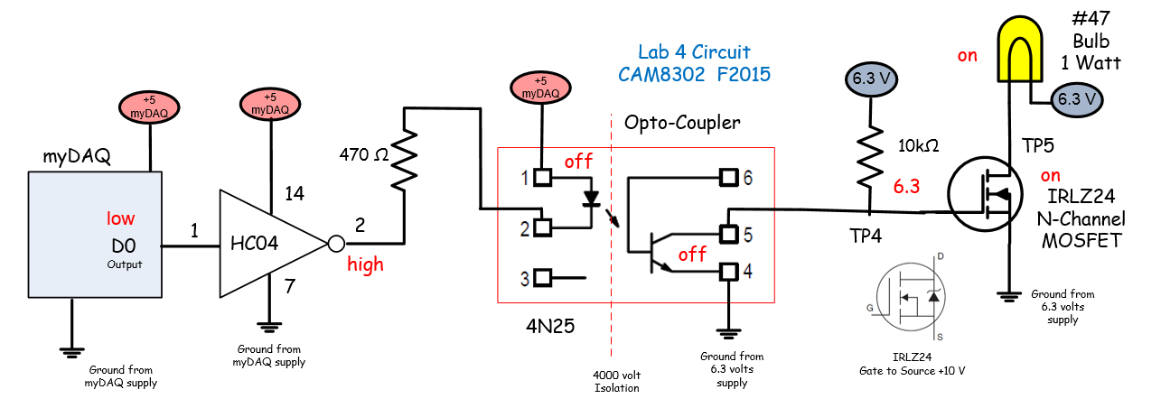

myDAQ o/p goes low, inverter o/p goes to about 4.7 volts.
With inverter output high the isolator IR led is off. The isolator transistor turns off.
The isolator transistor is open circuit and in a high impedance state, the pull up resistor provides 6.3 volts to the gate of the MOSFET turning it ON.
The resistance between drain and source is about 0.1 ohms providing a ground path to the lamp to turn it ON.

Slide 25
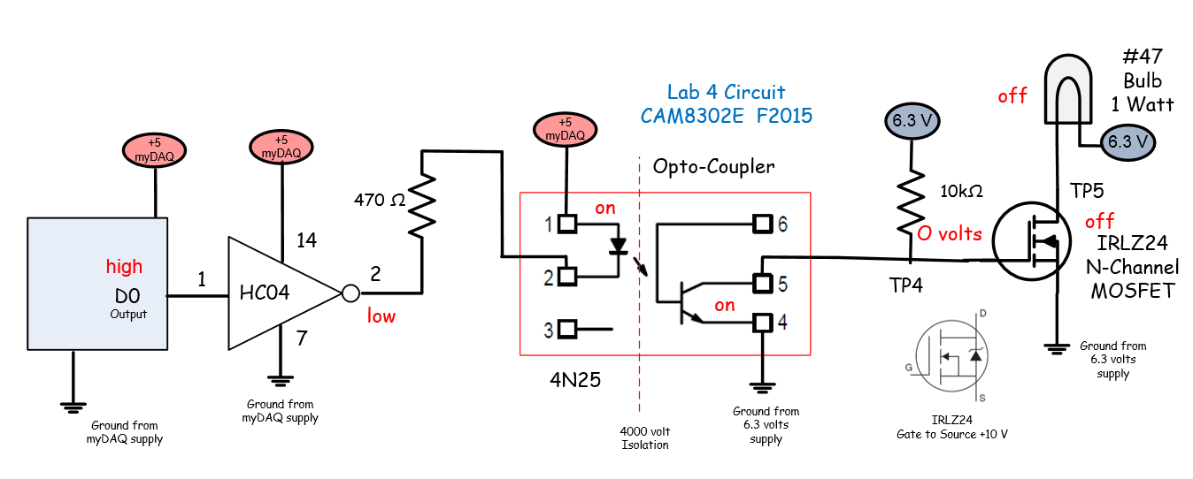
myDAQ o/p is high, inverter o/p goes low, about 0.2 volts.
With the inverter output low the isolator IR led is on. The isolator transistor also turns on.
The isolator transistor acts as a closed switch grounding the gate of the MOSFET turning it OFF.
The resistance between drain and source is infinite (off), with an open circuit the lamp turns OFF.

Slide 26

Lab 4 front panel: Chart indicates temperature, high and low limits and the state of the heater. The waveform is configured by right clicking on the chart and changing chart properties.

Slide 27
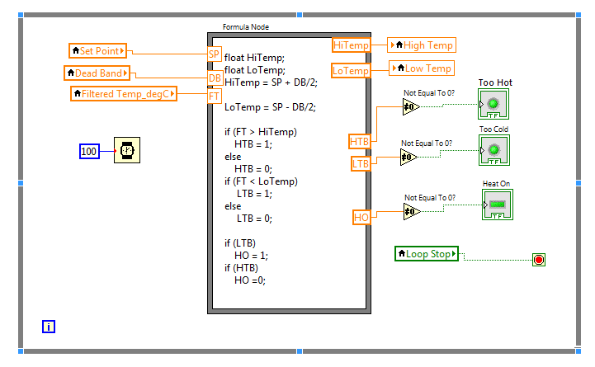

Slide 28
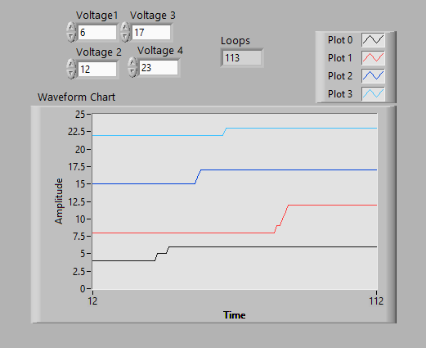
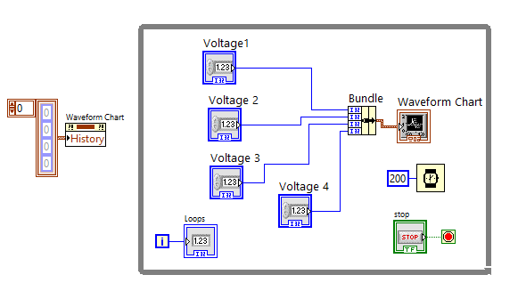

A waveform chart can have multiple inputs. A Bundle function is used to allow many inputs applied to a waveform chart. Each plot is configured under chart properties.
The chart can be cleared (programmatically) by creating a property node. A property node allows properties to be modified while the program is executing.

Slide 29
Lab 4 front panel: Chart indicates temperature, high and low limits and the state of the heater. The waveform is configured by right clicking and the chart and changing chart properties.

Slide 30

A bundle represents a group of various data type, the bundle can contain real, Boolean and integer data types. Four signal are being applied to the input of the waveform chart that will produce four signal traces. One for the temperature, the high limit, the low limits and the state of the heater.

Slide 31




Slide 32


Slide 33


Slide 34


Slide 35


