Slide 1

Week 8 Notes:
Quadrature encoding
Geared DC Motors and Motor Drivers
CAM8302E Fall 2018

Slide 2
Slide Index – Week 8
Slides Topic
3 Geared DC Motor with Encoder
4 Hall Sensor Review
6 Quadrature Encoding
10 74HC74 D-Type FF
15 Encoder with Optical Sensor
16 Measuring Torque
17 Gear Trains
21 Basic DC Brushed Motors
23 H-Bridge
28 Lab 6 Front Panel
31 Lab 6 Block Diagram

Slide 3
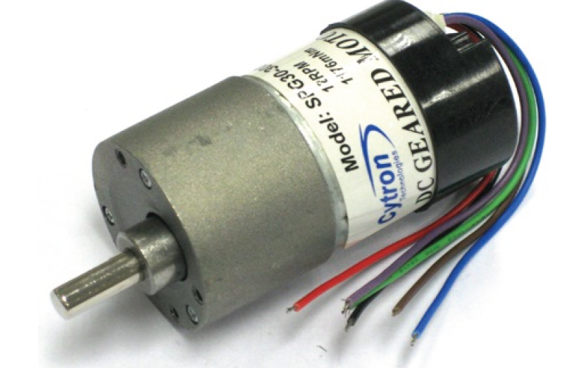
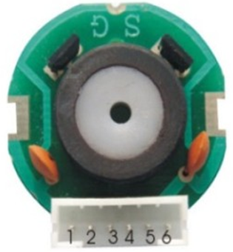
Geared DC Motor with Encoder
The motor used in the lab has a gear ratio of 30:1. The rotor of the DC motor turns 30 times for each revolution of the output shaft. The torque will increase by a factor of 30, the speed at the output is reduced by a factor of 30. The direction of the DC brushed motor is controlled by changing the voltage polarity to the positive and negative motor terminals. The link below is a short video showing the operation of the motor quadrature encoder.
Built in Hall Effect Sensors are separated by 90 degrees. The two sensors produce two pulses. The two combined signals produce 4 (quad) edges. They are used to measure direction and speed. There are three sections in the circular magnet. Each with a north and south pole.
http://www.youtube.com/watch?v=4YLTHjbZVP0&list=PLZedxz6zGNJwsdKPQZJ_9BFq6VRrxDypK

Slide 4
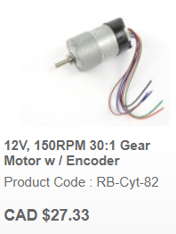
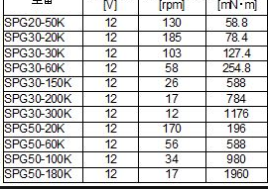

Geared DC Motor with Encoder
From robotshop.ca
12 volts DC 103 RPM 0.127 N.m torque 30:1 gear ratio

Slide 5
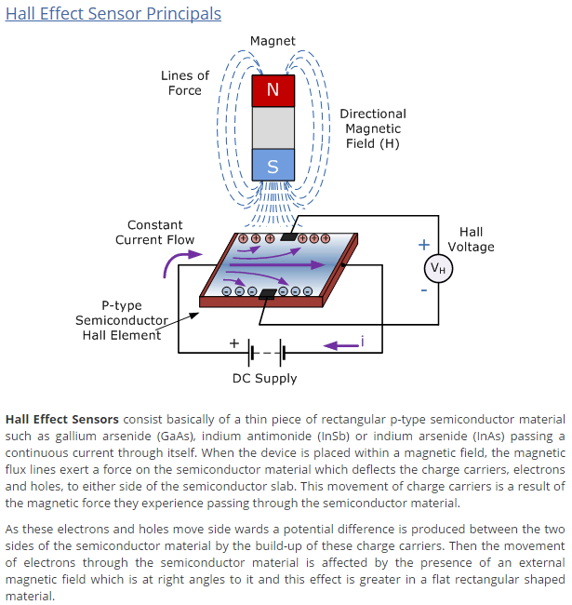
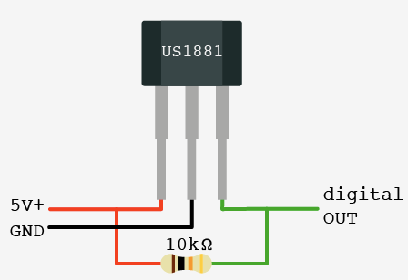

Non Contact Hall Effect Sensor
Magnetic Field causes a small voltage perpendicular to current flow in the wire. The Hall sensor used in the motor encoder has a latched output. A south pole cause a low output, a north pole causes a high output. The Hall sensor has three terminals. Ground, +5, and an open collector output which is pulled high using a 10k pull up resistor. Without the pull up resistor the signal is always a logic low.

Slide 6
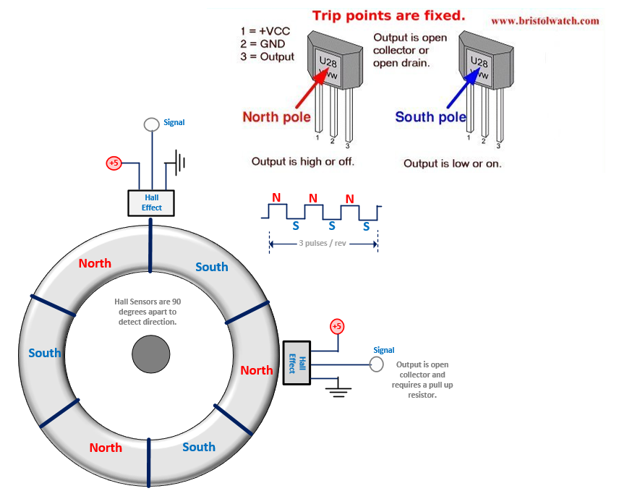
Direction Detection Using Encoder
A Magnetic Field causes a small voltage to be produced perpendicular to current flow in the wire. The Hall sensor used in the motor encoder has a latched output. A south pole cause a low output, a north pole causes a high output. The Hall sensor has three terminals. Ground, +5, and an open collector output which is pulled high using a 10k pull up resistor. Without the pull up resistor the signal is always a logic low.

Slide 7
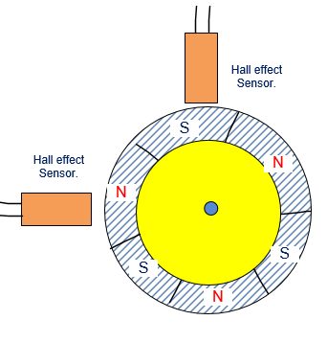
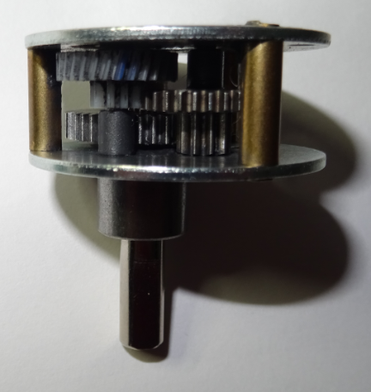
Direction Detection Using Encoder
A rotating magnet creates pulses through the Hall sensor. Since there are three magnetic areas there will be three pulses per revolution of the motor. There are three pulses on each Hall sensor. When both are applied to the controller they can determine motor speed and direction
Hall effect sensors are separated by 90 degrees. The two pulses create 4 edges. (quadrature o/p). The motor has 6 terminals. Two to supply the logic voltage for the Hall sensor. Two wires for the DC motor supply and two wire for the quadrature encoder output.
30 to 1 gear reduction. Lower speed but greater torque.

Slide 8
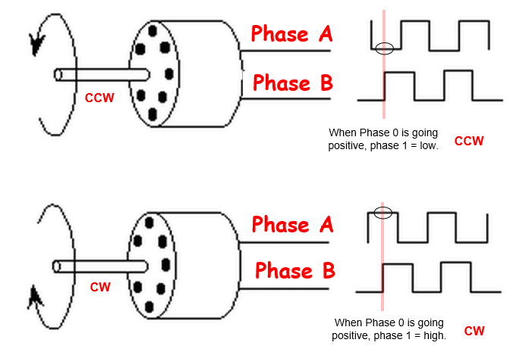
Direction Detection Using Encoder
These two timing diagrams demonstrate the differences in the A and B signals as the motor rotates clockwise the counter clockwise.
The motor in the upper diagram is rotating CCW. Assume the B signal is the clock input of our circuit. As the B signal goes through a positive transition the logic level of the A signal is low.
The motor in the lower diagram is rotating CW. Assume the B signal is the clock input of our circuit. As the B signal goes through a positive transition the logic level of the A signal is high.
The reason the signals produce the pulses in this pattern is that the sensors are placed 90 degrees apart from each other.

Slide 9
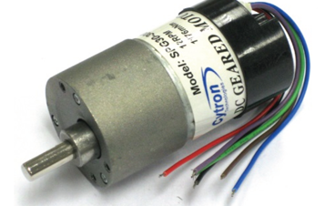
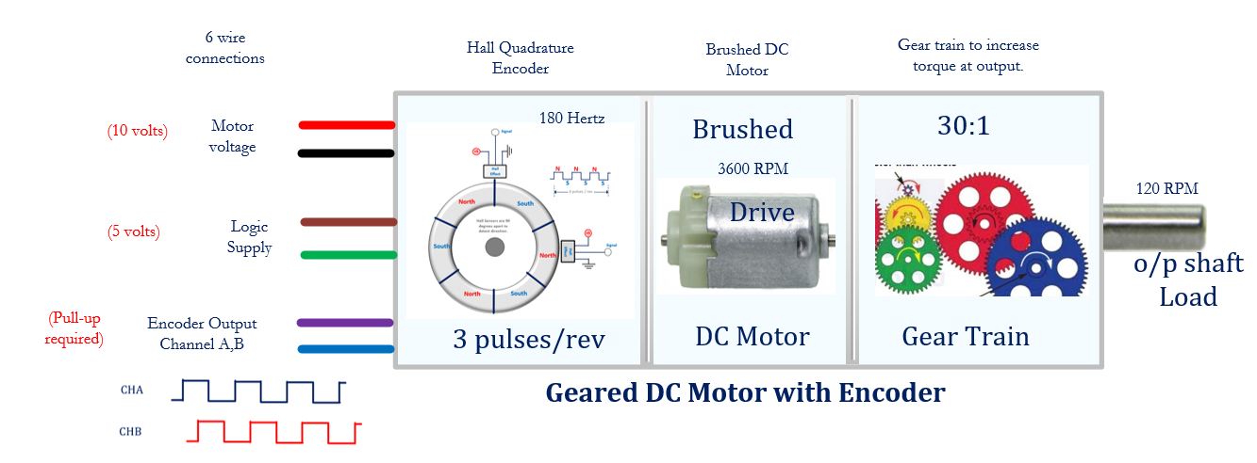
Gear Train of lab DC motor.

Slide 10
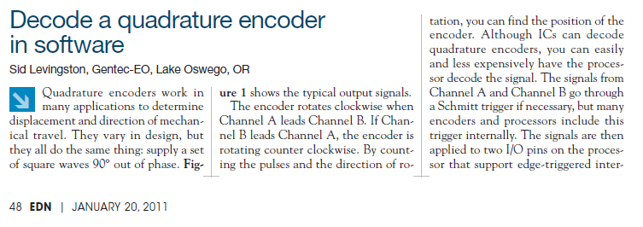
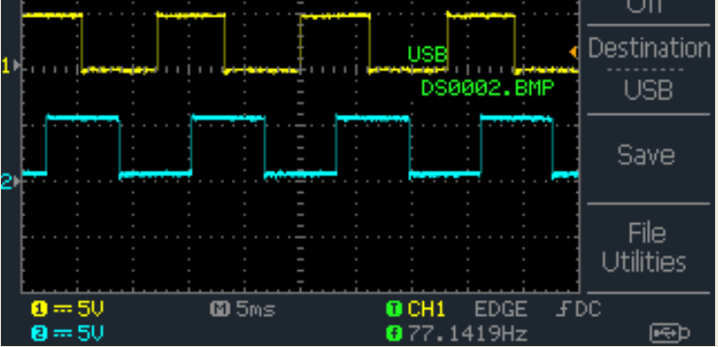
Quadrature Encoder (4 edges)
The Hall Effect Sensor is able to detect a magnetic field and produce output pulses as the motor rotates. The Hall sensors are 90 degrees apart. The encoder is used to measure speed and direction.

Slide 11
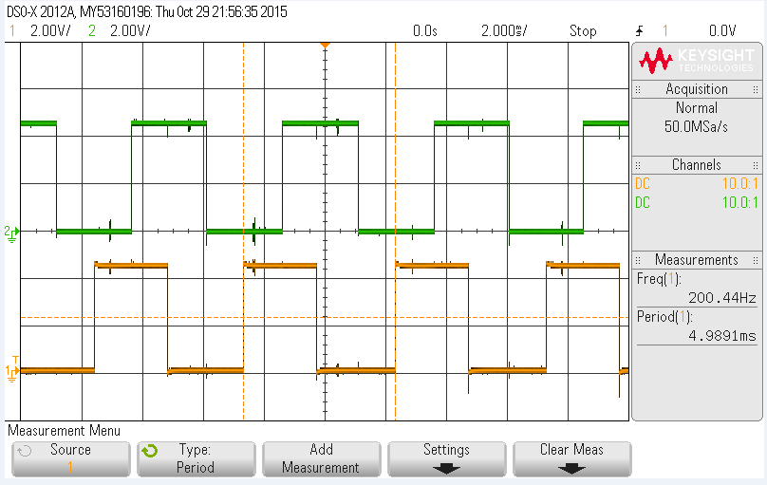
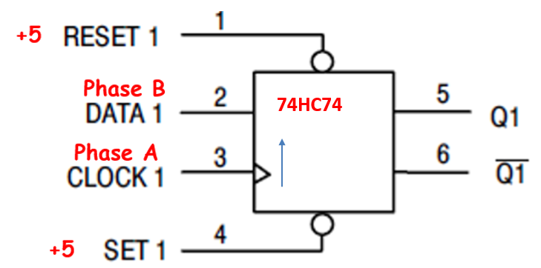
Encoder Signals Clockwise
The input to the HC74 is positive edge sensitive and is connected to the clock of the quadrature encoder.
In this case as the rising edge occurs the data is high, therefore the output o Q1 will be high.
Clock
Clockwise rotation
Clock
High
Data

Slide 12
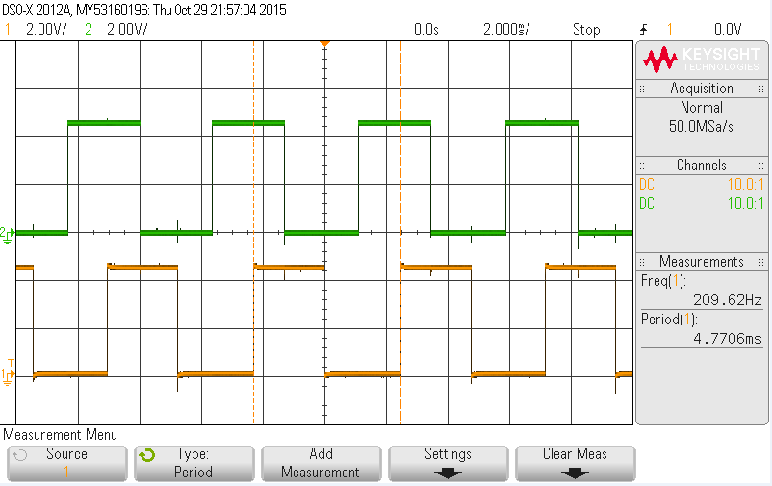
Encoder Signals CCW
Counter Clockwise rotation
The input to the HC74 is positive edge sensitive and is connected to the clock of the quadrature encoder.
In this case as the rising edge occurs the data is low, therefore the output o Q1 will be low.
Clock
Low
Data

Slide 13
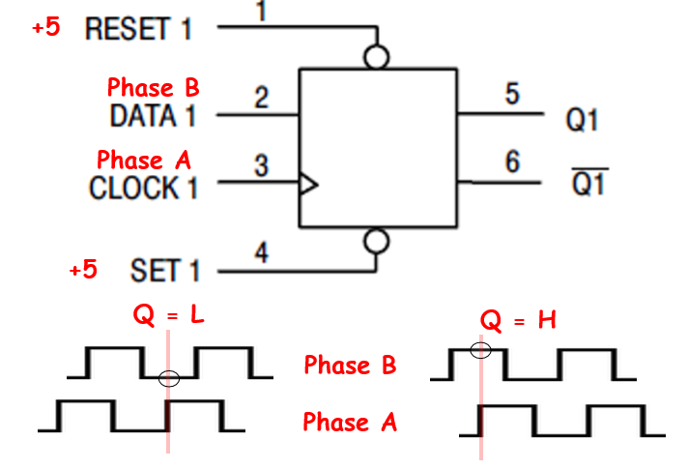
Direction Detection Using Encoder
A 74HC74 IC is used to decode direction and produce a logic low or high output on Q1 to provide direction information to other parts of the control circuit.
Pin 1 and 4 are tied to a high level to override the clear an set signals.
As a positive going edge occurs on pin 3 (the clock) the signal at pin 2 will be latced to the output Q1.
74HC74

Slide 14
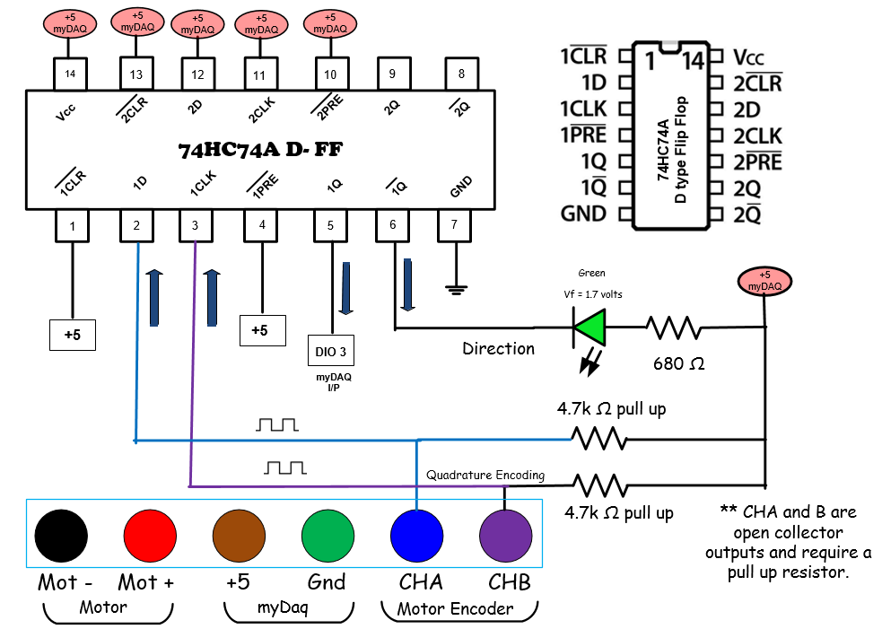
This circuit is used to detect the direction of rotation of the DC motor.
One of the output signals connects to an LED, the other connects to an input on the myDAQ, this will be used to indicate direction on the front panel.
Your circuit will not work as expected without the pull-up resistors.

Slide 15
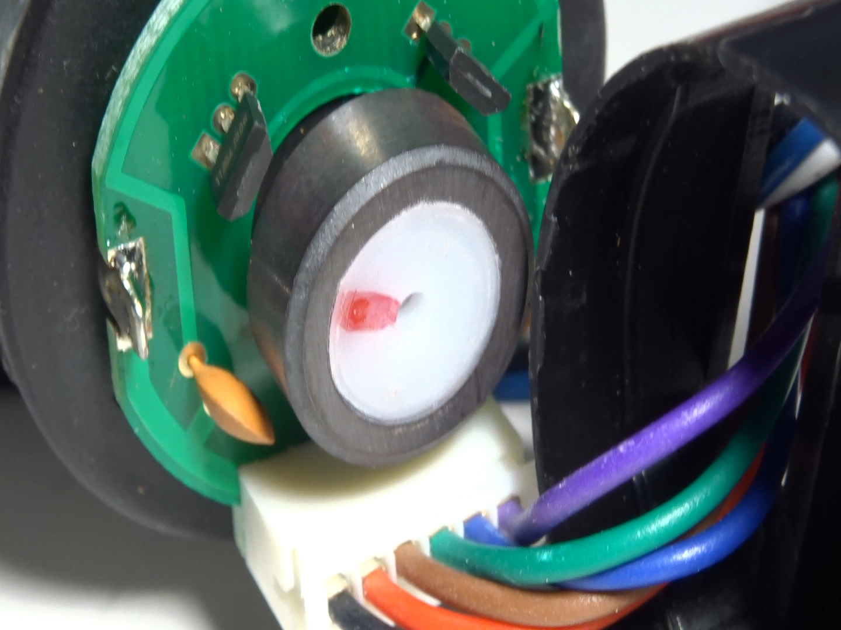
myDAQ Motor Speed
LabVIEW Front Panel (video)
Video of the DC motor Encoder.
The magnet wheel is comprised of three magnets with 3 north and south poles.
As the motor rotates 3 pulses occur on each Hall sensor output.
The motor is rotated CW and CCW.

Slide 16
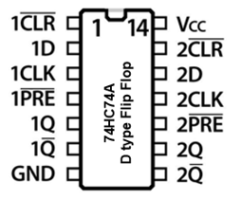
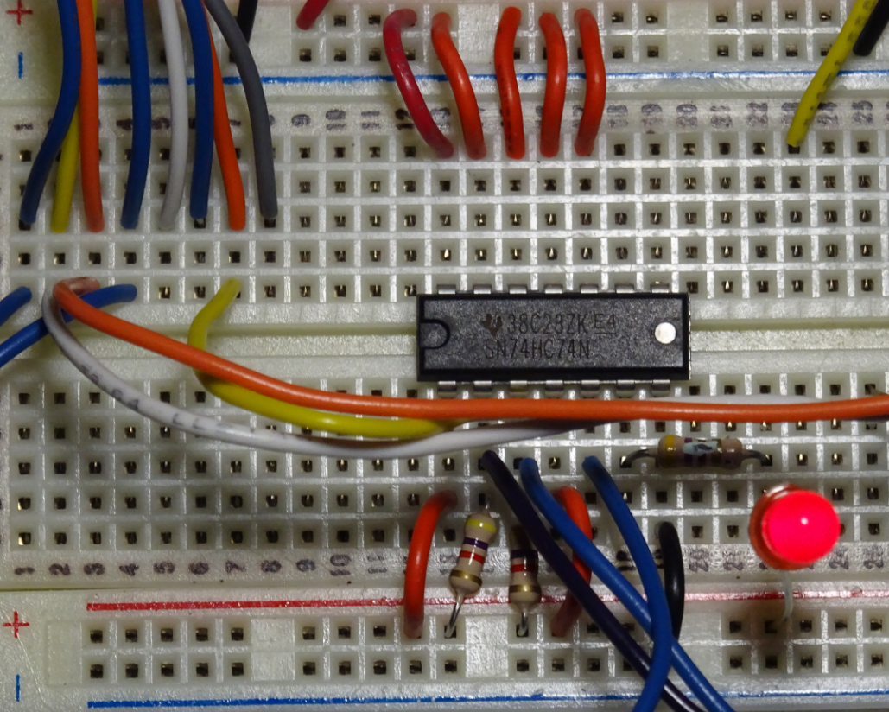
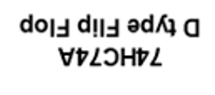
74HC74 D-Flip Flop

Slide 17
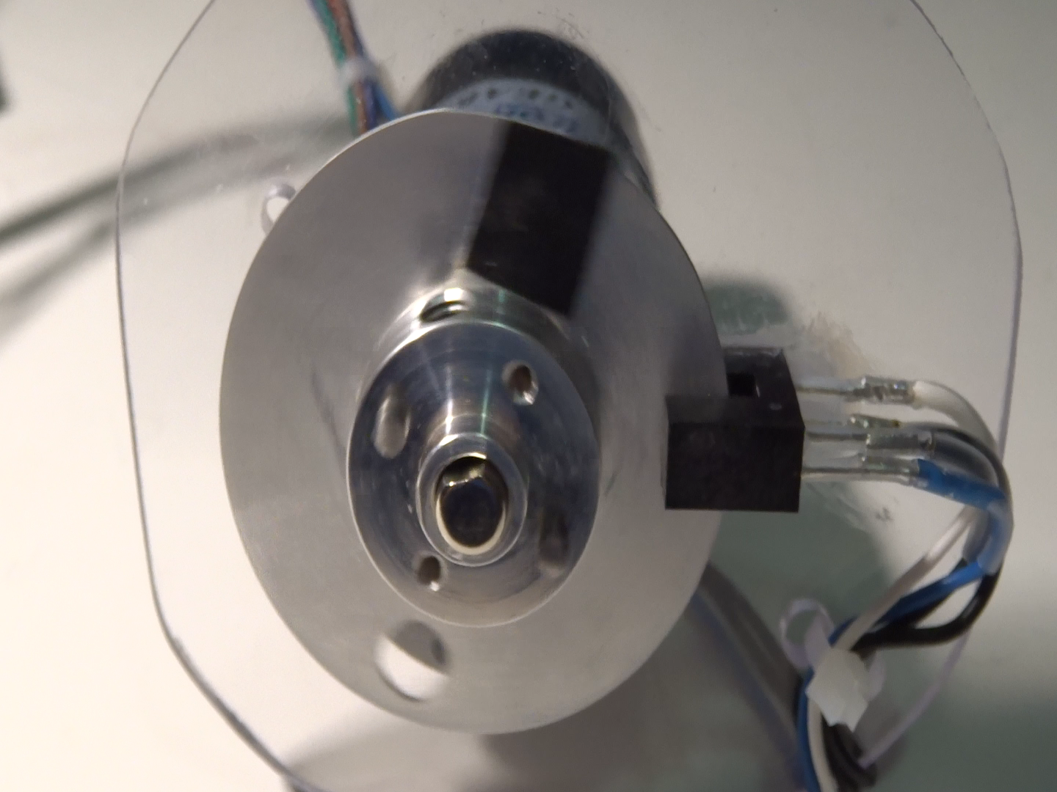
Motor Speed with Optical Sensor (video)
In this example and optical switch measures the rotation speed of the output shaft. 1 hole is drilled into the aluminum plate. As the motor rotated the optical switch gap is blocked or opened. The rotation causes 1 pulse per revolution.
The output signal is shown on the next slide.

Slide 18
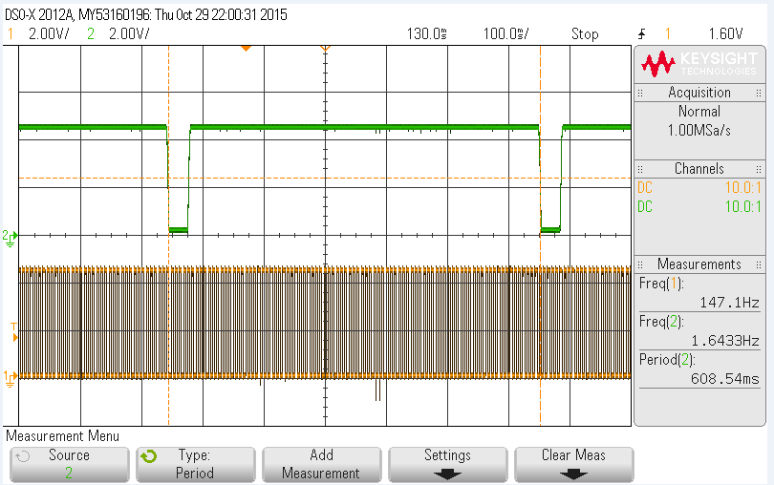
Encoder and Optical Sensor
Encoder pulses per second = 147.
There are 3 pulses per revolution.
147/3 = 49.
Motor rotates at 49 rev/sec.
X 60 = 2940 RPM.
Gear Ratio is 30:1
Divide RPM by 30 equals 98 RPM.
Divide by 60 equals 1.64 rev/second.
Optical Sensor
Encoder Signal
Rotation frequency = 1.64 seconds.
Rotation period = 608 ms.

Slide 19
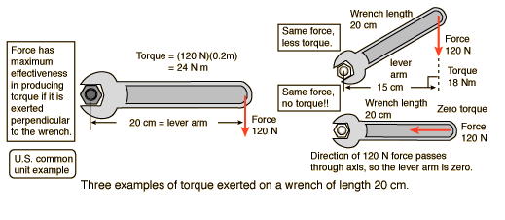
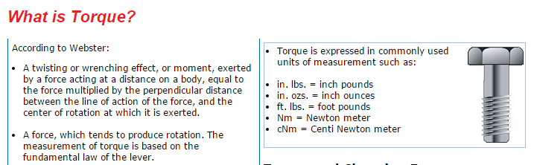
Torque (Rotational Force)

Slide 20
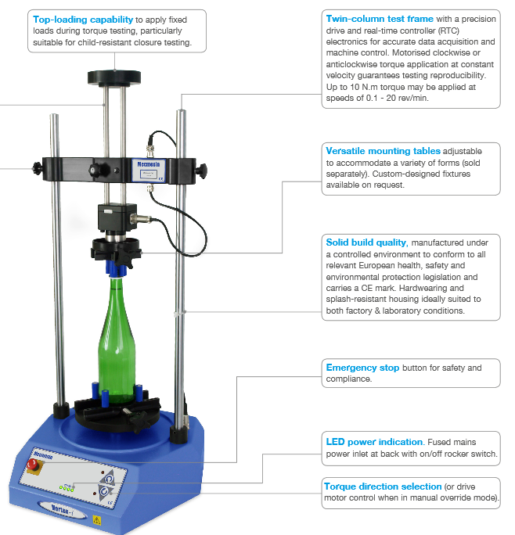
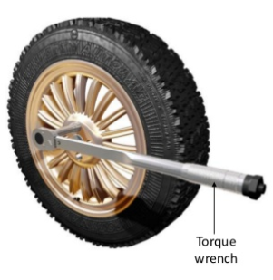

This instrument is used to measure the turning torque on bottle caps.
The range is from 0 to 10 N.m.
The torque for the nuts on a car wheel is between 75 to 100 foot-pounds, or about 135 newton-meter.
This is about 1000 time greater than the motor used in the lab. The lab motor has a maximum torque of about 0.1 foot-pounds or 0.127 Nm.

Slide 21
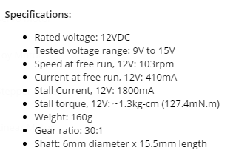
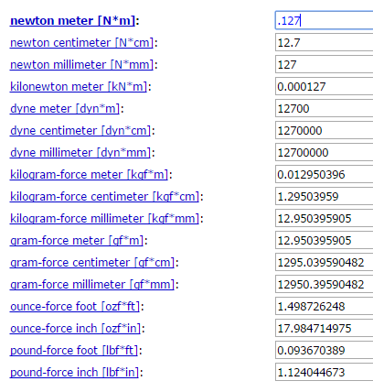
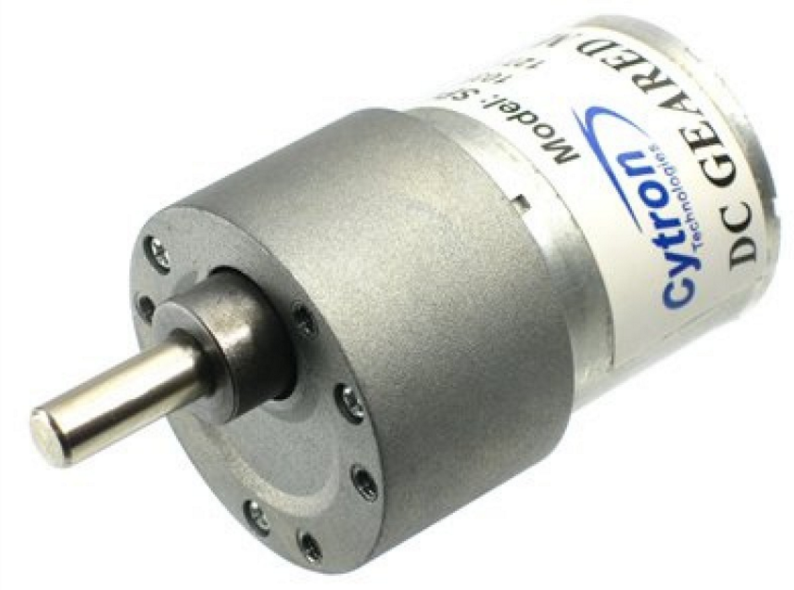
Geared Motor – Force

Slide 22
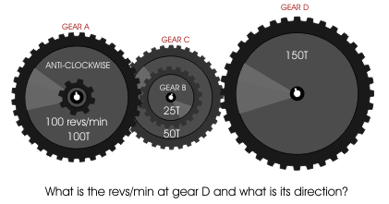
Gears and Drive Trains
Gears and gear trains are used to:
1) Increase or decrease speed
2) Increase or decrease torque
Torque is a turning or twisting force measured in Newton . metre (Nm).
A gear train is a group of gears used to achieve the desired torque or speed.
Gear Ratio – Ratio between the driving device and the final output.
Example a motor rotates at 30 rev/second, the output shaft rotates at 1 rev/second, the gear ratio is 30:1.
http://www.technologystudent.com/gears1/gears8.htm

Slide 23
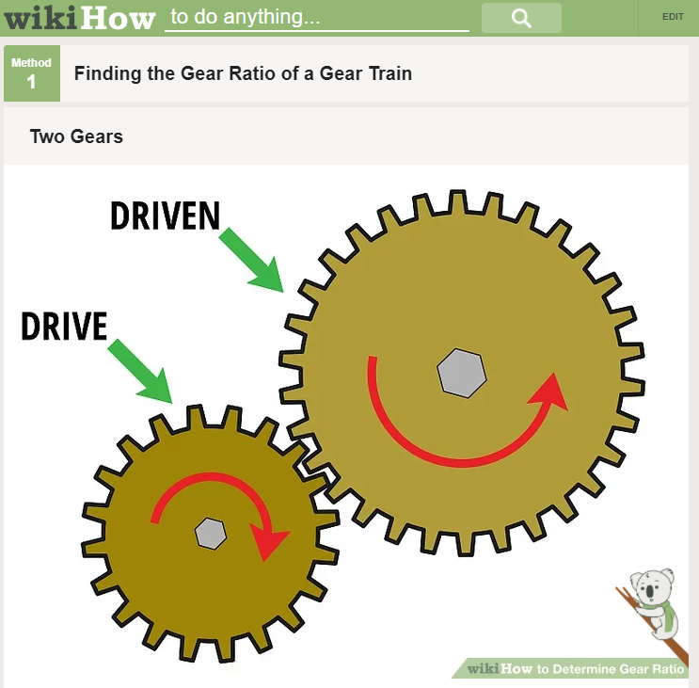
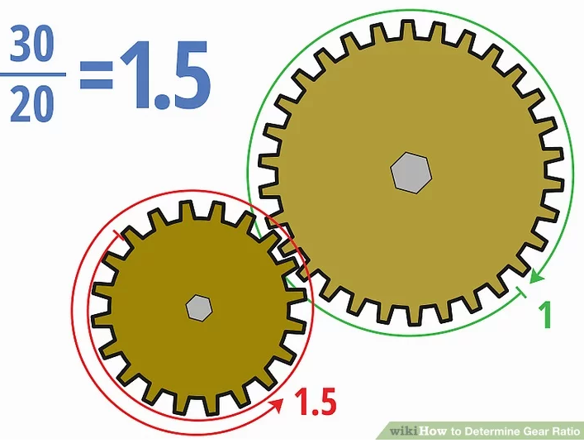
Gears and Drive Trains
The load gear turns slower than the drive gear but has greater torque. The direction is reversed.
If the drive gear turns at 100 RPM with a torque of 5 N.m the driven gear will turn 66 RPM and have a torque of 7.5 N.m
Load Gear
30 teeth
Drive Gear – attached to the motor.
20 teeth
Gear Ratio = Driven Gear/Drive Gear = 30/20 = 1.5

Slide 24
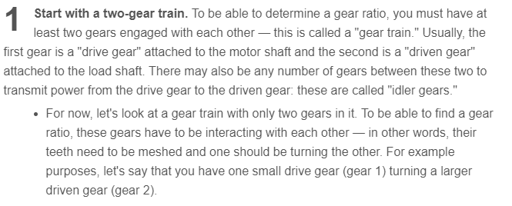
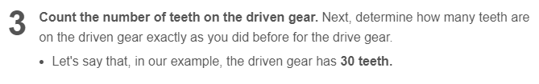
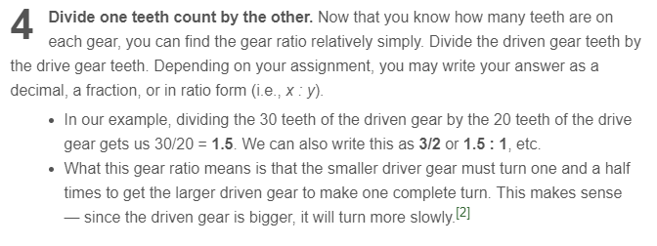
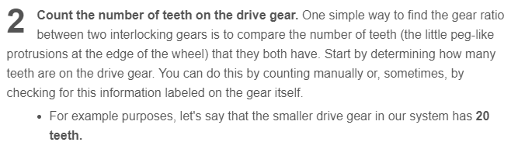
Gears and Drive Trains

Slide 25
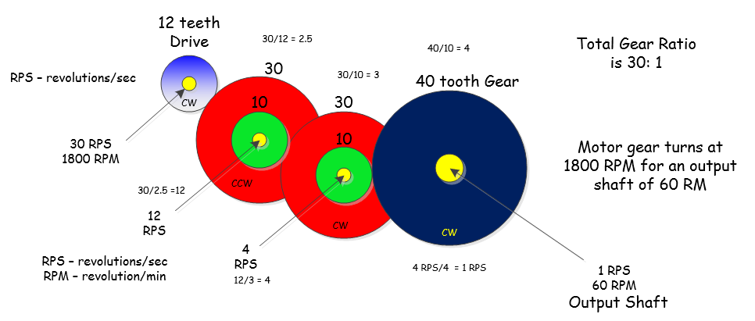
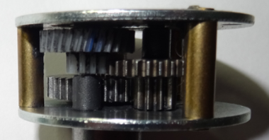
Compound Gears and Drive Trains
The gear set to the left is from the motor used in the lab. At 12 VDC the output shaft rotates at 103 RPM with a maximum torque of 0.127 Nm. The motor has a gear ratio of 30:1 If the output shaft is turning at 103 RPMs the motor is rotating at 3090 RPM or 51.5 RPS. The hall sensors will produce pulses at a rate of 154.5 Hz. Total gear ratio = 2.5 x 3 x 4 = 30

Slide 26
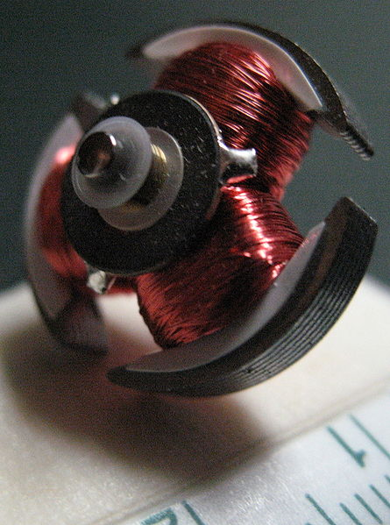
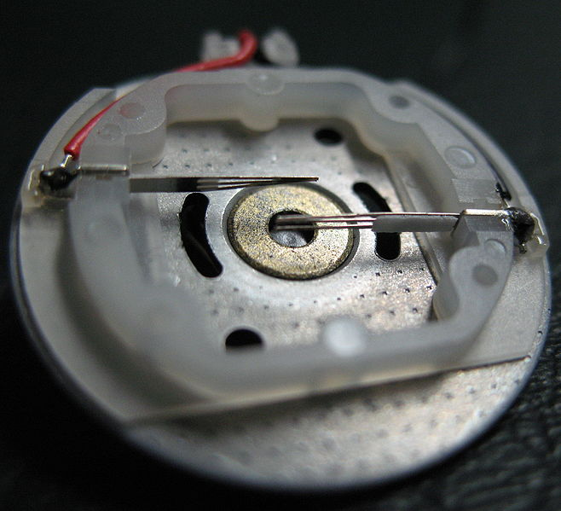
Basic Brushed DC Motors
DC Motor -- Wired Rotor
Brushes on the stator of a small DC Motor

Slide 27
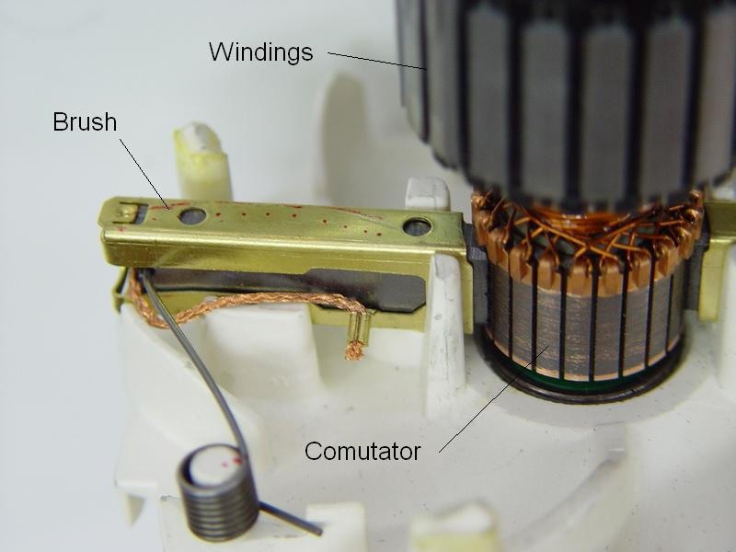
Basic DC Brushed Motors
DC Motor Components
This picture shows the details of one of the two brushes touching the commutator of the rotor. The commutator provides a path for current to flow through the coils of wire attached to the rotor.
Commutator

Slide 28
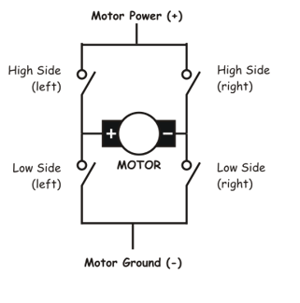
Simple H-Bridge
H-Bridge Manual Operation:
A group of four switches are used to control the direction of a DC motor. The circuit reverses which pins on the motor receive the positive and negative signals.
Clock Wise Operation
High Left, Low Right Closed
Positive on left of motor, Negative on right of motor.
Counter Clock Wise
High Right, Low Left Closed
Positive on right of motor, Negative on left of motor.

Slide 29
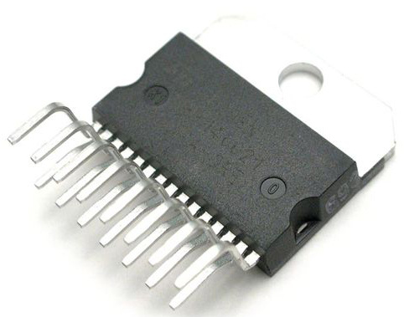
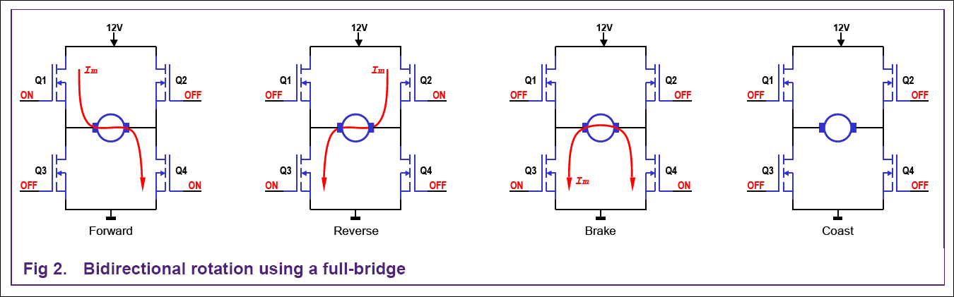
DC Motor Control H-Bridge
L293, L298 H-Bridge Operation:
A group of four transistors (MOSFETS) are used to control the direction of a DC motor. The circuit reverses which pins on the motor receive the positive and negative signals. Logic is built into the driver IC to prevent a short circuit.

Slide 30
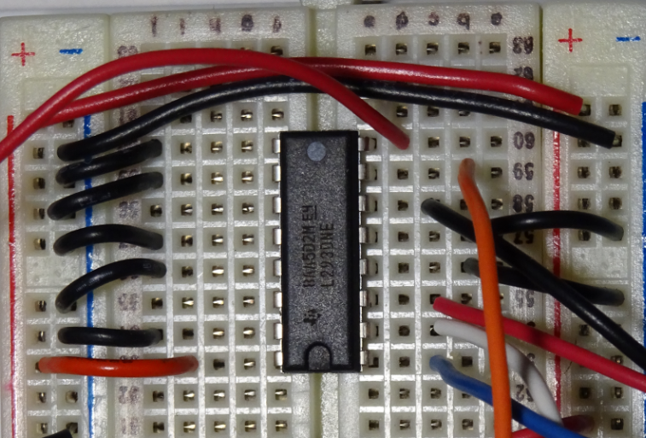
L293D H-Bridge Motor Controller
Motor Supply
I/P 2 DIO 5
Motor (-)
Motor (+)
I/P 1 DIO4
Enable DIO 3
L293D Motor Driver (600 mA)
With protection Diodes.

Slide 31
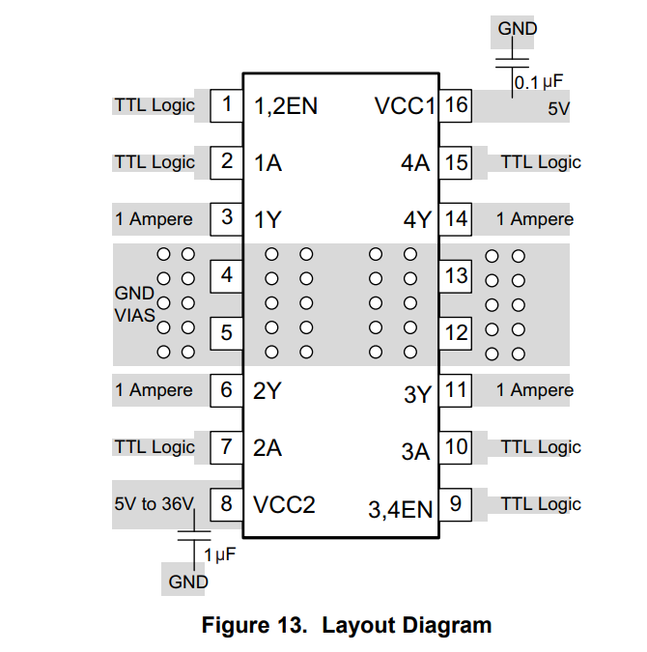
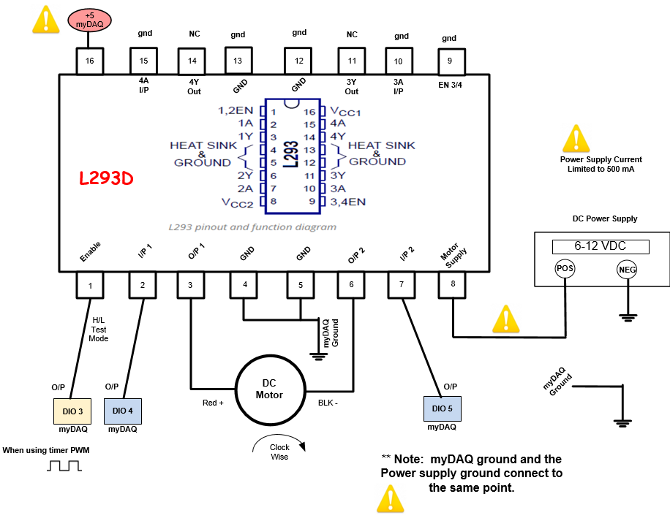
TB6612 Motor Driver Module

Slide 32


Motor Controller Function Table
The three control pins determine the motor direction, clockwise or counter-clockwise. The control signals also control whether the motor brakes or free runs to a stop. If the motor control IC is enabled and both inputs are at the same level the motor will stop quickly(brake). If the IC is disabled the motor free runs to a stop.

Slide 33



TB6612 Motor Driver

Slide 34


VNH5019 Motor Controller
12 Ampere DC motor Drive.

Slide 35

Regenerative Braking in Electric Cars

Slide 36

myDAQ Motor Speed
LabVIEW Front Panel

Slide 37

myDAQ Motor Speed
LabVIEW Front Panel

Slide 38

Motor Direction and speed Feedback

Slide 39

Motor Direction and speed Feedback

Slide 40


L293 Control Signals
This section of the VI controls the direction of the motor and enables and disables the driver.
The signals connect to IN1 and IN2 on the L293 motor controller.

Slide 41

LabVIEW Block Diagram Lab 6
2
6
The Frequency from the encoder is read using the timer frequency read function.
The DC motor produces 3 pulses / rotation so that is first divided.
The value from step 2 is multiplied by 60 to obtain a value in RPM.
The signal is divided by the gear train ratio to obtain the RPM speed at the output.
Read the data from the Q output of the 74HC74 latch.
Display a text value of the direction.
Encoder 3 pulses/rotation
Select
3
Change to RPM
Gear Ratio
4
Read Direction from 74HC74
If true CW
If false CCW
1
5
Read Frequency

