Slide 1
myDAQ USB Interface
Ver. 4 Dec 5th 2018 (120 slides)

Slide 2
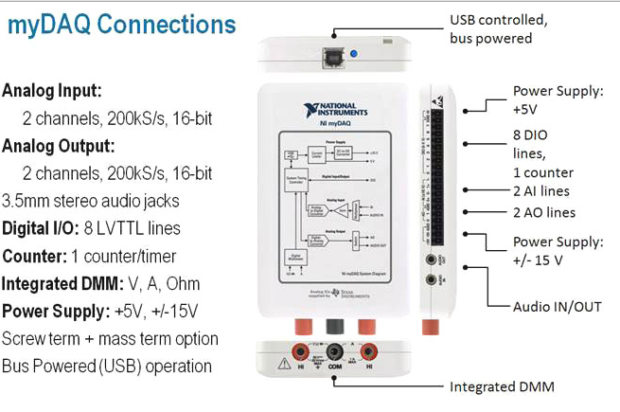
myDAQ USB Interface
How many digital I/O lines are on the myDAQ?
How many bits does the A/D use?
How many analog in and out are on the myDAQ?
What is the voltage resolution of the A/D converter?

Slide 3
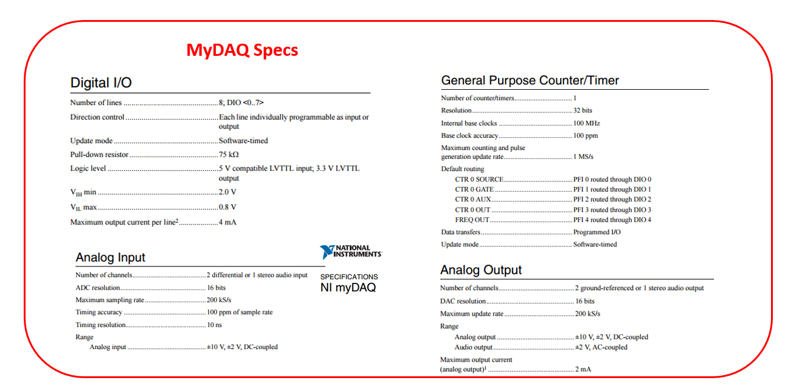
Which pin is used to measure an input frequency signal _______ , which pin is used to produce a counter/timer PWM signal? __________
Which two myDAQ pins are used to measure a quadrature signal?_______

Slide 4
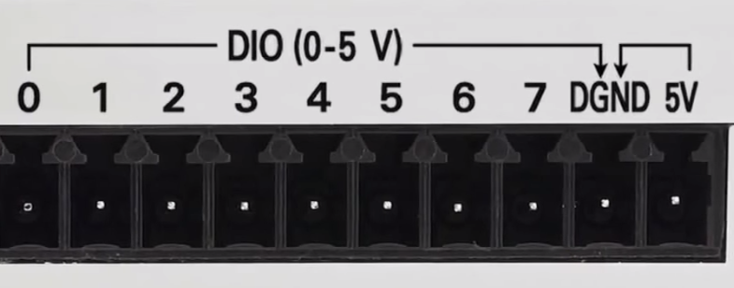
myDAQ Digital I/O specifications:
F2018
Digital In
Digital Out
3.3 volts LVTTL inputs
5.0 TTL volt tolerant
Explain how you can increase the current capacity of the myDAQ (4mA) output.
This may include adding additional circuitry such as a transistors, ULN2003A, MOSFETS. Be able to draw each.
Are the myDAQ inputs TTL tolerant?
3.3 volt LVTTL
Max. 4 mA drive

Slide 5
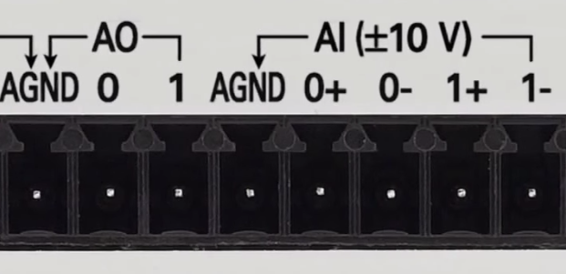
myDAQ Analog I/O Specifications:
Analog Out
Analog In
+/- 10 volts
2 mA drive
16 bit resolution
200 kilo samples/second
+/- 10 volts
10 G ohms input impedance
16 bit resolution
200 kilo samples/second
When measuring a signal such as the voltage across the DC motor you must use differential voltage measurements.
In this case neither (0+) or (0-) connect to ___________?
For single ended inputs, use a ground reference, the 0- and 1- inputs should connect to the ground reference.

Slide 6
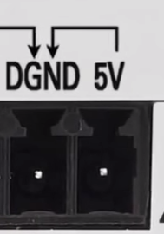
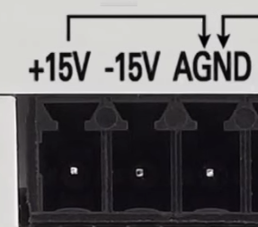
myDAQ Power Supply Specifications:
+/- 15 volts
32 mA drive / supply
+/- 14 volts at max. load
+ 5.0 volts
100 mA max. drive
4.0 volts(min) at maximum load
Note the current limitations of the supplies. Going over the current limits will cause the supply voltage level to decrease.
With a load applied to myDAQ supply the supply voltage will drop, at maximum load the supply will drop to a minimum of ______ volts.
Caution:
Do not connect another power supply to the myDAQ.
There is a 1.25 A internal
fuse.

Slide 7
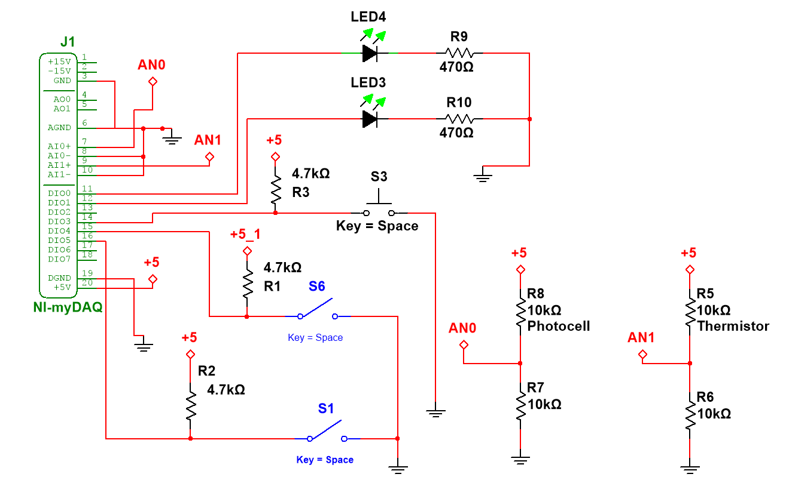
myDAQ Basic I/O Circuit:
This is a typical schematic using Multisim. The schematic shows all the components, component values and their connection to ground, the supply, other parts of the circuit or to the myDAQ interface device.
What is the voltage at AN0 when the photocell = 2.2k?
What is the voltage at AN1 when the thermistor = 7.1k?

Slide 8
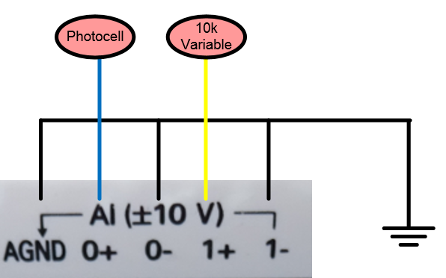
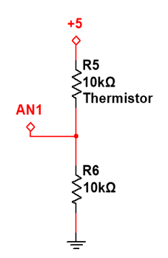
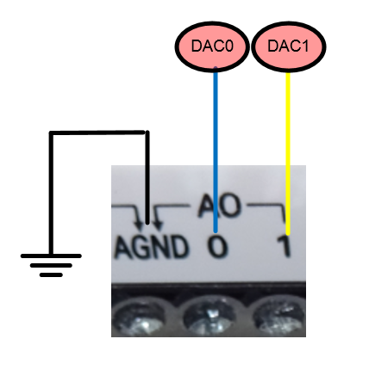
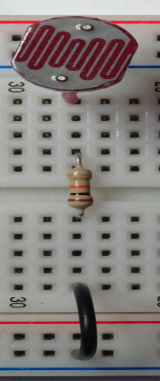
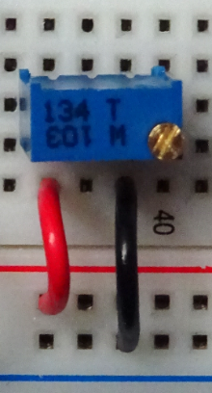
myDAQ Analog I/O Wiring
Voltage Divider
The AGND, 0- and 1- must connect to the ground of your circuit when measuring signals that are referenced to ground.
If the temperature is increased the thermistor resistance will ________ and the divider voltage will __________?
AIN0
A thermistor decreases resistance as it is heated and increases resistance when cooled. The thermistor used in the lab is:
10k at 25 degC.
8k at 30 degC
12.4k at 20 degC.
As the temperature increases the voltage to AN1 increases.
Photocell
A photocell increases resistance in darkness and decreases when exposed to daylight. They typically range from about 200 ohms to 100,000 ohms and are non linear. When the circuit is wired as above the AIN0 voltage decreases in darkness.
The 10k variable is used to provide a variable DC signal from 0 – 5 volts to the analog inputs. Connect the device so that turning it CW increases the voltage on the middle terminal.

Slide 9
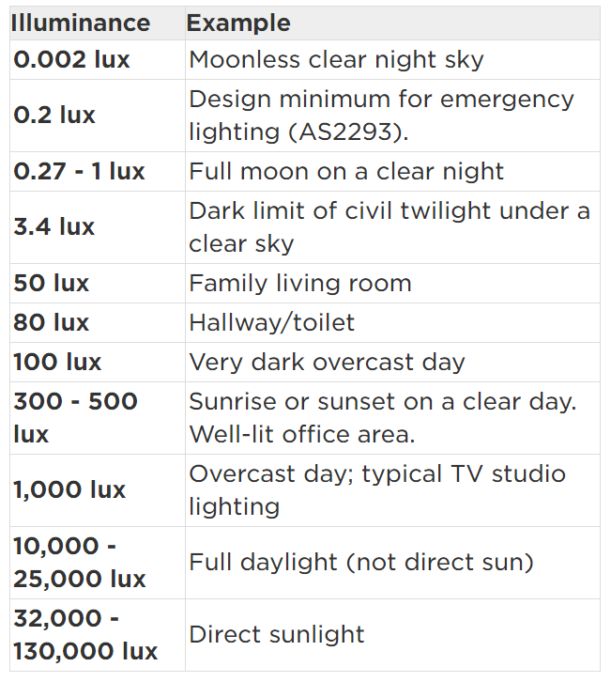
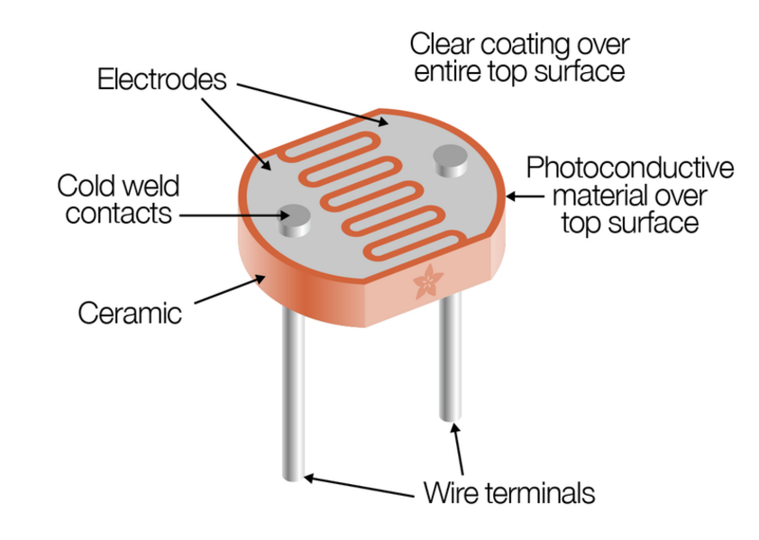
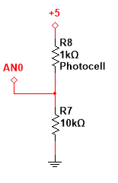
myDAQ/Arduino Sensors – Photocell
In a dark room the AN0 voltage will be about ______ volts?
The photocell resistance decreases with higher visible light and increases in darkness.
Placed in a voltage divider circuit, as shown, the output voltage will increase when exposed to brighter light levels.
(Wikipedia) Illuminance is a measure of how much luminous flux is spread over a given area. One can think of luminous flux (measured in lumens) as a measure of the total "amount" of visible light present, and the illuminance as a measure of the intensity of illumination on a surface. A given amount of light will illuminate a surface more dimly if it is spread over a larger area, so illuminance (lux) is inversely proportional to area when the luminous flux (lumens) is held constant.
200 k ohms dark room
2.0 k ohms office lighting
200 ohms - daylight

Slide 10
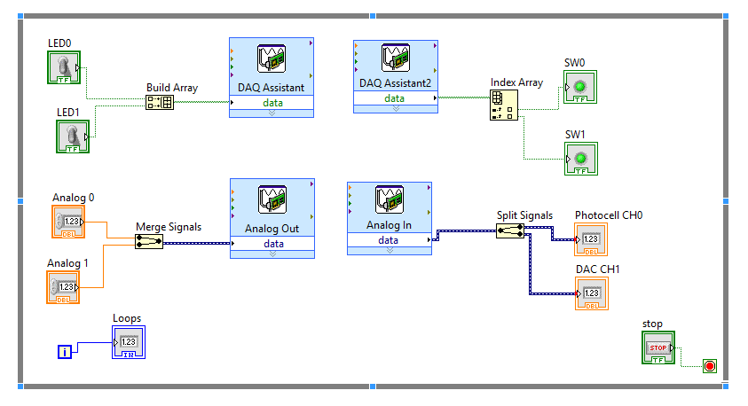
LabVIEW block diagram used to interface to the myDAQ.
F2018
The DAQ Assistant is a configurable function that is used to allow signals from the myDAQ interface to be controlled or monitored. There are 4 possibilities.
1) Digital In to read the digital signals. 2) Digital Out to control the logic levels on an output pin.
3) Analog In to read the voltage on an analog input pin.
4) Analog out to control the voltage on a pin.
Which DAQ assist is used to control a digital output?
A
B
Array
Array
C
D
Dynamic
Data
Type
Dynamic
Data
Type
DAQ
Assistant
Express VI
Which DAQ assist is used to read the analog input?

Slide 11
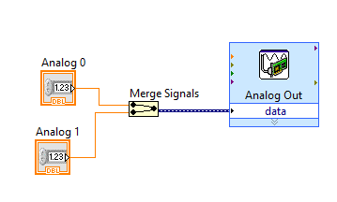
myDAQ Express Analog Output
F2018
The blue wire is a _______ data type?
The orange wire is a _______ data type?
The merge signal function inputs scalar numeric values and outputs dynamic data type. The dynamic data type is the input to the express VI.
The following is the VI (virtual instrument) or block diagram used to control the analog voltage to the myDAQ analog out terminals. The data into and out from the DAQ assistant for analog data is a Dynamic data type. The merge signals function can combine many scalar data values into one dynamic data type signal. The express VI reads the signals in sequence. The upper value will be applied to the first output signal.

Slide 12
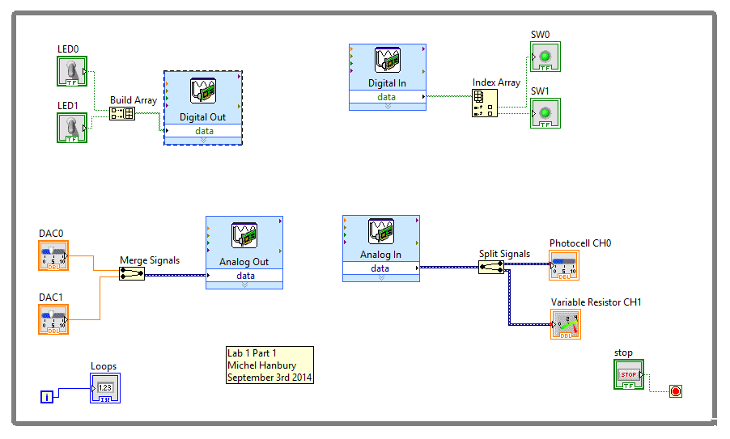
How many elements are in each array?
F2018
LabVIEW Block Diagram (Program)
The blue wires are __________ data type?
Boolean front panel(FP) indicators will display the digital state of the signals on a myDAQ digital input pin.
Boolean front panel(FP) controls will control the digital signal on a myDAQ output pin.
The green wires are __________ data type?
Numeric front panel(FP) controls will control the analog value of the signals on a myDAQ analog output pin.
Numeric front panel(FP) indicators will display the analog value of the signals on a myDAQ analog input pin.

Slide 13
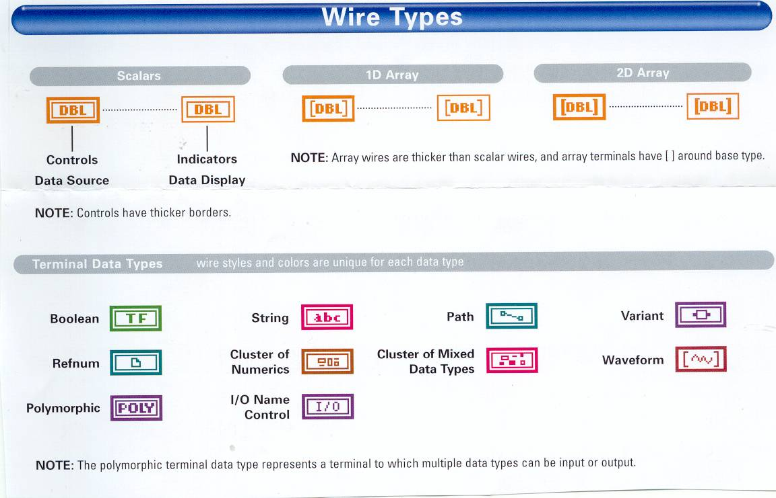
LabVIEW Wire Colours and Type:
What is the signed and unsigned range of a 8 bit integer?
What is the signed and unsigned range of a 16 bit integer?
What data type is each of the following colours.
Green?
Orange?
Blue?
Pink?

Slide 14
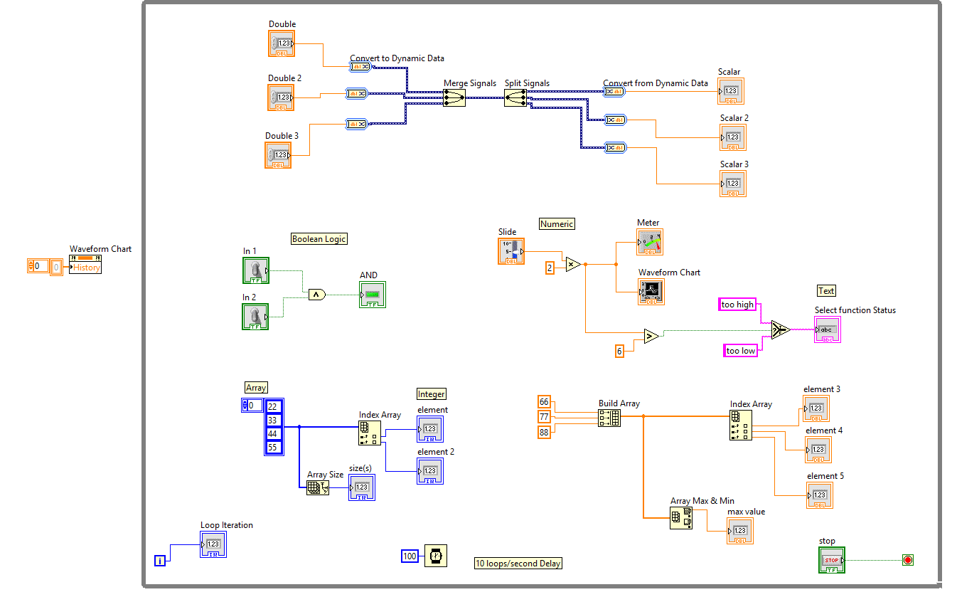
Block Diagram Example:
How many different variable types are shown in this block diagram? List each type.
Can the AND gate be used for both Boolean and Integer values?
Determine the value of: Max value, element2, element 4?

Slide 15
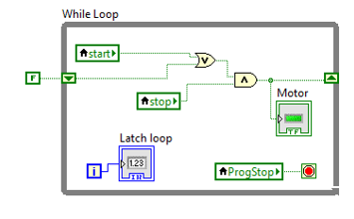
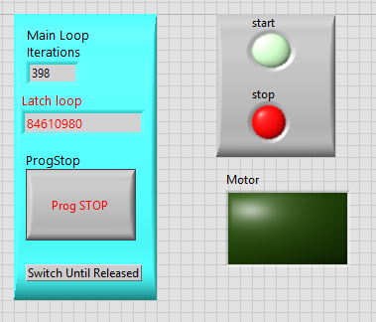
LabVIEW Shift Register Example
The up and down arrows on the edges of the While Loop indicate that a _______ _______ is being used.
Shift Register 2nd Example:
To create the shift register right click on the border of the while loop.
Select Add Shift Register.
The motor signal will go true when start is true and remain that way because of the shift register until stop is true. Take some time to understand the shift register, try it out in the lab.
The Boolean constant “F” is true only on the first iteration of the while loop.
The initial value of Motor equals _______?
The false constant is only applied on the first pass through the ___________?

Slide 16
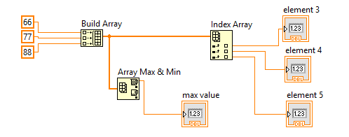
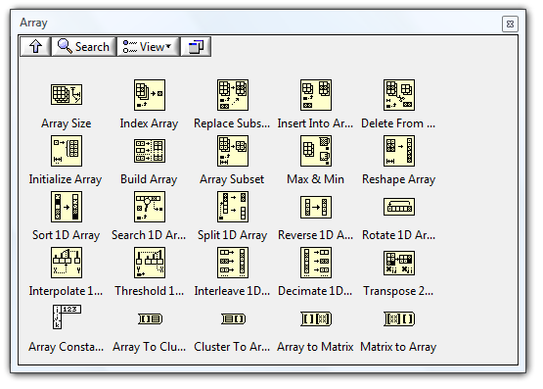






Arrays Functions:
There are array functions to:
Find the size of an array
Find the sum of an array.
Find the min and max value of an array.
Find the index of the min and max value.
Find the average of the array values.
What is the value of element 4? _______
Array
Size
Index Array
Build
Array
Array
Min/Max
Linear Interpolation
Array Constant

Slide 17
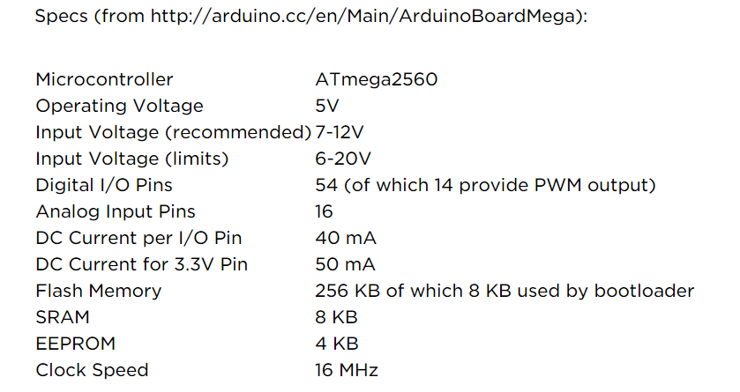
Arduino Mega Specs:
Each Arduino output pin can handle _____ mA?
Indicates amount of memory, I/O pins and basic voltage and current specs.
The A/D input voltage range is 0 to _____ volts.
The A/D number of bits equals _____?
10 bit (0-5 volts)
Flash – non volatile program storage. SRAM – variable storage.

Slide 18
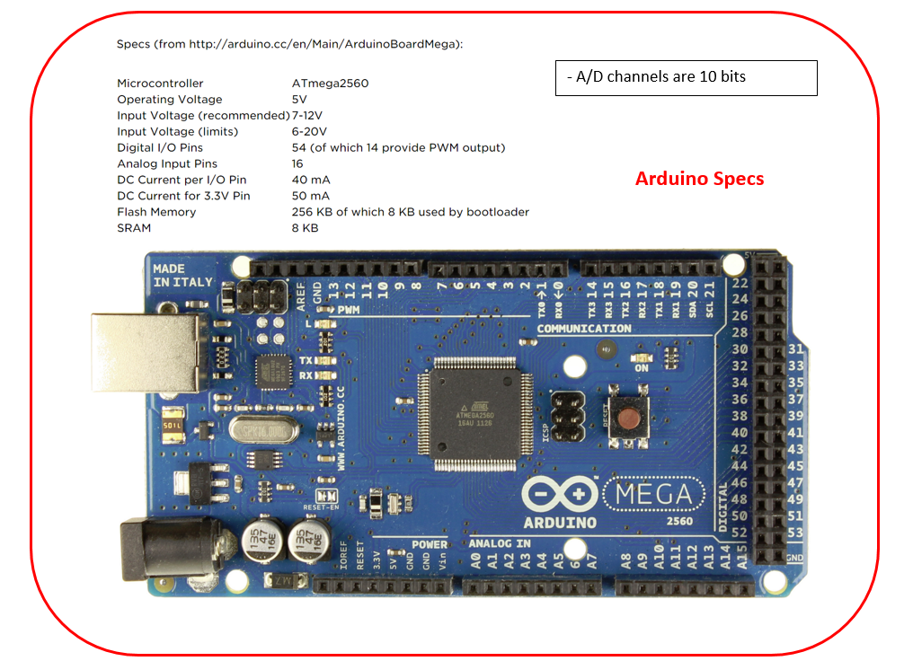
Identify which pin can be used for:
Connection to ground.
Connection to Vcc
Connect an analog signal.
Can produce PWM.
Can create a hardware interrupt

Slide 19
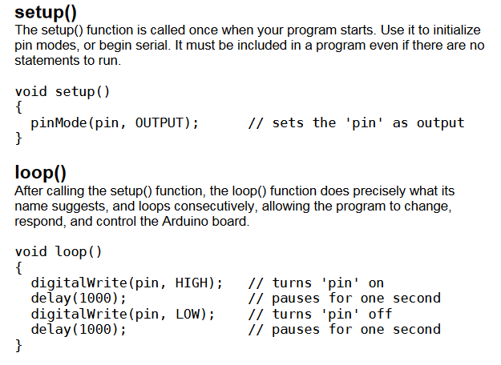
What is the frequency on the output pin?

Slide 20
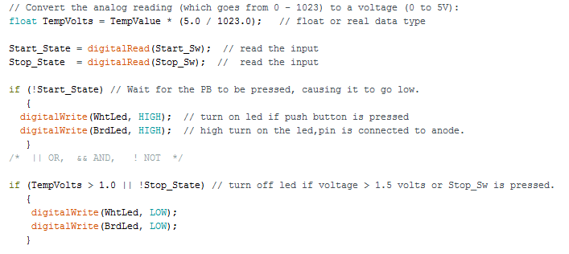
Does this program use polling or interrupts?

Slide 21
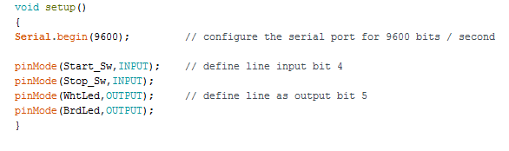
Code that is run only once
Other than bit rate what other parameters are required when specifying serial data parameters?
How long will is take to transmit one bit serially using a rate of 9600 bits per second?

Slide 22
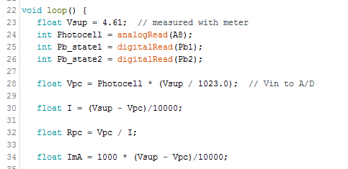
If Vpc = 3.7 volts then
Rpc = _______?
ImA = _______?
Calculations on data from photocell. The code converts the integer value from the A/D converter to a voltage and then to a resistance.

Slide 23
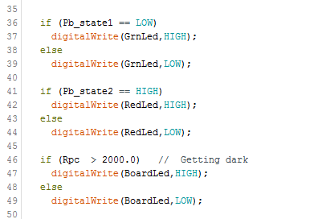
PB1 push button is normally HIGH using a pull up resistor. When the push button is pressed the pins short and a connection to ground is made.
Control output based on input conditions.
PB2 is normally LOW, a resistor is used to pull the signal to a low and a short on the pin ties it to +5.
What is the difference between a “==“ and “=“ in a program?
Pin 13 L on the board.

Slide 24
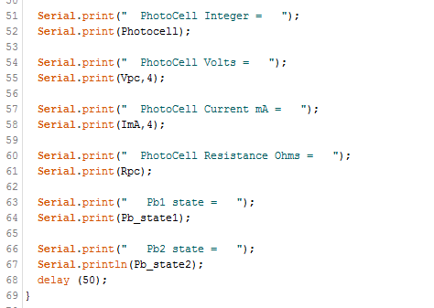


The Arduino Serial monitor can be used to output variable data to a computer screen.
The BPS (bits/second) baud rate must match the configuration in software. In this example the rate is 9600 bits per second.
Serial.println moves to the start of the next line, then prints.

Slide 25
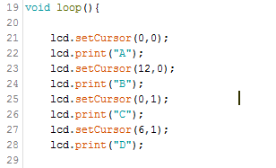
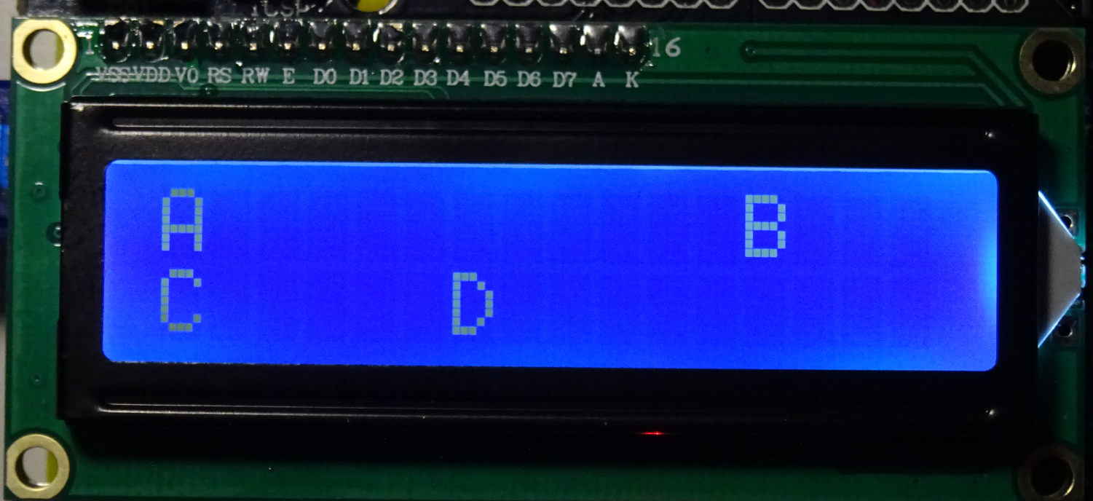
What is the position address of the most right column on the bottom row?
The LCD display is arranged as 2 rows and 16 columns. The numbering starts at 0 for the rows and columns. The first number represents the column the second the row.
The top left character is at 0,0.
For example 6,1 is the bottom row and the 7th position over.

Slide 26
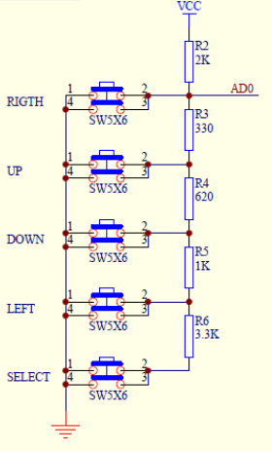
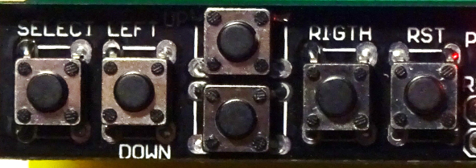
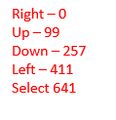
Arduino LCD / Shield Keypad
What is the voltage at AD0 when only the Left button is pressed?
302
3k Ω
331
330 Ω
The LCD display board also has a set of push button switches which are connected to a set of resistors used in a voltage divider. Pressing different switches will cause the voltage on Analog 0 (AD0) to change. The resistors shown are the actual values used on the board.
The numbers in red are values I found when testing my keypad. The range may vary by +/- 3.
681
680 Ω
102
1k Ω
302
3k Ω

Slide 27
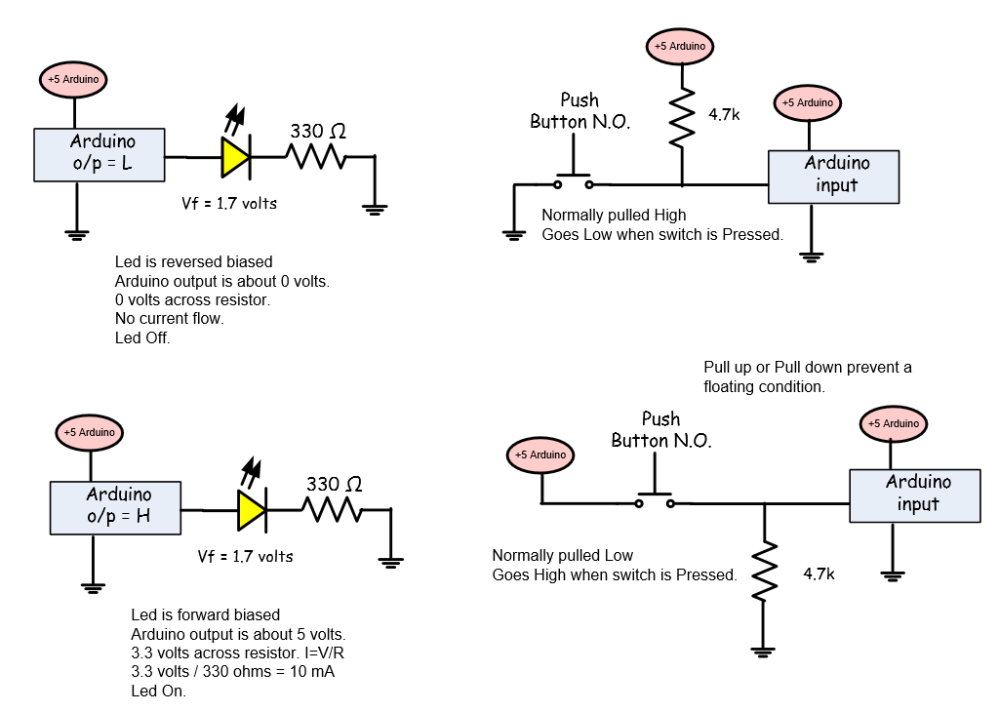
Why is a pull up resistor required in this circuit?
Why is the 330 ohm resistor required in the circuit?

Slide 28
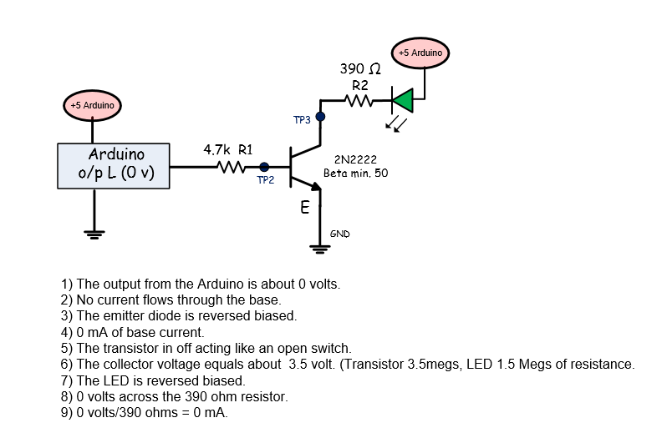
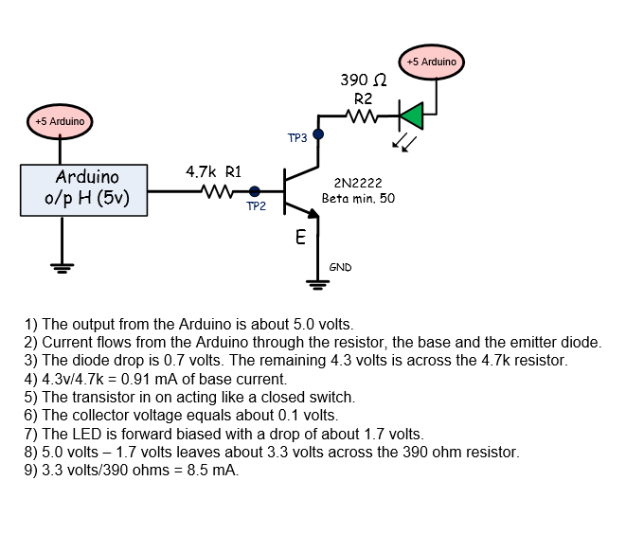
If the base resistor were changed to 3.3k the collector current would be greater? T/F
On
Off

Slide 29
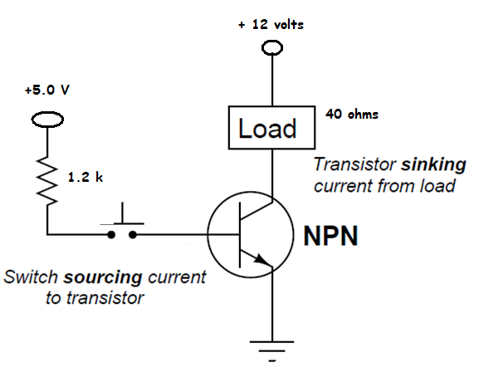
With a load of 40 ohms and a Beta = 75 the collector o/p current with a base current of 1.2 mA will be ______ mA?
NPN 2N2222 Transistor Switch – “ON”
Saturation – Transistor is turned on: The collector to emitter junction acts like a closed switch.
The base voltage must be greater than the emitter voltage by 0.8 volts.
The transistor has a gain of about 75.
Example: If the base current equals 3.5 mA and the gain = 75 mA the transistor will allow up to 263 mA of current to flow.
Transistors can only handle a certain amount of collector current specified in the data sheets.
The CE junction does not act like a perfect switch and may have a voltage across the CE junction of about 0.2 volts.
6.3 volts
153 mA
6.11 volts
3.5 mA
4.2 v
closed
0.8 v
CE = 0.2 v
Current Gain:
Ic/Ib
Minimum of 75 for 2N2222

Slide 30
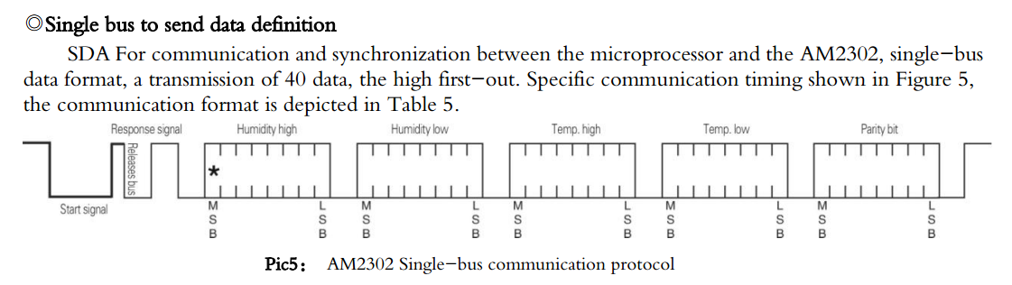
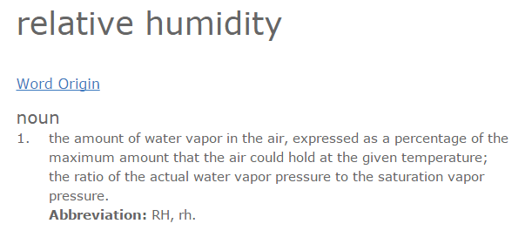
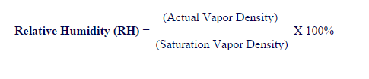
DHT22 Digital Temperature and Humidity Sensor (Serial Data Output)
The last byte is used for _______ checking?
The DHT22 temperature and humidity sensor sends a digital pattern to the Arduino representing % relative humidity and temperature in degrees Celsius .
The first 16 bits transmitted represent the humidity, the second 16 the temperature and the last 8 bits are a checksum to verify the data.

Slide 31
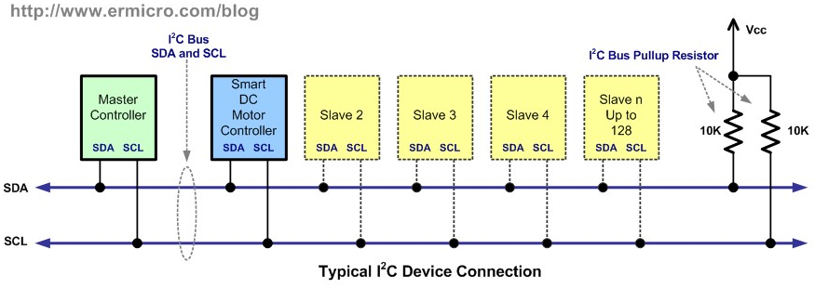
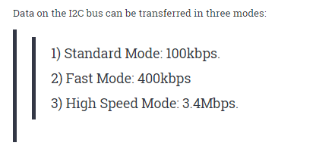
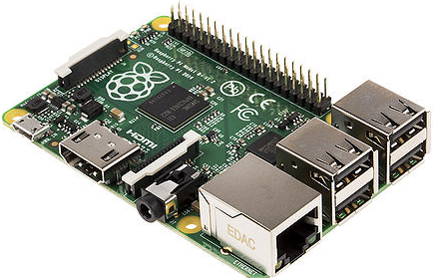

Only 2 device can be connected at once to the I2C bus? T/F
The I2C bus transmits data faster than the asynchronous serial I/O? T/F
The I2C uses Vcc, ground and 2 signal wires.
SDA – serial data
SCL – serial clock.
The bus is used to connect many devices to the I2C signals on the Arduino or other controllers such as a Raspberry PI low cost computer.

Slide 32
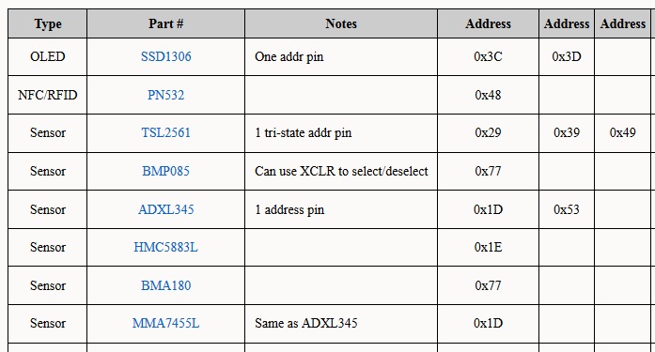

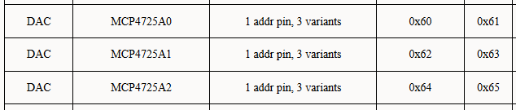
Each I2C device has a specific 7 bit address to select the I2C device.
In the lab three I2C devices will be used.
A MCP4725 12 bit DAC.
An ADXL345 Accelerometer.
A DS3231 real time clock.
There are many I2C devices that can be connected to the Arduino.
Displays, pressure and temperature sensors, etc.

Slide 33
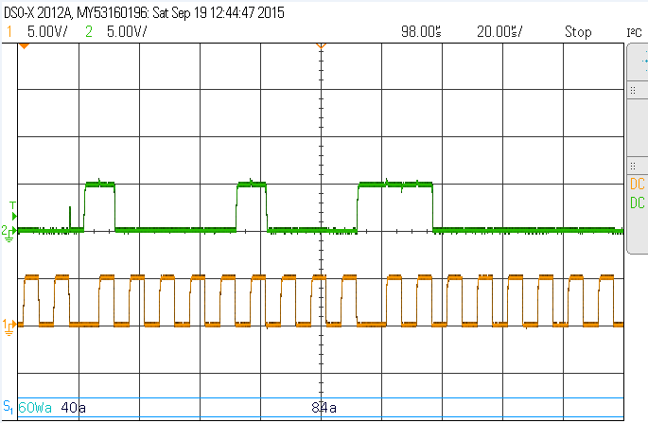
MCP4725 12 bit DAC Waveform
MCP4725 I2C DAC
Data = FFF
FFF/FFF * 5.0 volts
= 5.0
Data rate = 100,000 bps.
10 us / bit
D7
D6
D5
D4
D3
D2
D1
D0
Ack
Based on this scope screen capture; determine the approximate clock frequency.
Note: Horiz time ref = 20 us/div.
msb
1
0
0
0
0
1
0
0
ack

Slide 34



MCP4725 12 bit DAC (Arduino sketch)
MCP4725 I2C DAC
Data = 0x7AD
First 12 bits of the two byte number
= 1965 decimal
1965/4096
= 0.4797
0.4797 * 5.0 volts
= 2.4 volts.
The DAC uses ______ bits?
If the 7A in the data changed to 4D the o/p voltage would equal?
The DAC I2C address equals?

Slide 35

American Standard Code for Information Interchange
What is the ASCII code for the number “5” and the uppercase letter “j”?
The ASCII table shows the standard code used to transfer characters.
Examples: “1” = 0x31, “A” = 0x41 “U” = 0x55 or 01010101 in binary

Slide 36


An RS-232 serial connector has 9 pins. At least 3 pins are required to transmit and receive data
At TTL level the data begins with a low start bit, 8 data bits and a high stop bit.
To transmit at greater distance RS-232 levels are used. Typical values are +/- 12 volts.
Do RS-232 levels go to a negative voltage?
If the logic level of the TXD signal is 5.0 volts the RS-232 level equals _____ volts.

Slide 37


To convert from TTL levels to RS-232 levels it is common to use a level translator called a MAX232. This chip is manufactured by MAXIM.
The chip converts a logic high (5 volts) to (-12 volts)
A logic low (0 volts) is converted to (+12 volts DC)
The TX0 signal on the Arduino is at ______ levels. A______________ is required when interfacing to RS-232 levels.

Slide 38





At 19200 bits per second it will take _______ seconds to transmit 1000 bytes using 8 data,1 stop and no parity?
A typical USB to RS-232 converter.
Standard asynchronous serial bit rates.
Putty is a common (free) serial terminal program for a PC or MAC computer. It can be used to receive and transmit serial data from the Arduino or myDAQ to a PC or MAC.

Slide 39


Pin 2
Digital Output
Pin 4
Digital input
Arduino I/O setup

Slide 40




DHT Library
22,DHT22
Serial Port
Viewer
Baud must match setting
in your program.
Library Functions
Sensor Pin (22)

Slide 41



Thermistor Data and Conversion
If the input to the expression is 2.9 volts, the output of the expression equals ______. The temperature equals _______ degrees Celsius?

Slide 42



Moving Average Filter
Dynamic Data Type
A filter is useful when the input signal is noisy? T/F.
Express VI, Double Click to Configure

Slide 43


Know the value of each test point when the lamp is on and off.
myDAQ o/p goes low, inverter o/p goes to about 4.7 volts.
With inverter output high the isolator IR led is off. The isolator transistor turns off.
The isolator transistor is open circuit and in a high impedance state, the pull up resistor provides 6.3 volts to the gate of the MOSFET turning it ON.
The resistance between drain and source is about 0.1 ohms providing a ground path to the lamp to turn it ON.

Slide 44

myDAQ o/p is high, inverter o/p goes low, about 0.2 volts.
With the inverter output low the isolator IR led is on. The isolator transistor also turns on.
The isolator transistor acts as a closed switch grounding the gate of the MOSFET turning it OFF.
The resistance between drain and source is infinite (off), with an open circuit the lamp turns OFF.

Slide 45

Direction Detection Using Encoder
If pin 2 is high and the clock goes through a rising edge /Q1 would be a logic _______?

Slide 46

Why are pull-up resistors required?
What is a common pull-up value range?

Slide 47


Compound Gears and Drive Trains
To convert from RPS to RPM you must multiply by _____?
The gear set to the left is from the motor used in the lab. At 12 VDC the output shaft rotates at 103 RPM with a maximum torque of 0.127 Nm. The motor has a gear ratio of 30:1 If the output shaft is turning at 103 RPMs the motor is rotating at 3090 RPM or 51.5 RPS. The hall sensors will produce pulses at a rate of 154.5 Hz.

Slide 48


DC Motor Control H-Bridge
L293, L298 H-Bridge Operation:
A group of four transistors (MOSFETS) are used to control the direction of a DC motor. The circuit reverses which pins on the motor receive the positive and negative signals. Logic is built into the driver IC to prevent a short circuit.
Motor braking occurs when both sides of the motor have the ____ voltage applied?

Slide 49


Motor Controller Function Table
Motor braking only occurs when EN is a logic ____________ and IN1 and IN2 are at the ______ logic level?
The three control pins determine the motor direction, clockwise or counter-clockwise. The control signals also control whether the motor brakes or free runs to a stop. If the motor control IC is enabled and both inputs are at the same level the motor will stop quickly(brake). If the IC is disabled the motor free runs to a stop.

Slide 50

myDAQ Motor Speed
LabVIEW Front Panel
If the motor supply is reduced the period of the encoder signal would _________?

Slide 51


L293 Control Signals
This section of the VI controls the direction of the motor and enables and disables the driver.
The signals connect to IN1 and IN2 on the L293 motor controller.

Slide 52

Block Diagram
2
6
Encoder 3 pulses/rotation
Select
3
Change to RPM
Gear Ratio
4
Read Direction from 74HC74
If true CW
If false CCW
1
5
Read Frequency
The output of the DAQmxRead.vi is the ______________________?

Slide 53


Mechanical Switch Debouncing
How long will it take to fully charge the capacitor when the switch is opened?
When the PB is pressed and then released a ___________ edge is created at the HC14 ouptut?
RC time constant = 2.2 ms.
RC = 4.7k x 0.47 uF.

Slide 54


Schmitt Trigger Operation
When de-bouncing or wave shaping an HC14 Schmitt trigger inverter must be used.
An HC14 has ___
switching points and ______ and a _______?
HC04 (bad)
Multiple edges.
HC14 (good)
Single edges.
The Schmitt trigger converts the noisy or slow changing signals to vertical single edges.

Slide 55

Slotted Optical Switch
Most optical sensors use _____ leds?

Slide 56


Slotted Optical Switch
When the slot is blocked and then unblocked a _____ edge is created?

Slide 57




Optical Switch Conditioning Using a Schmitt Trigger Inverter
An optical switch is used to count the number of times an object passes through the slot of the switch. An HC14 Schmitt trigger is used to reduce signal noise, to obtain an accurate count.
Is the IR LED always ON?
Yes/No

Slide 58

DAQ Assistant Pulse Out
Pulse output can be configured to produce a time low or time high of any given value. The pulse out can be used to PWM (pulse width modulate ) loads such as heater motors and lamps.
The output signal is created on terminal DIO3.
The signals or LVTTL.
This configuration will produce a signal with a frequency of ______ ms. and it will last for _____ second.
The %DC = _____

Slide 59



DAQ Assistant Pulse Out
Volts/div = 2, time/div = 5 ms (myDAQ scope)
Frequency is 66.7 Hz.
Time high = 10 ms
Time Low = 5 ms.

Slide 60


TLC555 CMOS Astable Timer
Using the given values determine:
Period
Frequency
Time high
Time low
% duty cycle
The capacitor charges through RA + RB and discharges through RB only.

Slide 61



Direction Detection Using Encoder
Rotating magnet creates pulses.
Hall effect sensors are separated by 90 degrees. The two pulses create 4 edges. (quadrature o/p)
30 to 1 gear reduction. Lower speed but greater torque.
Changing the gear ratio to 40:1 would decrease the _____________?

Slide 62

74HC74 – D-Type Flip Flop
One phase of the encoder will attach to the clock input the other phase to the data input.
This device changes the output on a rising edge of the clock?
T/F?
When turning in one direction the data will be low when the clock goes through a rising edge.
In the opposite direction the data will be high when the clock goes through a positive edge,

Slide 63

Brushless motors are more _________ than brushed motors.

Slide 64

Bipolar/Unipolar stepper motors.
Unipolar stepper motors require a simpler drive circuit, bipolar stepper motors have higher torque capabilities.
Unipolar – current flow in only one direction
Bipolar – current flow in two directions
Bipolar motors always have _____ wires. Unipolar motors can have ______ or ______?

Slide 65

For Loop – Used in Stepper Program
The statement in this loop is executed ______ times?

Slide 66

Unipolar to Bipolar Stepper Modification Motor
Assume a bipolar motor.
With a 10 volts supply and two coils energized the power supply will draw ______ mA while the motor is stopped.
While the motor is turning the current will ________.

Slide 67


Bipolar DC Stepper Motor Controller
Yellow
Orange
Blue
Arduino
Violet
Wired as shown the motor turns clockwise.
If the violet and blue wires are switched the motor will turn in a ______ direction?

Slide 68

The frequency of the coil signal is ______ less than the step signal?
The top signal is measuring one of the outputs from the stepper motor. The bottom trace is the step signal. The signal is from the stepper control.
The frequency of the step signal is ______ more than the coil signal?
The stepper motor advance by its step angle on the _______ edge of the step signal?
If the step frequency = 4 kHz the coil frequency will equal ________ kHz?

Slide 69


How long with this motor turn before changing direction?
How many revolutions are made in each direction?
Assume a bipolar stepper with a step angle of 7.5 degrees/step?

Slide 70


The scope is triggered on channel ____?
The scope is triggered on a _______ edge?
The scope is triggered at the ____ horizontal position?
Channel 1 vertical position = _____ and the ground is _____ division higher than the base?
The trigger level = ___ volts.
The two traces above are measuring the signal on the driver outputs connected to the yellow wire and the blue wire.
The two signals are 90 degrees out of phase. When the motor is turning in one direction the signal is leading by 90 degrees, in the opposite direction the signal is lagging by 90 degrees to the other coil.

Slide 71

If the motor is turning at 150 RPM the period of the hall effect sensor o/p will equal _____?
The Hall Effect sensor, and the magnet were added to measure the RPMs of the stepper motor. The magnet has three N/S poles that generate three pulses per revolution.

Slide 72

The motor takes 480 ms. per revolution, 1/480 ms. = 2.08 revolutions per second or about 120 RPM.
What is the voltage level of the step signal and the coil signal with respect to ground?

Slide 73

Servo hardware configuration.
The period of the servo motor PWM control signal = ____ ms.
The position of the shaft is changed by altering the time _____ of the PWM signal from 1 to 2 ms.
Servo Motor Connections to Arduino: Connect the power for the servo to a 4.5 to 6.5 volt battery or DC power supply. The signal controlling the servo motor shaft position is controlled using an Arduino PWM output.

Slide 74


At 1.5 ms. high the servo output shaft is in the ______ position?

Slide 75

Servo Motor test program.
If A/D 0 = 2.1 volts then Analog_In = _______ and Servo_Angle = ______?

Slide 76



Servo motor at the middle neutral position. This is normally about 1.5 milliseconds.
This screen captures shows a time high of ~1.5 ms.
Program Output
The analog input voltage equals?

Slide 77

This level converter converts _____ to ______ levels and vice versa.
When interfacing the accelerometer to the Arduino a 3.3 volt to TTL level converter is required. This board converts 3.3 levels to TTL and vice versa.

Slide 78


Interrupts vs Polling
A rising edge on pin 2 will execute the slow() routine?
T/F?
Interrupts can be configured for rising or falling edges?
T/F?
Lines 21-24 configure the interrupt. The program is telling the Arduino that when a rising edge occurs on pin 2 (interrupt 0) then stop what the program is currently doing, execute the “slow” routine then return to where it was before the interrupt.

Slide 79


Inside a Solid State Relay (OAC5) Black
A triac has ____ terminals?
The output is ____________ isolated from the input?
The snubber is used to ________ the internal circuit.
The solid state relay includes opto-isolation, a zero crossing detector, a triac and a snubber circuit to suppress transients from inductive loads.

Slide 80


Circuit is required in lab 8.
The ULN2003A drivers is added to the digital output on the myDAQ. The specifications for the myDAQ indicate a maximum current of 4 mA. The SSR has a load of about 15 mA when active.
The ULN2003A inputs draw less then 1 mA when controlling the SSR.
What is the voltage on pin 10 when pin 7 is 3.3 volts?
Could this SSR handle a 200 watt lamp at 120 volts? How much current would flow through the SSR?

Slide 81


OAC5 – Controls an AC signal using logic levels. Current flowing through the LED energized a photo transistor. A triac is energized using a zero voltage detection circuit. The zero detection circuits used to energize the device only while the current is low, this helps to reduce spikes when turning the device on or off.
This is the most common type of SSR? T/F?
Why is the transistor required on the Arduino?

Slide 82


IAC5 – Measures an AC input voltage and converts it to a logic level. The AC is converted to DC using a bridge rectifier. The DC current activates an led which then turns on an LED and transistor causing the logic level to change.
What is the purpose of the bridge rectifier?

Slide 83


IDC5 – Measures an DC input voltage and converts it to a logic level.
This device can be used to interface an Arduino input to a PLC output? T/F
How much power is dissipated by the load when the supply is 24 volts and the load is 40 ohms?

Slide 84


ODC5 – Controls A DC voltage using logic levels.
This device can be used to interface an Arduino output to a PLC input? T/F
When are diodes required at the output?

Slide 85


Transducer Specs
A transducer converts one signal form to another.
Examples:
Resistance to voltage: 0-100 ohms to 0- 10 volts.
Voltage to current: 0-10 to 4-20 mA.
Current to Voltage: 4 to 20 mA to 0 to 5 volts.
What power supply voltage is required for this device?
List 5 common instrumentation signals ranges?

Slide 86


A set of jumpers are used to select the input and output signal range. Examples:
0-20 mA
4-20 mA
0 – 10 VDC
2-10 VDC
0-5 VDC
1-5 VDC
Circle the setting to select an input of 4-20 mA and an output of 2-10 volts?

Slide 87



Omega T/C Transducer
This converter is powered by
24 VDC.
The input can be a type “K”, “T” or “J” thermocouple selected using jumpers.
The device includes cold junction compensation.
The output is jumper selectable for 4 to 20 mA or 0 to 10 volts.
The device is calibrated using zero and span adjustments.
The _____ wire on a thermocouple is the negative signal?

Slide 88


The Darlington pair transistor has a very _________ Beta?
When using inductive loads pin 9 must connect to the _______ ?

Slide 89

When turned on the voltage between the CE junction is very ________?

Slide 90

Triacs have ______ leads and usually control an ______ load?

Slide 91

http://www.electronics-tutorials.ws/
The MOSFET source connects to __________?
To “turn ON” the MOSFET the gate voltage must be _________ than the trigger voltage?
The MOSFET on resistance is very ________ the off resistance is very _________?

Slide 92

http://www.electronics-tutorials.ws/
F2018
A stepper motor with a step angle of 1.8 degrees per step has _____ steps per revolution?
A stepper motor has 48 steps per revolution, each step angle equals ______ degrees.
A 1.8 degrees/step stepper motor is operated using 1/32 micro stepping. How long will it take to rotate one revolution a 30 us/step? _____________

Slide 93

http://www.electronics-tutorials.ws/
What is the typical period of the PWM signal of a typical servo motor? _________ ms.
What is difference between an incremental optical encoder and an absolute optical encoder?
Which encoder type is used in the DC motors used in the lab? _____
Which type is used in industrial robots? ____________

Slide 94



http://www.electronics-tutorials.ws/
Brushless motors usually last _________ because they have no _____________?
ESC – Electronic Speed Control (PWM)

Slide 95


Calculate the period, frequency, % duty cycle, time high and time low of the 555 timer above.

Slide 96

Yellow Coil
Step signal DRV8825
** Assume the motor is 7.5 degrees/step.
The scope trigger level should be set to about ______________ in this example?
What is the speed of the stepper motor in RPS?
The scope is triggered on a rising edge T/F?

Slide 97

List two ways the motor direction can be changed, one software and one hardware?

Slide 98

Unipolar Motor 120 ohms between the centre tap wire and an outside lead. White1 to blue = 120 ohms.
Bipolar stepper motor – this is the modified stepper the centre tap white wires were cut. The bipolar motor can be used with the DRV8825 bipolar motor and will have a greater maximum torque.
How much current flows through white and violet with a 10 volt supply to the stepper controller?
How much current flows through blue and violet with a 10 volt supply to the motor controller?

Slide 99


Brushless DC Motor (BLDC)
If the time high of the feedback signal is 40 microseconds the TH variable will equal ______?
Moving the variable resistor clockwise will cause the motor to _________ in speed?

Slide 100

If the encoder frequency equals 1000 Hertz the output shaft RPM equals ______?
The gears are used in this application to ___________ the _________ on the output shaft?

Slide 101
If the analog input equals 3.0 volts, the PWM variable will equal ____________?

Slide 102

F2018
This is a screen capture from lab 6. Which trace is the PWM signal, which trace is the encoder signal?
The encoder signal is from one of the two channels from the DC motor. The motor produces 3 encoder pulses for each revolution of the DC motor. The motor has a gear ratio of 30:1.
How fast is the output shaft turning in RPMs ________?

Slide 103
F2018
This is a screen capture from lab 6. One trace is the PWM signal the other is the motor encoder signal.
Which trace is would you measure to determine motor speed PWM or encoder signal?
Explain why?
Is the PWM signal synchronized with the encoder signal?
If the duty cycle of the PWM signal is increased the period of the encoder signal will _______?

Slide 104

F2018
Based on the information in the screen capture the DC brushless motor is turning at _______ RPM.
Based on the information in the screen capture the PWM signal has a duty cycle of ______% and a frequency of _____ Hz.

Slide 105

Absolute Encoder
What is the benefit of using an absolute encoder compared to an incremental encoder?
The absolute encoder knows the current position on startup of the system. The encoder uses a pattern on the rotating disk and optics to determine position. A quadrature encoder is an incremental encoder.

Slide 106
Servo hardware configuration.
What is the typical period of a servo motor control signal?
The time high of the control signal is about _____ ms when the servo is in the centre position.
Servo Motor Connections to Arduino: Connect the power for the servo to a 4.5 to 6.5 volt battery or DC power supply. The signal controlling the servo motor shaft position is controlled using an Arduino PWM output.

Slide 107

F2018
Analog_In = 1023
Servo_Angle = 149
Based on the information in the screen capture the Servo Motor will rotate about ________ from the full CCW position.
Based on the information in the screen capture the Servo Motor control signal will have a PWM duty cycle of ______% and a period of ________Hz.

Slide 108


Determine the Arduino integer value when the temperature equals 20 degC.
Determine the Arduino integer value when the temperature equals 30 degC.

Slide 109

When the electronic switch is energized the PLC input equals _______ volts?

Slide 110

Approximately how much current flows through the output of the PLC?

Slide 111

Complete the circuit sections that are greyed out.

Slide 112

Inductive Sensor
If the target is detected the Arduino input will equal a logic _________?

Slide 113

When is it required to connect pin 9 of the ULN2003A to the supply voltage.

Slide 114

Type “K” (yellow) Thermocouple
If the CJ is at 22 degC and the HJ is 40 degC the T/C voltage equals _____ mV?
About 40 uVolts /degree Celsius Type K

Slide 115



AD623 Instrumentation Amplifier
The AD623 is an instrumentation amplifier. The gain of the amplifier is easily configured using one resistor. An output offset can also be easily added with a reference input pin. The device can be used to amplify signals from load cells, pressure sensors and thermocouple. The device has rail to rail output meaning the output signal can go from min supply to maximum supply.
If the gain resistor equals 1.8k the gain equals ______?

Slide 116

Determine the gain of the AD623 instrumentation amplifier when using a 470 ohm resistor?
If the CJ = 22 degC and the HJ is 39 degC the output of the amplifier equals ______ volts. Answer to +/- 2mV.
If the resistance from the wiper to ground equals 4k, the reference voltage equals _____ volts.

Slide 117

What is the value of the gain resistor?
What is gain value?
What is the purpose of the variable resistor?

Slide 118

Which IC and pin is used to determine the motor speed? _________
Which IC and pin control the motor speed? _______

Slide 119

Interrupt Program for Stepper
What are the two benefits of interrupts over polling? _________________ , __________________

Slide 120

Quadrature Encoding
This signal will be equal to a logic ________ after the motor has turned ______ revolutions.
** Assume the default front panel.
After turning 2 revolutions the “Encoder Pulses since start” will equal______?

