Slide 1

Week 13, 2018 Notes:
Instrumentation Op-Amps and
Solid State Relays, Drivers and
Interface Circuits
CAM8302E Fall 2018

Slide 2
Final Week: (Total 49 slides):
3-11: Level Converts PLC < - - - -> Logic
12-14: ULN2003A Driver Circuits
15-37: Solid State Devices – Information and interface circuits
38-43: AD623 Instrumentation Amplifier and Interfacing to the myDAQ
44-49: Transducers

Slide 3
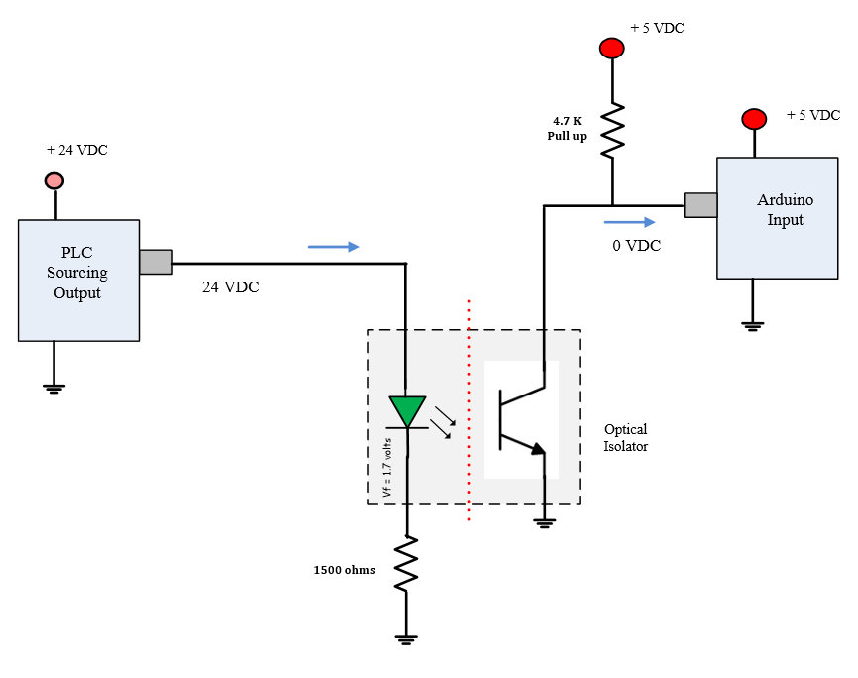
Converting PLC levels to logic levels.
When PLC output equals 24VDC Arduino input equals a logic low.
When PLC output equals 0 volts Arduino input equals 5 volts.
O/C
~15 mA
Level Conversion PLC -- Arduino

Slide 4
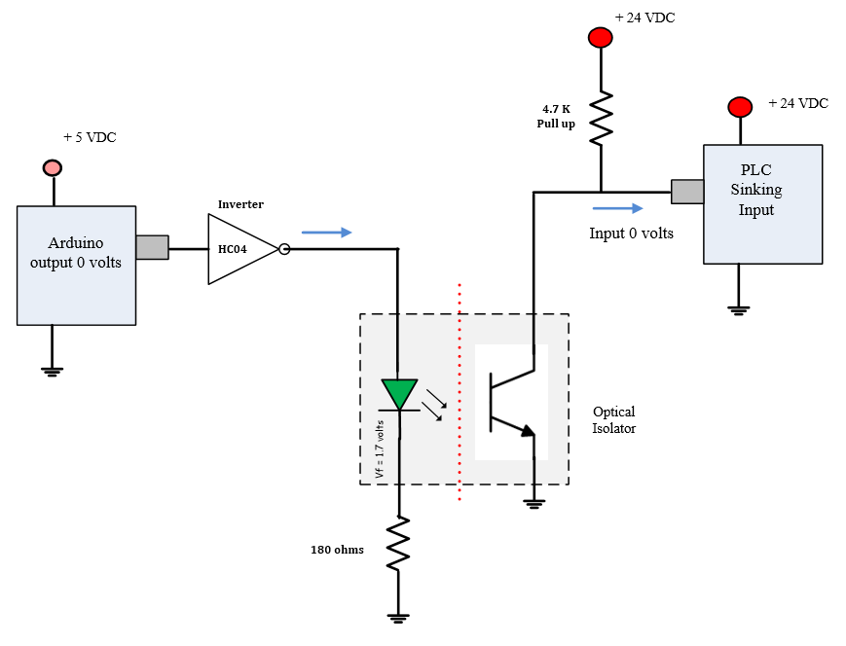
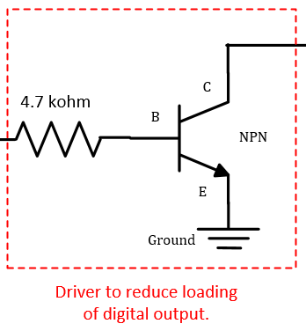
Converting Arduino output levels to PLC input levels.
When Arduino output equals 0.0 VDC PLC input input equals 0 volts DC.
When Arduino output equals 5 volts PLC input equals 24 VDCs.
O/C
Driver
Level Conversion Arduino ---- Arduino
~18 mA

Slide 5
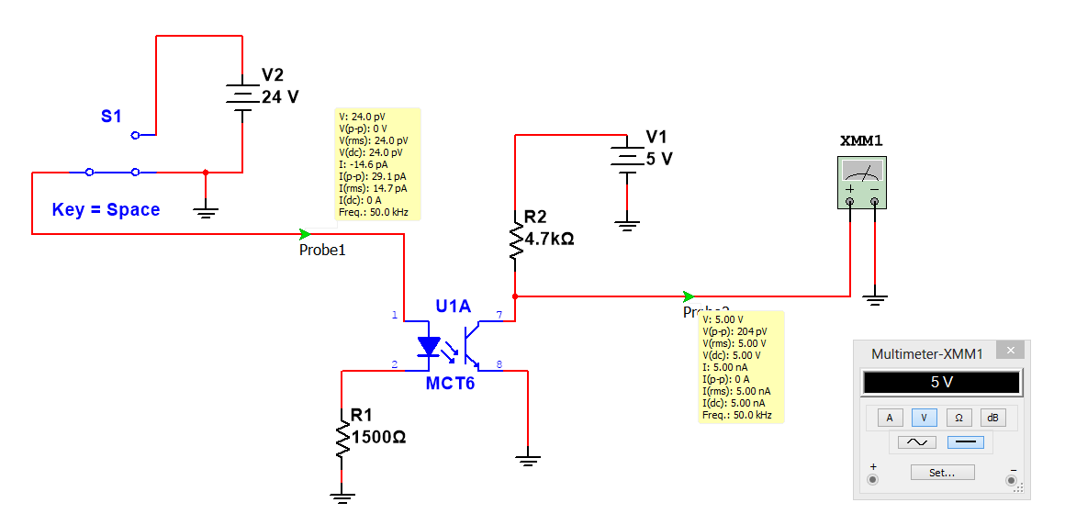
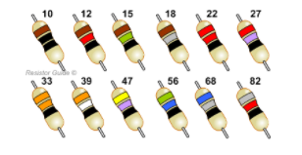
Level Conversion (PLC to Logic) – Optical Isolation
A PLC signal low. The IR led is off, the transistor is off (open), the pull up resistor provides a logic high of about 5 volts (you could also use 3.3 volts). The IR led must have a current flow between 7 to 15 mA when ON.
PLC Low
Logic High
When interfacing a PLC to logic devices such as the Arduino or myDAQ an optical coupler can be used to convert one logic level to another. The opto coupler isolates one device from the other.

Slide 6
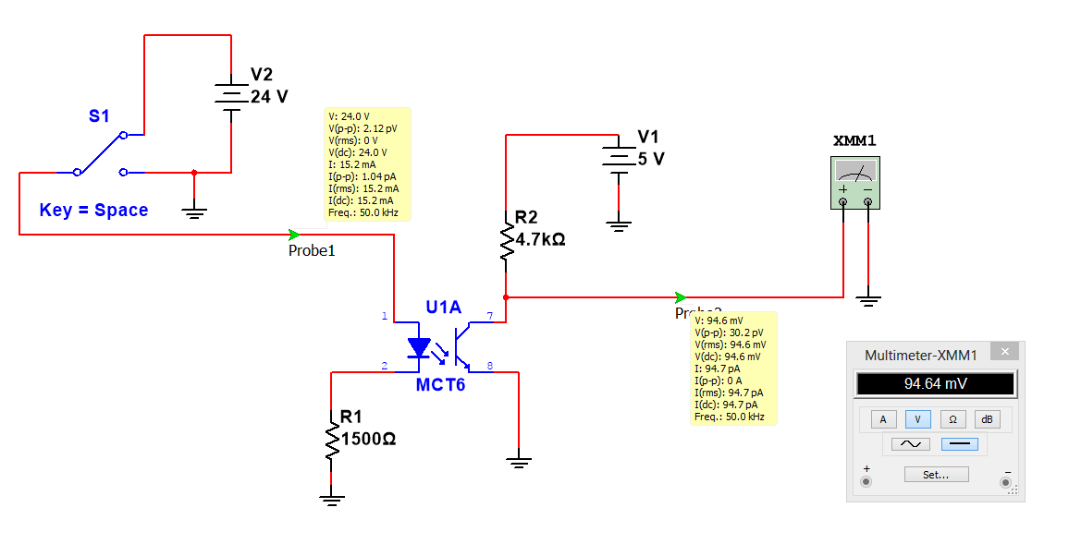
Level Conversion (PLC to Logic) – Optical Isolation
A PLC signal high (24 VDC). The IR led is on (current flows through the IR LED), the transistor is on (the cathode is about 0 volts), the signal is a logic low. The 4.7k resistor has a current flow of about 1 mA.
PLC High to logic Low
PLC High
Logic Low
The yellow boxes show the Multisim simulation results at each point with the switch connected to +24 VDC.

Slide 7
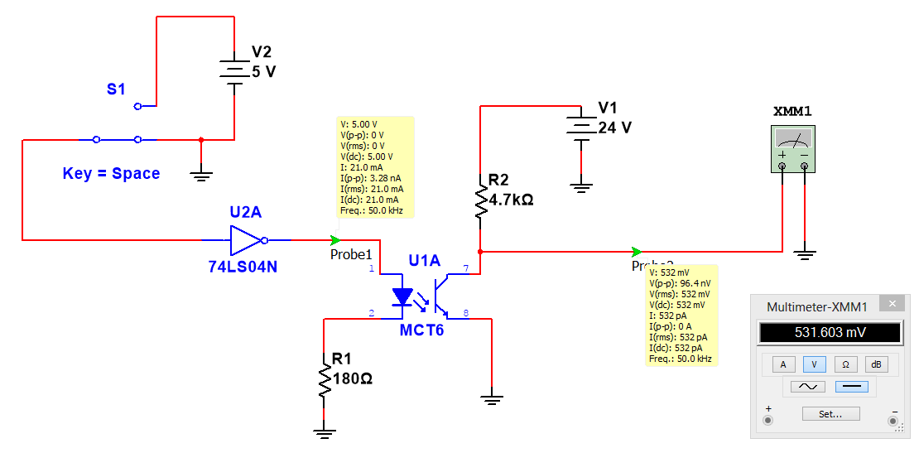
Level Conversion (Logic to PLC) – Optical Isolation
A Logic low signal is applied to the inverter, the inverter output is high, the IR led is on, the transistor acts like a closed switch, the collector provides a PLC low level.
Logic Low to PLC Low
Logic Low
PLC Low

Slide 8
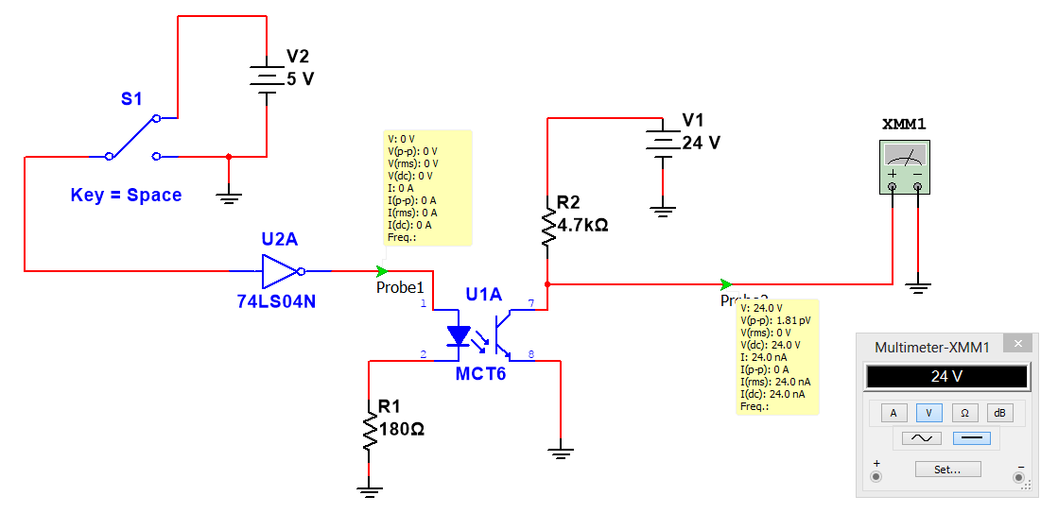
Level Conversion(Logic to PLC) – Optical Isolation
A Logic high signal is applied to the inverter, the inverter output is low, the IR led is off, the transistor acts like a open switch, the pull up resistor provides a PLC high level (24 VDC).
Logic High to PLC high
Logic High
PLC 24

Slide 9
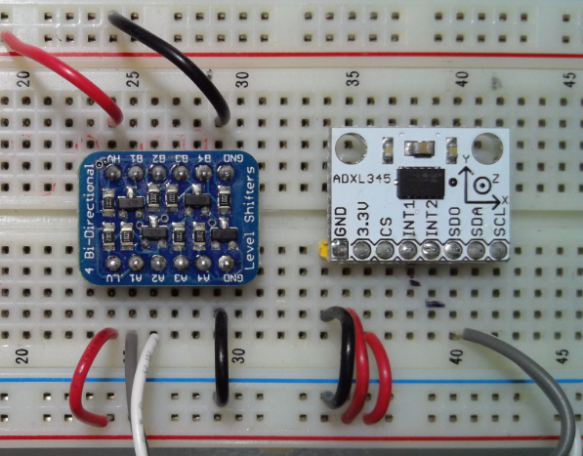
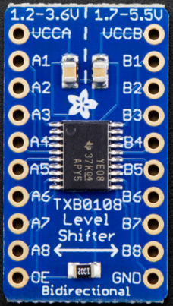
When interfacing the accelerometer to the Arduino a 3.3 volt to TTL level converter is required. This board converts 3.3 levels to TTL and vice versa.

Slide 10
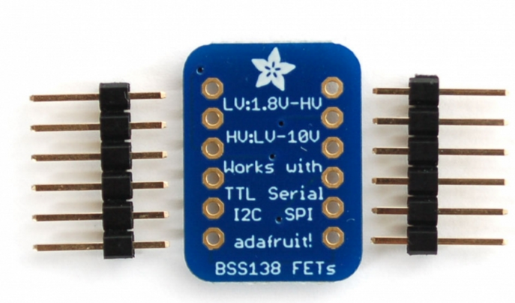
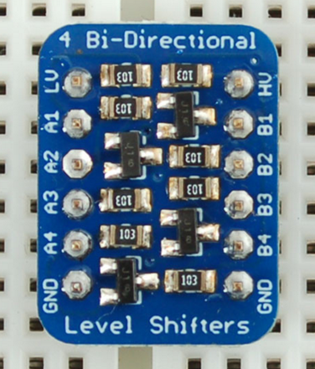
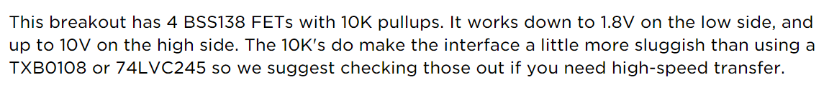
The Bi-Directional level converters allow signals of one logic levels to interface to signals of a second logic level. Each side must be powered by the high logic level.

Slide 11
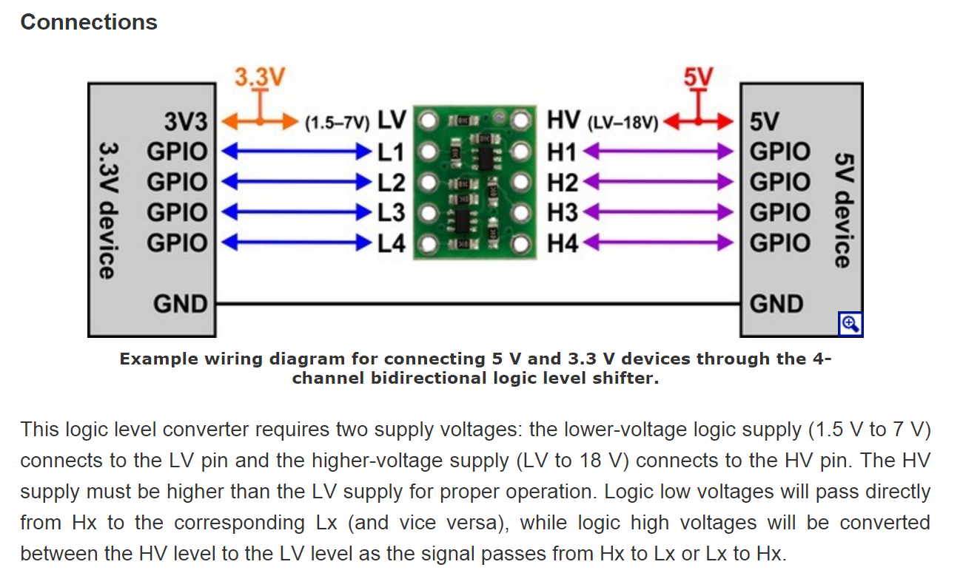
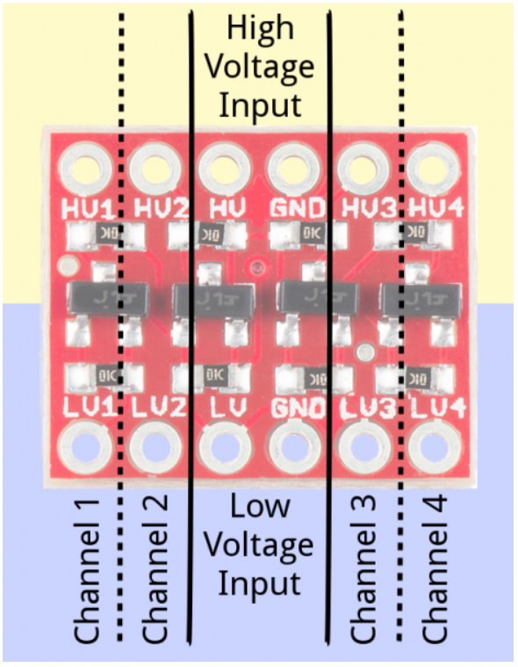

Slide 12
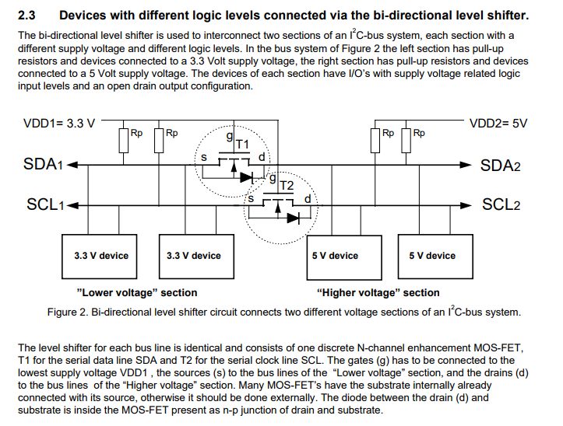

Slide 13
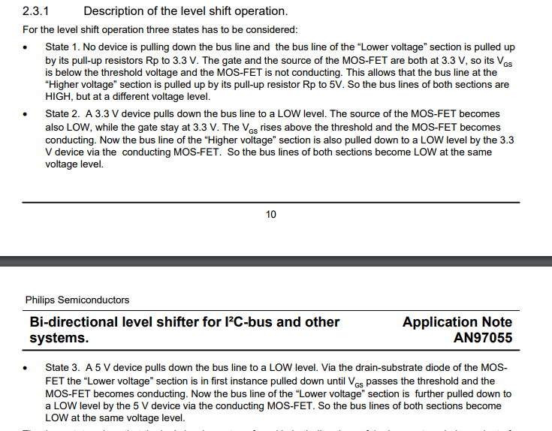

Slide 14
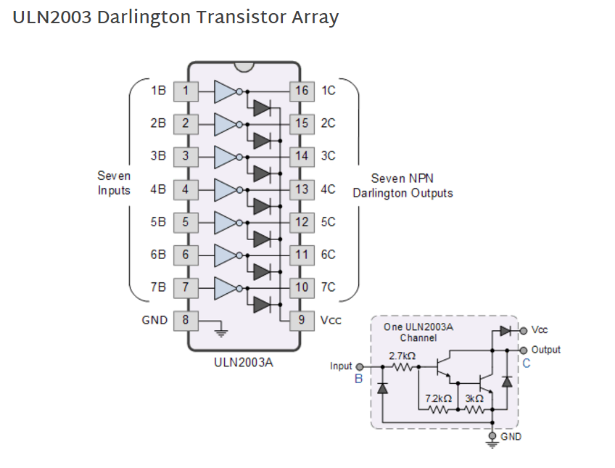
The ULN2003A is a very common high voltage high current driver.
The input current is less than 1 mA when driven by TTL or LVTTL circuits. There are 7 outputs capable of driving inductive loads up to 500 mA on each channel.
When driving inductive loads pin 9 must be connected to the positive supply of the inductive device.
The diodes suppress the spike that occurs when an inductive device is turned off.

Slide 15
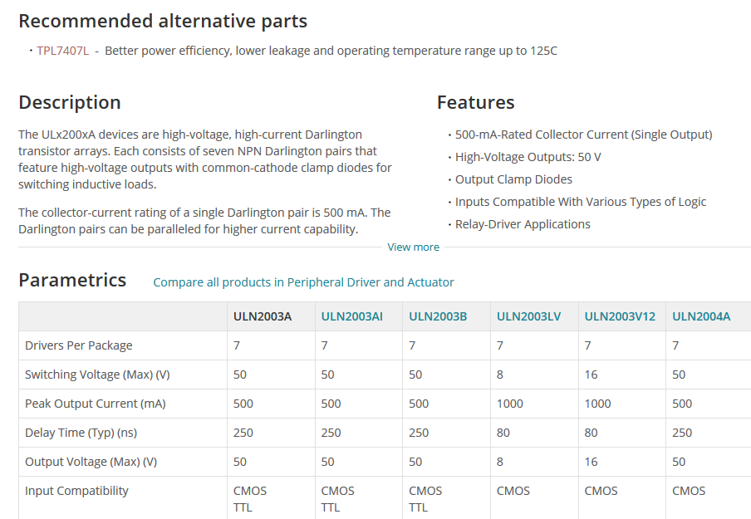
ULN2003A

Slide 16
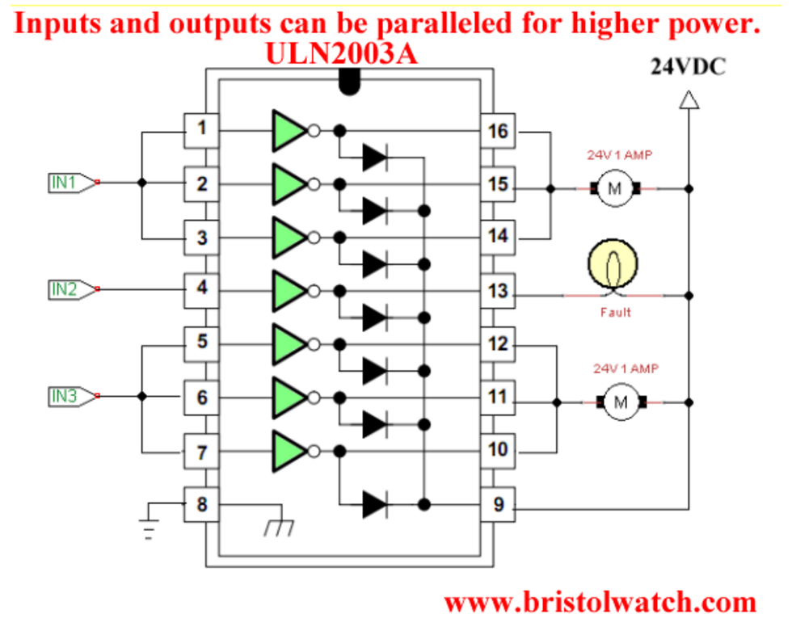
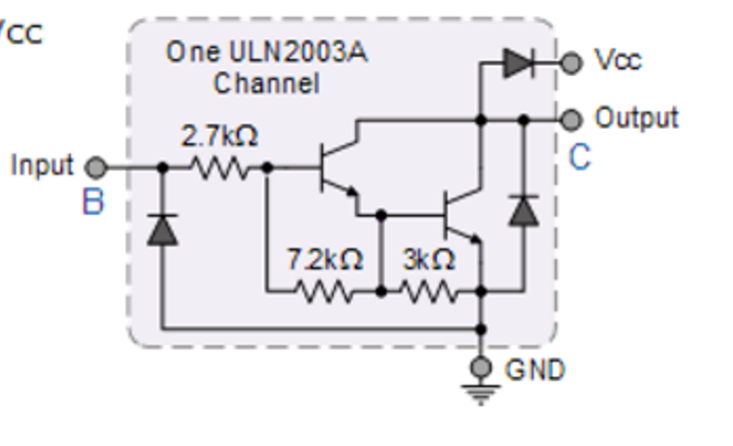
The ULN2003A inputs and outputs can be paralleled to drive high power outputs.
When driving inductive loads the supply voltage must be connected to pin 9 (this connects the internal “Flywheel diodes”).
The ULN2003A uses a Darlington transistor. This arrangement gives the circuit a very high Beta value. A low current at the input (about 1 mA can drive about 500 mA at the output.

Slide 17
Solid State Relays
Solid state relays have no moving parts, they are very reliable and are long lasting.
The controlling circuit can be low voltage and low current. The SSR is designed to interface to logic circuits.
SSR (solid state relays) can be used to control high voltage and high current AC and DC circuits.
SSR use internal optical isolations to protect the low voltage circuits.
They come in many different versions.
120 and 240 VAC outputs
5, 12, 24 volt DC outputs
120 and 240 VAC input
5-60 VDC input
1 amp to >100 amps outputs

Slide 18
The Solid State Relay.
While the electromechanical relay (EMR) are inexpensive, easy to use and allow the switching of a load circuit controlled by a low power, electrically isolated input signal, one of the main disadvantages of an electromechanical relay is that it is a “mechanical device”, that is it has moving parts so their switching speed (response time) due to physically movement of the metal contacts using a magnetic field is slow.
Over a period of time these moving parts will wear out and fail, or that the contact resistance through the constant arcing and erosion may make the relay unusable and shortens its life. Also, they are electrically noisy with the contacts suffering from contact bounce which may affect any electronic circuits to which they are connected.
To overcome these disadvantages of the electrical relay, another type of relay called a Solid State Relay or (SSR) for short was developed which is a solid state contactless, pure electronic relay.
The solid state relay being a purely electronic device has no moving parts within its design as the mechanical contacts have been replaced by power transistors, thyristors or triac’s. The electrical separation between the input control signal and the output load voltage is accomplished with the aid of an opto-coupler type Light Sensor.

Slide 19

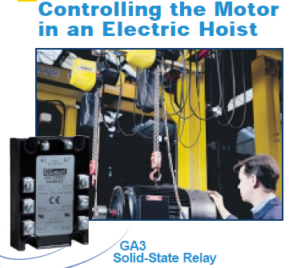
Solid State Relay Applications

Slide 20
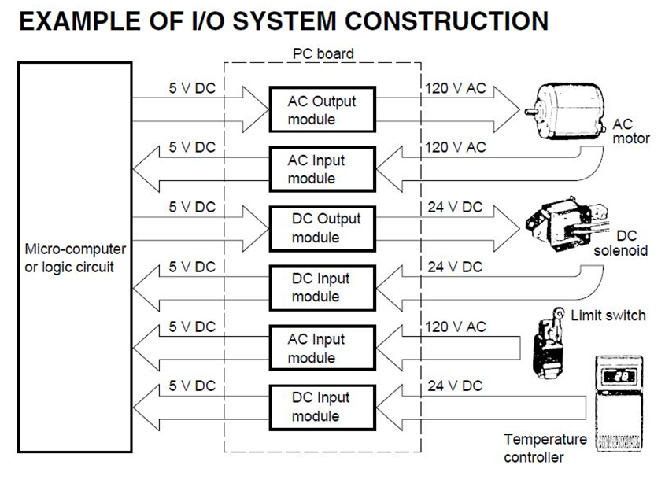
Solid State Relay Applications
Logic controlling an AC load with high voltage and currents.
Logic controlling a DC load with high voltage and currents.
Logic measuring the status of a limit switch that uses 120 VAC.
Logic measuring the status of a temperature Sensor outputting 0 volts or 24V DC.

Slide 21
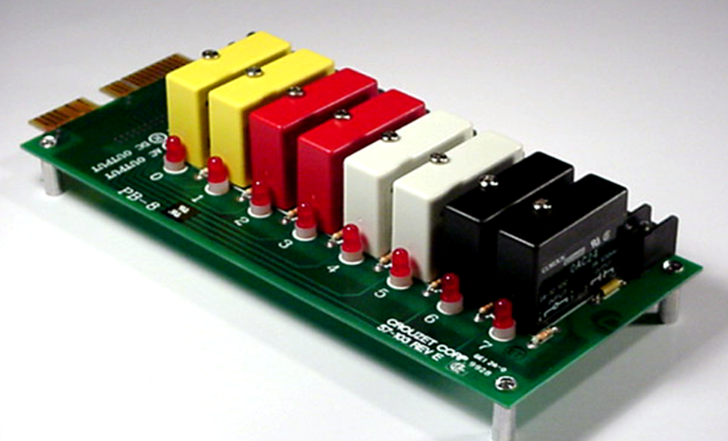
Solid State Relay Packages
Solid State Relays
Each solid state relay type is colour coded.
The yellow device measures and AC input signal and outputs a logic low or high.
The red device outputs a high voltage DC signal that is controlled using a logic signal.
The white device measures a high voltage DC signal and converts it to a logic level.
The black device (most common) controls an AC signal using logic levels)
Colour Coded Solid State Relays
AC Input
DC Output
DC Input
AC Output

Slide 22

The AC type Solid State Relay turns “ON” at the zero crossing point of the AC sinusoidal waveform, prevents high inrush currents when switching inductive or capacitive loads while the inherent turn “OFF” feature of Thyristors and Triacs provides an improvement over the arcing contacts of the electromechanical relays.
Like the electromechanical relays, a Resistor-Capacitor (RC) snubber network is generally required across the output terminals of the SSR to protect the semiconductor output switching device from noise and voltage transient spikes when used to switch highly inductive or capacitive loads. In most modern SSR’s this RC snubber network is built as standard into the relay itself reducing the need for additional external components.
Non-zero crossing detection switching (instant “ON”) type SSR’s are also available for phase controlled applications such as the dimming or fading of lights at concerts, shows,lighting etc, or for motor speed control type applications.

Slide 23
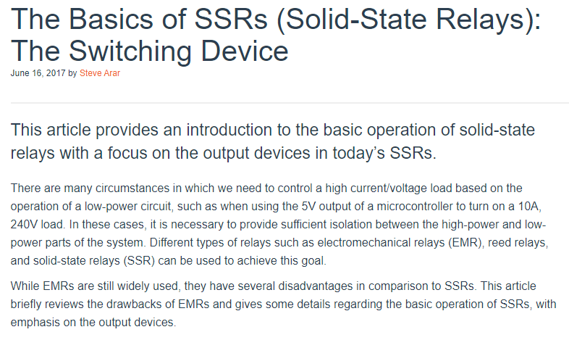
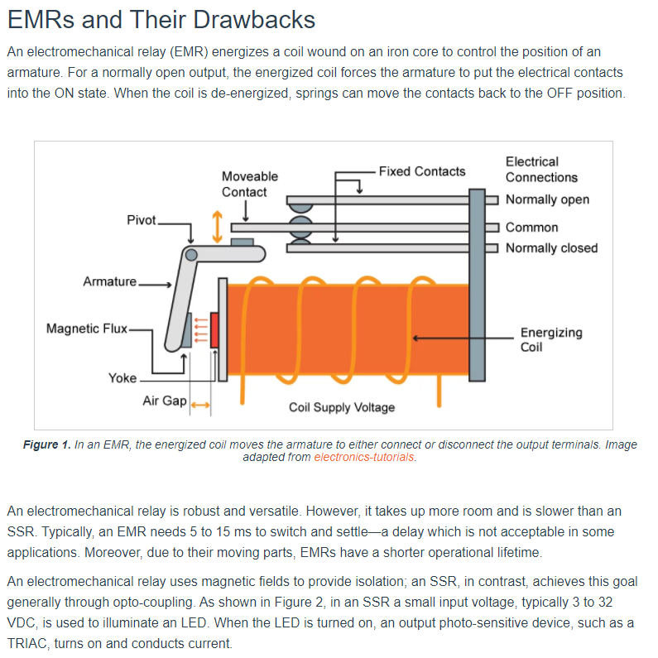


Slide 24
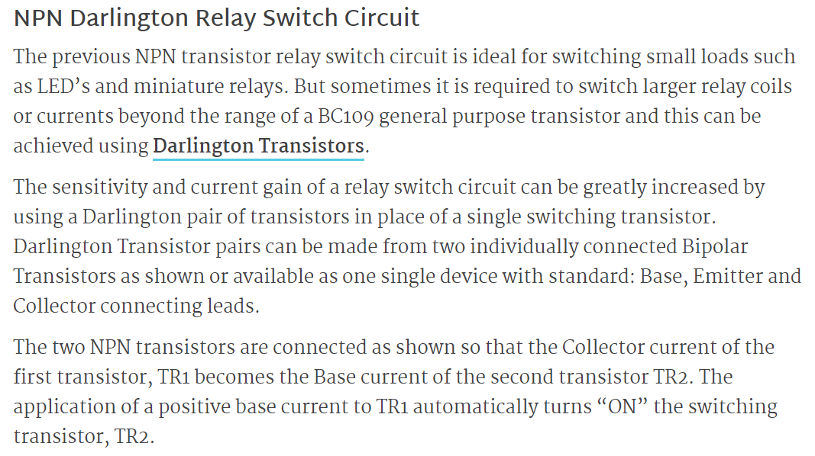
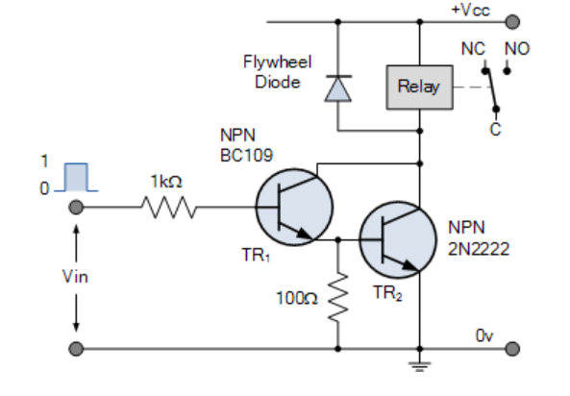

Slide 25
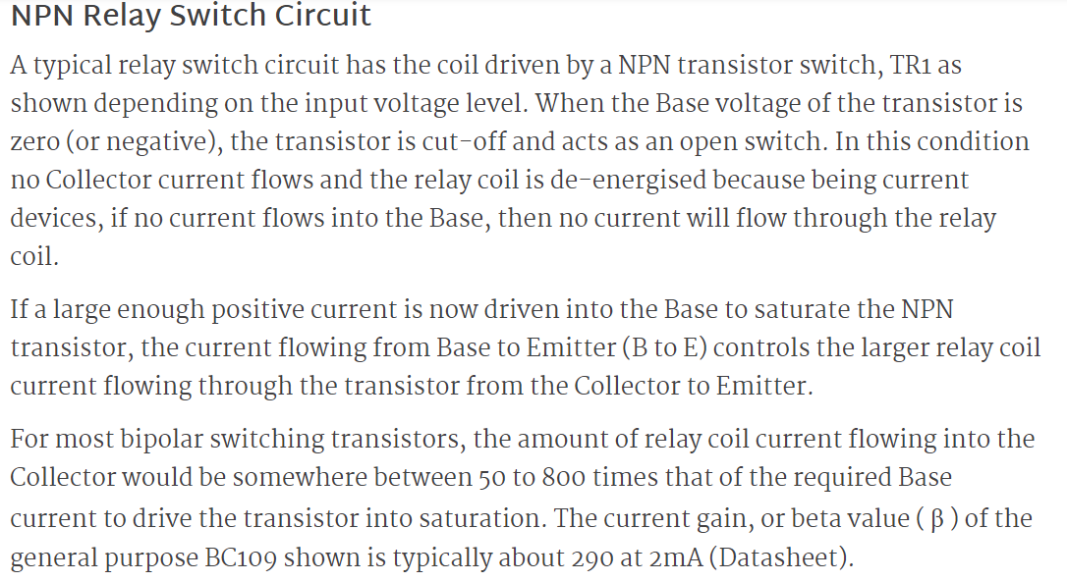
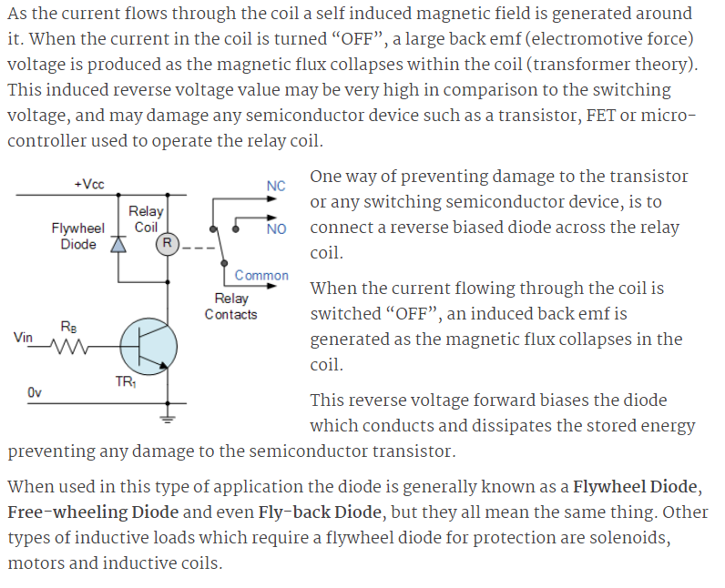
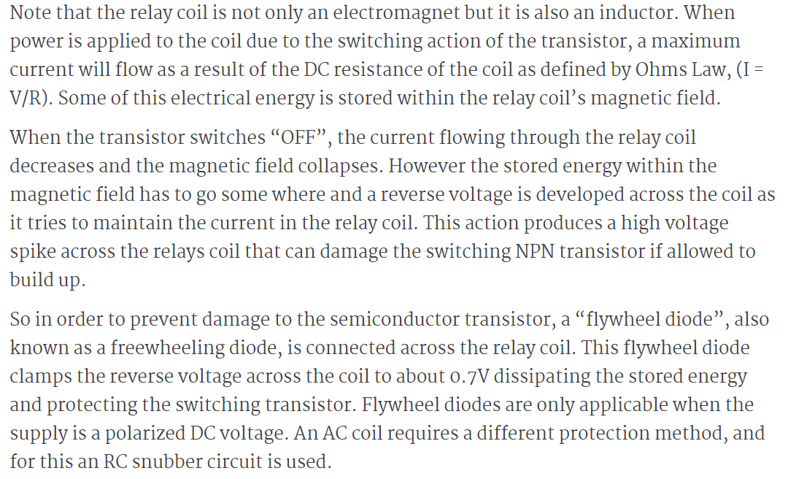

Slide 26
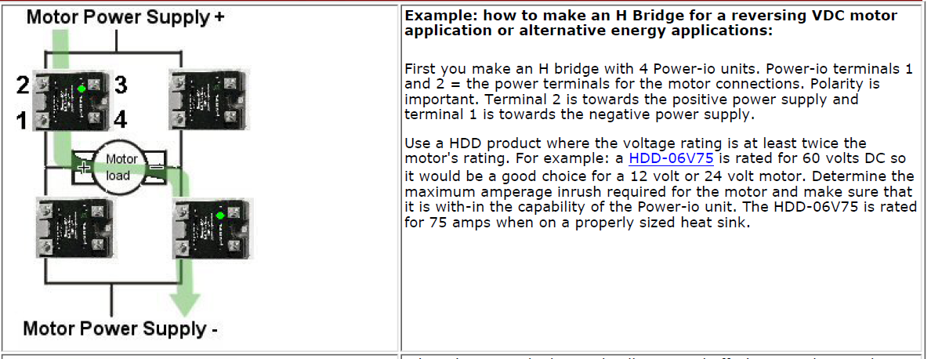

Solid State Relay H-Bridge

Slide 27
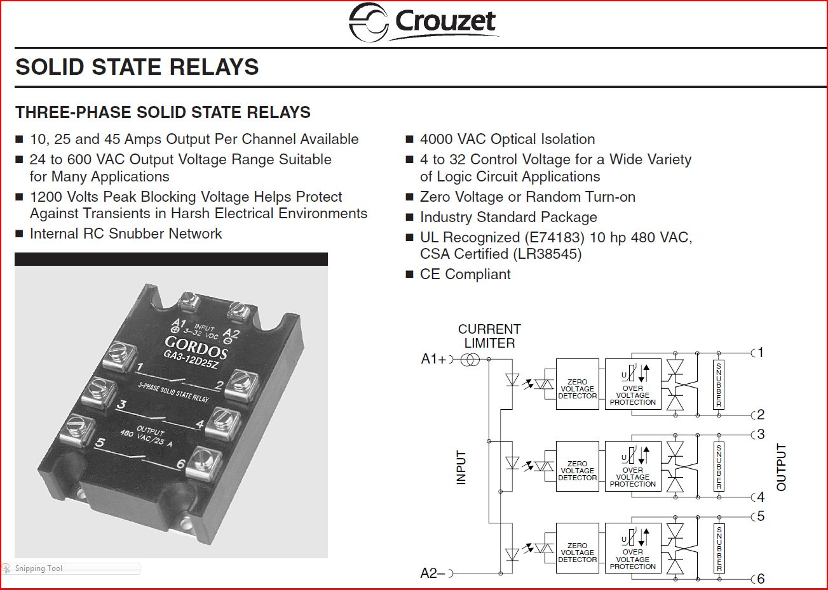
Three-Phase Solid State Relay

Slide 28
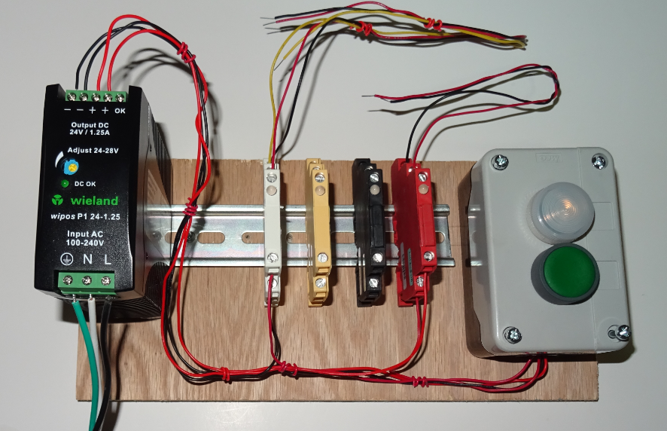
Various SSR and Power Supply
Black(OAC5) – used to control an AC load using a logic signal.
Red(ODC5) – used to control an DC load using a logic signal.
Yellow IAC5 – Measures an AC input voltage and converts it to a logic level.
White - (IDC5) – Measures a DC input voltage and converts it to a logic level.
The modules shown above are used to interface to a PLC.

Slide 29
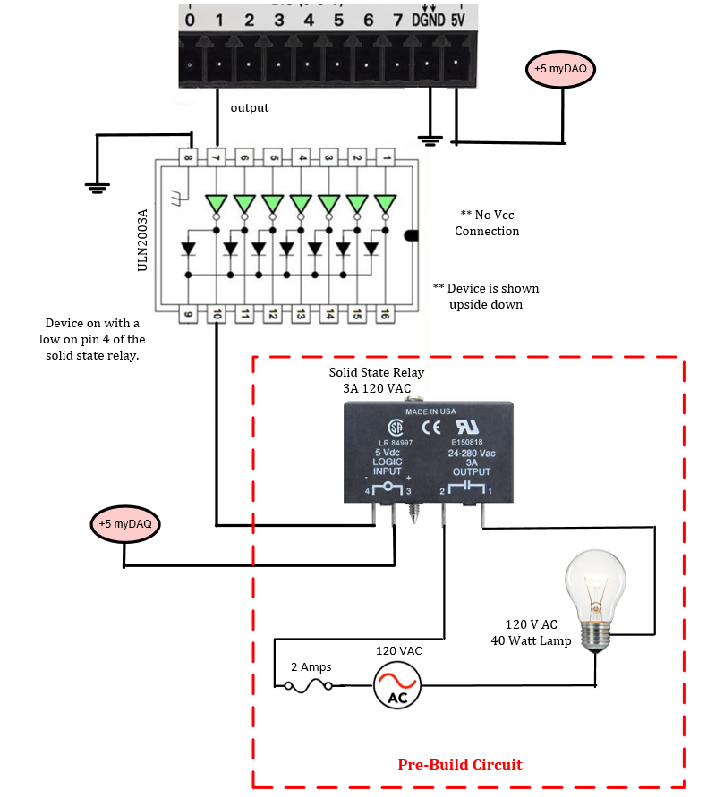
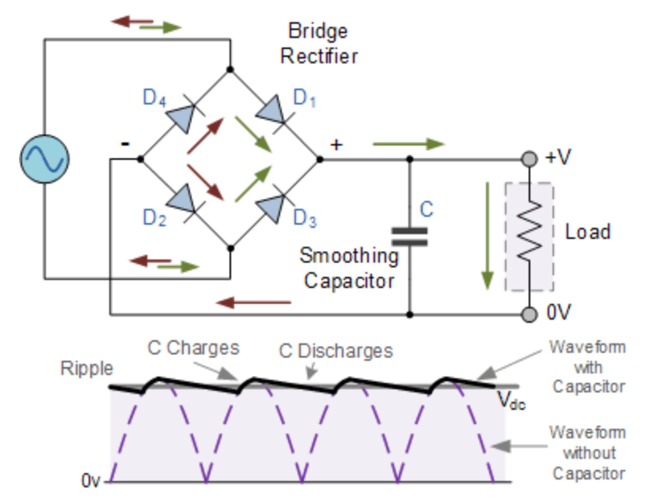
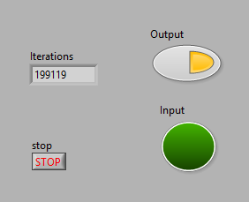
Circuit is required in lab 8.
The ULN2003A drivers is added to the digital output on the myDAQ. The specifications for the myDAQ indicate a maximum current of 4 mA. The SSR has a load of about 15 mA when active.
The ULN2003A inputs draw less then 1 mA when controlling the SSR.

Slide 30
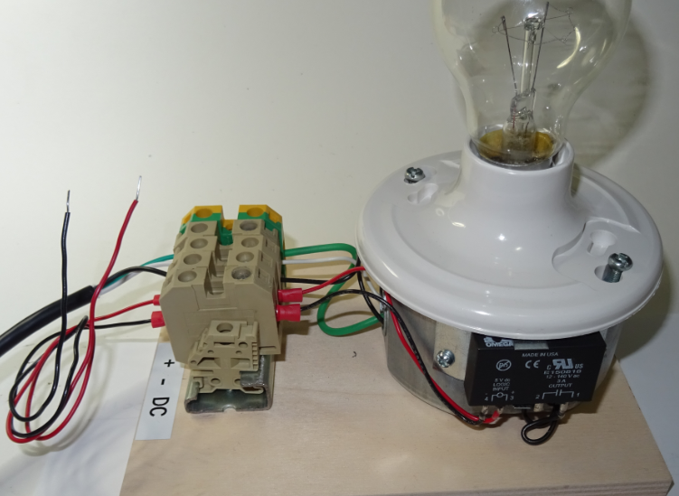
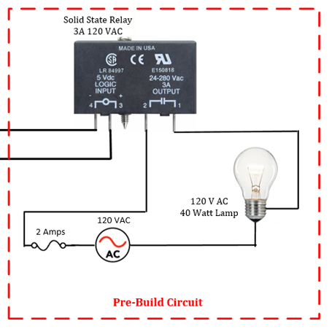
SSR AC Lamp Control
Lamp and SSR used in lab 8.

Slide 31
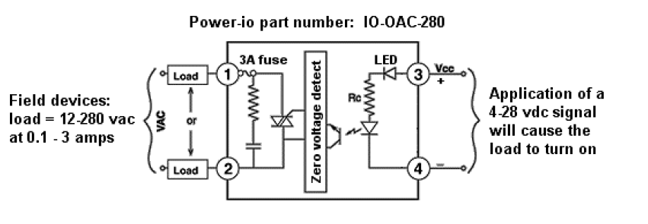
Logic Input
DC Output
Black(OAC5) – used to control an AC load using a logic signal.
OAC5
The circuit connected to pins 3 and 4 are the inputs to the solid state device. When a logic voltage is applied to the input the IR LED activates the zero crossing detector. The output of the zero crossing detector then energizes a ”Triac” allowing current to flow through the output load. The load voltage can be as high as 280 VAC with a current up to 3 amps.

Slide 32
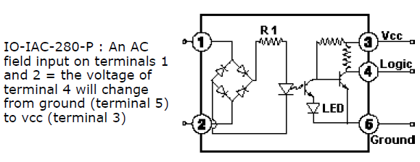
Logic Input
AC Input
Yellow IAC5 – Measures an AC input voltage and converts it to a logic level.
IAC5
The circuit connected to pins 1 and 2 converts the AC input signal to DC it is called a bridge rectifier circuit. The output of the rectifier turns on the LED which acts as the optical isolation to the base of the photo transistor. The output switches between low and high and connects to the input of the Arduino or the myDAQ.

Slide 33
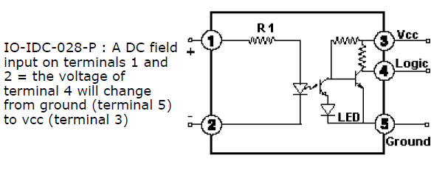
Logic Output
DC Input
IDC5
White - (IDC5) – Measures a DC input voltage and converts it to a logic level.
(IDC5) The circuit connected to pins 1 and 2 turn on an IR LED when a DC voltage is applied to the input. The output controls the logic level being applied to pin 4. Pins 3 and 5 connect to a logic supply.

Slide 34
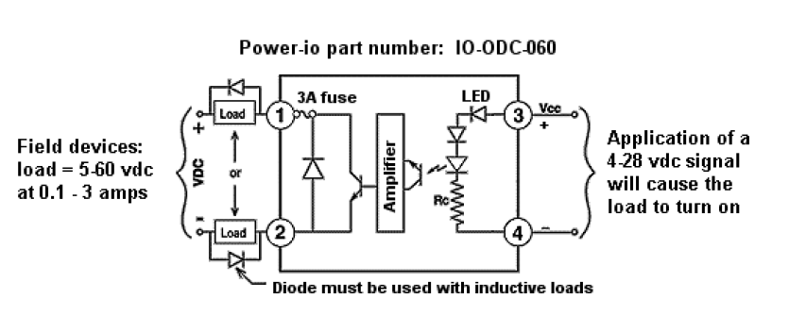
Logic Input
DC Output
Red(ODC5) – used to control an DC load using a logic signal.
ODC5
The circuit connected to pins 3 and 4 energizes an IR LED. The output controls a DC load. Use diodes if the load is inductive.

Slide 35
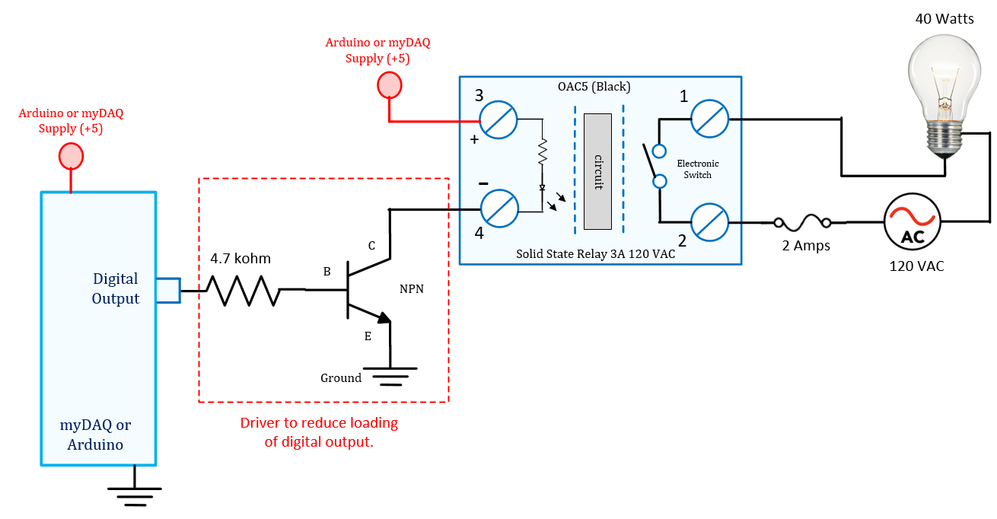
OAC5 (most common)– Controls an AC signal using logic levels. Current flowing through the LED energized a photo transistor. A triac is energized using a zero voltage detection circuit. The zero detection circuits used to energize the device only while the current is low, this helps to reduce spikes when turning the device on or off. The output has a snubber circuit to prevent damage from inductive devices.
Output
Input

Slide 36
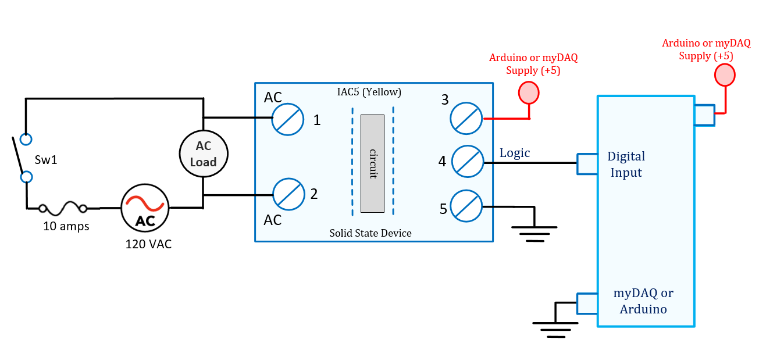
IAC5 – Measures an AC input voltage and converts it to a logic level. The AC is converted to DC using a bridge rectifier. The DC current activates an led which then turns on an LED and transistor causing the logic level to change.
Input
Output
Input
Output

Slide 37
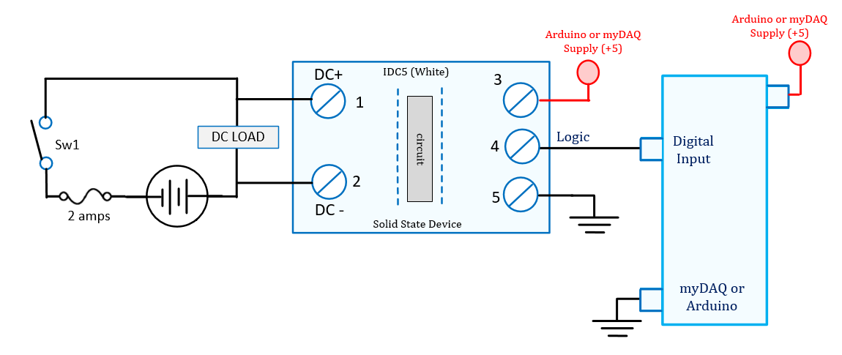
IDC5 – Measures an DC input voltage and converts it to a logic level.
Output
Input
IDC5
This module is used to determine the state of a DC load. With a value between 4 to 28 VDC the module output will be a logic high.
Input
Output
4-28 VDC

Slide 38
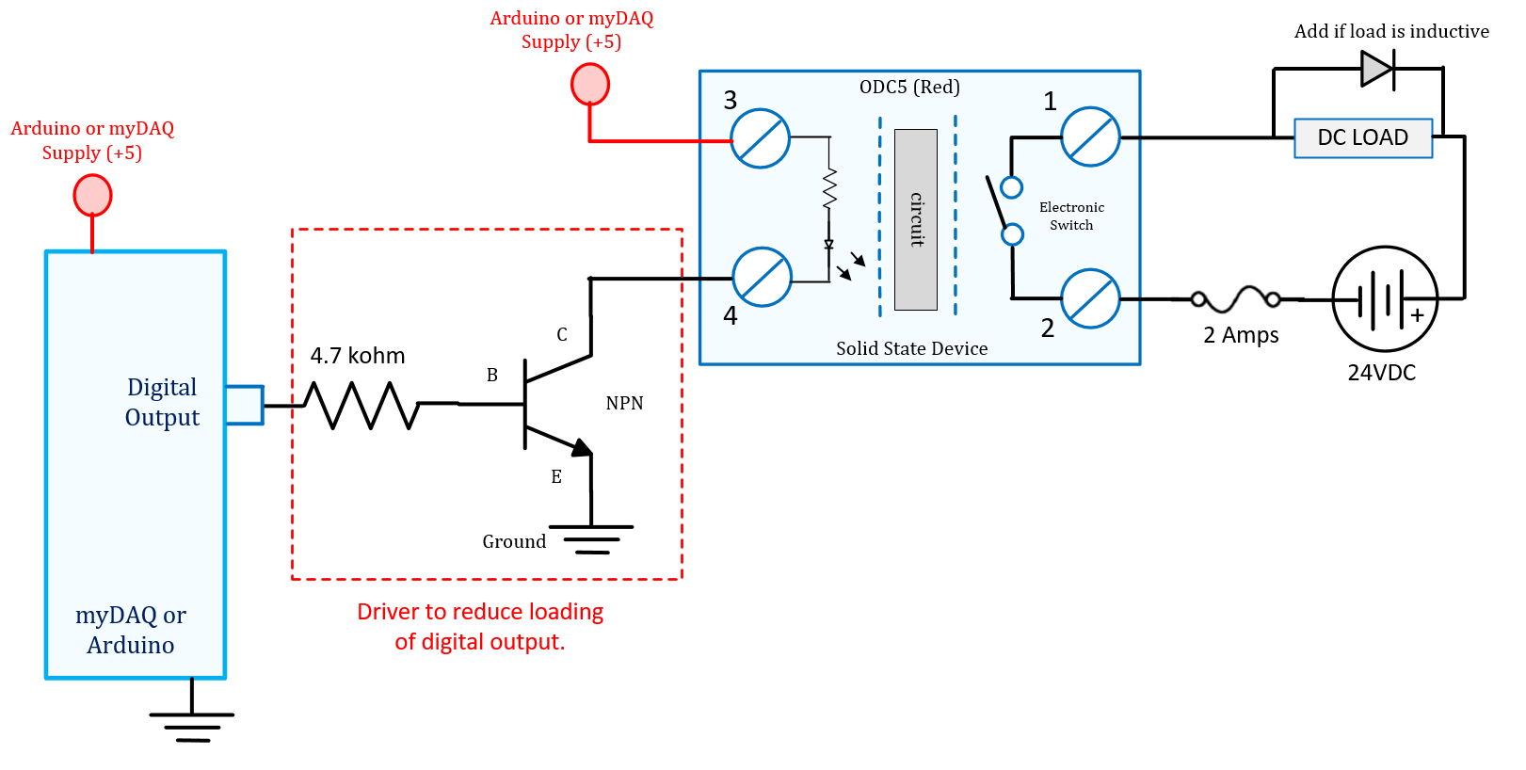
ODC5 – uses a logic signal to controls a DC voltage. The transistor driver is added to reduce the load on the output pin of the controller. The diode across the load is a flyback diode which will reduce the spike created when an inductive load is turned off.
Output
Input
Output
Input
ODC5 – when a DC voltage is applied to the input an IR LED turns on a transistor causing the output to energize.

Slide 39
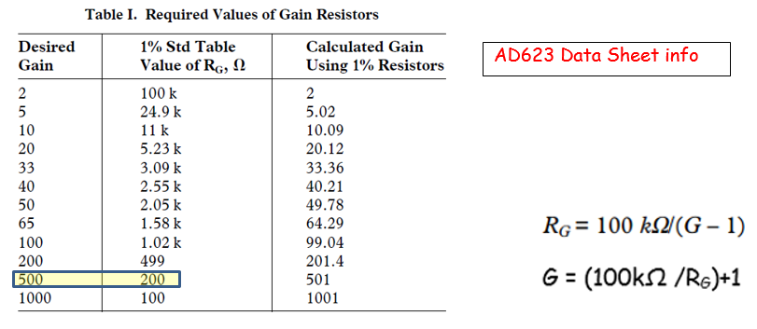
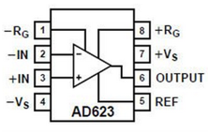
AD623 Instrumentation Amplifier
The AD623 is an instrumentation amplifier. The gain of the amplifier is easily configured using one resistor. An output offset can also be easily added with a reference input pin. The device can be used to amplify signals from load cells, pressure sensors and thermocouple. The device has rail to rail output meaning the output signal can go from min supply to maximum supply.

Slide 40
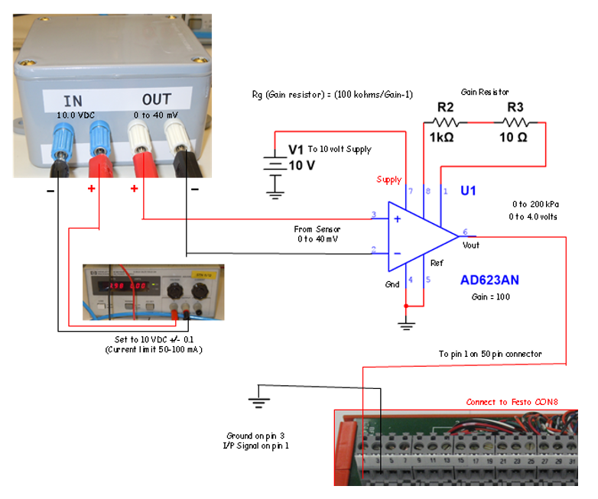
AD623 Instrumentation Amplifier
0 – 200 kPa differential Pressure
produces an output of 0 to 40 mV.
The output from the sensor is 0 to 40 mV. This is too low for the A/D converter of the Arduino or the myDAQ. The amplifier will increase the voltage by a factor of 100 using the instrumentation amplifier. The output will have a range of 0 to 4 volts for a pressure of 0 to 200 kPa.

Slide 41

Type “K” (yellow) Thermocouple
About 40 uVolts /degree Celsius Type K

Slide 42

Solid State (PLC to Arduino)

Slide 43

Solid State Relay (Logic to PLC)

Slide 44
Solid State Relay

Slide 45


Arduino or myDAQ T/C Amplifier
The AD623 is an instrumentation amplifier. The gain of the amplifier is easily configured using one resistor. An output offset can also be easily added with a reference on pin 5.
The gain resistor is placed between pins 1 and 8. The output is on pin 6.
In this example the gain =
Gain = (100kohm/470)+1
= 214
214 * 41uV = 0.0087 volts.
Assume CJ = 22 degC
Assume offset = 2.0 volts.

Slide 46


Slide 47



Configurable Transducers

Slide 48


Transducer Specs
A transducer converts one signal form to another.
Examples:
Resistance to voltage: 0-100 ohms to 0- 10 volts.
Voltage to current: 0-10 to 4-20 mA.
Current to Voltage: 4 to 20 mA to 0 to 5 volts.

Slide 49

Display and keypad configuration.
Some devices can easily be configured using an LCD display and a basic keypad.
They include a built in controller for configuration.
Most of these modules fit onto an industrial DIN rail.

Slide 50

WAGO – JUMPFLEX configuration.
Smart phone configuration
using a Bluetooth adapter.
Now I have a reason for using my $800.00 smartphone!

Slide 51


A set of jumpers are used to select the input and output signal range. Examples:
0-20 mA
4-20 mA
0 – 10 VDC
2-10 VDC
0-5 VDC
1-5 VDC

Slide 52



Omega T/C Transducer
This converter is powered by
24 VDC.
The input can be a type “K”, “T” or “J” thermocouple selected using jumpers.
The device includes cold junction compensation.
The output is jumper selectable for 4 to 20 mA or 0 to 10 volts.
The device is calibrated using zero and span adjustments.

Slide 53

Sink and Source Examples

Slide 54


Slide 55



Slide 56



Slide 57


Slide 58


Slide 59


Slide 60


Slide 61


Slide 62



Slide 63

Inside a Solid State Relay (OAC5) Black
The solid state relay includes opto-isolation, a zero crossing detector, a triac and a snubber circuit to suppress transients from inductive loads. The zero crossing detector is used to turn on the load at the time the current is the lowest when using AC loads.

Slide 64


Slide 65

When used in this type of application the diode is generally known as a Flywheel Diode, Free-wheeling Diode and even Fly-back Diode, but they all mean the same thing. Other types of inductive loads which require a flywheel diode for protection are solenoids, motors and inductive coils.
As well as using flywheel Diodes for protection of semiconductor components, other devices used for protection include RC Snubber Networks, Metal Oxide Varistors or MOV and Zener Diodes.

