Slide 1
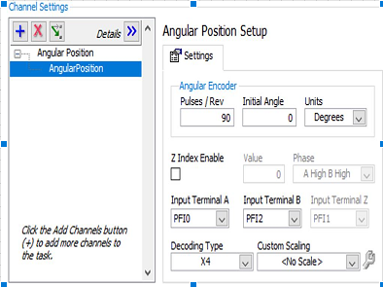

Slide 2
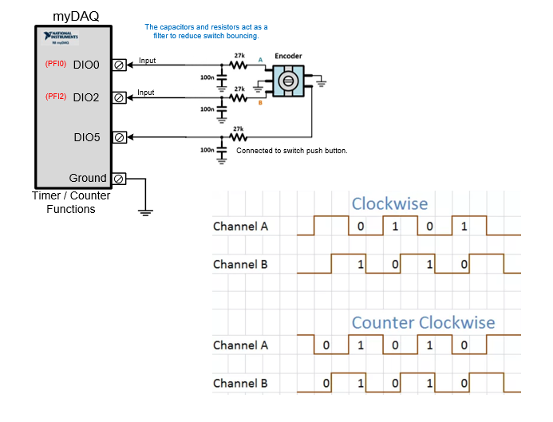

Slide 3
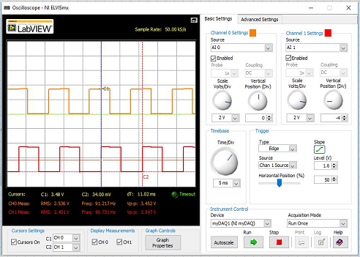

Slide 4
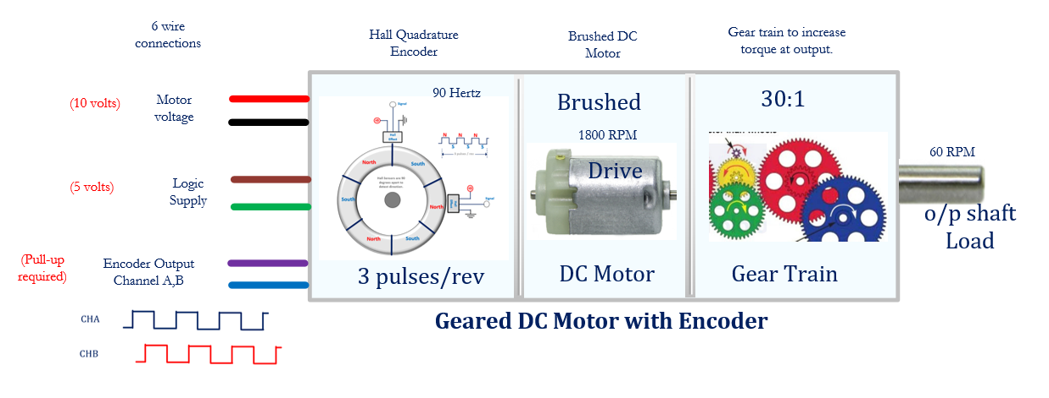
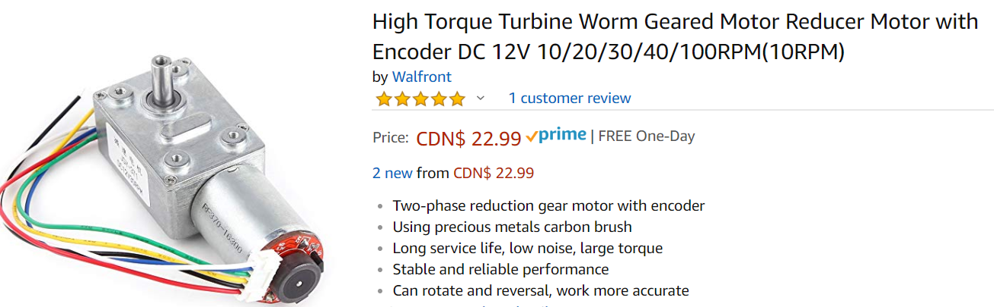

Slide 5
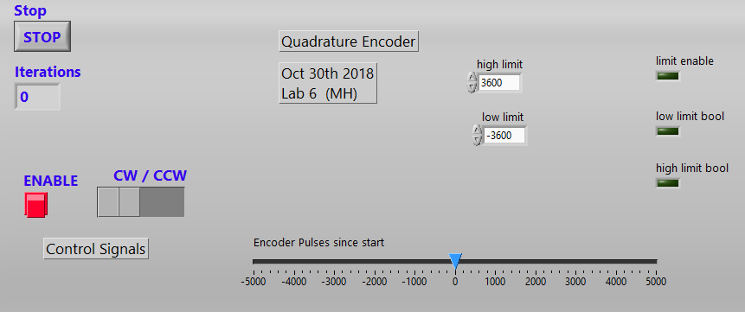

Slide 6
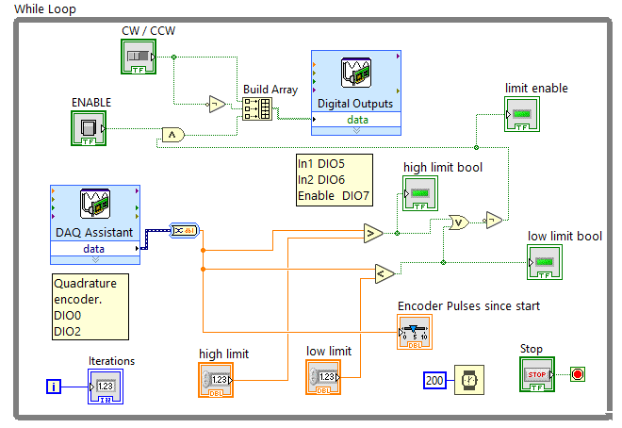

Slide 7
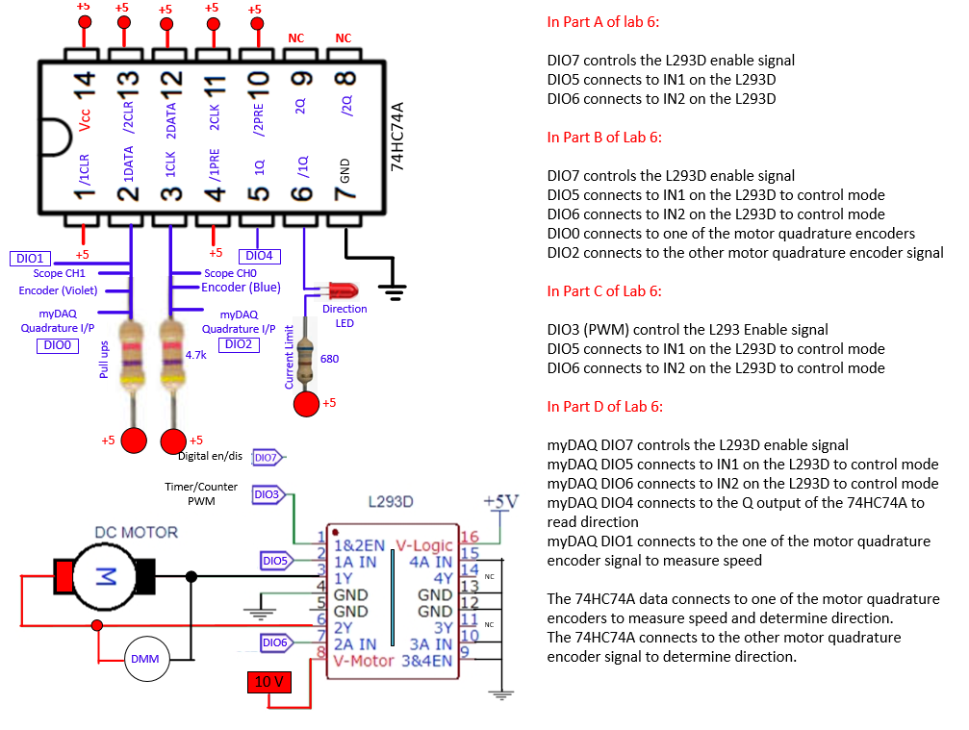

Slide 8
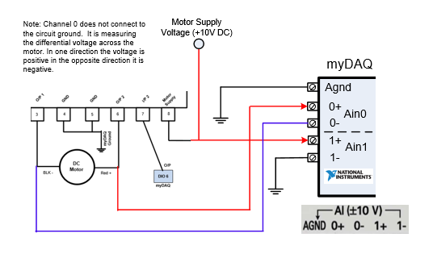

Slide 9
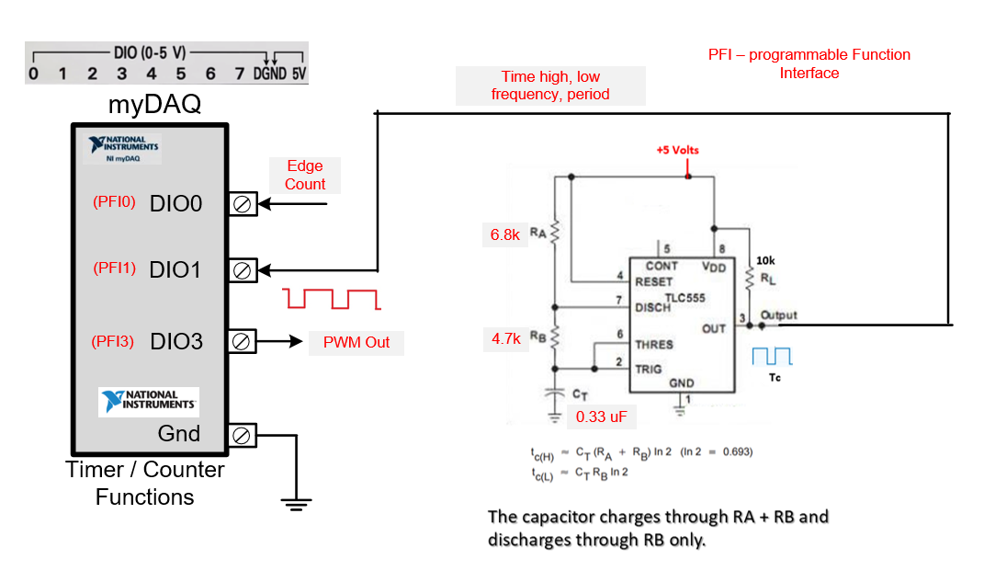

Slide 10
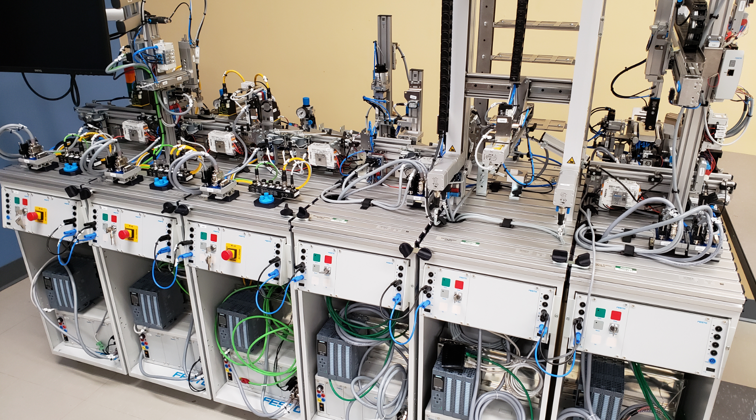

Slide 11

Class Notes:
DC Stepper and Servo Motor Controls
CAM8302E Fall 2018

Slide 12
Slide Index (Total 62 slides):
3: Dc motor types – brushed, brushless and stepper.
4: Basic servo description.
5-14: Basic stepper motor information
15-16: Bipolar stepper motors
17-18: Unipolar stepper motors
19-20: Unipolar and bipolar stepper windings
21: Stepper applications
22-32: Unipolar drive
33-34: For loop, Arduino software for unipolar motors.
35-45: Bipolar stepper motor drive
46-48: Inductive protective circuits snubbers, and diode protection
49-61: Servo motors and drive circuits

Slide 13
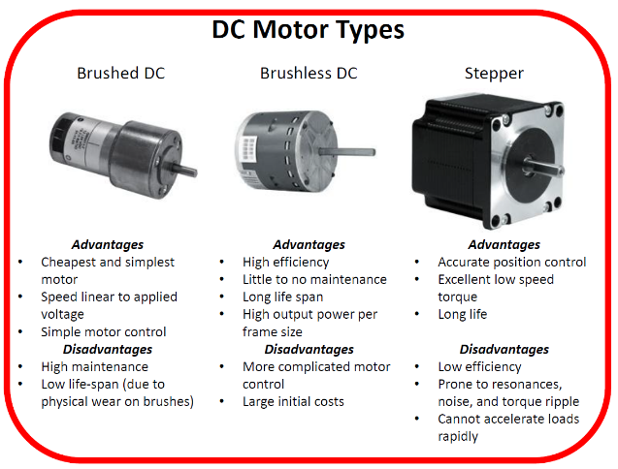

Slide 14
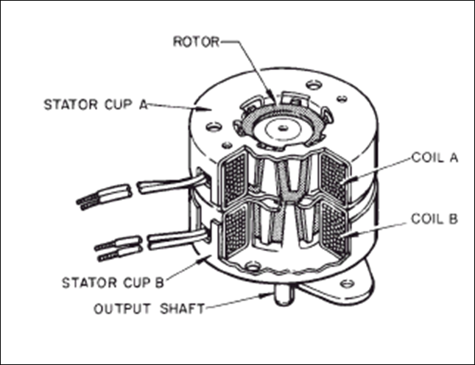
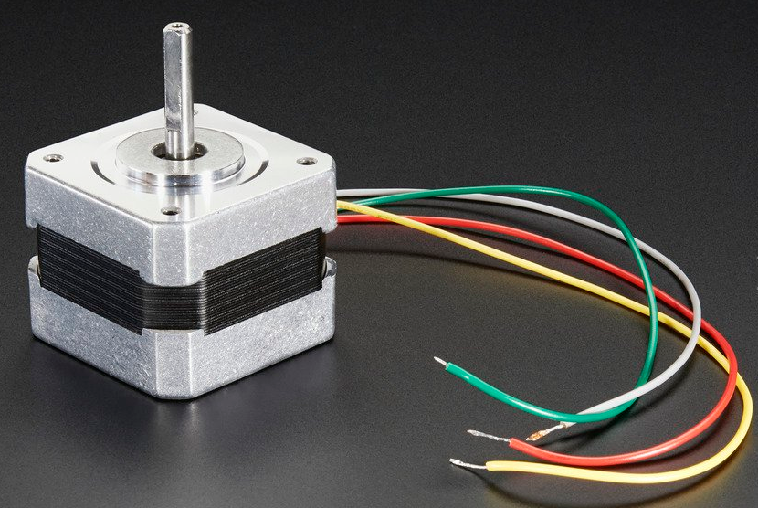
Stepper Motor
A stepping motor is a motor which has the capability of:
rotating in either direction
starting or stopping in various positions
moving the rotor in precise angular increments for each step applied
the motor can be stopped so that is not easily rotated (holding torque).

Slide 15
https://www.youtube.com/watch?v=vxxnPJBxG3M
https://www.youtube.com/watch?v=TWMai3oirnM
https://www.youtube.com/watch?v=KbDPgxHpgAA
Microchip Stepper Motors
How To Mechatronics
Stepper with Arduino
http://howtomechatronics.com/projects/diy-vending-machine-arduino-based-mechatronics-project/
How To Mechatronics
Vending Machine

Slide 16
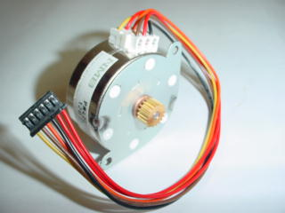
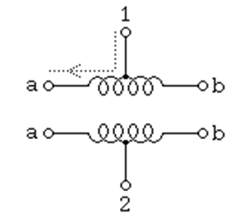
Stepper Motors
Permanent Magnet Unipolar Stepper Motor
Unipolar – current flow in only one direction
Bipolar – current flow in two directions

Slide 17
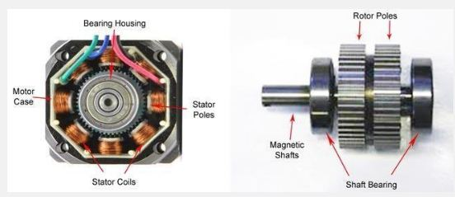
Inside A Stepper Motor
Stator – Parts that do not rotate.
Rotor – Rotating parts.
Pole/Phase – coil of wire.

Slide 18
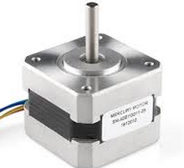
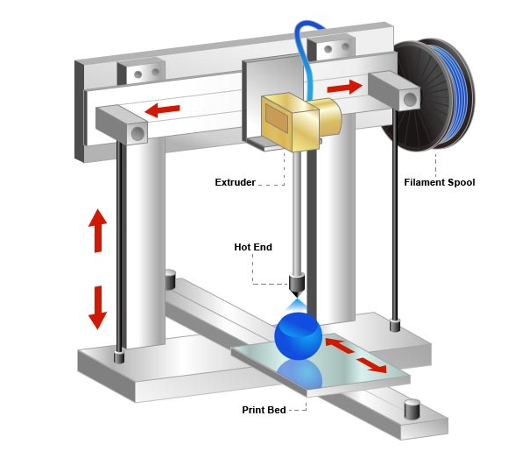

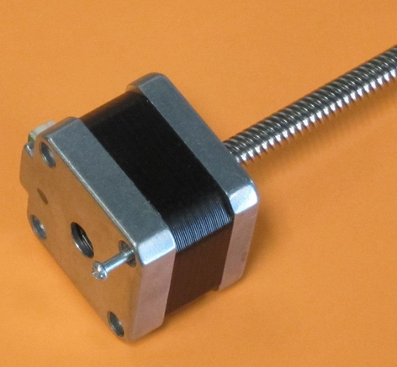
3D Printer Parts for Position
Y – movement
Control (Fwd/Rev)
Stepper motors
are used in 3D printer to control the X, Y and Z axis position.
The motors are connected to a belt drive or a lead screw.
Z – movement
Control (Up/Down)
X – movement
Control (Left/Right)
4th stepper used to drive the
filament to the print head.

Slide 19
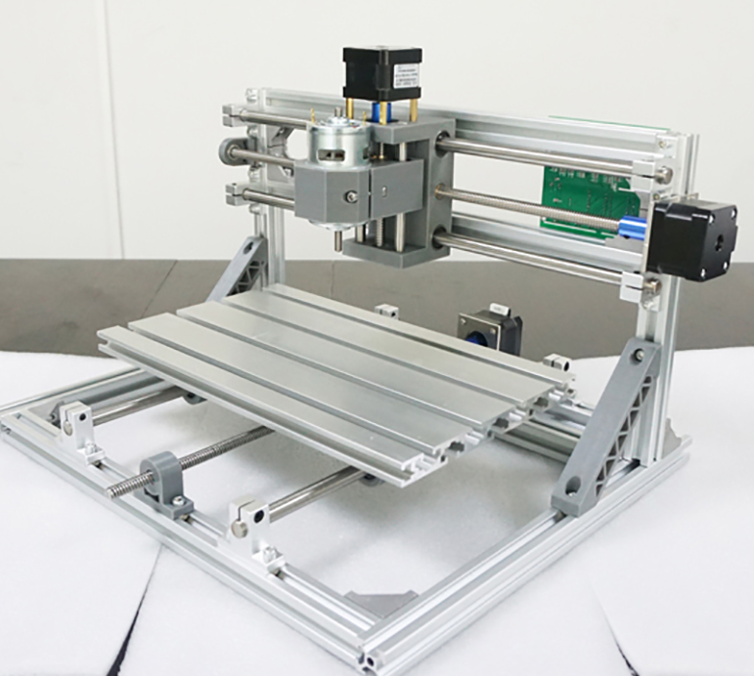
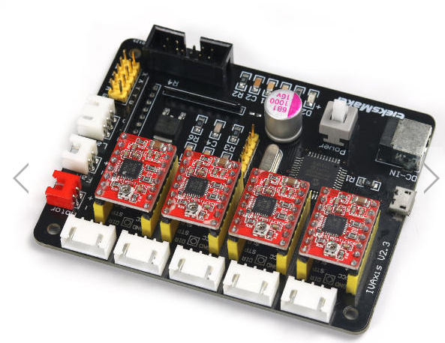
CNC Using 3 Stepper Motors
CNC – computer numerical control
Laser Etcher
PCB etching
Controller for 4 stepper motors.
Z
X
Y

Slide 20

3D Printer Parts

Slide 21
Stepper YouTube Videos
https://www.youtube.com/watch?v=vxxnPJBxG3M
Microchip Video
https://www.youtube.com/watch?v=MHdz3c6KLrg
https://www.youtube.com/watch?v=t-3VnLadIbc
Part 1 operation
Part 2 operation
https://www.youtube.com/watch?v=blJxz28HuQI
https://www.youtube.com/watch?v=dmk6zIkj7WM
https://www.youtube.com/watch?v=eyqwLiowZiU
3D Printer
Anaheim Automation
Stepper Animation

Slide 22
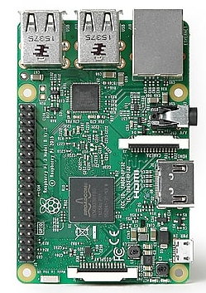
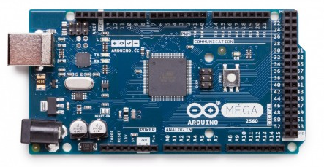
DC Stepper Motor
Stepper motors are easy to control with digital / microcontroller boards such as the Arduino or the Raspberry PI.
Stepper motors provide very precise angular positioning.
Speed and direction are easily controlled with digital circuits .
Stepper motors have no feedback and may miss steps under high torque conditions.
Stepper motors often use a switch or sensor to determine a known home position.

Slide 23
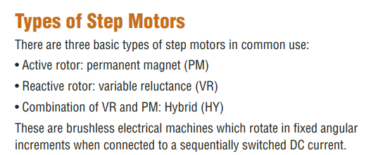
DC Stepper Motor
The Hybrid type is most common for higher torque and higher speed applications.

Slide 24
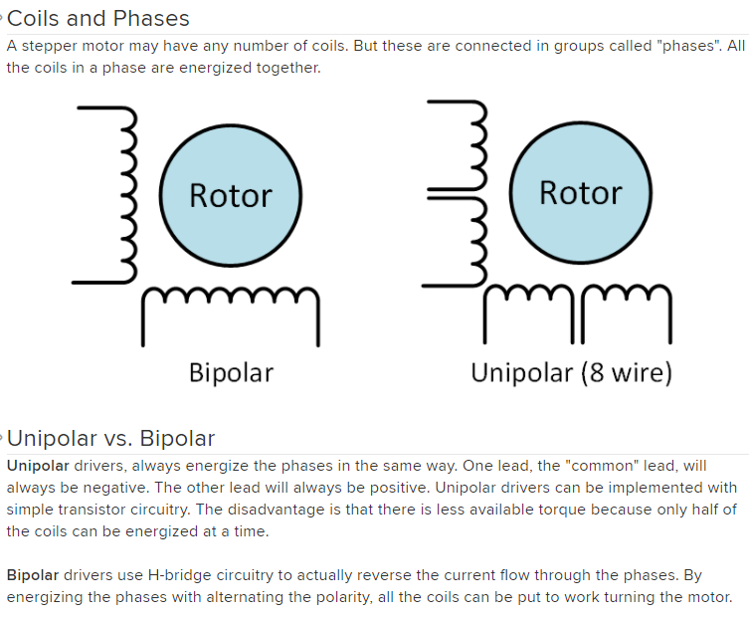

Stepper Motors Types
* May have 5, 6 or 8 wires.

Slide 25
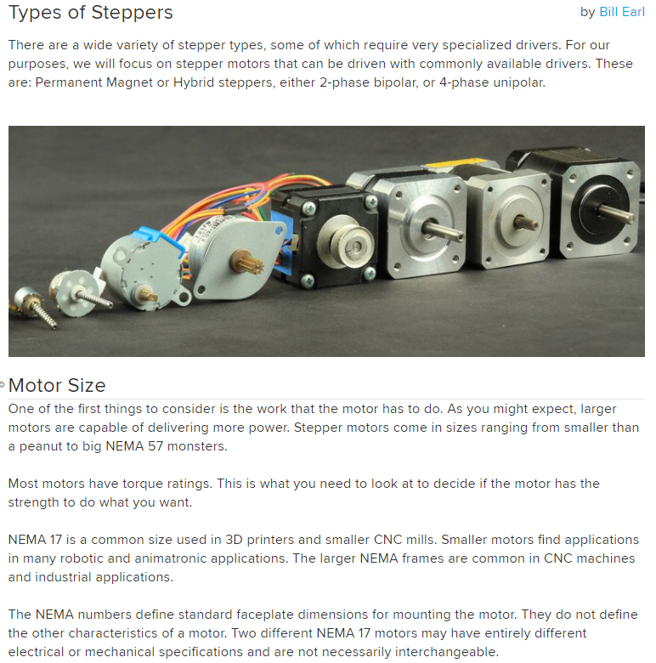
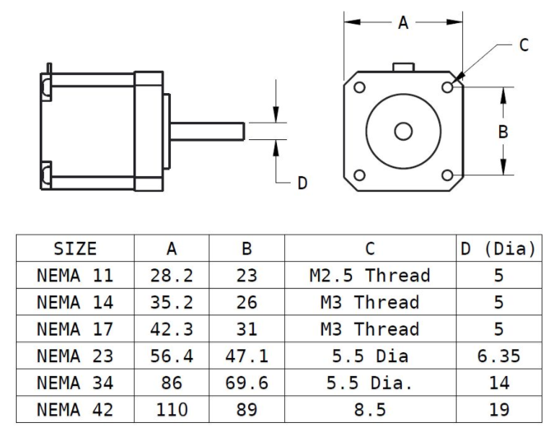
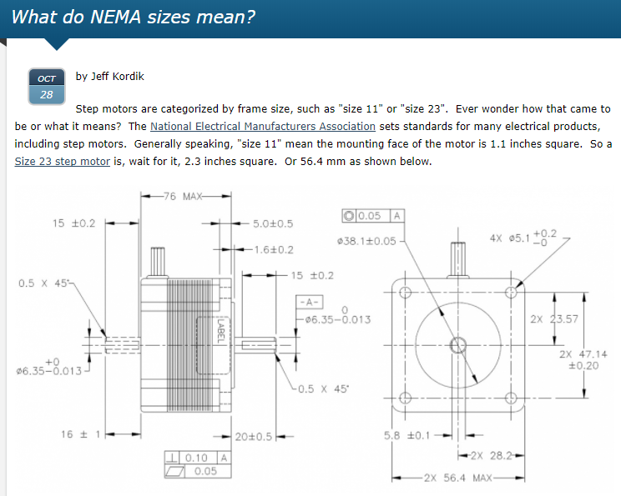
NEMA – national electrical manufacturers association

Slide 26
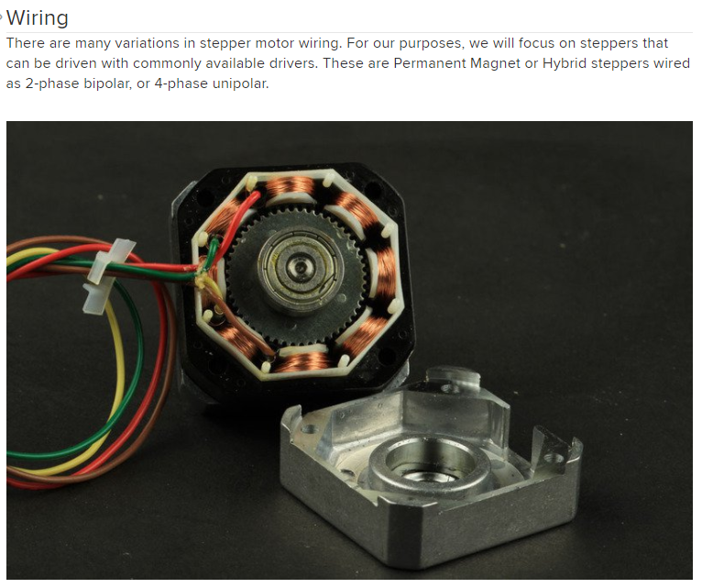
This is a bipolar hybrid stepper.
There are only 4 wires and the rotor has teeth.

Slide 27
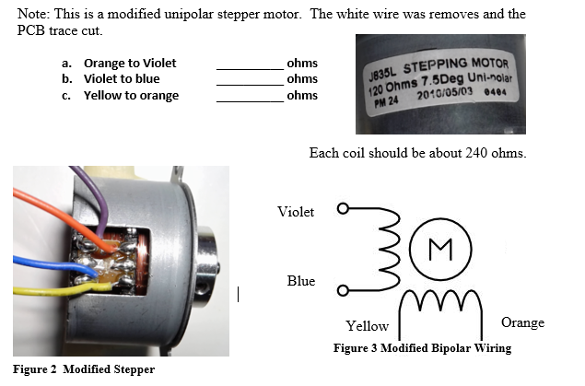

Slide 28
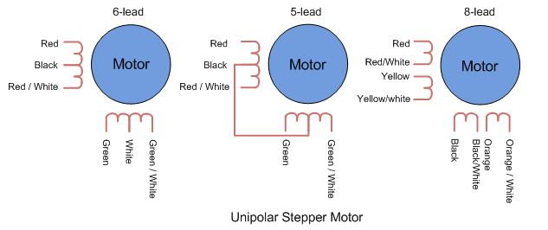
Unipolar stepper motors have 5, 6 or 8 leads.
They all use two coils with a centre tap.
Some steppers have the wires connected internally, others are connected externally.

Slide 29
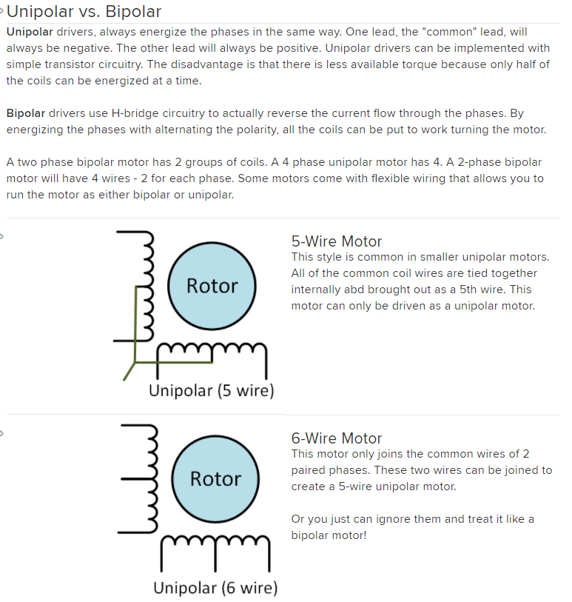

Slide 30
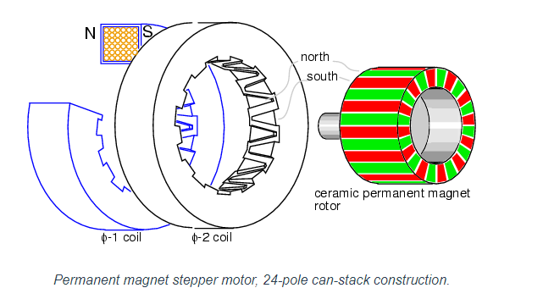
Stepper Motor

Slide 31
Stepper Motor
A stepping motor is a motor which has the capability of rotating in either direction, starting or stopping in various positions, and moving the rotor in precise angular increments for each step applied. The motor can be stopped so that is not easily rotated (holding torque).

Slide 32
Stepper Motor Characteristics
Two Coils of fine gauge wire – Unipolar has a centre tap.
Permanent magnet rotor
No Brushes
Good Holding Torque (not turning)
Rotates at precise angular increments. 1.8 deg, 5.0 deg. 7.5 deg.
Stops and starts quickly
Digital Control of direction and speed.
No Feedback circuit is required.

Slide 33
Stepper Motor Applications
Drive Conveyor Belts
Robotics
Mechanical Positioning
Ventilation/Lighting Control
Camera Controls
Pick & Place Machines
Assembly Lines
Industrial Control
CNC and 3D printers

Slide 34
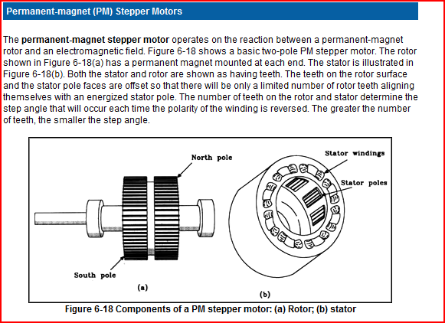
Stepper Motor
From NI.com
NI – National Instruments
(LabVIEW)

Slide 35
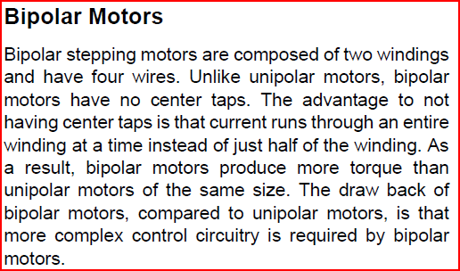

Bipolar Stepper Motor

Slide 36
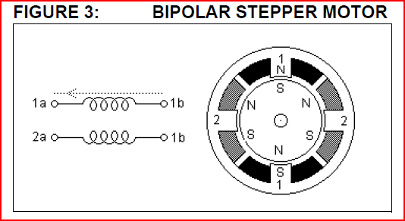
Bipolar Stepper Motor

Slide 37
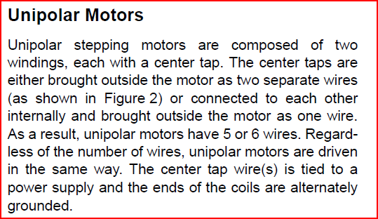
Unipolar Stepper Motor

Slide 38
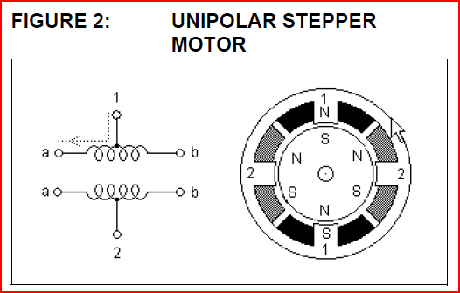

Unipolar Stepper Motor

Slide 39
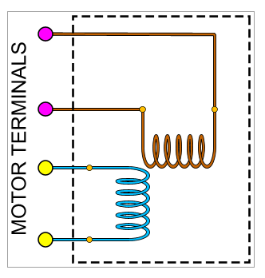
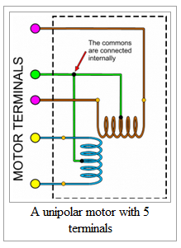
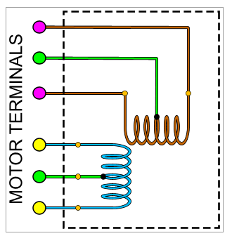
Stepper Motor Wiring
Bipolar Stepper Motor
4 Wires
Unipolar Stepper Motor
5 Wires
Unipolar Stepper Motor
6 Wires

Slide 40
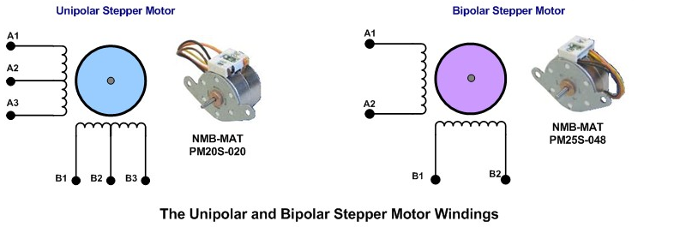
Bipolar/Unipolar stepper motors.
Unipolar stepper motors require a simpler drive circuit, bipolar stepper motors have higher torque capabilities.
Unipolar – current flow in only one direction
Bipolar – current flow in two directions

Slide 41

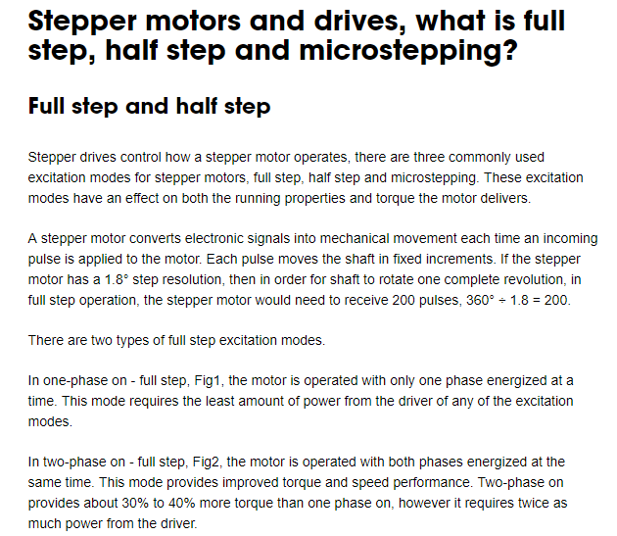

Slide 42
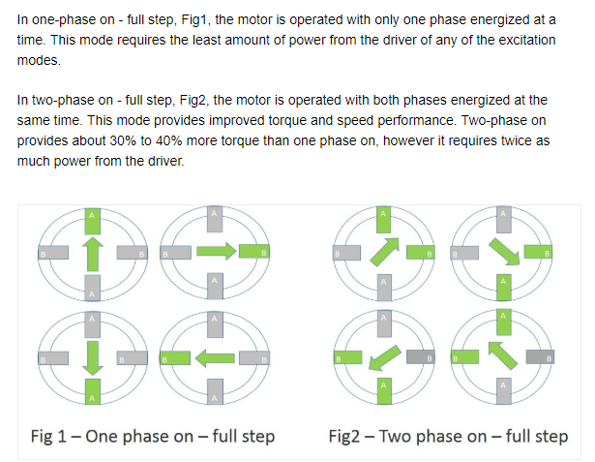

Slide 43
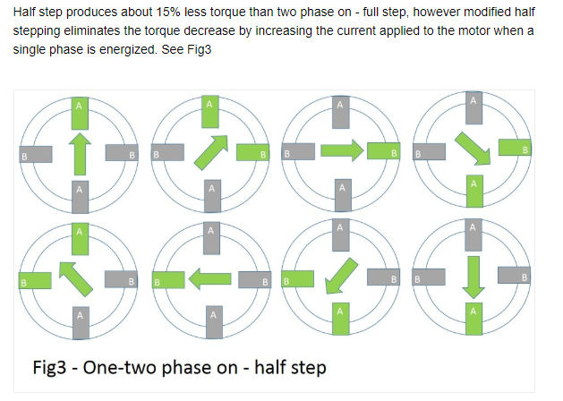

Slide 44
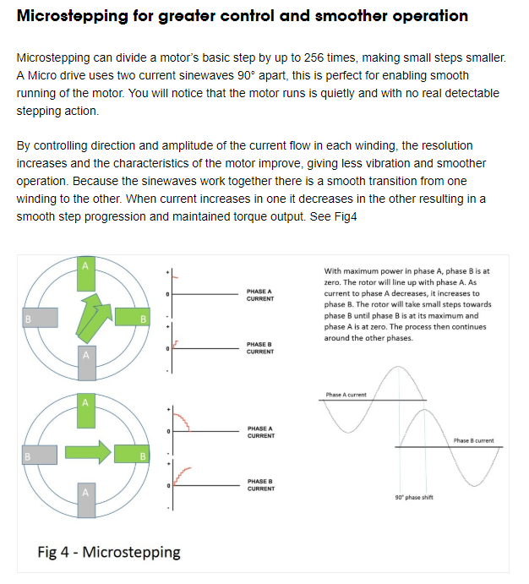

Slide 45
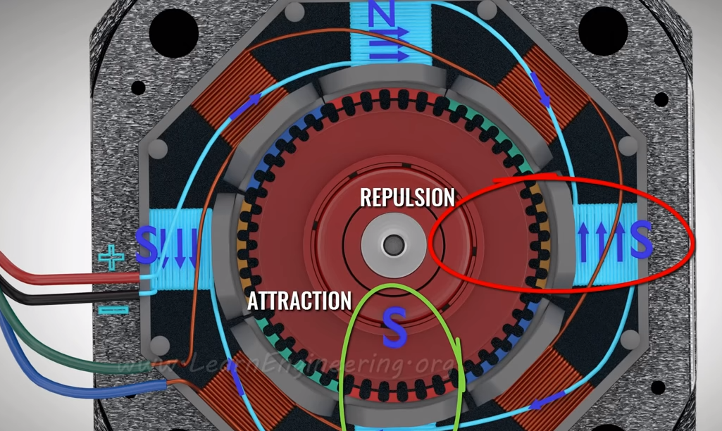
Two Coils, 48 teeth, rotor is magnetized with north and south poles.

Slide 46
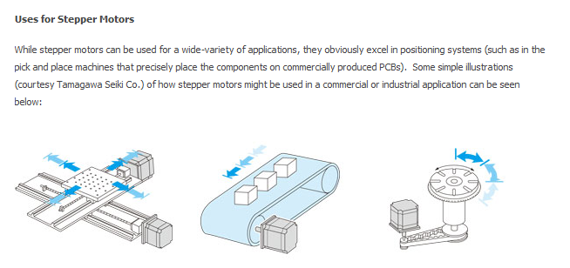
Stepper Motor Applications

Slide 47
Stepper Motors – Unipolar Drive

Slide 48
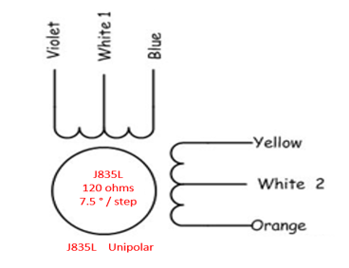
Unipolar Full and Half Step Mode
The Unipolar motor can be operated in full step or half step.
In full step mode one side of each of the two centre tapped coils is turned on.
The motor moves 7.5 degrees / step. There are 4 different discrete steps.
In half step mode two coils are energized and then one is energized in sequence. In this mode the step angle is half the angle as in full step mode. The drawback is that the half step mode has less torque. In half step mode there are 8 distinct steps.

Slide 49

Half Step Animation
Half Step Sequence:
Animation of half step sequence. Centre tap pins 1 and 2 are connected to a positive voltage and the a and b pins are grounded.

Slide 50


Half and Full Step Sequence Unipolar
Full step – always two coils turned on. Has better torque but less step resolution.
1 step sequence
Half step – one or two coils turned on. Has reduced torque but greater step resolution.
8 step sequence

Slide 51

Stepper Full Step Sequence Unipolar Motor
Full Step Sequence Timing Diagram:
Full Step Sequence:
With a 7.5 degrees/step motor this sequence will take 48 steps to complete one revolution(360 degrees). The full step sequence must be repeated 12 time for 1 revolution.

Slide 52


Stepper Motor
Half step sequence has the highest resolution and is most stable at higher speeds.
Half step twice the resolution as full step. ( degrees / step )

Slide 53
Unipolar Half Step Mode
Timing Example 1:
Determine the time required per step to rotate a stepper motor at 80 RPMs in half step sequence.
Step 1: With a 7.5 degrees/step motor this sequence will take 96 steps to complete one revolution.(360 degrees ÷ 3.75/step = 96).
Step 2: Convert the RPMs to RPS(rotations per second) divide by 60.
80 RPM/60 = 1.333 RPS
Step 3: Determine the number of steps / rev. in half step mode. = 96
Step 4: Convert the RPS to time / rotation ( 1/RPS) 1/1.333 RPS = 0.75 sec/rev
Step 5: Divide the time/rev by the steps/rev 0.75 sec/rev ÷ 96 steps/rev = 7.81 ms
Time / step = 7.81 ms./step Result 96 steps x 7.81 ms/step = 0.75 seconds.

Slide 54


Unipolar Full/Half Step Sequence
Full / Half Step Sequence Timing another example:
Full 4 Step and Half 8 Step Pattern:
In full step mode coils are on for 2 steps then off for 2 steps, this mode produces more torque.
In half step mode a coil is on for three steps then off for five. This mode has twice the resolution for a given stepper motor.

Slide 55


Unipolar Stepper Motor Driver
The ULN2003A is a driver IC. The input is a low voltage, low current digital signal. The IC is capable of driving output loads of higher currents and voltages.

Slide 56


Unipolar Stepper Motor Driver
ULN 2003A Driver IC
This IC drives inductive loads such as DC motors, solenoids and relays.
The output of the circuit includes suppression diodes to prevent damage to the electronics. The device that appears as an inverter is actually a Darlington Pair transistor drive circuit. When the input is a logic high the output is driven to 0 volts. The Darlington Pair transistor has a much greater Beta than a single NPN transistor.
The input is typically less than 1 mA. Output can handle at least 100 mA per channel.

Slide 57

For Loop – Used in Stepper Program

Slide 58



Arduino Control of a Unipolar Motor in Full Step

Slide 59
Stepper Motor – Bipolar Drive

Slide 60


Bipolar Stepper Motor
The Bipolar stepper motor has only 4 wires.
Since the full coil is energized it has a higher torque then the unipolar motor.
The J835L motor used in the lab was modified to operate as a bipolar so that it can be controlled with a bipolar motor controller module. The white wire was cut on both coils.
The DRV8825 is a bipolar stepper motor driver. The driver requires only a step and direction control signal.

Slide 61



Bipolar DC Stepper Motor Controller

Slide 62


Bipolar DC Stepper Motor Controller

Slide 63

The top signal is measuring one of the outputs from the stepper motor. The bottom trace is the step signal. The signal is from the stepper control.

Slide 64



Slide 65

Stepper Half Step Sequence Unipolar Stepper

Slide 66


Stepper CW and CCW Direction
Controller clock signal compared to coil signal.
The output changes on the rising edge of the clock.
There are 4 clock periods for 4 steps. One high and one low on the coil represents four steps.
4 steps * 7.5 deg./step = 30 degrees.

Slide 67


Stepper CW and CCW Direction
CW direction: (direction = 0)
Lower signal rising edge leads the rising edge of the upper signal by 90 degrees.
CCW direction: (direction = 1)
Top signal rising edge leads the rising edge of the lower signal by 90 degrees.

Slide 68

Interrupts vs Polling
The section of code above uses input polling to test the state of a mechanical switch. If the switch is a logic high an LED is turned on otherwise it is turned off. This method is not efficient and most of the loop time is consumed in testing the switch. If the loop if long then if may take time before the switch is tested and an event may be missed.

Slide 69


Interrupts Setup
Lines 21-24 configure the interrupt. The program is telling the Arduino that when a rising edge occurs on pin 2 (interrupt 0) then stop what the program is currently doing, execute the “slow” routine then return to where it was before the interrupt.

Slide 70


Interrupts vs Polling

Slide 71

Using Interrupts

Slide 72

Interrupts Syntax

Slide 73

Interrupts Modes

Slide 74

Interrupt Program for Stepper P1

Slide 75

Interrupt Program for Stepper P2

Slide 76

The two traces above are measuring the signal on the driver outputs connected to the yellow wire and the orange wire.
The direction of current flow in the coil changes on every two steps.

Slide 77

The two traces above are measuring the signal on the driver outputs connected to the yellow wire and the blue wire.
The two signals are 90 degrees out of phase. When the motor is turning in one direction the signal is leading by 90 degrees, in the opposite direction the signal is lagging by 90 degrees to the other coil.

Slide 78

The Hall Effect sensor, and the magnet were added to measure the RPMs of the stepper motor. The magnet has three N/S poles that generate three pulses per revolution.

Slide 79

The motor takes 480 ms. per revolution, 1/480 ms. = 2.08 revolutions per second or about 120 RPM.

Slide 80

A unipolar stepper requires a simpler driver circuit because coil current flows in only one direction. The bipolar driver requires a dual H-Bridge. This example uses MOSFET transistor which are much more efficient than bipolar transistors.

Slide 81

Back EMF – Back Electromotive Force.
When inductive loads such as relays, solenoids and motors are switched off the stored energy in the magnetic field around the inductor collapses. The collapsing field produces a current in the opposite direction than when the coil is energized. Without the diode a high voltage spike may damage electronic circuits used to drive the coil. Adding the diode provides a path for the current to flow through the diode and the load, preventing damage to the electronic circuits.
During normal operation the diode is reverse biased.
Flyback, Flywheel,Transient Suppression Diode.
Inductive
Load

Slide 82


Slide 83

The snubber circuit reduces the peak voltages when an inductive load is removed. If the control is a switch it reduces the spark across the switch. If the control is an electronic circuit (transistor) the snubber prevents damage to the electronics.

Slide 84
Servo Motors

Slide 85


Servo Motor – used in robotics and remote controlled devices.
Position is controlled using PWM signal. The motor has a feedback potentiometer to determine the current position of the output control arm. The servo motor moves CW and CCW with about 180 degrees of movement. The servo has a gear train to give it a greater torque.

Slide 86

DC Servo Motors
Another type of DC motor is called a servo motor. Servos are often used for position control.
A servo motor is controlled using a pulse width modulated signal.

Slide 87


A servo motor consists of four main sections:
DC motor
Gear set
Potentiometer for feedback.
Electronic Circuit

Slide 88


DC Servo Motors
Servo Motor Block Diagram (2nd image)

Slide 89


DC Servo Motors
A servo motor connects to a controller using three wires.
One of the wires connects to ground a second wire to 4.5 – 6.3 volts DC.
The 3rd wire is the input signal. The signal originated from a controller producing a PWM output signal.
The PWM signal has a period of 20 ms. The time high ranges from about 1 to 2 ms.

Slide 90

Servo hardware configuration.
Servo Motor Connections to Arduino: Connect the power for the servo to a 4.5 to 6.5 volt battery or DC power supply. The signal controlling the servo motor shaft position is controlled using an Arduino PWM output.

Slide 91



Smart Servo Motor – used in robotics and remote controlled devices.
Smart Servos communicate between a controller and many servos through a serial link.

Slide 92



Slide 93

Servo Motor test program.

Slide 94



Servo motor fully CCW. There are hard limits to the servo position, do not drive the motor to the maximum or minimum positions.
This screen captures shows a time high of ~0.9 ms.
Program Output

Slide 95



Servo motor at the middle neutral position. This is normally about 1.5 milliseconds.
This screen captures shows a time high of ~1.5 ms.
Program Output

Slide 96



Servo motor fully CW. There are hard limits to the servo position, do not drive the motor to the maximum or minimum positions.
This screen captures shows a time high of ~2.1 ms.
Program Output

Slide 97

Screen capture showing the period of the PWM for the Servo. The period equals 20 milliseconds. It is the time high that is changed to control position.

Slide 98

Pololu DC Motor Controller
DC Motor Controller can handle 12 Amps at 24 volts. Direction and speed control.
Easy interface to PLC, myDAQ or Arduino.

