Slide 1

Week 9 Notes:
Review for Test 2 Quadrature encoding
Geared DC Motors and Motor Drivers< Scope Displays
CAM8302E Fall 2018

Slide 2
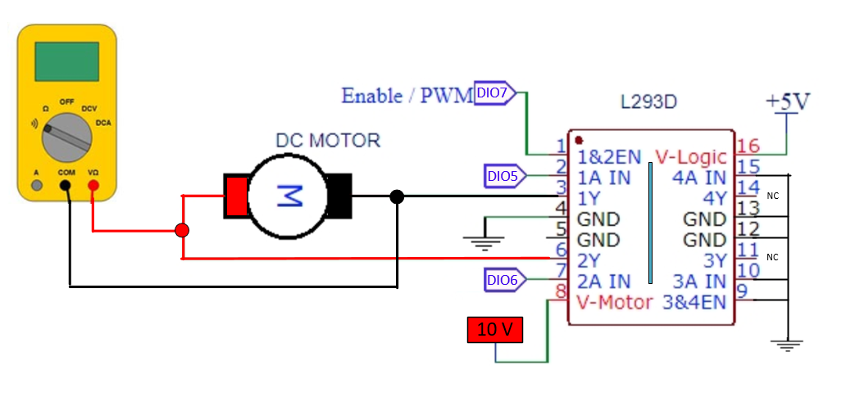
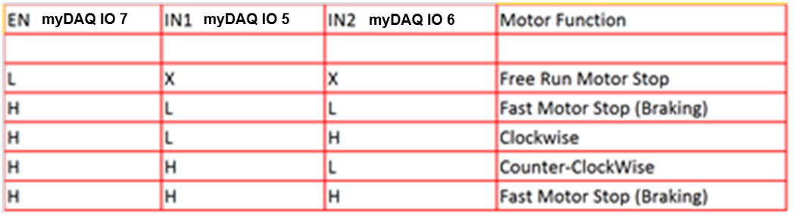
Motor Control IC – Control motor speed using PWM. The motor operating mode, CW,CCW, brake and free run or coast are controlled Mode using IN1 and IN2.
The output voltage to the motor is lower than the input supply voltage on pin 8 by approximately 1.4 to 1.8 volts due to the two internal BJT CE voltage drops.
The signal on pin 1 (Enable) input is required to enable the motor drivers it can also be used to PWM the motor voltage to reduce the average DC voltage to the motor.
The dual H-bridge motor driver can handle about 600 mA per side, on the L293D version there are internal diodes that protect the circuit from the inductive spike that occurs when the motor turn off. The motor controller reverses the motor voltage when switched from CW to counter clockwise.

Slide 3
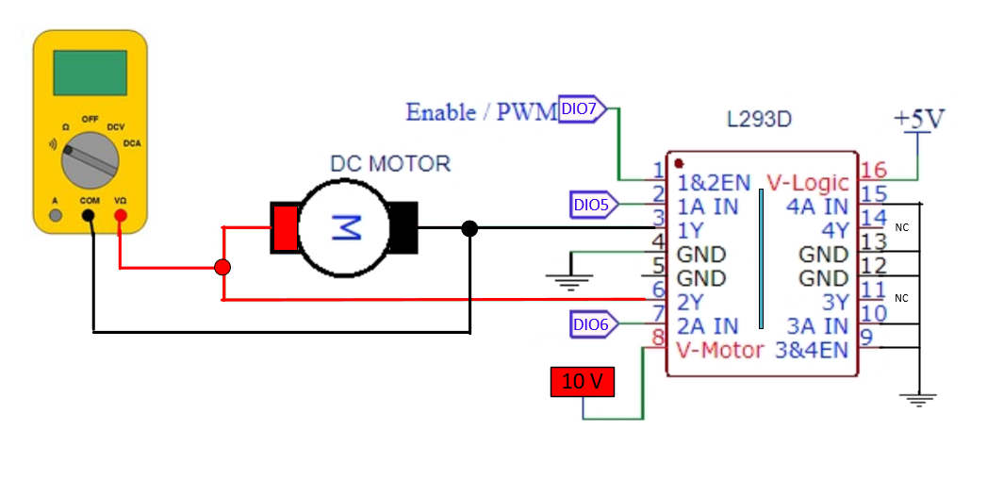
The speed of the DC motor will be controlled using a PWM signal applied to pin 1 of the L293D motor controller.
With the Enable pin at a logic high the motor terminals receive the maximum voltage. For example with a motor supply of 10 volts DC the motor voltage will equal about 8.5 volts. The drop is due to the voltage drop across the two internal BJT transistor collector emitter junctions.
The IN1 and IN2 pins determine the operation of the motor: CW, CCW, coast or brake.
Note: At times the PWM signal connects to DIO3
8.5 volts when EN = 1
Lower with PWM

Slide 4
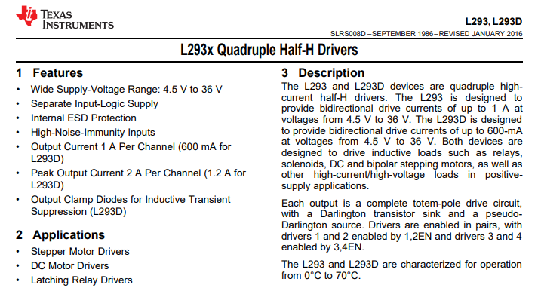
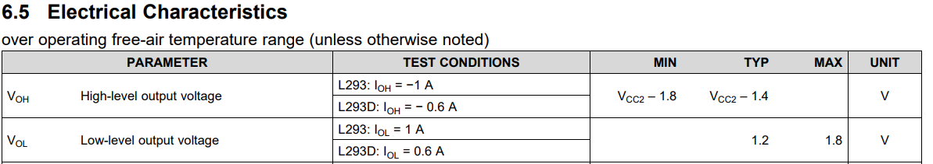
L293D Motor Control IC description – Control speed using PWM, Mode using IN1 and IN2

Slide 5

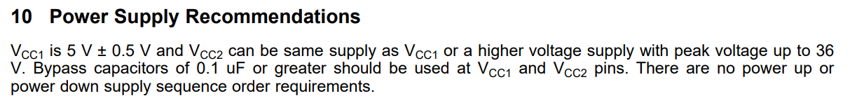
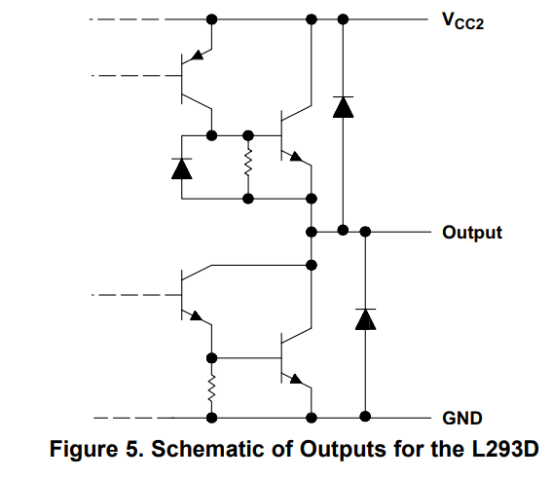
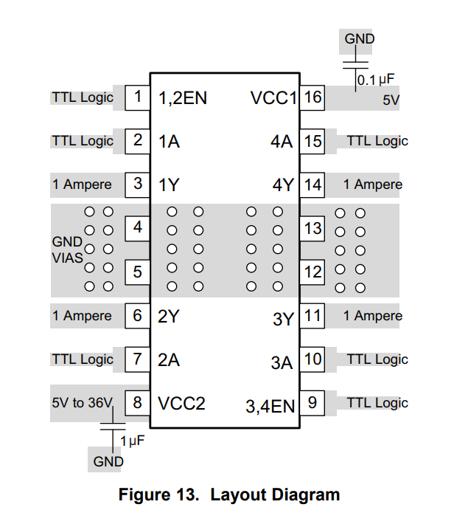

Motor Control IC – Control speed using PWM, Mode using IN1 and IN2

Slide 6
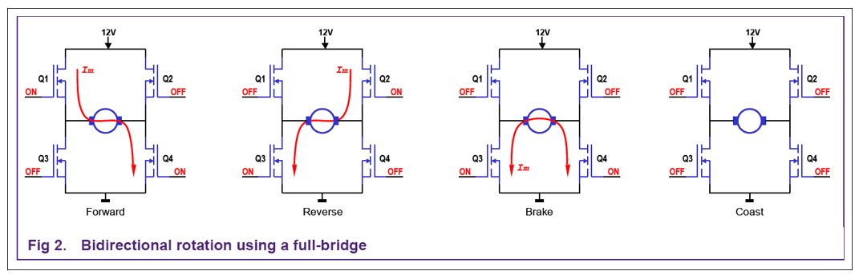
In free run mode (coast) all four transistors are turned off and the motor coasts to a stop.
In brake mode the motor leads are shorted to ground or the supply. The motor acts as a generator and stops quickly.
Note: This diagrams shows the concepts of the four modes of operation of the motor control IC, the actual L293 uses BJT transistors not MOSFETS as shown in the image below.
+
-
-
+
10.5V
-10.5V

Slide 7
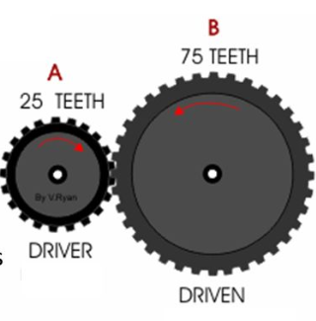
Gear Ratios - Calculations
Gear Ratio = Driven Gear # teeth/ Drive gear # teeth.
Gear Ratio = 75/25 = 3:1
Assume the drive gear is rotating a 360 RPM with a torque of 2.0 Newton meters (Nm).
Determine the speed and torque of the driven gear?
To convert to REV/SECOND from REV/MIN divide by 60.
_______________ Nm (torque)
_______________ RPMs
_______________ RPSs
Time/Revolution = ___________
Adding gears are used to:
Increase or decrease speed.
Increase or decrease torque
Change direction

Slide 8
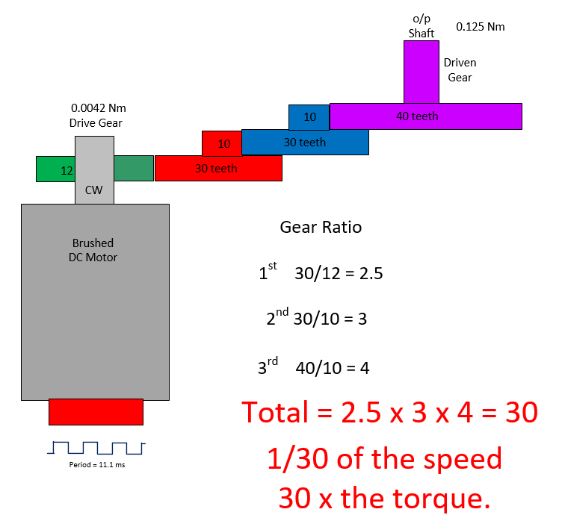
Lab 6 Brushed DC motor with Hall Effect encoder and 30:1 gear train ratio.
120 RPM
Gears inside the lab DC brushed motor. In this example the applied DC voltage is at about 12.0 volts.
Gear train ratio of 30:1
When the DC motor turns at 3600 RPMs
The output shaft turns at: 120 RPMs
2 revolutions/ second
1 revolution every 500 ms.
3600 RPM
DC motor
Speed.
The Encoder produces 3 pulses for each revolution of the DC motor.
1 revolution of DC motor = 16.65 ms
1/16.65 ms = 60 REV/SEC (DC motor)
Encoder
Period = 5.55 ms
180 Hertz

Slide 9
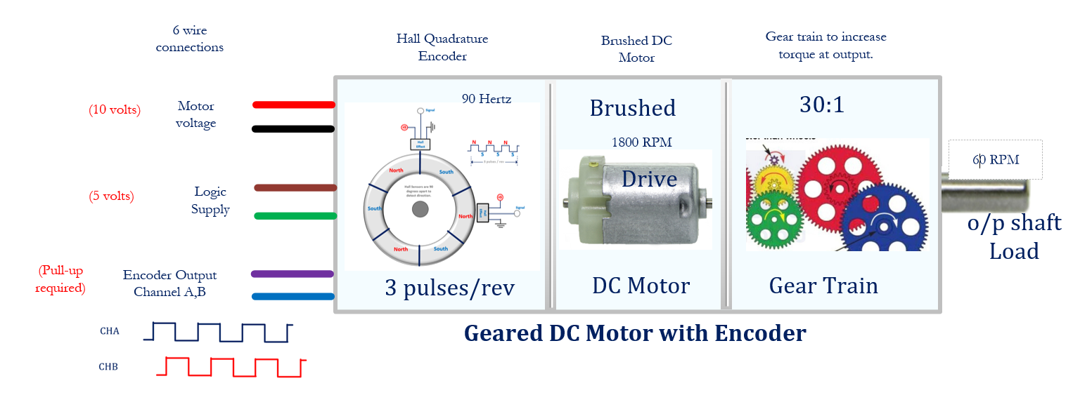
Brushed DC Motor with Gear Train and Hall Effect Encoder

Slide 10
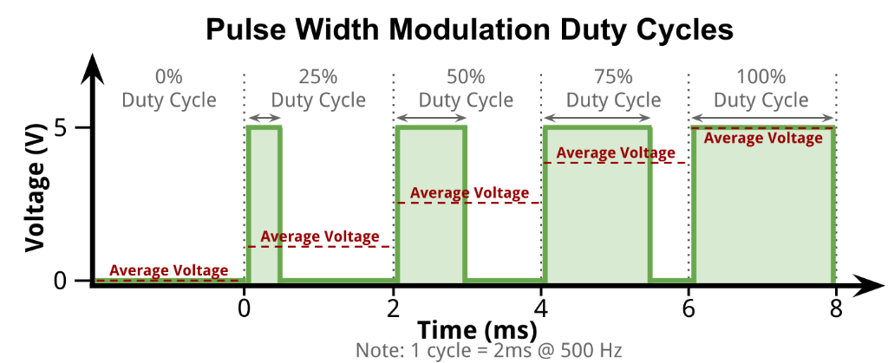
The speed of the DC motor will be controlled using a PWM signal applied to pin 1 of the L293D motor controller.
As the duty cycle of the PWM signal is increased the average DC motor voltage increases.
At 0% PWM (logic low) the motor in the lab will stop turning and have a DC voltage of 0 volts across the motor terminals. The encoder frequency will equal 0 Hertz.
At 100% PWM (logic high) the motor is rotating at the maximum speed and the encoder frequency will be at the maximum frequency (minimum period).

Slide 11
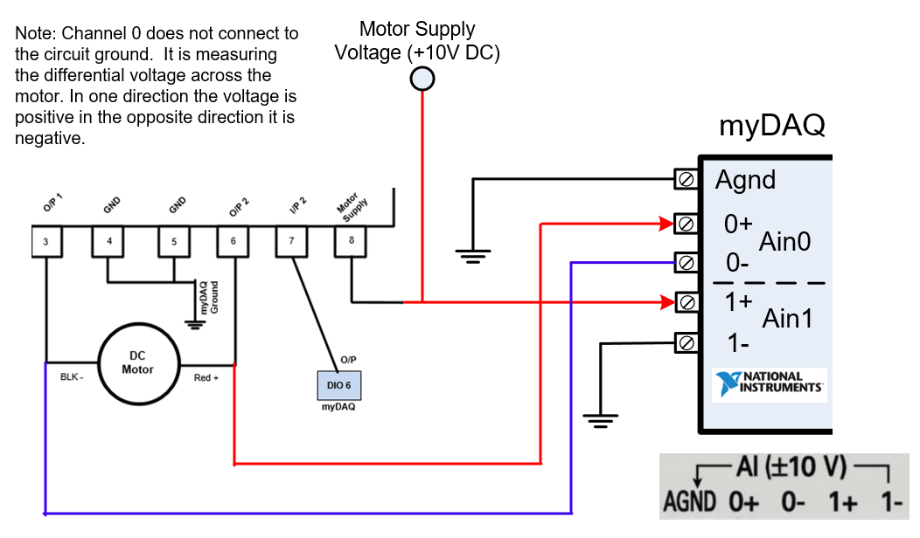
Motor connections when measuring the voltage across the motor. Notice that channel 0 is not grounded, this is because the voltage on these two pins reverse when the motor direction is changed. The myDAQ measures the difference in voltage.

Slide 12
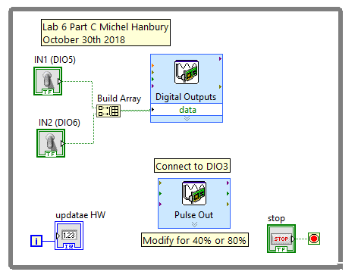
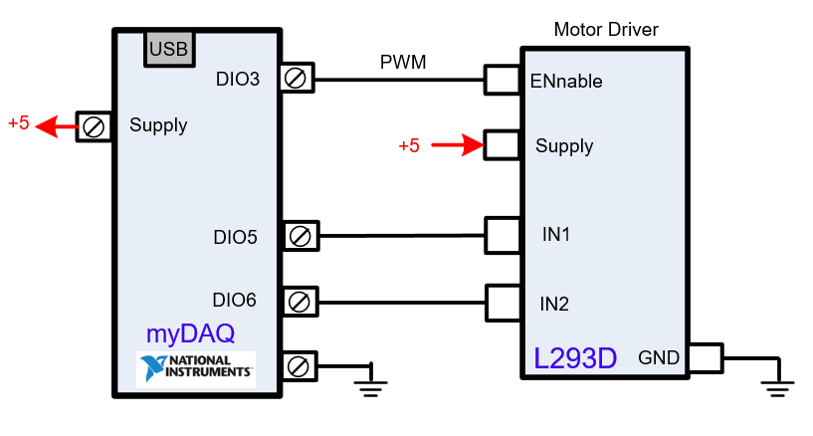
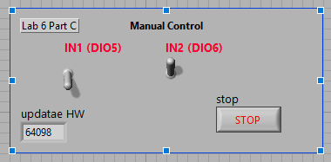
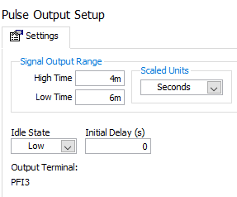
PWM control of the DC motor speed
Lab 6 Part C.
Part C: of lab 6 is used to control the average DC voltage to the motor using PWM. In this example the PWM is 40%. The PWM signal is at a frequency of 100 Hertz.
When this part of the lab is running the DIO3 pin on the myDAQ produces the PWM using the counter/timer. The DIO3 signal will connect to the EN pin on the motor controller.

Slide 13
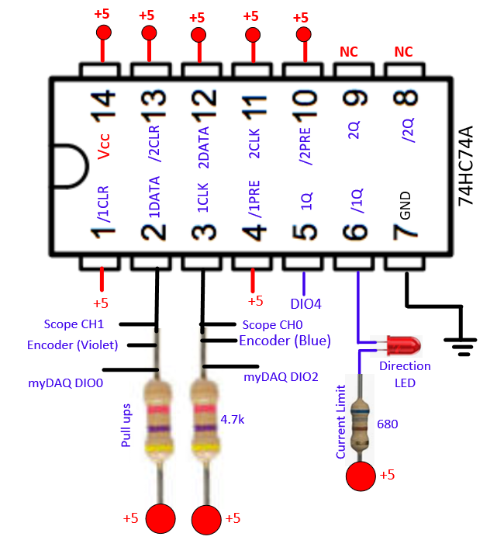
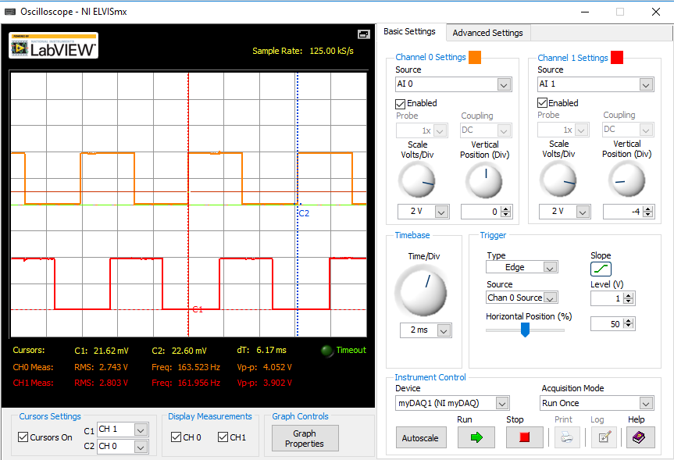
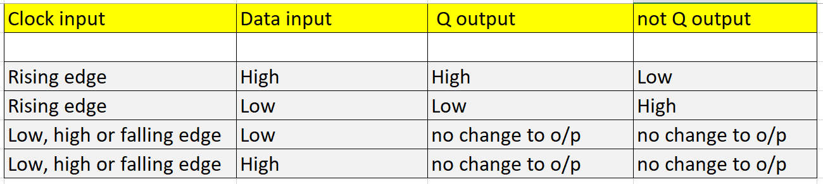
74HC74A D-type flip-flop
When the Data input is high and the clock goes through a rising edge the Q output will go high and the not Q or /Q output will go low.

Slide 14
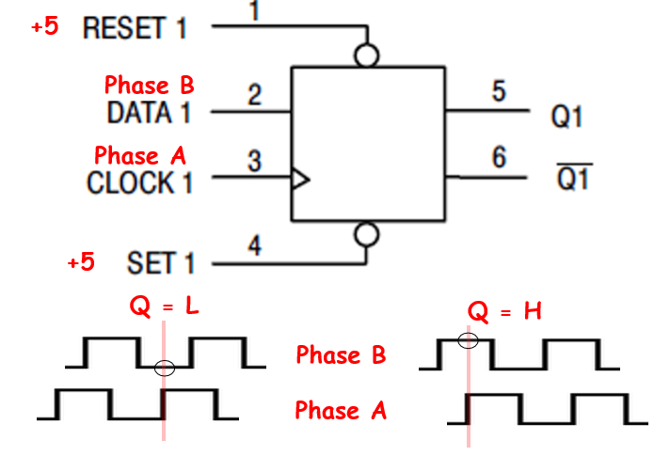
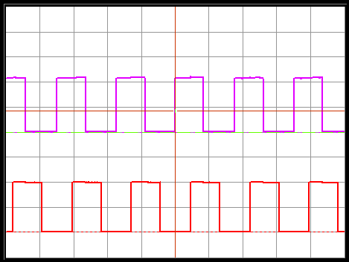
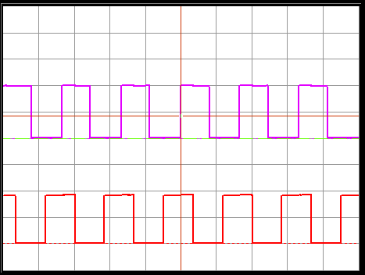




Direction Detection Using Encoder
A 74HC74 IC is used to decode direction and produce a logic low or high output on Q to provide direction information to other parts of the control circuit.
Pin 1 and 4 are tied to a high level to override the clear an set signals.
As a positive going edge occurs on pin 3 (the clock) the signal at pin 2 will be latched to the output Q1.
74HC74
Counter Clockwise
Clockwise
CH0 to clock
CH0 to clock
CH1 to data
CH1 to data
Q Output Low
Q Output High

Slide 15
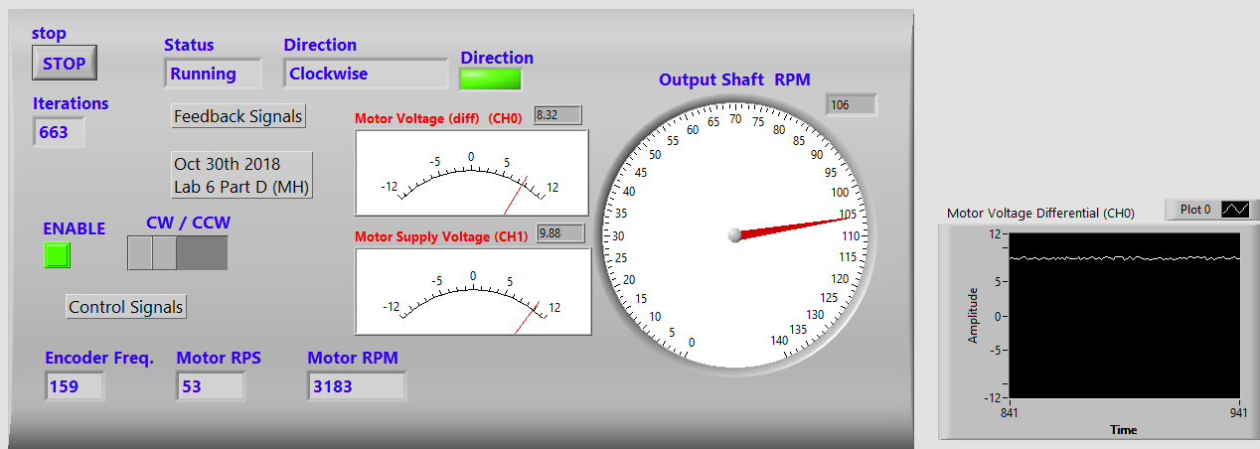
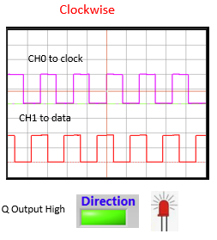
In this screen capture of Lab 6 Part D:
The motor is turning clockwise, the supply voltage is 10 VDC.
The voltage across the motor terminals is at 8.3 volts.
The encoder frequency equals 159 Hz or at a period of 6.3 ms.
The REV/SEC of the DC motor equals 159 Hz/3 (3 pulses/REV) = 53 Hz
The motor RPM = DC motor freq. x 60 sec/min. = 3180 RPM.
The output shaft RPM = 3180 RPM/30 gear ratio = 106 RPM
106 RPM/60 = 1.8 REV/SEC or 560 ms per revolution.

Slide 16
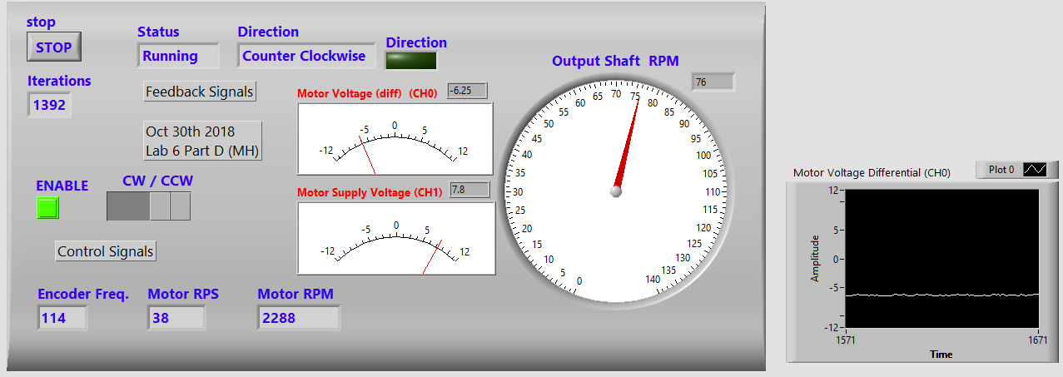
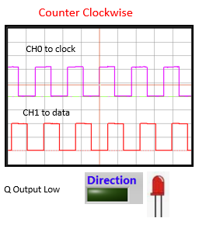
In this screen capture of Lab 6 Part D:
The motor is turning counter clockwise, the supply voltage is 7.8 VDC.
The voltage across the motor terminals is at -6.25 volts.
The encoder frequency equals 114 Hz or at a period of 8.8 ms.
The REV/SEC of the DC motor equals 114 Hz/3 (3 pulses/REV) = 38 Hz
The motor RPM = DC motor freq. x 60 sec/min. = 2280 RPM.
The output shaft RPM = 2280 RPM/30 gear ratio = 76 RPM
76 RPM/60 = 1.3 REV/SEC or 770 ms per revolution.

Slide 17
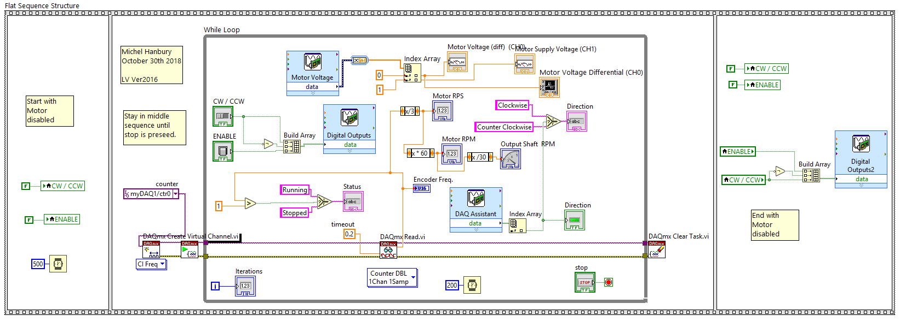
A flat sequence structure controls the sequence of execution of a LabVIEW program. In this example the left box is executed for 0.5 seconds, the second box executes until the user presses stop button on the front panel. The box on the right is executed after the front panel stop button is pressed causing the motor to stop.
Lab 6
Part D

Slide 18
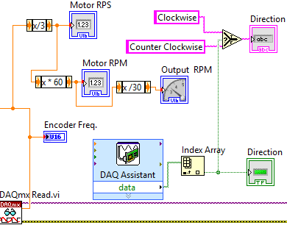
LabVIEW Block Diagram Lab 6 Part D
2
6
The Frequency from the encoder is read using the timer frequency read function.
The DC motor produces 3 pulses / rotation so that is first divided.
The value from step 2 is multiplied by 60 to obtain a value in RPM.
The signal is divided by the gear train ratio to obtain the RPM speed at the output.
Read the data from the Q output of the 74HC74 latch.
Display a text value of the direction.
Encoder 3 pulses/rotation
Select
3
Change to RPM
Gear Ratio
4
Read Direction from 74HC74
If true CW
If false CCW
1
5
Read Frequency

Slide 19
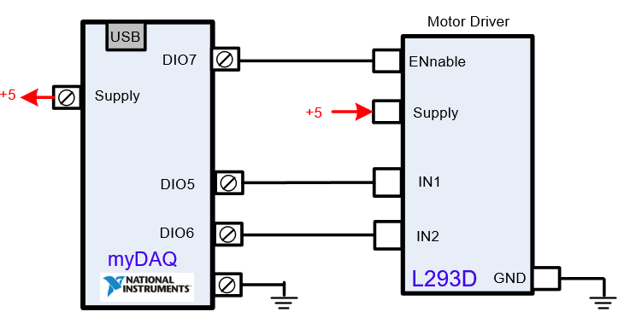

The enable pin on the L293D motor control will change for the different parts of Lab 6.
Part A,B,D: connect to DIO7 (H/L)
Part C: connect to DIO3 (PWM)

Slide 20
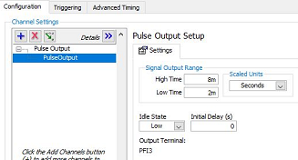
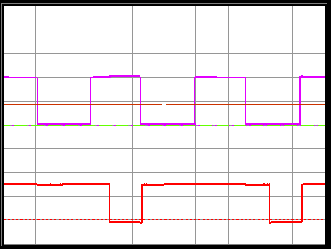
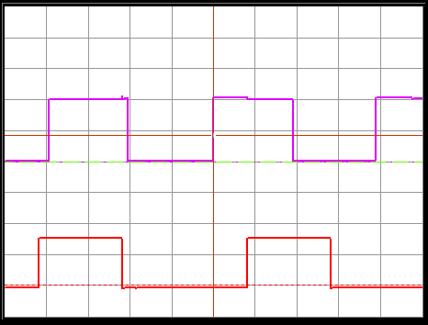
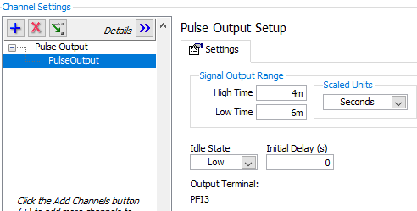
AVG DC Volts to motor when EN = High
= 8.5 V, when EN = 0 AVG DC = 0 volts
Encoder = 6ms when EN = 1
motor = 3333 RPM when EN = 1
2ms / div, 2v/div
Encoder
80% PWM freq. = 100 Hz
PWM
Average DC voltage = 8.1 (3120 RPM)
2ms / div, 2v/div
Encoder
40% PWM
PWM
Average DC voltage = 6.7 (2564 RPM)

Slide 21
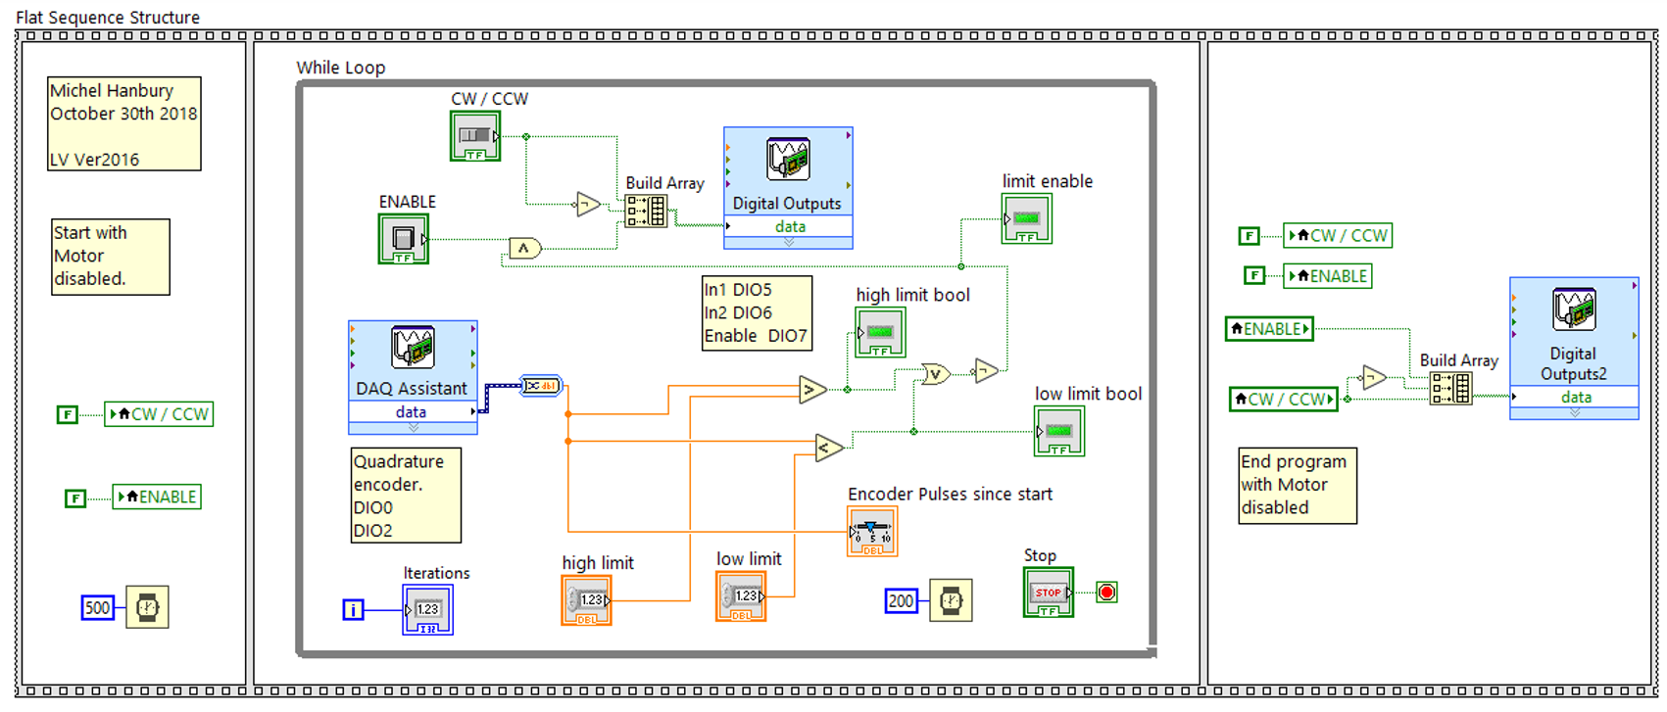
A flat sequence structure controls the sequence of execution of a LabVIEW program. In this example the left box is executed for 0.5 seconds, the second box executes until the user presses the front panel stop. The box on the right is executed and then the program stops running. The output of the Quadrature DAQ assist is output degrees of revolution. For each rotation of 360 degrees of the output shaft the motor turns one revolution and produces 90 encoder pulses.

Slide 22
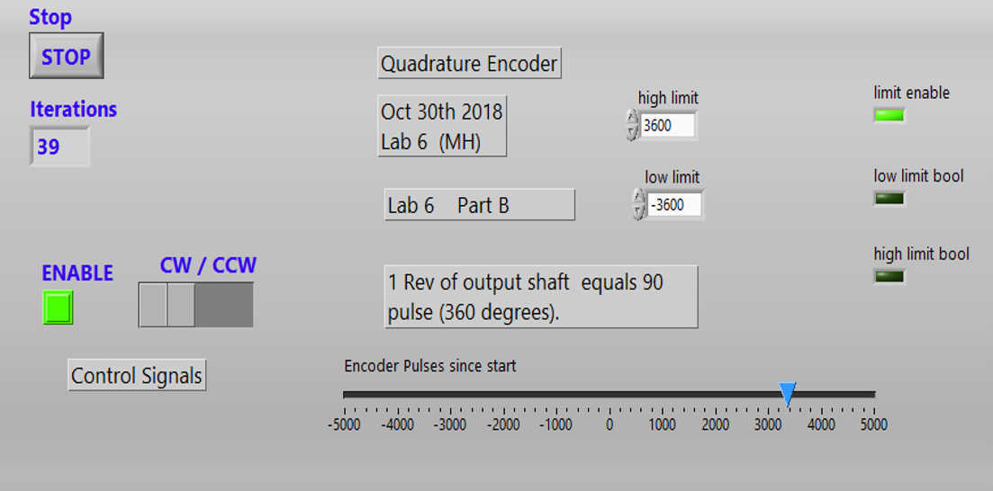
Lab 6 Part B – measuring angular rotation. Increases in one direction, decreases in the opposite. Stops when a minimum and maximum value is reached.

Slide 23
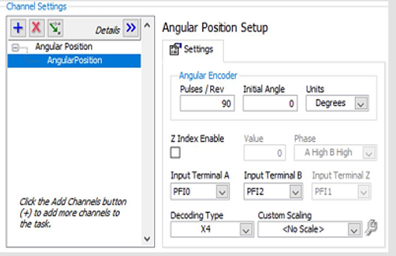
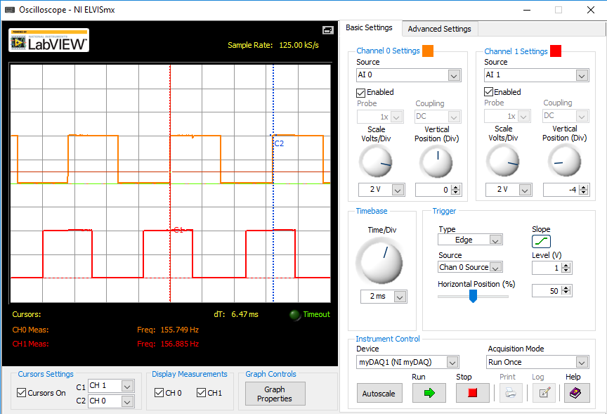
Quadrature Encoder:
The myDAQ has a DAQ assist to measure the signals from a quadrature encoder. The two signals connect to DIO0 and DIO2 inputs. The angular encoder produces 90 pulses per revolution of the motor output shaft.

Slide 24
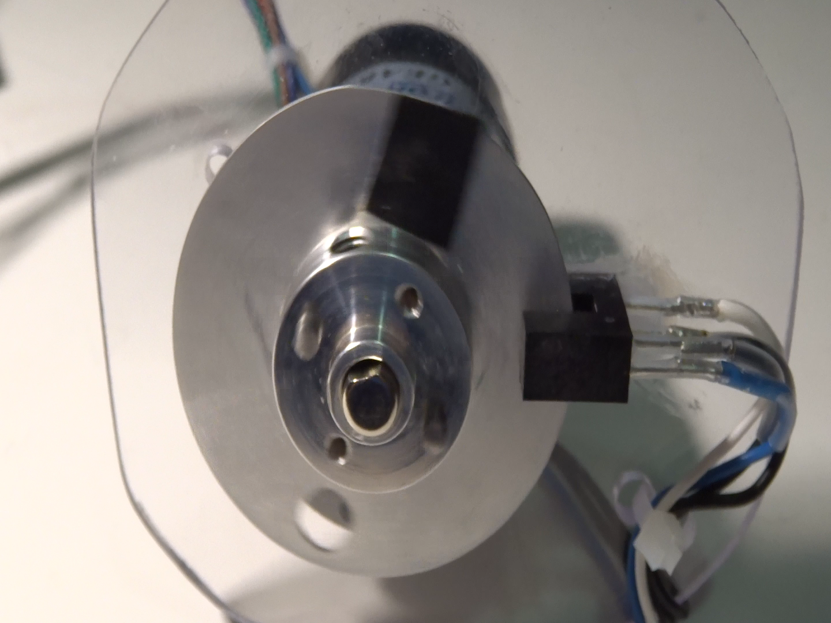
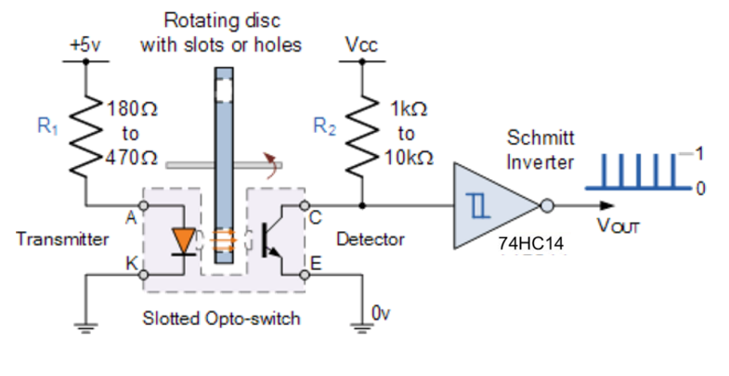
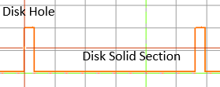
Motor Speed with Optical Sensor (video)
In this example and optical s;otted switch measures the rotation speed of the output shaft. 1 hole is drilled into the aluminum plate. As the motor is rotated the optical switch gap is blocked or opened. The rotation causes 1 pulse per revolution.
The output signal is shown on the next slide. As the hole in the disk passes the optical sensor a logic high is produced at the output of the Schmitt trigger.

Slide 25
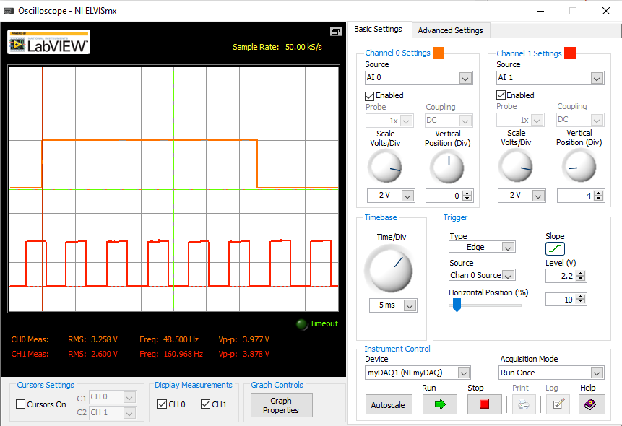
Encoder and Optical Sensor
Encoder freq. 161 Hz.
There are 3 pulses per revolution.
1/161 = 6.2 ms.
Motor rotates at 6.2 ms x 3 = 18.6 ms.
1/18.6 ms = 54 Hertz.
54 Hz x 60 = 3226 Hz (DC motor).
Gear Ratio is 30:1
Divide RPM by 30 equals 108 RPM
Divide by 60 equals 1.8 rev/second.
1/1.8 Hz = 0.56 seconds.
Slotted Disk Opening
Hall Encoder Signal

Slide 26
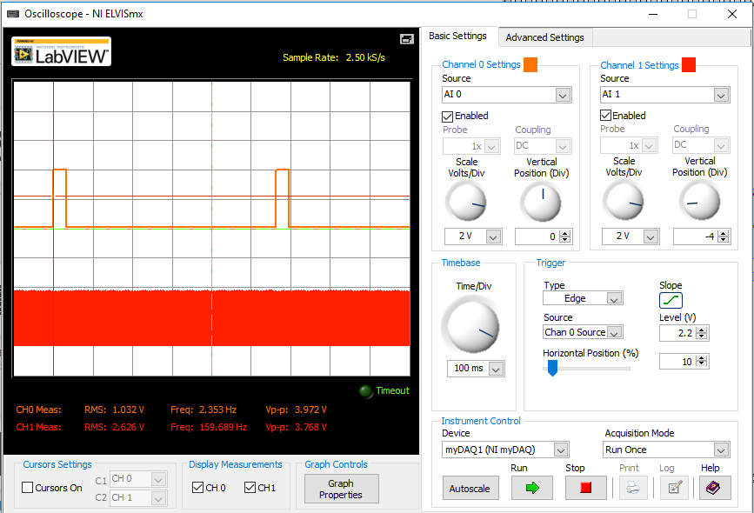
Encoder and Optical Sensor
Period of the output shaft is 560 ms.
Therefore the motor output shaft is turning at 1.8 rev/second.
The DC motor is turning at 54 rev/second or 3214 RPM.
1/54 = 18.5 ms
There are 3 pulses per DC motor revolution.
18.5 ms/3 = 6.2 ms.
Disk Hole
Disk Solid Section
Encoder
o/ shaft rotation period = 560 ms.
o/p shaft rotation frequency = 1.8 rev/sec.

Slide 27
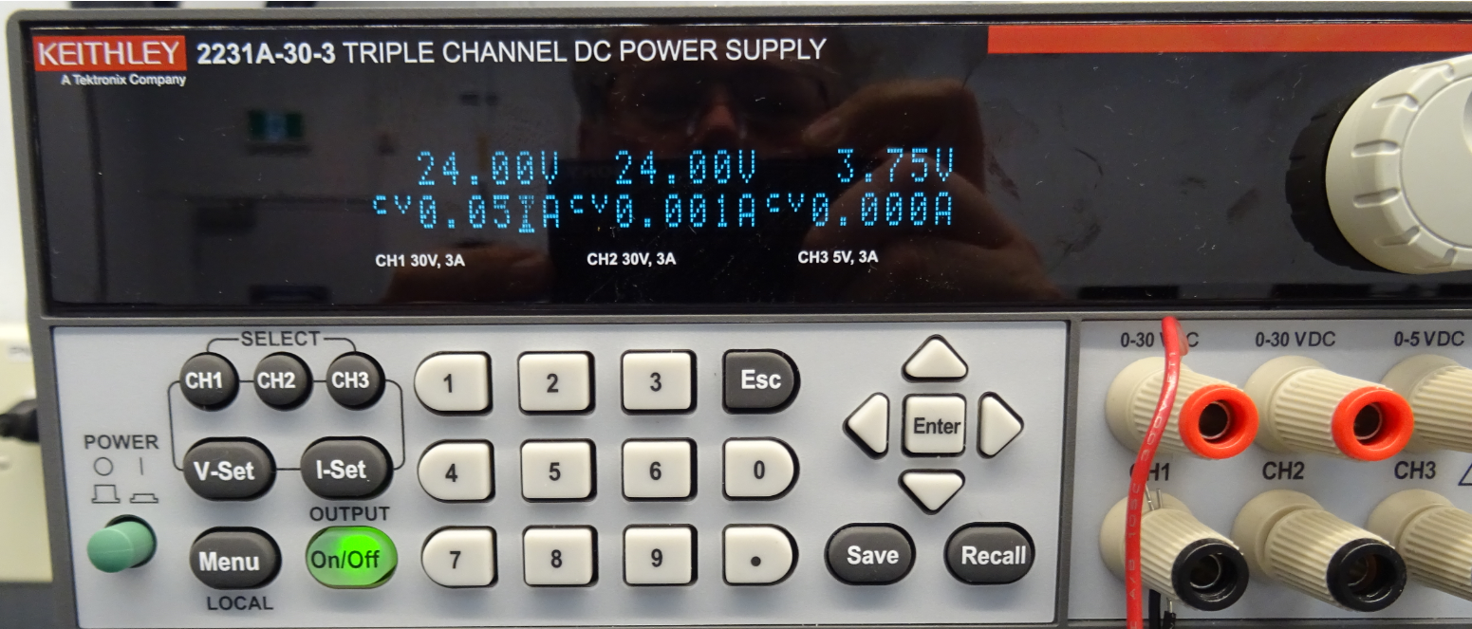
When setting up the lab power supply you should configure the current limit to a value of about 1.5 times the value you expect the typical current to be when your circuit is operating normally.
If the current is not exceeded the letters “CV” (Constant voltage) will appear near the circuit current reading.
If your circuit has a problem or it is trying to draw more current than the maximum you have set the letters “CC” (constant current) will appear near the circuit current reading. You may also notice that the DC voltage drops when in “CC” mode.

Slide 28
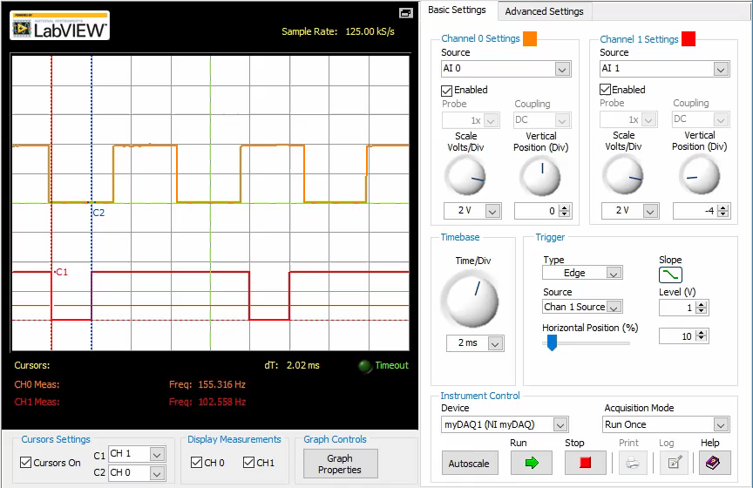
Scope Configuration Video (no audio)

Slide 29
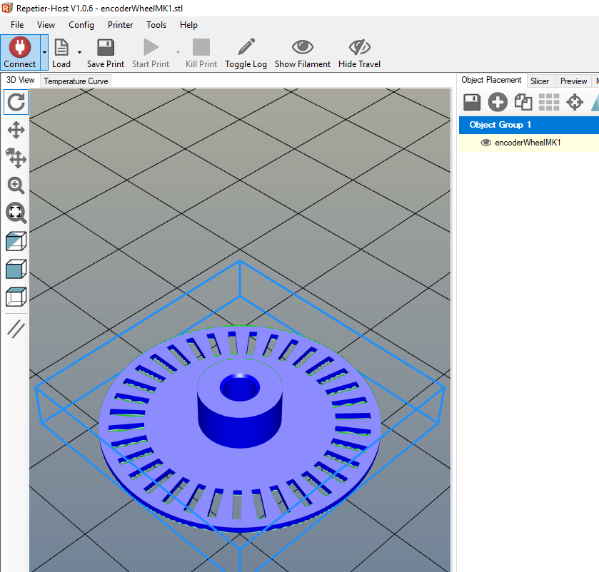
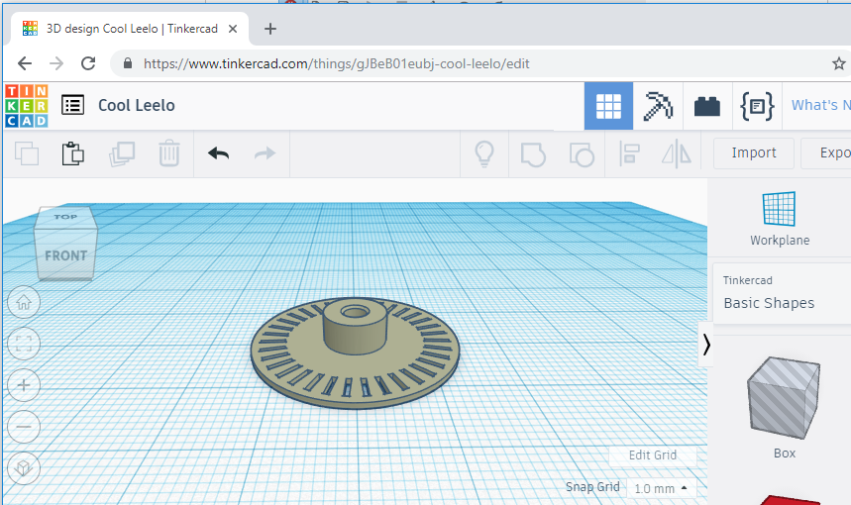
Slotted Wheel 3D Printed.
A slotted wheel along with slotted optical sensor can be used to measure output shaft speed.

Slide 30
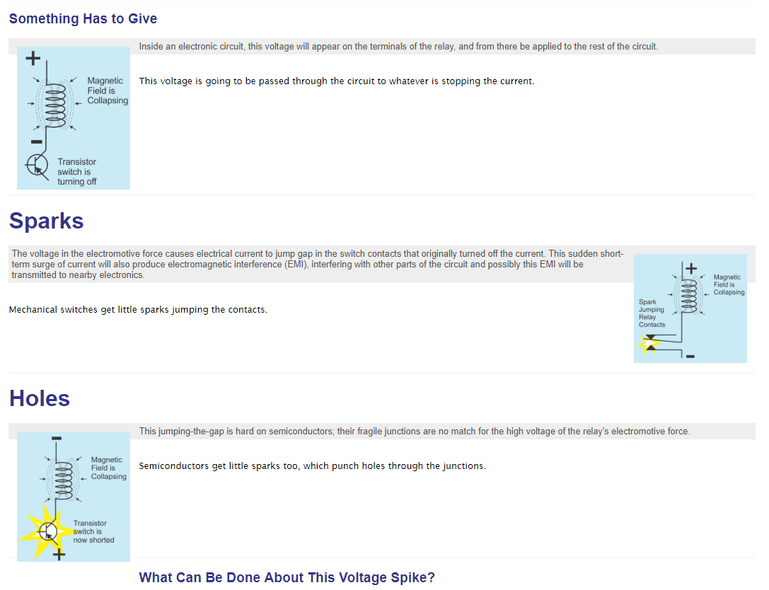
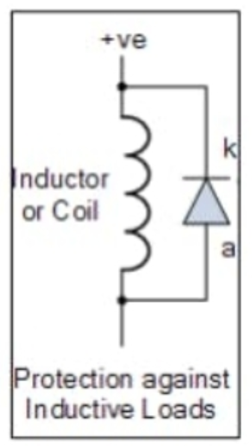
Notes: Suppressing spikes when using inductive loads. Page 1

Slide 31


Notes: Suppressing spikes when using inductive loads. Page 2.

Slide 32

Flyback, Flywheel, Transient Suppression Diode.
Back EMF – Back Electromotive Force.
When inductive loads such as relays, solenoids and motors are switched off the stored energy in the magnetic field around the inductor collapses. The collapsing field produces a current in the opposite direction than when the coil is energized. Without the diode a high voltage spike may damage electronic circuits used to drive the coil. Adding the diode provides a path for the current to flow through the diode and through the load, preventing damage to the electronic circuits.
During normal operation the diode is reverse biased.
Inductive
Load

Slide 33


Slide 34

The snubber circuit reduces the peak voltages when an inductive load is removed. If the control is a switch it reduces the spark across the switch. If the control is an electronic circuit (transistor) the snubber prevents damage to the electronics.

